Slide 1
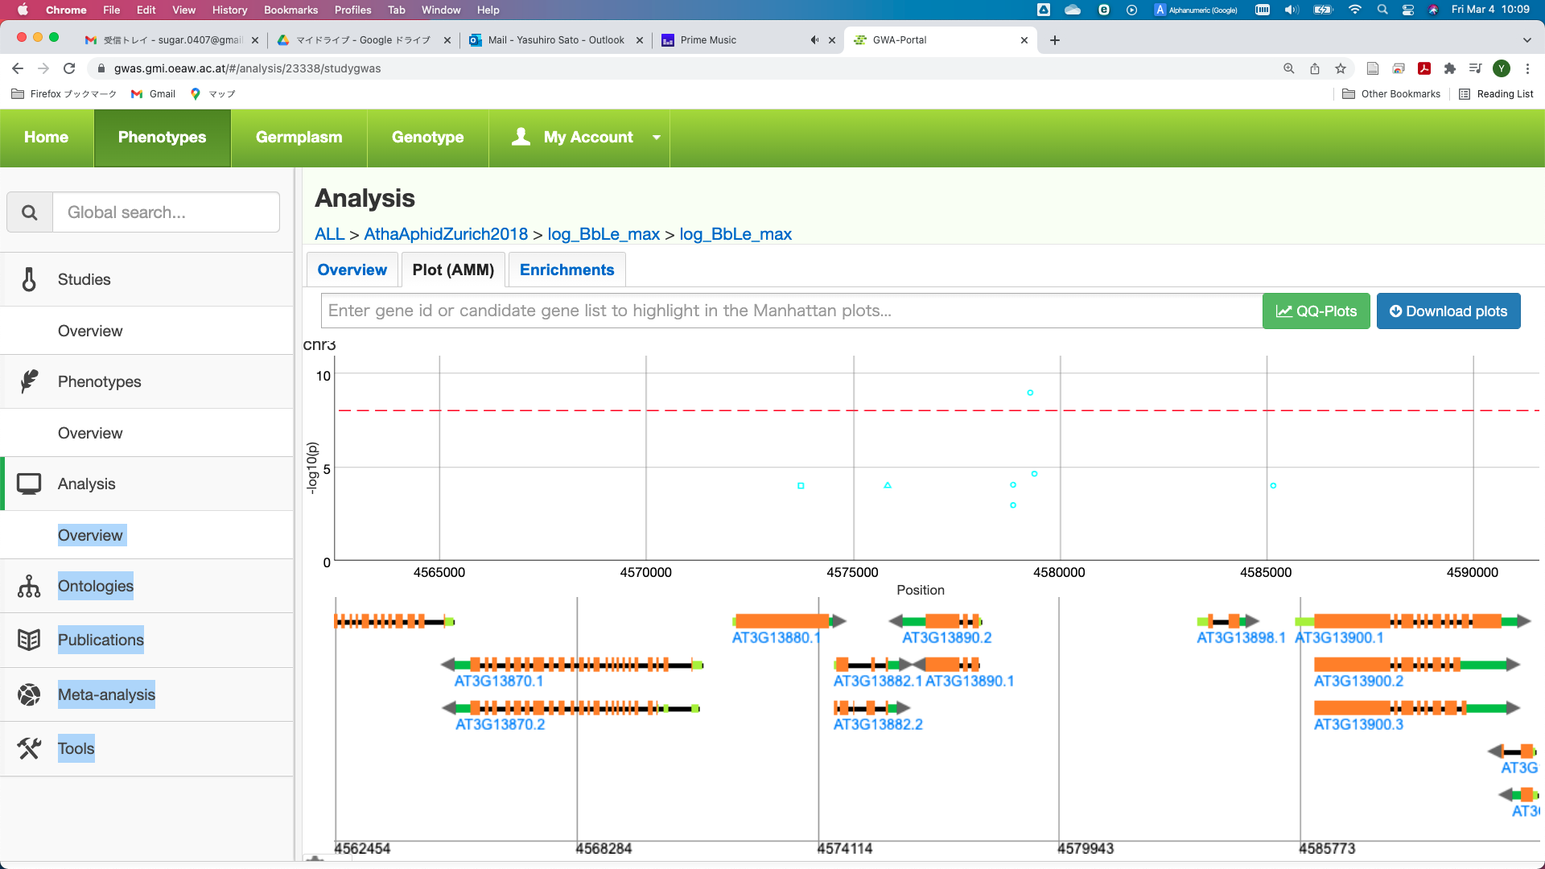
chr3-4579292

Slide 2
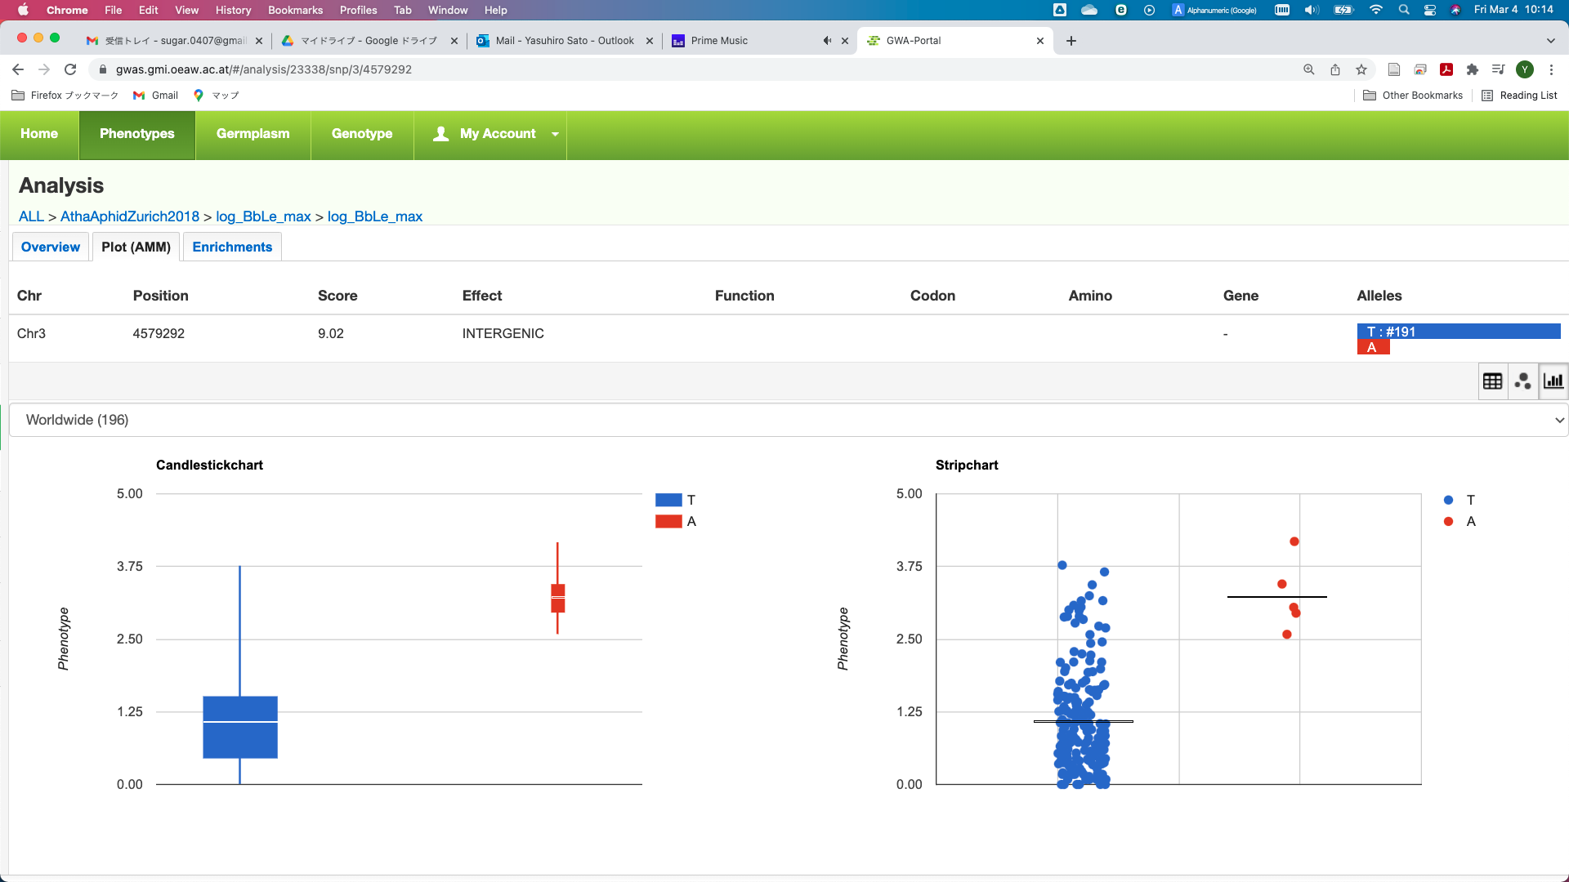

Slide 3
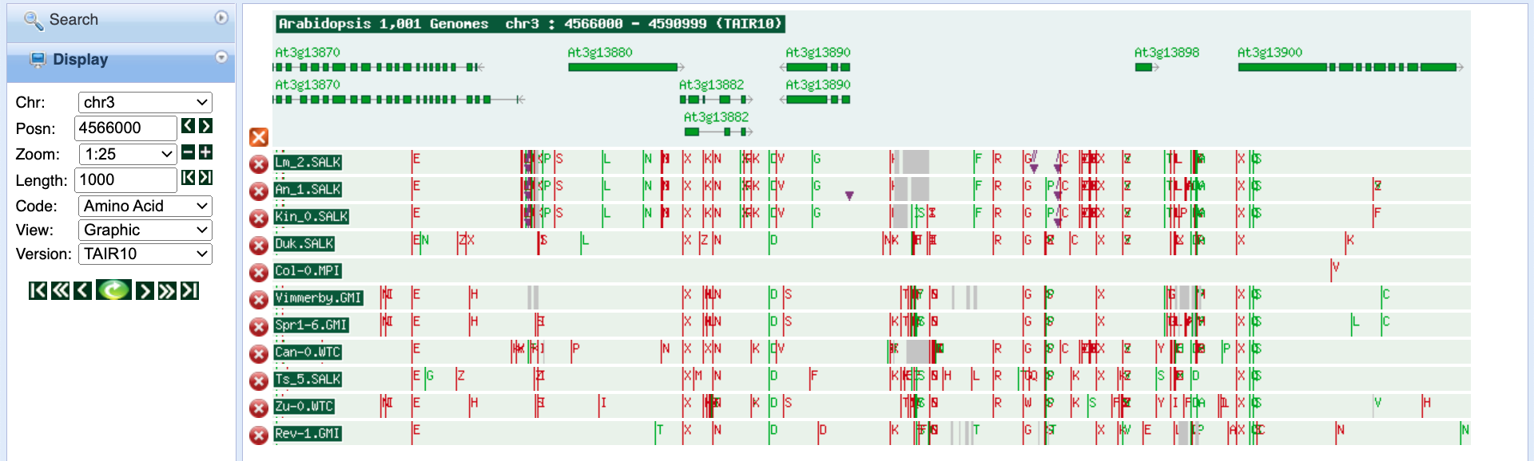
(a)
log(no. of aphids)
(b)

Slide 4
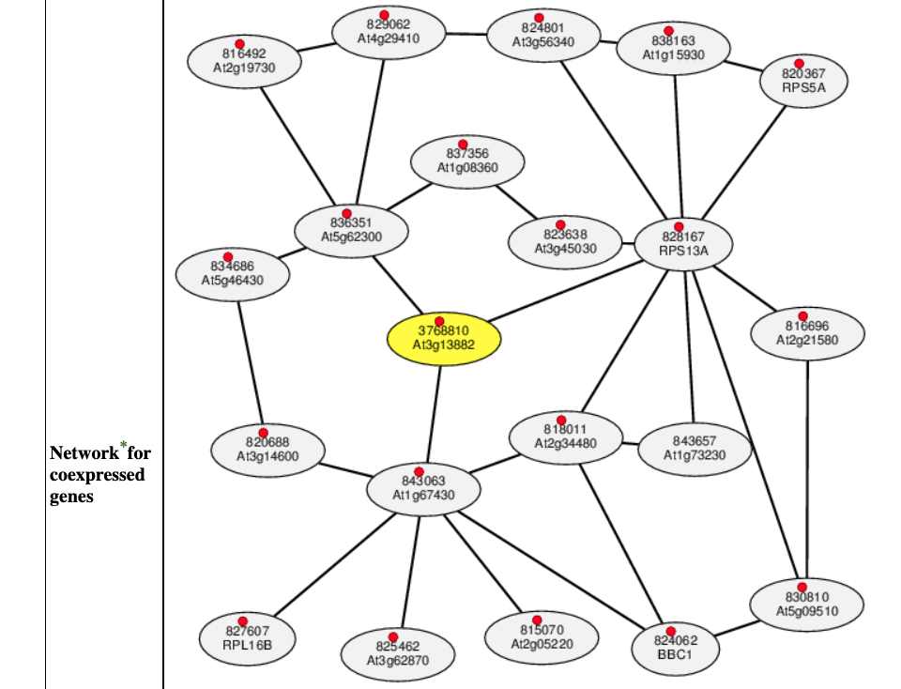

Slide 5
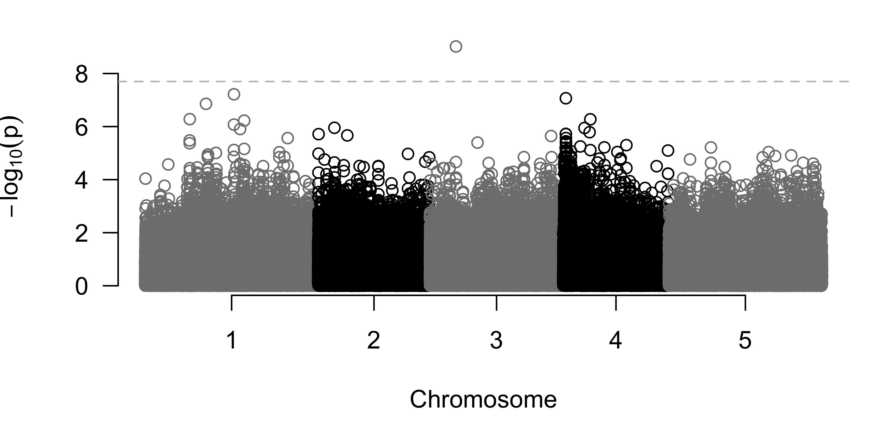
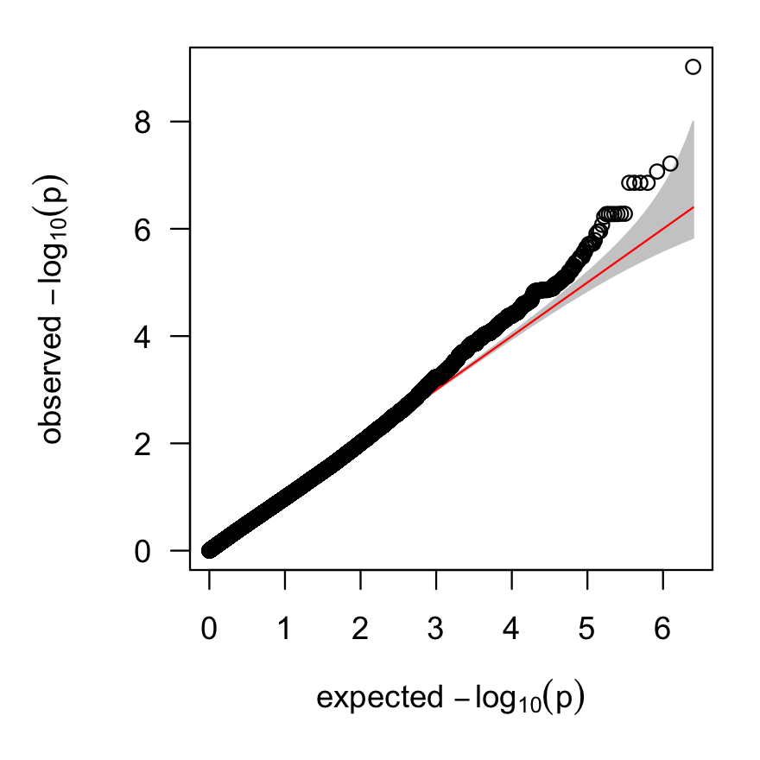
OTP72
MYB26
AT3G13860.1
RHD3
AT3G13880.1
AT3G13890.1
AT3G13898.1
AT3G13900.1
AT3G13870.1
AT3G13882.1
AT3G13890.2
AT3G13900.2
AT3G13870.2
AT3G13882.2
AT3G13900.3
AT3G13910.1
AT3G13920.1
4562454 4568284 4574114 4579943 4585773
4579292

Slide 6
(a)
OTP72
MYB26
AT3G13860.1
RHD3
AT3G13880.1
AT3G13890.1
AT3G13898.1
AT3G13900.1
AT3G13870.1
AT3G13882.1
AT3G13890.2
AT3G13900.2
AT3G13870.2
AT3G13882.2
AT3G13900.3
AT3G13910.1
AT3G13920.1
4562454 4568284 4574114 4579943 4585773
(b)
4579292
(c)

Slide 7
