Slide 1
Family Feud
Logan Docherty, Todd Noreen, Connor Yass

Slide 2
Client
Server

Slide 3
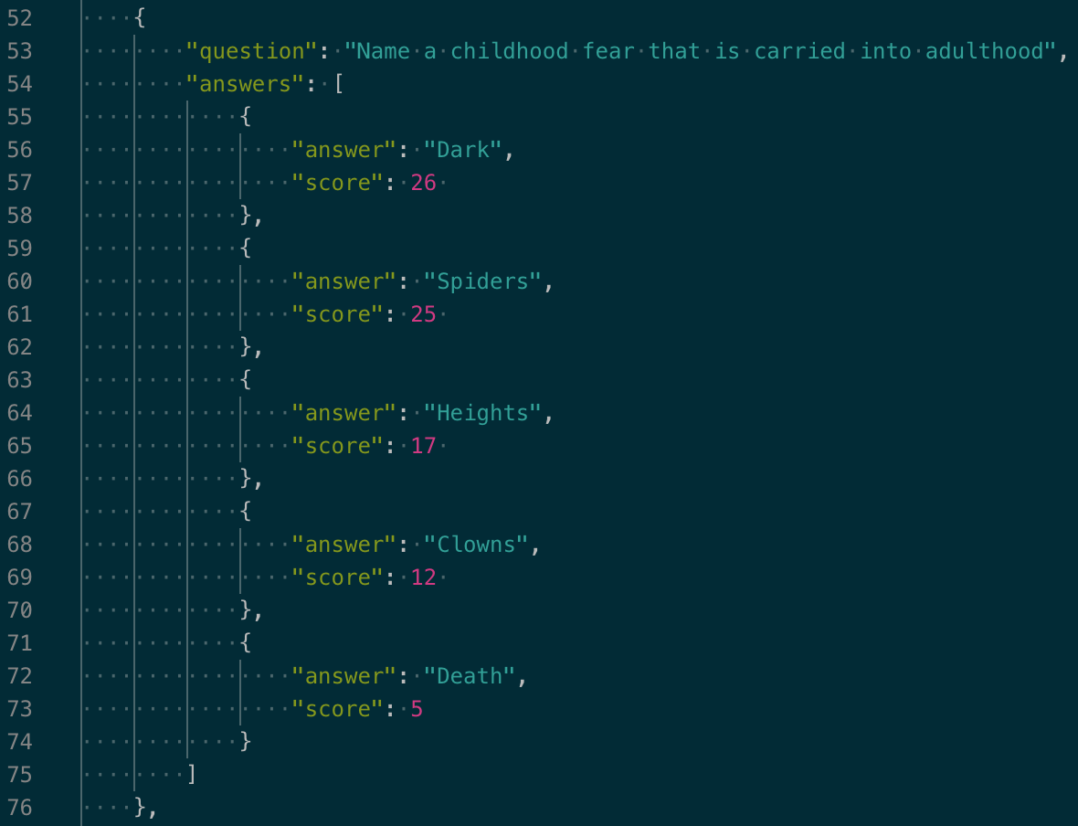
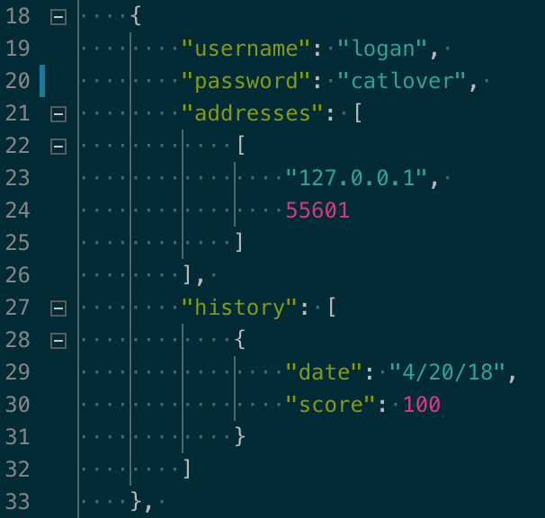
JSON

Slide 4
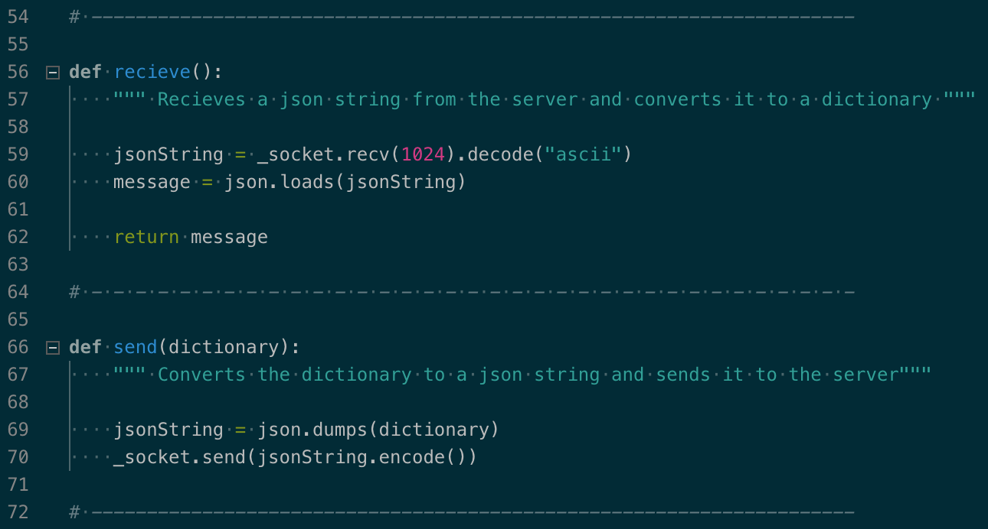
Networking

Slide 5
Https://

