Slide 1
Family Feud
Logan Docherty, Todd Noreen, Connor Yass

Slide 2
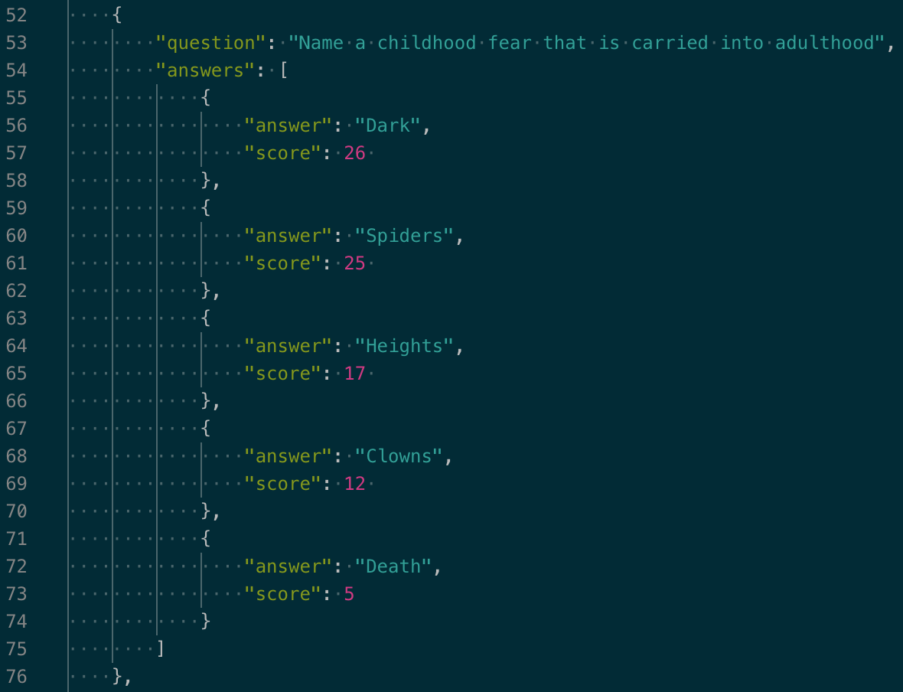
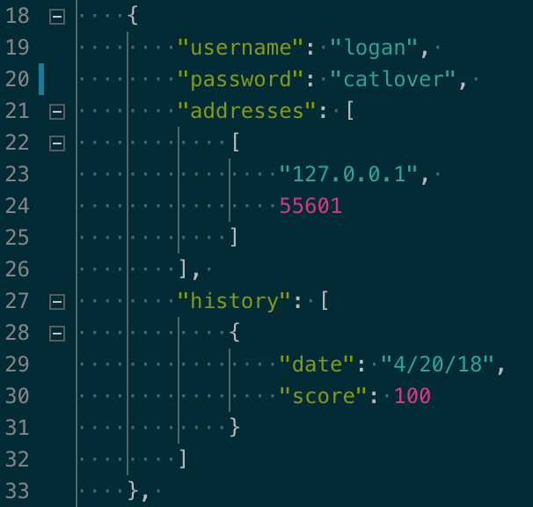

Slide 3
