Slide 1
welcome
.

Slide 2

About ?
This presentation is about Store data Analysis, as we tried to find out the weak areas and some solutions for this weakness

Slide 3
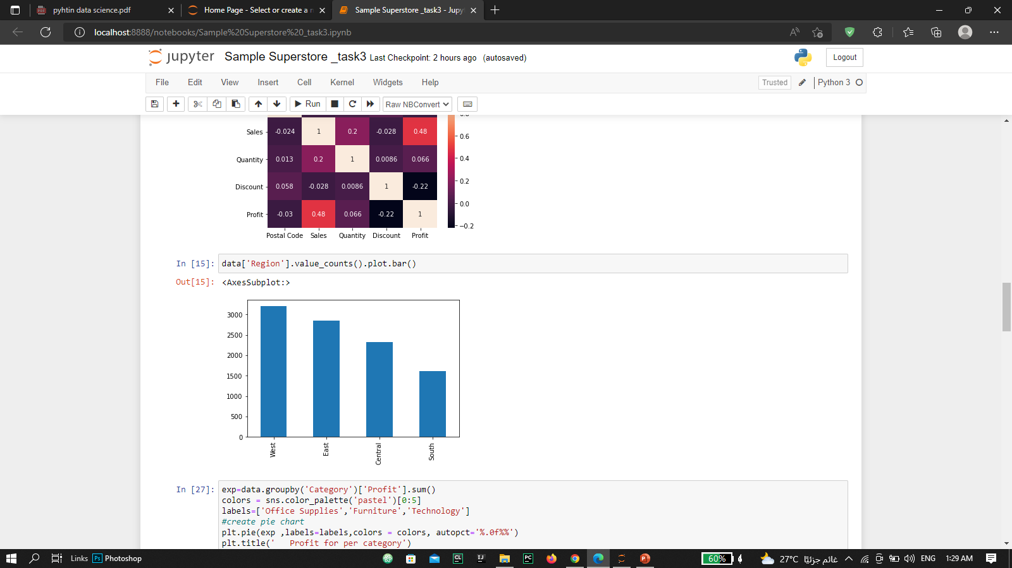
Most popular regions?
West region is most popular

Slide 4
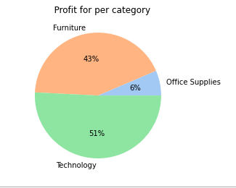
Profit for per category
Technology is the most profitable categories

Slide 5
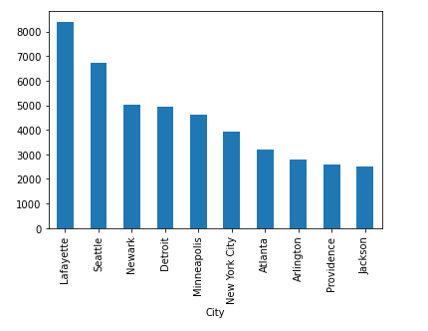
Most profitable cities ?
Lafayette is Most profitable cities , but I think it
depends on available categories
in it and discounts

Slide 6
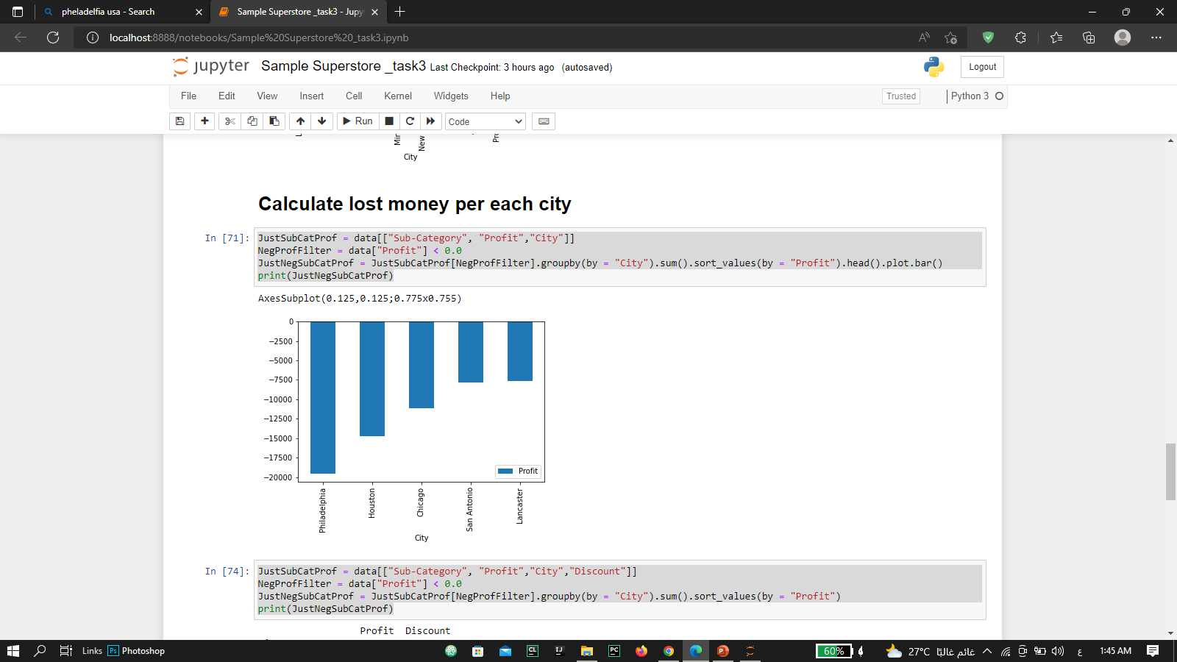
Most lost cities ?
Philadelphia is most lost cities but
I think that because it’s the biggest city
which offer more discounts

Slide 7
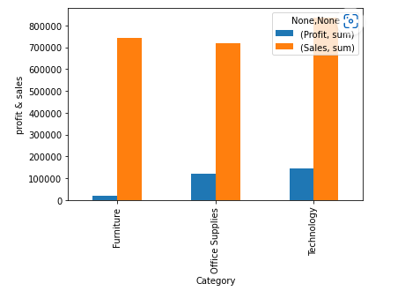
Profit and Sales
We note that the technology category
is in the most sales and profit as well,
and office suppliers are less than furniture
in sales but bigger in profit

Slide 8

My notes and recommendations
I see that discounts is the reason in lost so we should look at this point and also We must look at the categories in each area and ask ourselves whether the category fits the region

