Slide 1




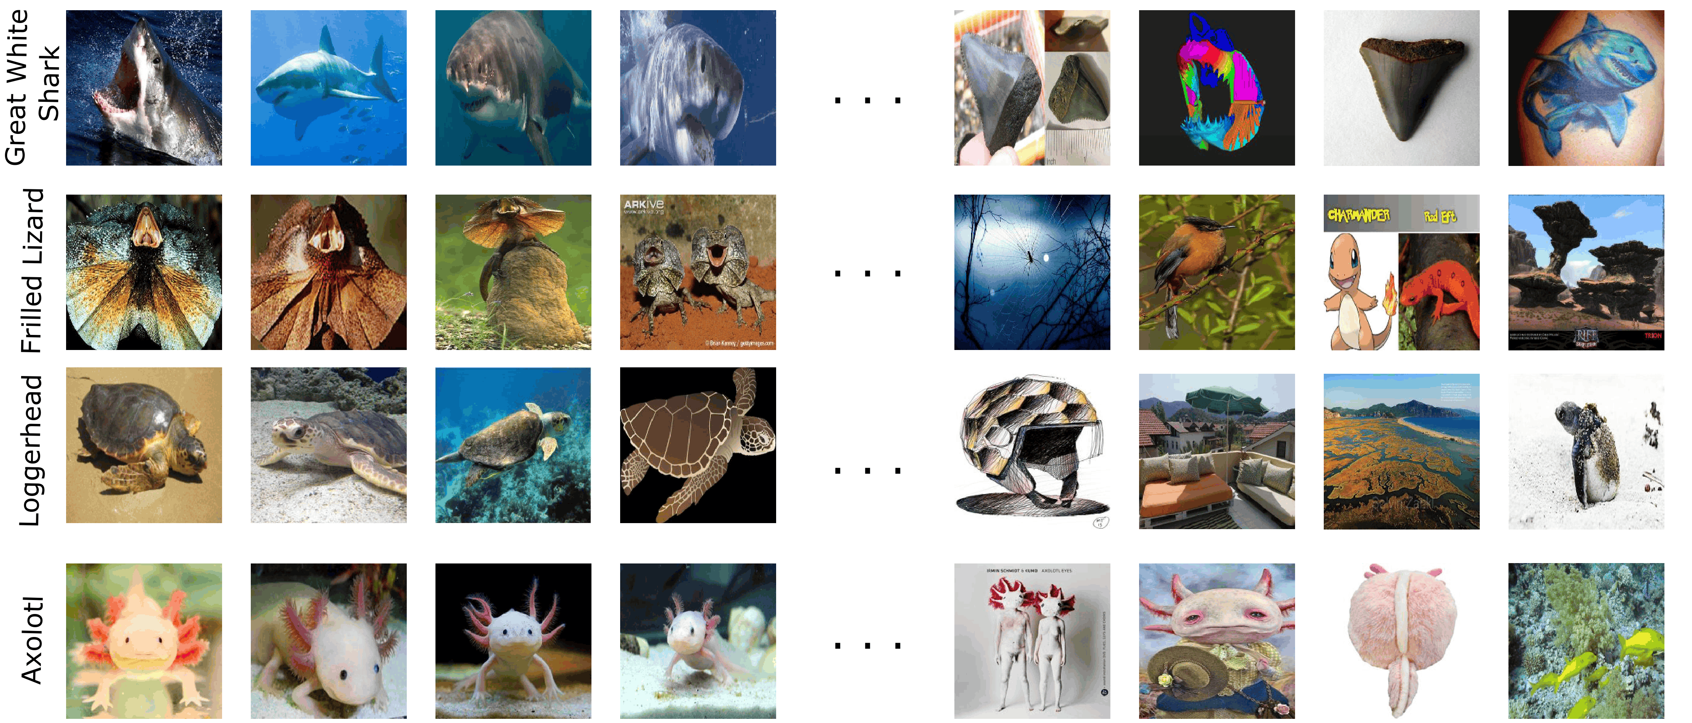
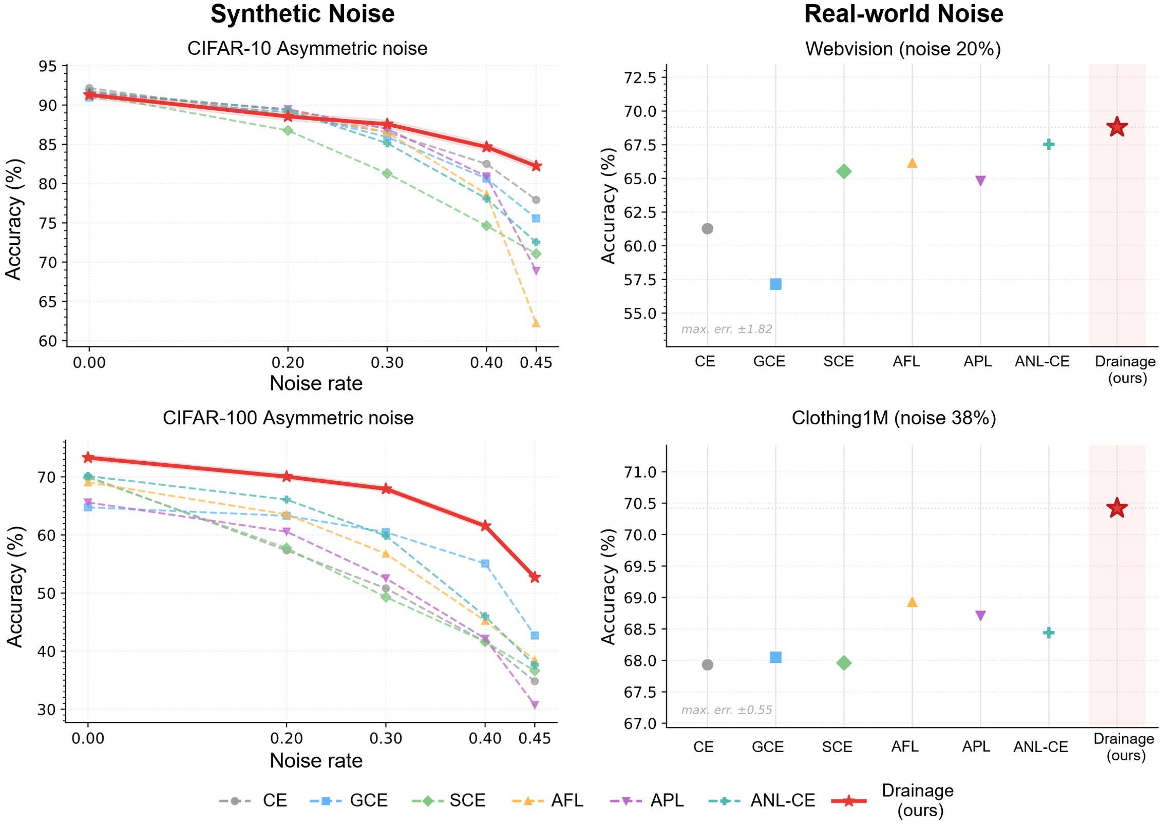
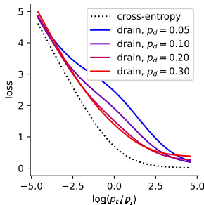
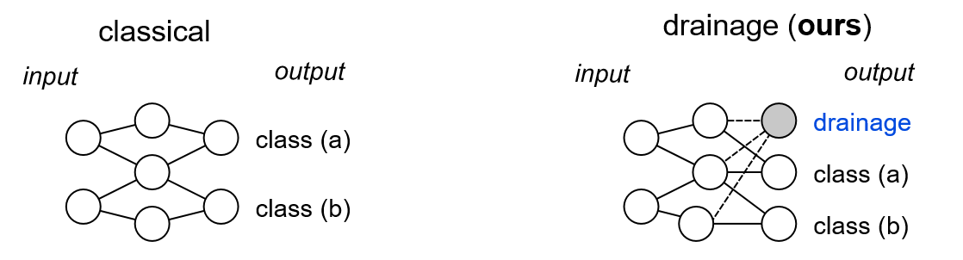
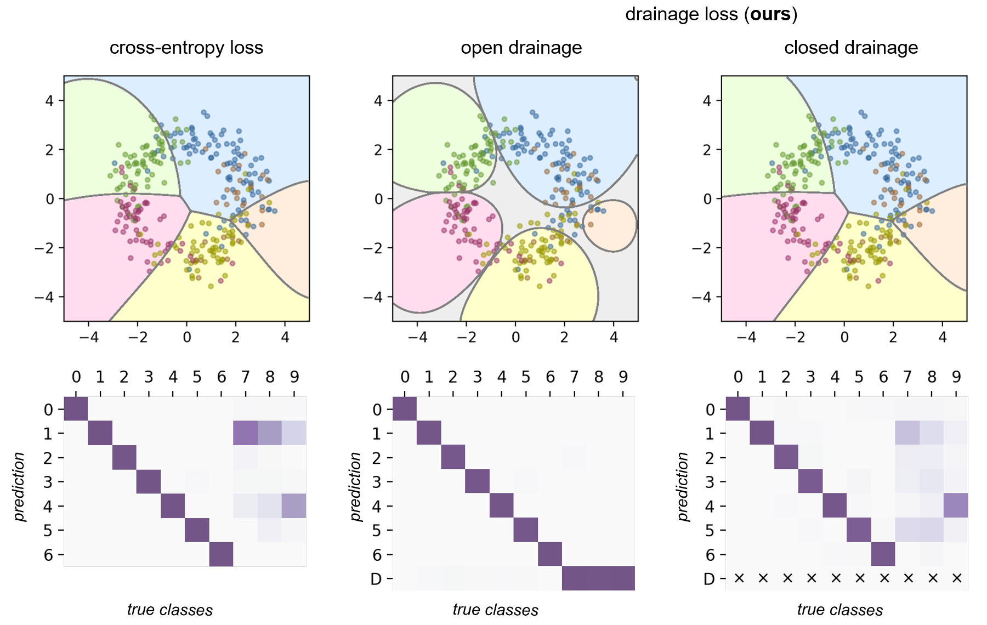
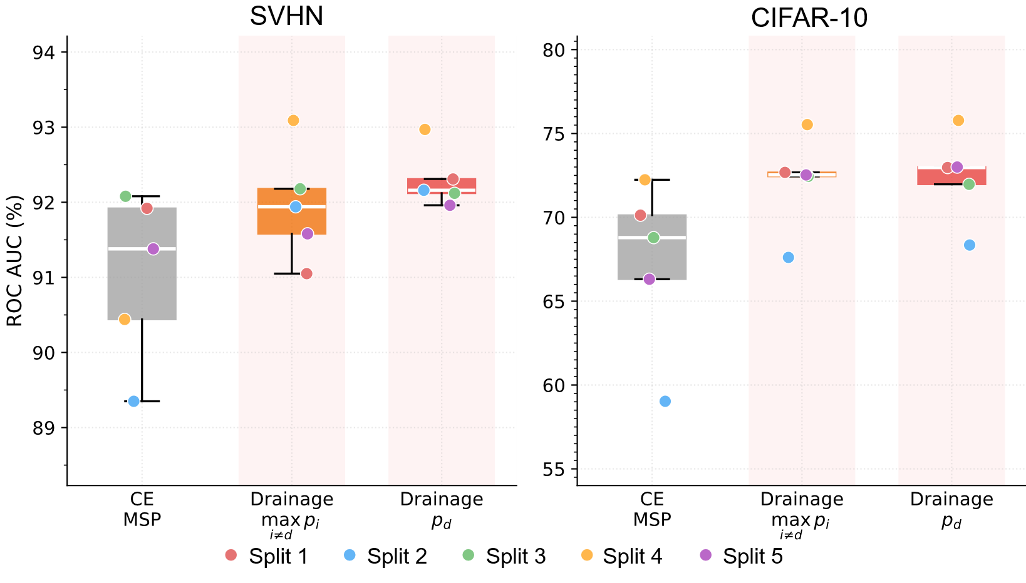
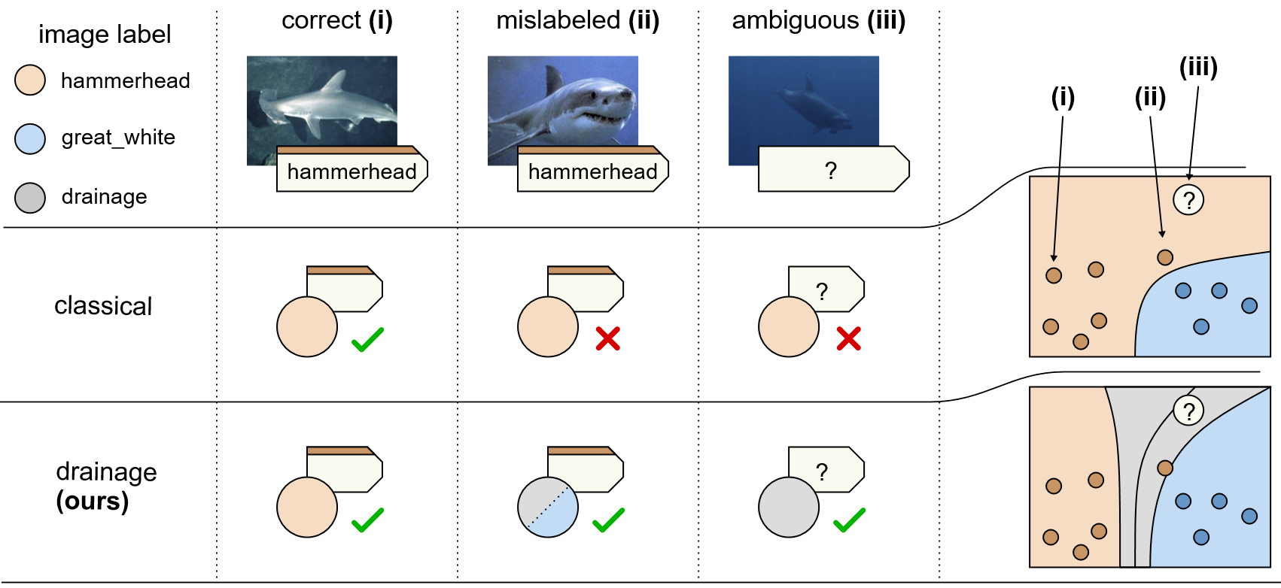
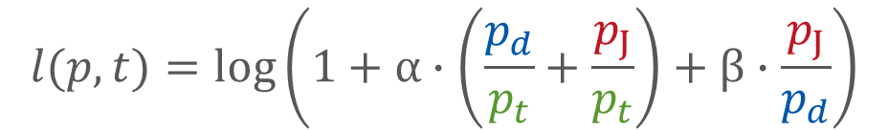
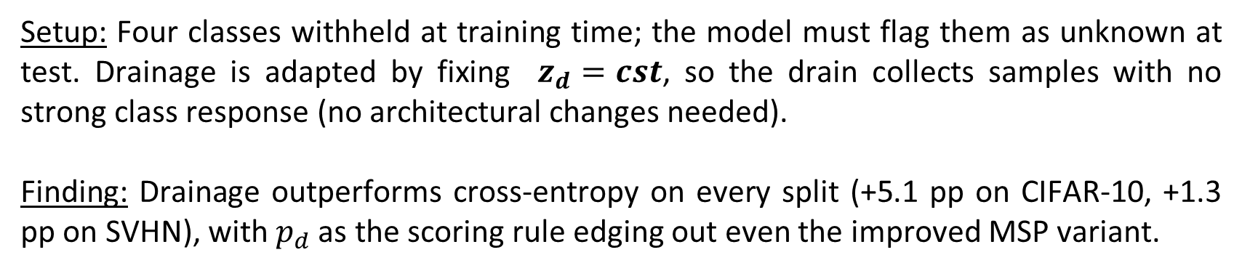

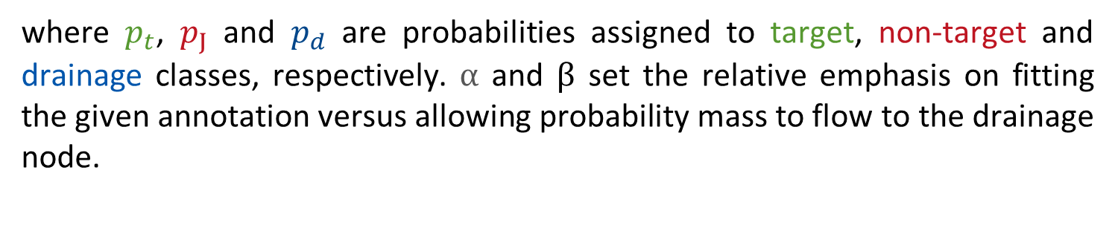
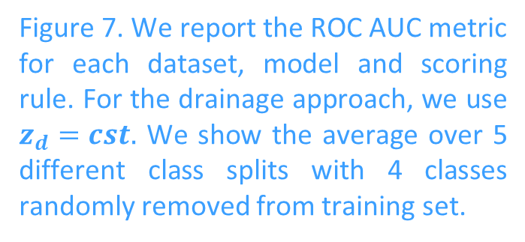
Drainage: A Unifying Framework for Addressing Class Uncertainty
Yasser Taha¹, Grégoire Montavon^{2,3,*}, Nils Körber^{1,*}
¹Centre for Artificial Intelligence in Public Health Research, Robert Koch Institute ²BIFOLD – Berlin Institute for the Foundations of Learning and Data
³Institute for AI in Medicine, Charité – Universitätsmedizin Berlin *Equal Supervision
Introduction
Methods
Results
Abstract:
Modern deep learning struggles with noisy labels, class ambiguity, and out-of-distribution samples. We propose a drainage node added to the network output, which absorbs probability mass from ambiguous, anomalous, or corrupted samples; providing a principled escape from forced hard classification. Our method improves accuracy under severe label noise, matches or surpasses state-of-the-art on real-world noisy datasets, and naturally extends to open-set recognition without architectural changes.
B. Drainage Loss
C. Experiments
C.2. Qualitative Evaluation of the Drainage Node
B.1. Loss Formulation
We evaluate our drainage framework on two challenging settings: label noise and out-of-distribution detection. For label noise, we consider both synthetic noise and real-world noise on large-scale datasets.
$$l(p,t)=log⁡\left(1+α∙\left(\frac{p_{d}}{p_{t}}+\frac{p_{J}}{p_{t}}\right)+β∙\frac{p_{J}}{p_{d}}\right)$$
where $p_{t}$, $p_{J}$ and $p_{d}$ are probabilities assigned to target, non-target and drainage classes, respectively. $α$ and $β$ set the relative emphasis on fitting the given annotation versus allowing probability mass to flow to the drainage node.
C.1. Robustness to Noise
A. Overview
A.1. Drainage Architecture
B.2. Loss Properties
A drainage node is added on top of the classification head acting as a sink for mislabeled or ambiguous samples.
CE reduction: the drainage loss reduces to cross entropy as β → 0 (with $α$ = 1, $p_{d}$ → 0).
Monotonicity: Moving probability mass from non-target classes to the target class or the drainage node decreases the loss.
Convexity: The drainage loss is convex in the logits, guaranteeing a unique minimum for linear models.
Figure 6. Examples from four Mini-WebVision classes. Validation samples are ordered from left to right according to increasing drainage response $p_{d}$
C.3. Out of Distribution Detection
Setup: Four classes withheld at training time; the model must flag them as unknown at test. Drainage is adapted by fixing $z_{d}=cst$, so the drain collects samples with no strong class response (no architectural changes needed).
Finding: Drainage outperforms cross-entropy on every split (+5.1 pp on CIFAR-10, +1.3 pp on SVHN), with $p_{d}$ as the scoring rule edging out even the improved MSP variant.
Figure 3. Monotonic behavior of the drainage loss under different drainage allocations.
Figure 1. Depiction of the classical neural network-based classification architectures (left) and our proposed drainage architecture (right).
B.3. Toy Example
A.2. Drainage Use Cases
Figure 5. Classification accuracy under synthetic and real-world noise on CIFAR-10 and CIFAR-100. Compared methods include GCE, SCE, AFL, APL, and ANL-CE.
Figure 7. We report the ROC AUC metric for each dataset, model and scoring rule. For the drainage approach, we use $z_{d}=cst.$ We show the average over 5 different class splits with 4 classes randomly removed from training set.
Synthetic noise: Drainage maintains accuracy where all baselines degrade sharply, with the largest gains at high noise rates (asymmetric 0.45: +4.3 pp on CIFAR-10, +10.0 pp on CIFAR-100 vs. best baseline).
Real-world noise: Drainage achieves state-of-the-art accuracy on real-world noisy benchmarks, demonstrating that the drain mechanism generalizes beyond controlled synthetic settings.
Conclusion
Figure 2. Sources of class uncertainty and how they are handled by standard versus our drainage model. Unlike standard classifiers, our approach is robust to mislabeled, ambiguous, and outlier instances, which can be assigned to “drainage” instead of forced into arbitrary classes.
Figure 4. Top: Toy 2D example illustrating drainage-dominated regions (gray) and refined decision boundaries. Bottom. On MNIST, relabeling classes 7–9 during training causes the model to consistently route these unseen patterns to drainage at test time.
We introduced Drainage, a simple and general framework for uncertainty-aware learning that separates class predictions from model uncertainty through an explicit drainage node. Across synthetic and real-world label noise settings, Drainage consistently improves robustness and learns cleaner class boundaries under severe ambiguity. Beyond noisy-label learning, the framework also benefits related tasks such as open-set.

