Slide 1


Quiz App
Yasser Mahmoud Abd Elghany
Moustafa Ibrahem Abd Elbaset
Under Supervision of
Dr. Dr Mohamed Abd Elfattah
Lecturer at Department of Computer Science
Misr Higher Institute for Commerce and Computers in Mansoura
Eng. Amany Mamdouh
Teaching assistant at Department of Computer Science
Misr Higher Institute of Commerce and Computers in Mansoura

Slide 2
Introduction To android
1_1 What is Android?
1.1.1 The Android operating system
1.1.2 Task
1.1.3 Android platform components
1.1.4 Google Play
1_2 Android Development Tools
1.2.1 Android SDK
1.2.2 Android debug bridge (adb)
1.2.3 Gradle and the Android plug-in for Gradle
1.2.4 Android Developer Tools and Android Studio
1.2.5 Android RunTime (ART)
1_3 Android Security and permissions
1.3.1 Security concept in Android
1.3.2 Permission concept in Android
1_4 Programming software for Android

Slide 3
Introduction To Agile
2_1 SW Engineering
2_2 Traditional SW Development Methodologies
2.2.1 Types of Traditional SW Development Methodologies
2.2.2 Traditional Methods Drawbacks
2_3 Agile
2.3.1 What is Agile?
2.3.2 Agile Manifesto
2_4 Agile Methods
2.4.1 Extreme Programming (XP)
2.4.2 Scrum

Slide 4
Requirement Definition
3_1 Description for quiz app.
3_2 UseCase

Slide 5
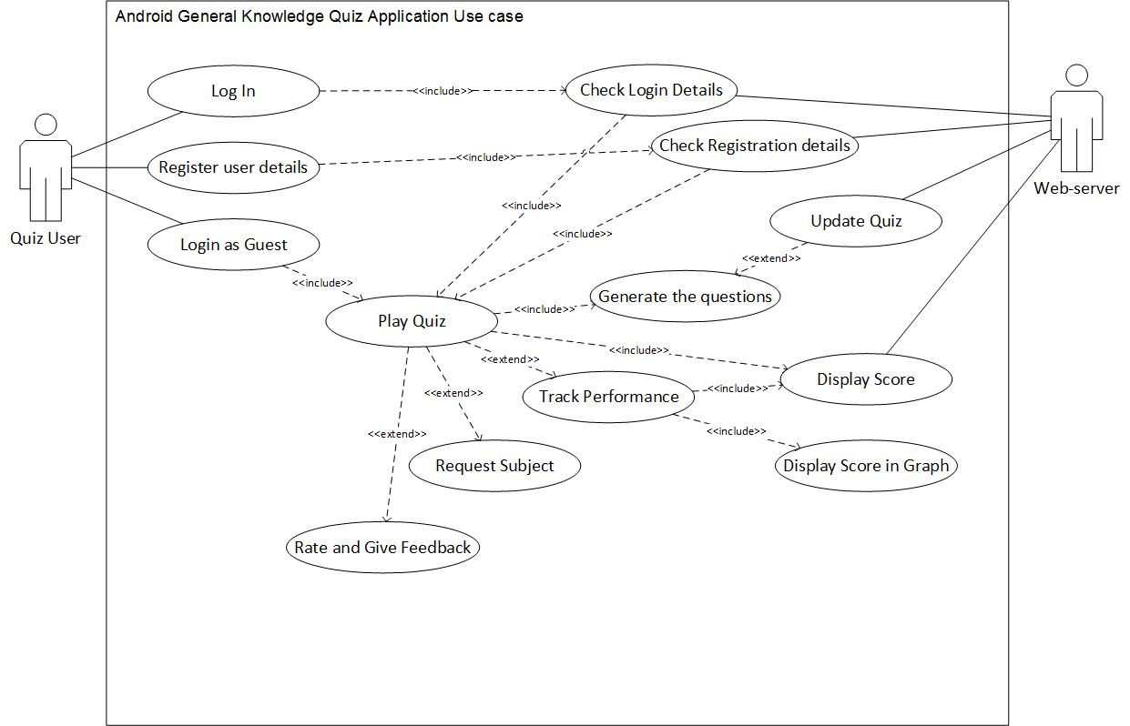
USeCase

Slide 6
Development
4_1 Azure
4_2 Implementation

Slide 7
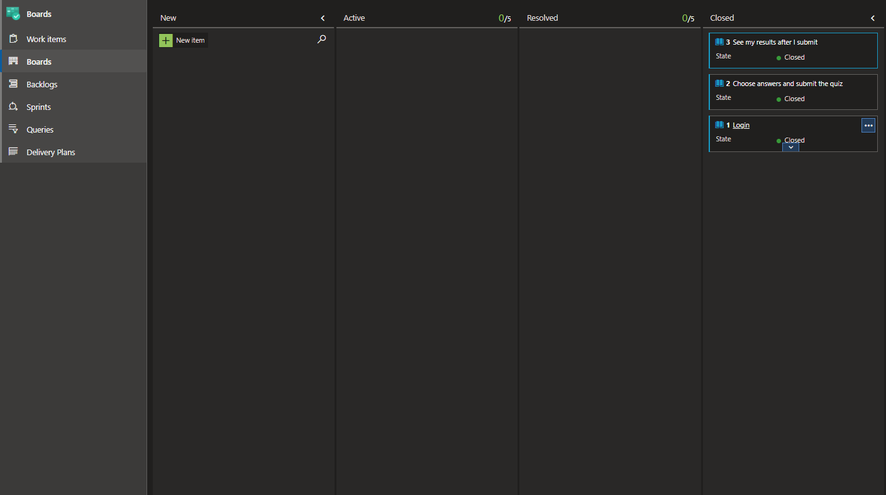
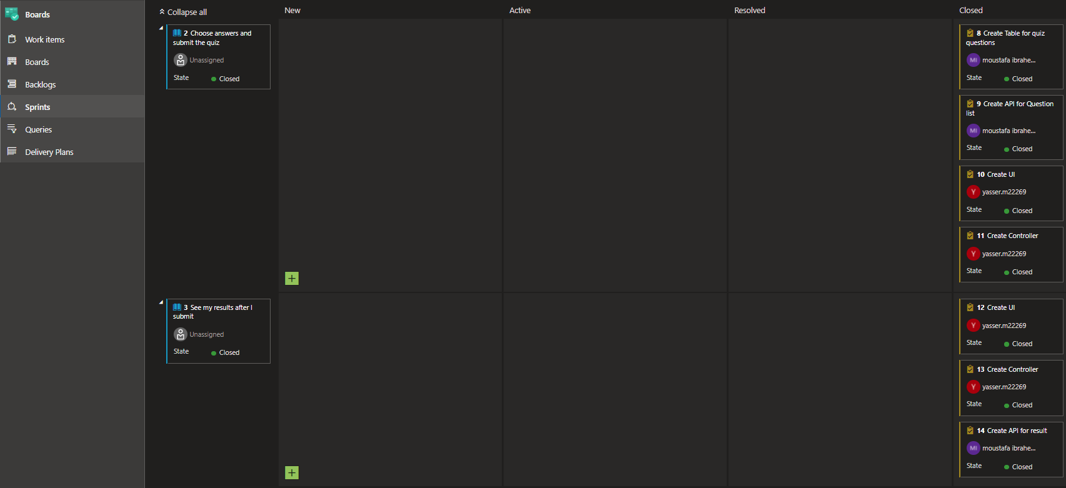
Azure (Boards - Sprints)

Slide 8
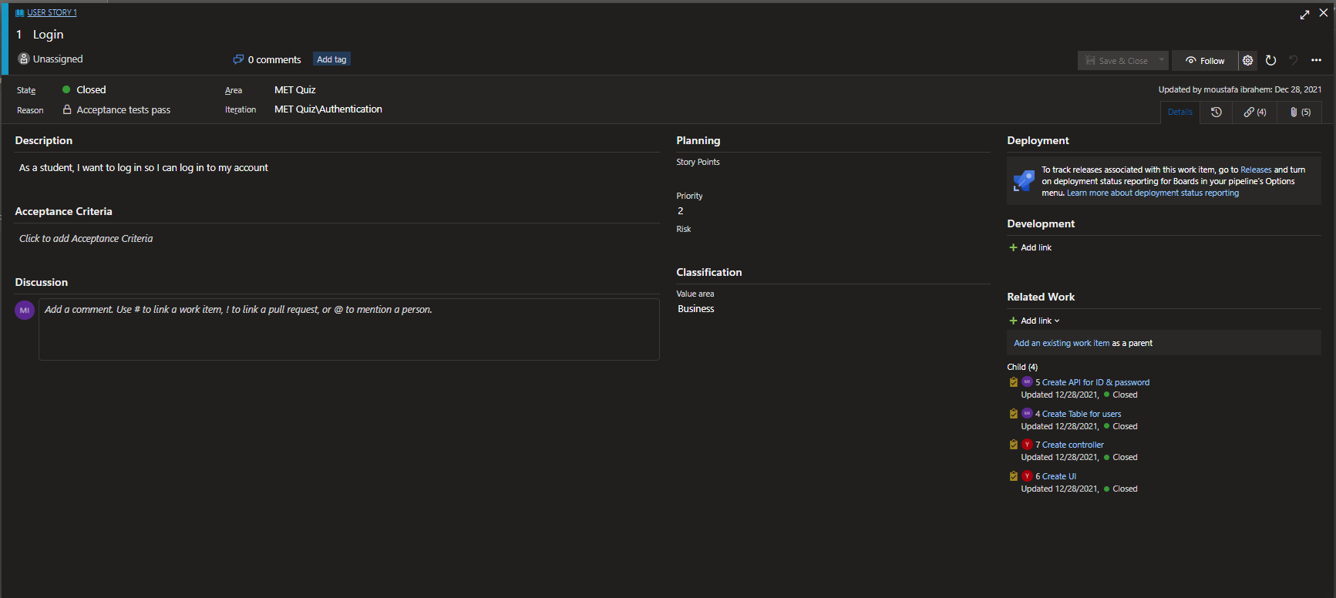
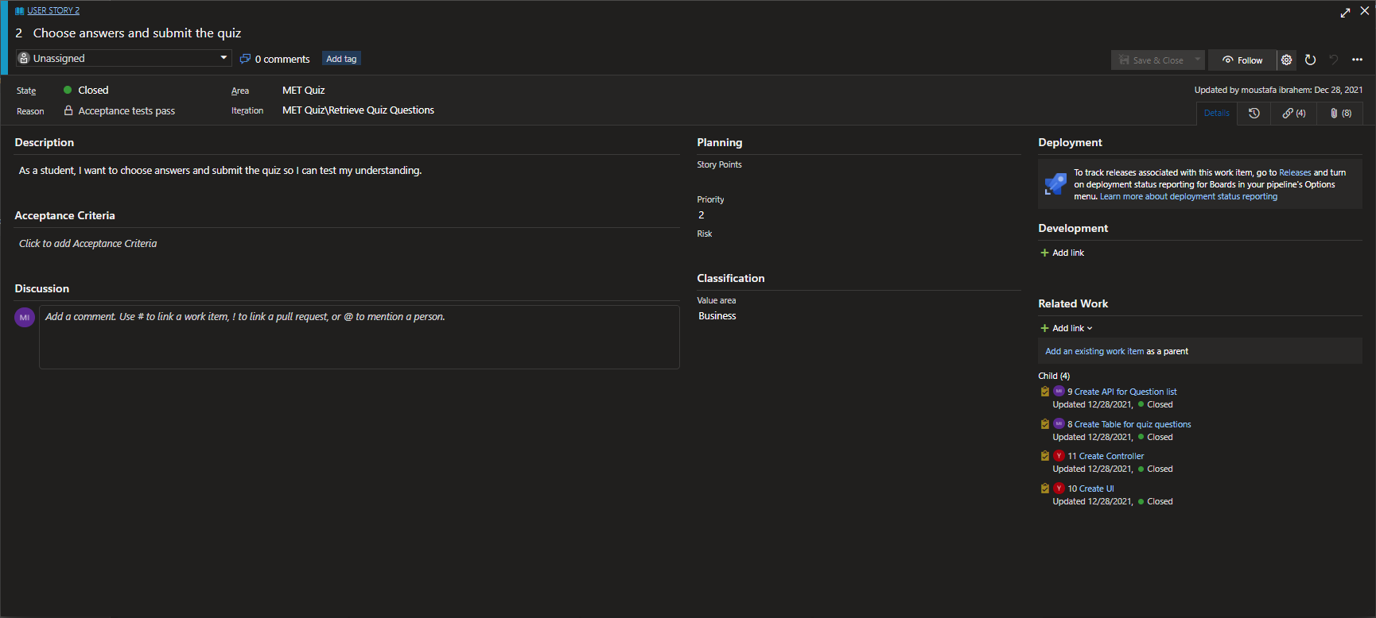
Work Items
Login
Choose answers and submit the quiz

Slide 9
Testing
5_1 UI
5_2 Test cases

Slide 10
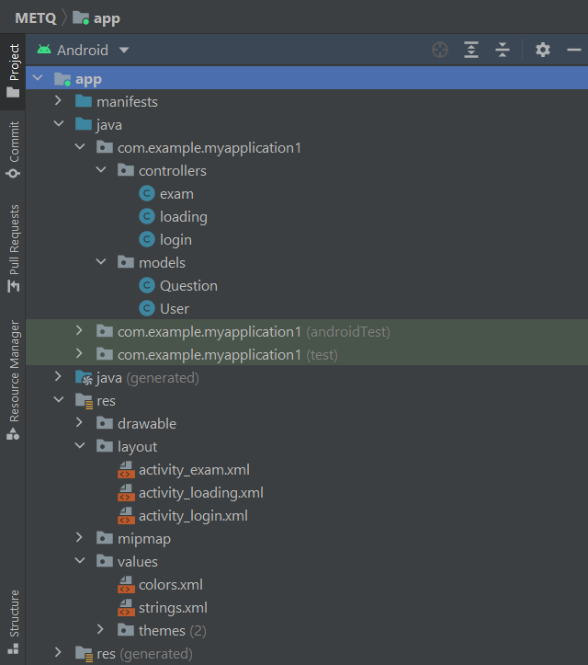
MVC Pattern

Slide 11
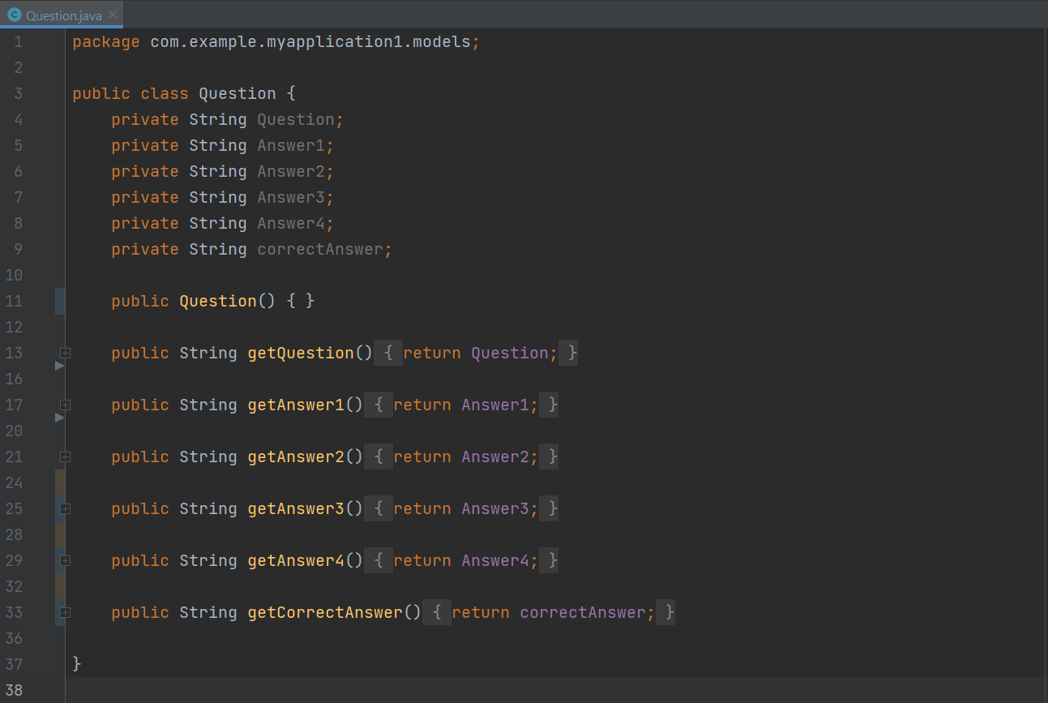
Models

Slide 12
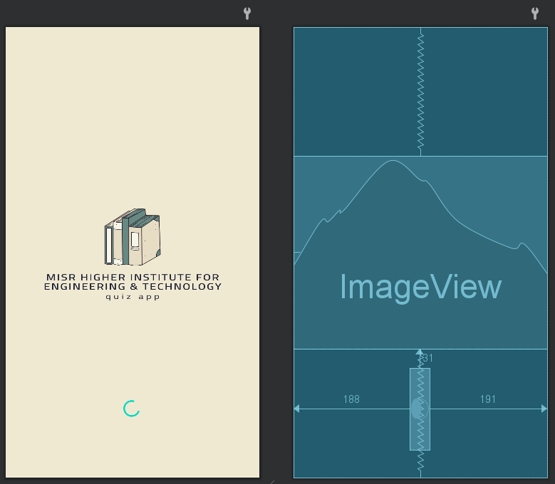
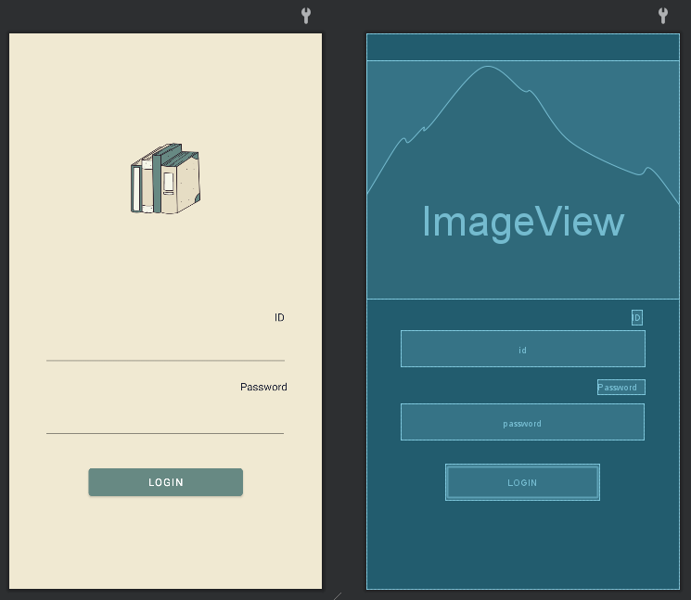
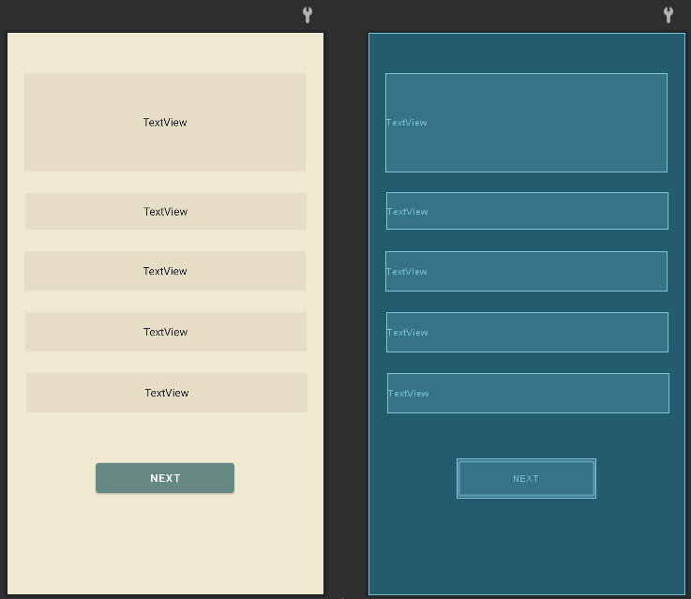
Views ( loading , Login, Exam)

Slide 13
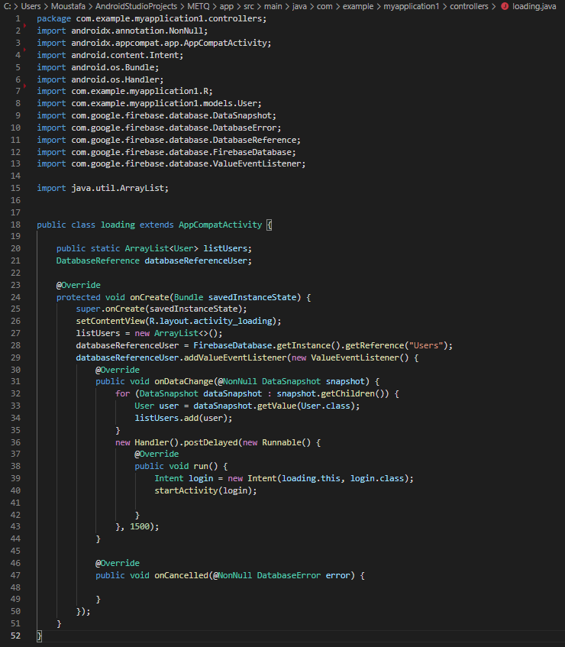
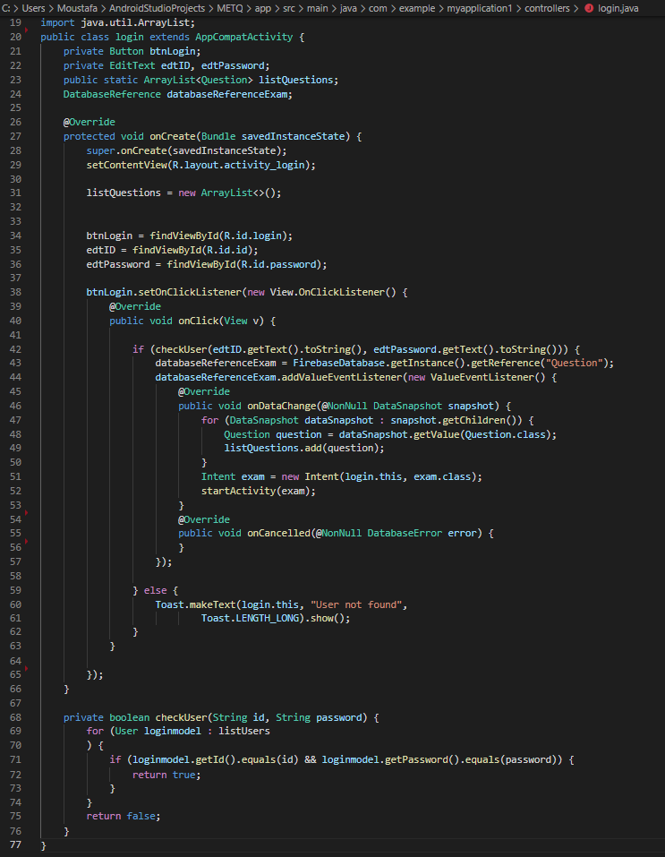
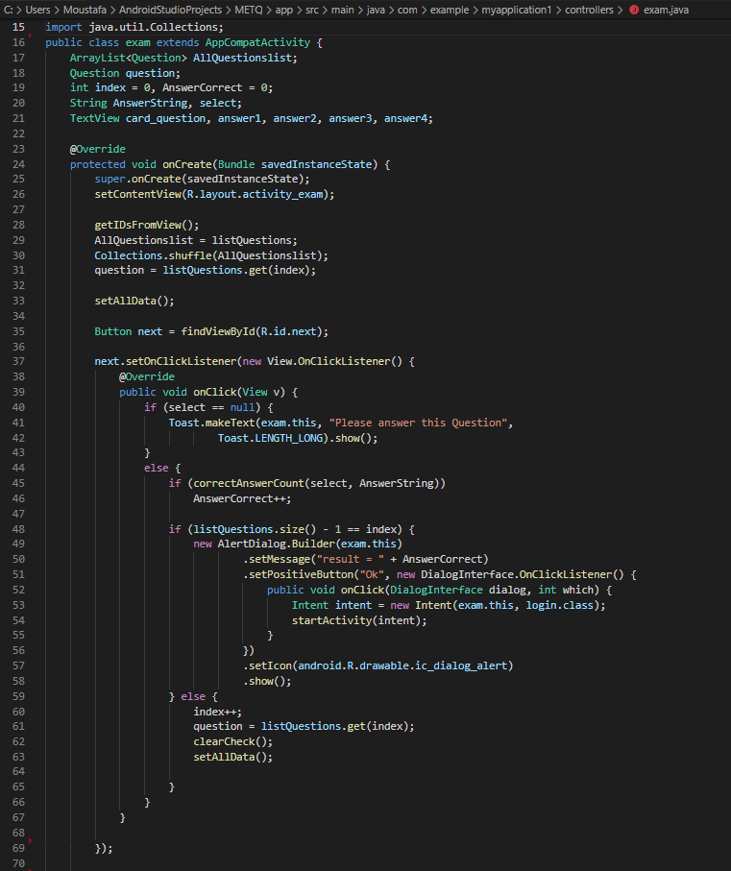
controllers

Slide 14
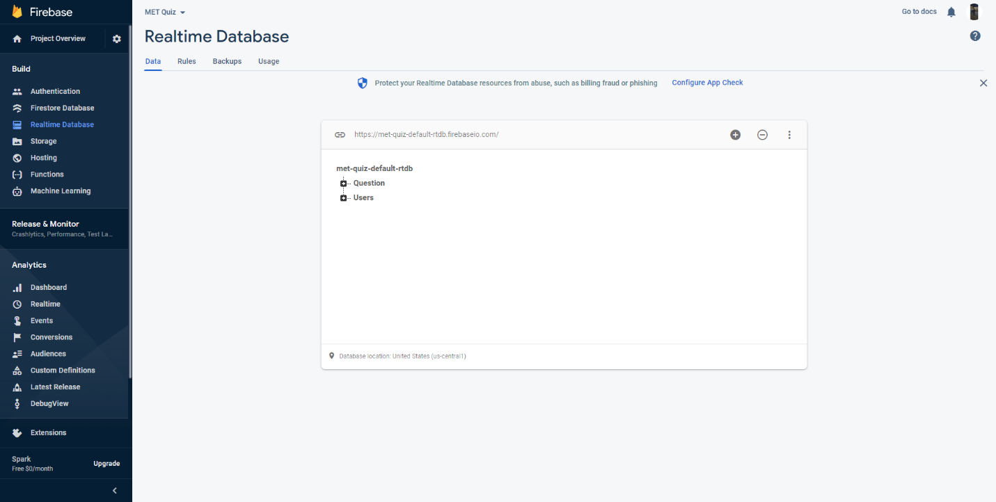
firebase

Slide 15
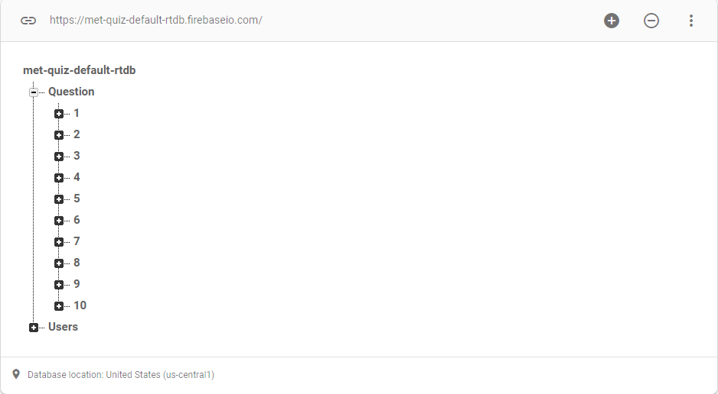
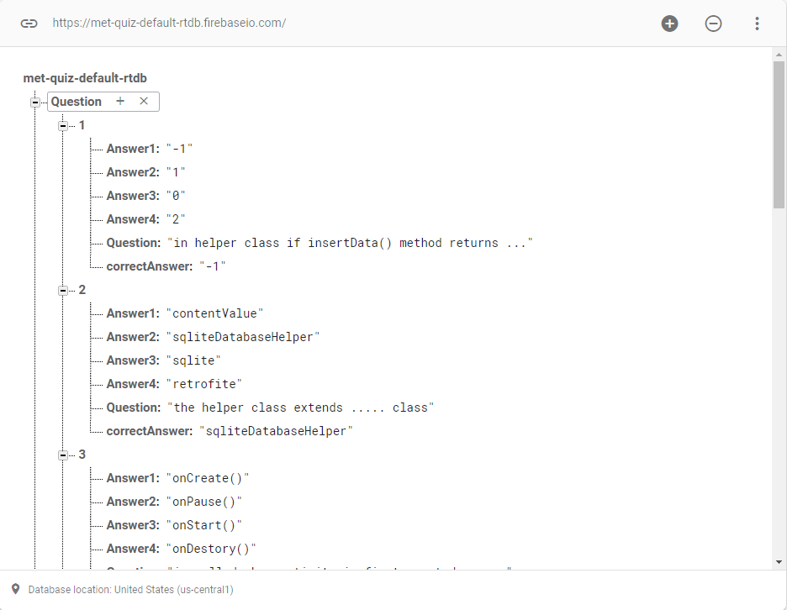
firebase

Slide 16
Test cases
A suitable ui has been used for all users, not forgiving of interface errors
User cannot login without ID and password is correct and must make sure that the text box is filled in
He cannot skip a question without answering it

Slide 17
Future Work
Some future work:
An admin system, adding questions, modifying an exam, and starting an exam and all results for students.
Improvement in design.
Right and wrong option.

