Slide 1

Social Insurance Management System
Our Team Members
Names:
1- Mariam Nabil Asham .
2-Nabil Fawzy Halim.
3-Yasser Ahmed Mohamed.
4-Youssef Ali Khairy.
5-Youssef Salah Ahmed .

Slide 2
Supervision
Supervised by : Dr.Sherien Rady.
TA’s : Passant Kandil.
Mohammed Asharf.

Slide 3
Agenda
1-Introduction.
2-Statistics
3-Problem Definition .
4-Motivation.
5-Objective .
6-Related Works .
7-System Architecture.
8-Functional Requirements.
9-Use case diagram.
10-Software & Hardware Tools.
11-Time Plan.
12-References.

Slide 4
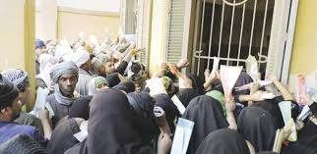
Introduction
Any family has someone who deals with official offices to get Pension, so Did you see the crowd in official offices ?

Slide 5
Introduction (con’t)
Most Elderly people suffer from staying on long queues and crowded places to get Pension, And if they send a someone on his behalf still also the problem exists, And the problem continues if citizen has no time to spend in this queue to get his pension.

Slide 6
Introduction (con’t)
Using computer vision and biometric verifications in a web application to verify that citizen is still alive and deserves the payment can enhance the pension service
After ensuring the citizen deserves the payment, the money can be transferred to nearest place that Supports money transfer services

Slide 7
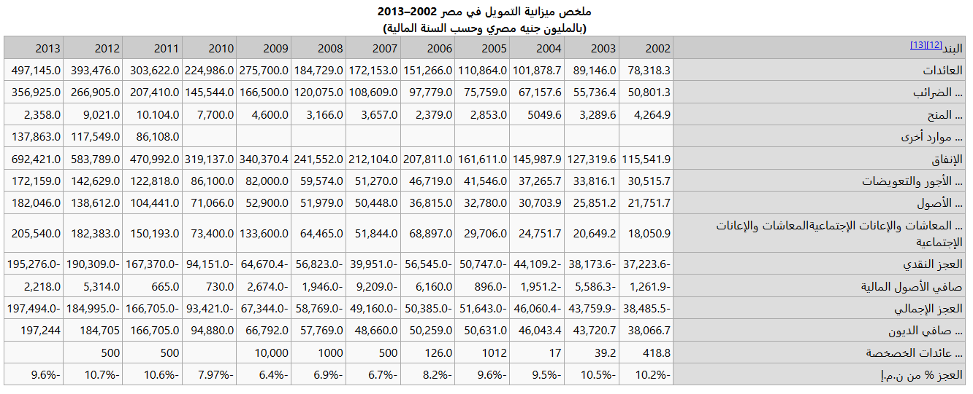
Statistics For budget of Pension
https://www.marefa.org/%D8%A7%D9%82%D8%AA%D8%B5%D8%A7%D8%AF_%D9%85%D8%B5%D8%B1

Slide 8
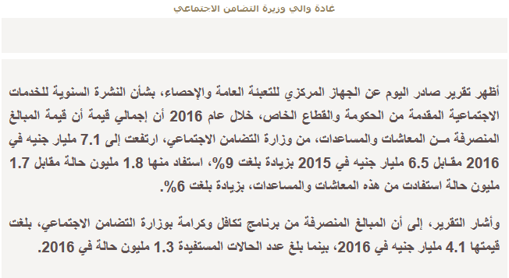
Statistics For Budget of Pention
In 2015 6.5 billion LE
In 2016 7.1 billion LE
https://www.elwatannews.com/news/details/2770882

Slide 9
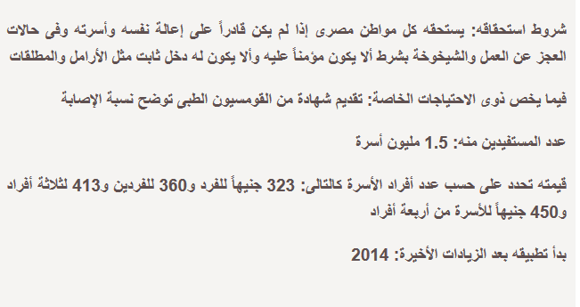
Statistics Pentioners
Types of people who gets pension 1.5 million family have a big problem to get their pension.
https://www.elwatannews.com/news/details/954523

Slide 10
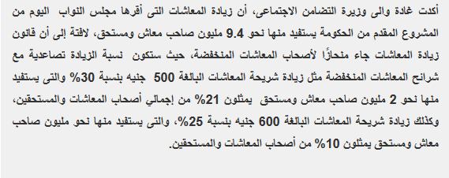
Statistics Pentioners By the Minister there are about 9.4 Million citizens receive a pension . All of them need a system facilitate getting pension.

Slide 11
Problem Definition
Citizens encounter crowds in the post offices and long queues to get their pension, they are exposed to suffering , stealing and being tired cause Of their age.
It can also happen that some offices in some places can be crowded more than others.

Slide 12
Motivation
1- The findings of this system will (redound???) to the benefit of the society if the system is integrated with the current system of The Ministry of Social Solidarity. Citizens can benefit from system by being notified using our application.

Slide 13
Motivation (con’t)
2-the system can help authorities to know about densities at post offices, which can help them in decision making for avoiding crowds.
Citizen will get benefit of enhanced services, and avoiding crowded queues which exposed to wasted time, stolen money or because of old age.

Slide 14
Objective
This project aims to:
1- provide a better service to both authority and citizen where a developed mobile application can help the citizen verify identity at home through computer vision and other biometric verifications.
2-The project will also support a website for data management and map visualization to provide better services.

Slide 15
Related Works 1.)MPAO Mobile App The Official Mobile Application for Maldives Pension Administration Office. Features Included: a-) Retirement savings account balance checking b-) RSA summary c-) RSA activity d-) Contributions history and payout history

Slide 16
Related Works Con’t
2.) تاميناتى It is the official mobile application of the electronic services of the general organization for social insurance .It allows subscribers to benefit from the following electronic services: a-) Review of expected monthly pension. b-) Extraction of certificate with the amount of pension.

Slide 17
Related Works Con’t
3.) Public Pension Agency The official mobile application for Kingdom of Saudi Arabia . This application allows access to the electronic services provided by the institution to pensioners. Features Included: a-) Pension adjustment statement. b-) Pension account checking.

Slide 18
Related Works Con’t
4.) My Pension My Pension’ is an easy-to-use Application for smartphones designed to help you with your retirement planning. Features Included: a-) See the current value of your pension fund, total contributions paid to date and years to go to retirement. b-) Calculate the estimated value of your annual pension at retirement.

Slide 19
Related Works Con’t
5.) selfie pay
MasterCard launches biometric authentication app in Europe . So basically application enabling users to confirm an online payment by showing their face to their smartphone’s camera.
To get around attempts to spoof the authentication process by holding up a static photo to the lens the app requires the user to blink to confirm it’s really their face in shot.

Slide 20

System Architecture
Presentation Layer
Citizen
Admin
Application Layer
Logging
Notify Pension
Find Process
Edit
Feature Extraction
Citizen verification
Data Layer
Database

Slide 21
Functional Requirements
1-The system should agree to accept service request for logging in.
1.1-The system check the entry according to fields.
2- the system After checking allow citizen to open connection with system for recognitions terms by camera phone .
2.1 –The system check the retrieving information.
3-The system should give response (Alert) according to user information with acceptance (deserve ) and your money transferred to your account OR with rejection(not deserve).
4-The system give the user ability with opening Gps system to detect the nearest places with low crowded people (optional).

Slide 22
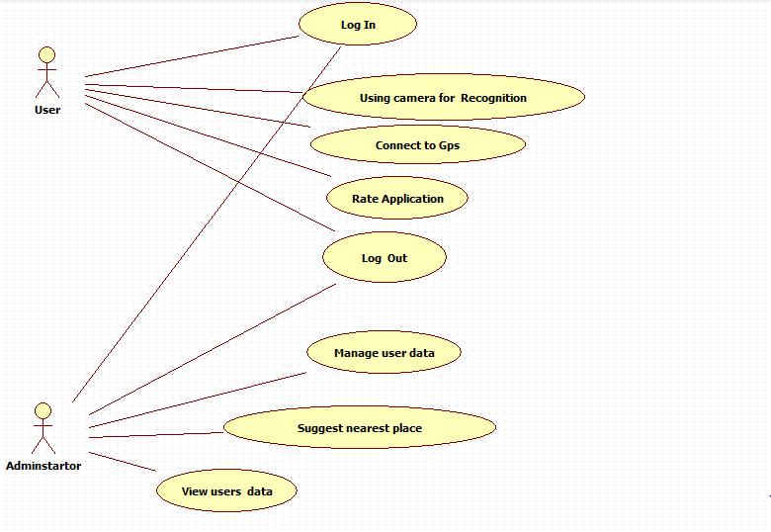
Use case

Slide 23
Software & Hardware tools
Software tools:
1-Anroid Studio.
2-Visual Studio.
2.1-asp.net
3-Sql Database.
Hardware tools:
1-Mobile 2.Server.

Slide 24
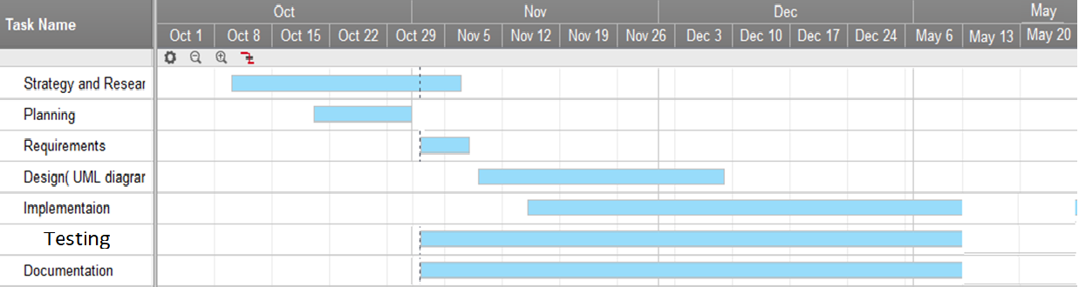
Time Plan

Slide 25
References
5 -https://www.marefa.org/%D8%A7%D9%82%D8%AA%D8%B5%D8%A7%D8%AF_%D9%85%D8%B5%D8%B1
6-https://www.elwatannews.com/news/details/2770882
7- https://www.elwatannews.com/news/details/954523
8- http://www.youm7.com/story/2017/6/19/%D9%88%D8%B2%D9%8A%D8%B1%D8%A9-%D8%A7%D9%84%D8%AA%D8%B6%D8%A7%D9%85%D9%86-%D8%B2%D9%8A%D8%A7%D8%AF%D8%A9-%D8%A7%D9%84%D9%85%D8%B9%D8%A7%D8%B4%D8%A7%D8%AA-%D8%AA%D9%86%D8%AD%D8%A7%D8%B2-%D9%84%D9%84%D8%A3%D9%82%D9%84-%D8%AF%D8%AE%D9%84%D8%A7%D9%8B-%D9%889-4-%D9%85%D9%84%D9%8A%D9%88%D9%86/3291368
1- https://www.smartsheet.com/
2- https://play.google.com/store/apps/details?id=mv.gov.pension.app
3- https://play.google.com/store/apps/details?id=com.irishlife.mypension.activities
4- https://www.visual-paradigm.com/tutorials/writingeffectiveusecase.jsp.

Slide 26


