Slide 1
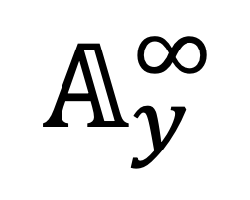
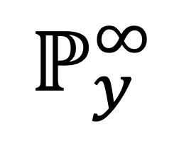
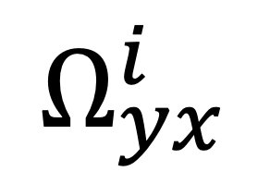
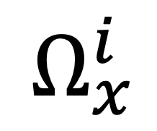
$$Ω_{x}^{i}$$
$$ℙ_{y}^{∞}$$
$$𝔸_{y}^{∞}$$
$$Ω_{yx}^{i}$$

Slide 2

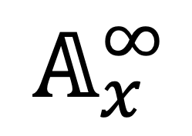
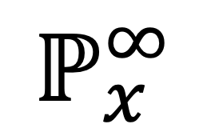
$$ℙ_{x}^{∞}$$
$$ℙ_{y}^{∞}$$
$$ω_{∗}$$
$$𝔸_{y}^{∞}$$
$$𝔸_{x}^{∞}$$

