Slide 1
CautiousOneShotAgent for ANAC2024 SCML OneShot Track
Ryoga Miyajima
Tokyo University of Agriculture and Technology
Katsuhide Fujita Lab.
Notes:
Hello everyone, I’m Ryoga Miyajima, from Tokyo University of Agriculture and Technology.
Now, let’s start my presentation of strategies of my agent for SCML2024 OneShot Track, CautiousOneShotAgent.

Slide 2
Concepts
Based on SyncRandomOneShotAgent
Negotiate all partners synchronously to meet the required quantity.
Generally a good strategy, but room for improvement.
Selective Acceptance and Complementary Offering
Accept received offers that well meet the required quantities.
Complement shortage with counter offers.
Avoid The Risk of Shortfall Penalty
Set the acceptable quantity error range for avoiding shortfall penalty.
Notes:
There are concepts of CautiousOneShotAgent.
CautiousOneShotAgent is based on an SCML samlple agent, SyncRandomOneShotAgent.
SyncRandomOneShotAgent negotiates multiple partners synchronously to meet the quantity required by exogenous contracts.
It is generally a good strategy because quantity is a much more important issue than unit price in OneShot Track.
However, it still leaves some room for improvement, so I improved it to be more efficient and lower risk.
CautiousOneShotAgent makes selective acceptance and complementary offering.
CautiousOneShotAgent accepts a combination of received offers from its partners that well meet the required quantities and complements shortage with counter offers.
CautiousOneShotAgent avoids the risk of shortfall penalty.
CautiousOneShotAgent sets the range of acceptable quantity error for avoiding shortfall penalty.

Slide 3
Selection of Acceptable Offers
Select a Combination from a Power Set of Received Offers.
Select a combination minimizing over-quantity error
If quantity is the same, better total price is preferred.
Select a combination minimizing under-quantity error
If quantity is the same, fewer partners is preferred.
If number of partners is also the same, better total price is preferred.
Accept either combination of offers.
Accept the one that meets the condition by the thresholds*.
*: Refer to Risk Management(Page 4).
If both of them meet the condition, accept the smaller quantity error.
Notes:
Now, I will start explaining the details of the strategies of CautiousOneShotAgent.
First, I will explain how to select acceptable offers.
CautiousOneShotAgent selects a combination from a power set of received offers.
First, CautiousOneShotAgent selects a combination of offers minimizing over-quantity error and a combination minimizing under-quantity error.
In selection of a combination minimizing over-quantity error, if their total quantities are the same, the one with the best total price is selected.
In selection of a combination minimizing under-quantity error, if their total quantities are the same, the one with. the fewest partners is selected.
If their number of partners are also the same, the one with the best total price is selected.
Then, CautiousOneShotAgent selects from combinations of offers minimizing over and under quantity errors.
CautiousOneShotAgent selects the one that meets the quantity condition by the thresholds and accepts it.
The details of the thresholds are referred later.
If both of them meet the condition by the thresholds, CautiousOneShotAgent selects the one with the smaller quantity error and accepts it.

Slide 4
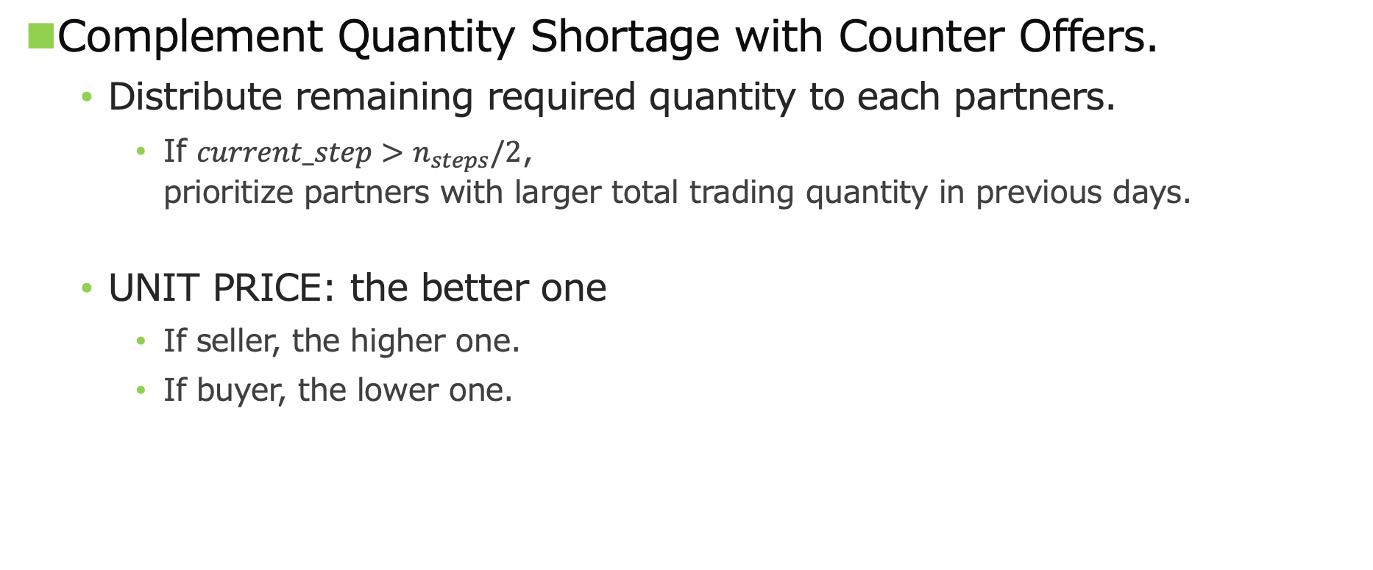
Making Counter Offers
Complement Quantity Shortage with Counter Offers.
Distribute remaining required quantity to each partners.
If $current_step>n_{steps}/2$, prioritize partners with larger total trading quantity in previous days.
UNIT PRICE: the better one
If seller, the higher one.
If buyer, the lower one.
Notes:
Next, I will explain how to make counter offers.
If it hasn’t met the required quantity, CautiousOneShotAgent proposes offers to remaining partners.
CautiousOneShotAgent distributes remaining required quantity to each partners.
Then, if it has passed more than half of the total number of days, CautiousOneShotAgent prioritizes partners with larger total trading quantity in previous days.
Offering unit price is the better of the two options of unit price.
This figure is the image of selecting acceptable offers and proposing offers to remaining partners to complement quantity shortage.

Slide 5
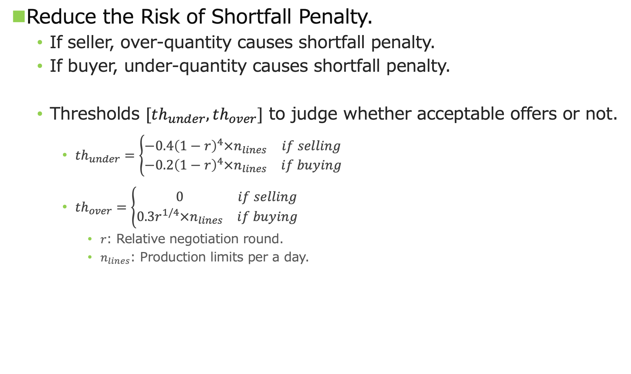
Risk Management
Reduce the Risk of Shortfall Penalty.
If seller, over-quantity causes shortfall penalty.
If buyer, under-quantity causes shortfall penalty.
Thresholds $[th_{under}, th_{over}]$ to judge whether acceptable offers or not.
$th_{under}=\left\{\begin{matrix}−0.4{\left(1−r\right)}^{4}×n_{lines} & if selling \\ −0.2{\left(1−r\right)}^{4}×n_{lines} & if buying\end{matrix}\right.$
$th_{over}=\left\{\begin{matrix}0 & if selling \\ 0.3r^{1/4}×n_{lines} & if buying\end{matrix}\right.$
$r$: Relative negotiation round.
$n_{lines}$: Production limits per a day.
Notes:
In SCML world, the shortfall penalty is a larger risk than the disposal cost.
If CautiousOneShotAgent negotiates as a seller, over-quantity causes shortfall penalty, but if it negotiates as a buyer, under-quantity causes shortfall penalty.
To reduce the risk of shortfall penalty, the thresholds of quantity error are calculated by this equation.
If CautiousOneShotAgent negotiates as a seller, it is more strict on over-quantity error,
but if it negotiates as a buyer, it is more strict on under-quantity error.
In addition, as the negotiation rounds progress, CautiousOneShotAgent allows for over-quantity errors and no longer allows for under-quantity errors.

Slide 6
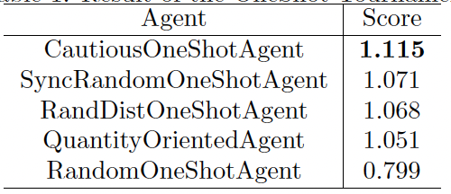
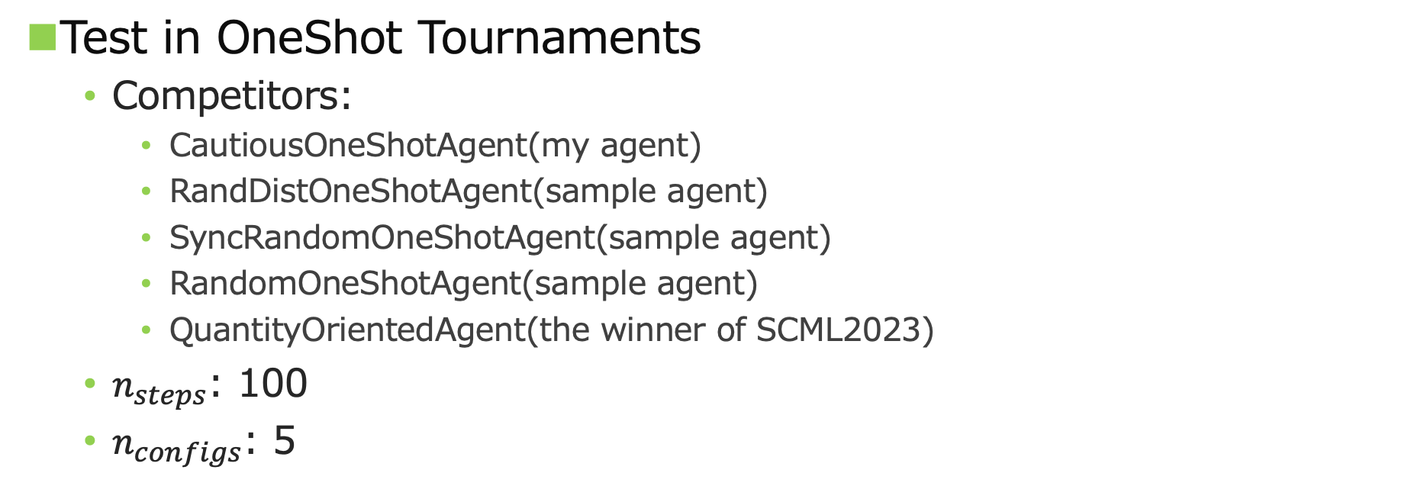
Evaluation
Test in OneShot Tournaments
Competitors:
CautiousOneShotAgent(my agent)
RandDistOneShotAgent(sample agent)
SyncRandomOneShotAgent(sample agent)
RandomOneShotAgent(sample agent)
QuantityOrientedAgent(the winner of SCML2023)
$n_{steps}$: 100
$n_{configs}$: 5
Notes:
To evaluate CautiousOneShotAgent, I tested it in OneShot tournaments with sample agents, RandDistOneShotAgent, SyncRandomOneShotAgent, and RandomOneShotAgent and the winner of SCML2023, QuantityOrientedAgent.
As shown in this table, the score of CautiousOneShotAgent is higher than those of any other agents, so it is considered that the strategies of CautiousOneShotAgent are effective for SCML2024 OneShot Track because most participants in SCML 2024 are likely to be referring to the sample agents and state-of-the-art agents of SCML 2023.
That’s all, thank you for listening.

