Slide 1
CautiousStdAgent for ANAC2024 SCML Standard Track
Ryoga Miyajima
Tokyo University of Agriculture and Technology
Katsuhide Fujita Lab.
Notes:
Hello everyone, I’m Ryoga Miyajima, from Tokyo University of Agriculture and Technology.
Now, let’s start my presentation of strategies of my agent, CautiousStandardAgent.

Slide 2
Concepts
Buy at a Low Price and Sell Out Soon.
Successful sales are necessary to make a profit.
For successful sales, the following is important.
Sell immediately after buying materials.
Sell even at a low price.
To sell at a low price, buy at a lower price.
Notes:
There are concepts of CautiousStandardAgent.
CautiousStandardAgent tries to buy at a low price and sells out as soon as possible.
That is because successful sales are necessary to make a profit.
For successful sales, it is important to try to sell immediately after buying materials and sell even at a low price.
Furthermore, to sell at a low price, it is required to buy at a lower price, so CautiousStandardAgent tries to buy at a low price.

Slide 3
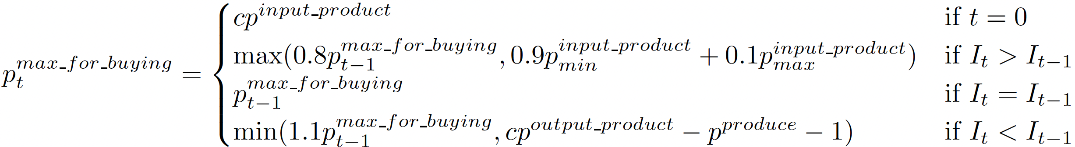
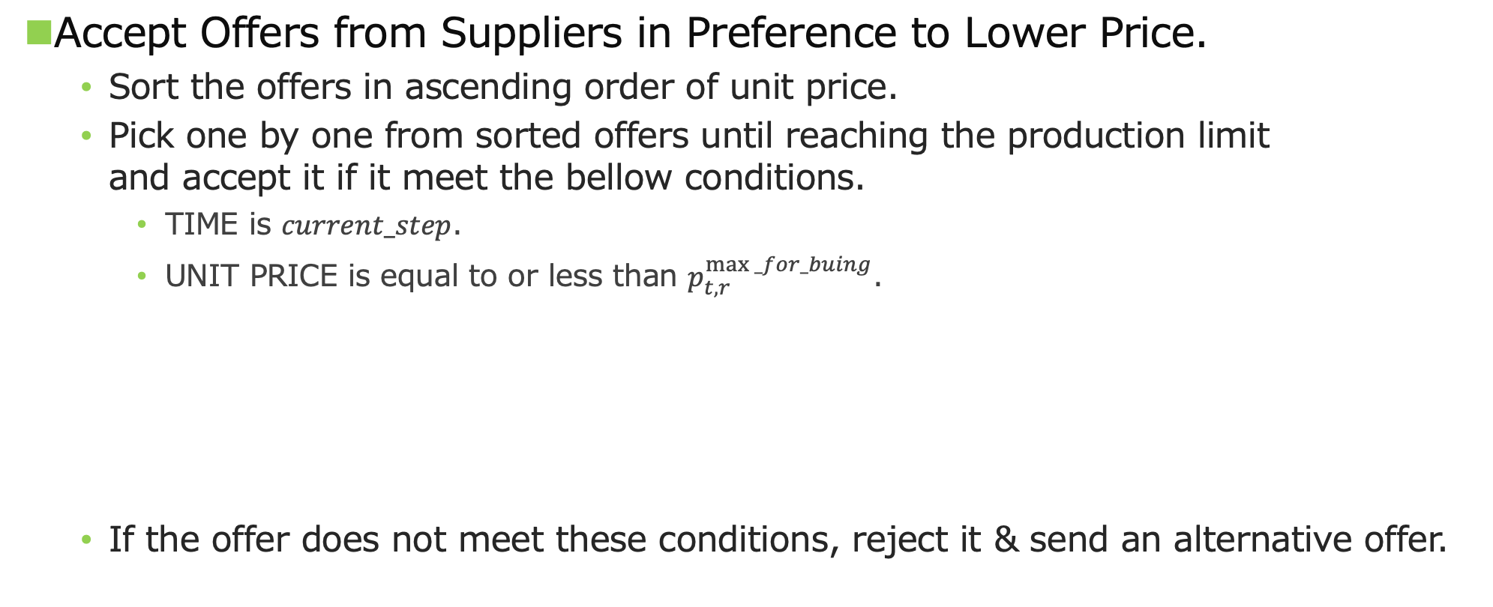
Buying Strategy
Accept Offers from Suppliers in Preference to Lower Price.
Sort the offers in ascending order of unit price.
Pick one by one from sorted offers until reaching the production limit and accept it if it meet the bellow conditions.
TIME is $current_step$.
UNIT PRICE is equal to or less than $p_{t,r}^{max⁡_for_buing}$.
If the offer does not meet these conditions, reject it & send an alternative offer.
Notes:
Now, I will start explaining the details of the strategies of CautiousStandardAgent.
First, I will explain buying strategy.
CautiousStandardAgent accepts offers from its suppliers in preference to lower price.
When CautiousStandardAgent receives offers from its suppliers, it sorts the received offers in ascending order of unit price.
Then, CautiousStandardAgent picks one by one from the sorted offers until reaching the daily production limit.
If its deliverly date is current_step and UNIT PRICE is equal to or less than the price defined by this equation, depending on its inventory, CautiousStandardAgent accepts it.
If it doesn’t meet these conditions, CautiousStandardAgent rejects it and sends an alternative offer modified to meet these conditions.

Slide 4
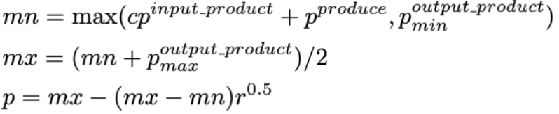
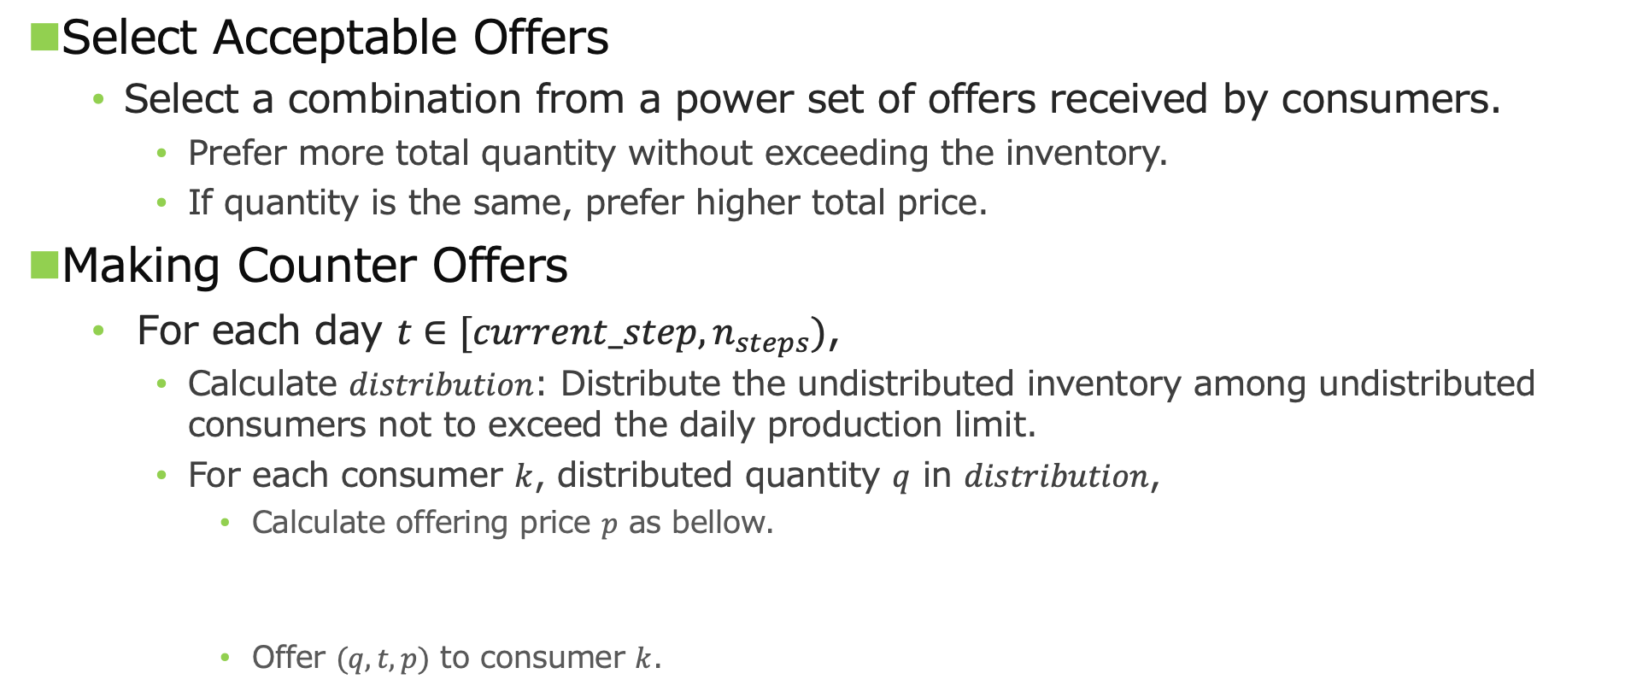
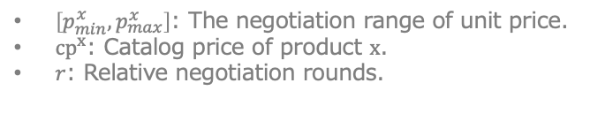
Selling Strategy
Select Acceptable Offers
Select a combination from a power set of offers received by consumers.
Prefer more total quantity without exceeding the inventory.
If quantity is the same, prefer higher total price.
Making Counter Offers
For each day $t∈[current_step,n_{steps})$,
Calculate $distribution$: Distribute the undistributed inventory among undistributed consumers not to exceed the daily production limit.
For each consumer $k$, distributed quantity $q$ in $distribution$,
Calculate offering price $p$ as bellow.
Offer $(q,t,p)$ to consumer $k$.
$\left[p_{min}^{x},p_{max}^{x}\right]$: The negotiation range of unit price.
$cp^{x}$: Catalog price of product $x$.
$r$: Relative negotiation rounds.
Notes:
Next, I will explain the selling strategy.
When CautiousStandardAgent receives offers from its consumers, it selects a combination from a power set of the received offers.
In this selection, CautiousStandardAgent prefers more total quantity without exceeding its inventory and today’s exogenous input quantity.
If the total quantity is the same, CautiousStandardAgent prefers higher total price.
If CautiousStandardAgent still needs to sell, it sends offers to unagreed consumers.
For each day $t$ from current_step to final_step, CautiousStandardAgent sends offers that are executed on day $t$ to distribute remaining quantity to be sold.
First, CautiousStandardAgent gets the dictionary $distribution$ calculated by distributing the undistributed inventory among undistributed consumers as much as possible without exceeding the daily production limit.
Then, for each consumer k and distributed quantity $q$ in the items of 𝑑𝑖𝑠𝑡𝑟𝑖𝑏𝑢𝑡𝑖𝑜𝑛, CautiousStandardAgent calculates the offering unit price $p$ by this equation and sends the offer to consumer k.
If there are no undistributed consumers or undistributed remaining quantity to be sold, CautiousStandardAgent exits this loop.

Slide 5
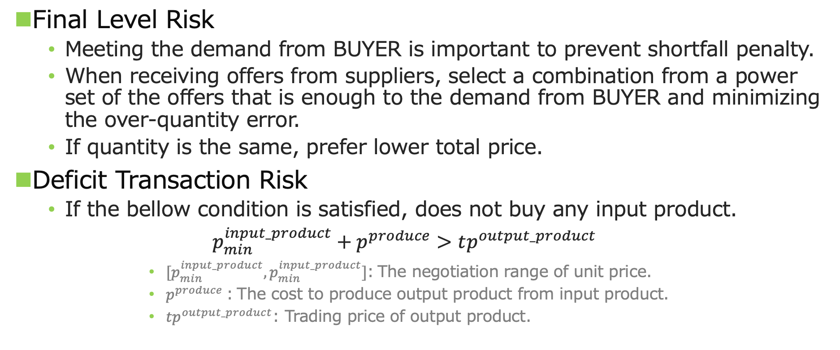
Risk Management
Final Level Risk
Meeting the demand from BUYER is important to prevent shortfall penalty.
When receiving offers from suppliers, select a combination from a power set of the offers that is enough to the demand from BUYER and minimizing the over-quantity error.
If quantity is the same, prefer lower total price.
Deficit Transaction Risk
If the bellow condition is satisfied, does not buy any input product.
$$p_{min}^{input_product}+p^{produce}>tp^{output_product}$$
$[p_{min}^{input_product},p_{min}^{input_product}]$: The negotiation range of unit price.
$p^{produce}$: The cost to produce output product from input product.
$tp^{output_product}$: Trading price of output product.
Notes:
There are some risks in SCML worlds.
One of them is the final level risk.
If CautiousStandardAgent is at the final level layer, meeting the demand from terminal consumer BUYER is important to prevent shortfall penalty.
So, when CautiousStandardAgent at the final level layer receives the offers from its suppliers, it selects a combination from a power set of the offers that is enough to the demand from BUYER and minimizing the over-quantity error.
If total quantity is the same, lower total price is preferred.
Another possible risk is deficit transaction risk.
Since the negotiation range of unit price depends on the dynamic trading price, it can be happen that it is impossible to sell output product at a profitable price.
Therefore, if the minimum unit price of the input product plus production cost is larger than the trading price of the output product, CautiousStandardAgent doesn’t buy any input product.

Slide 6
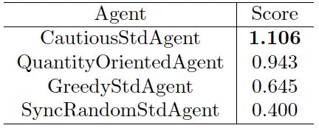
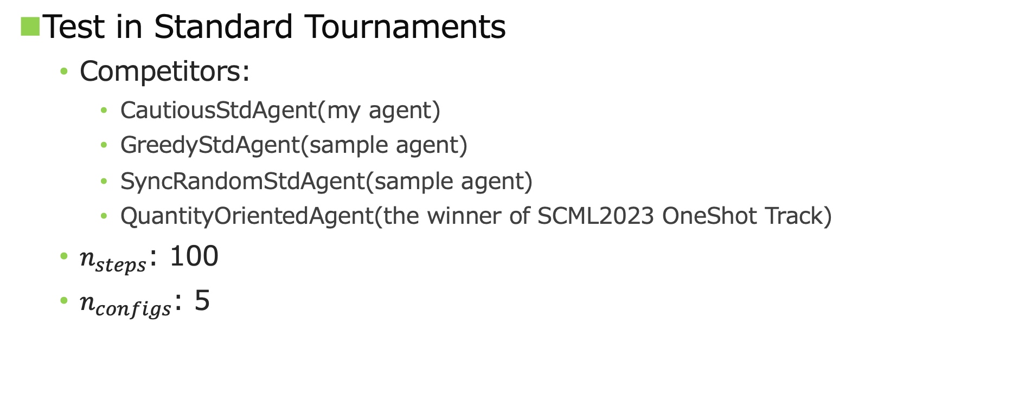
Evaluation
Test in Standard Tournaments
Competitors:
CautiousStdAgent(my agent)
GreedyStdAgent(sample agent)
SyncRandomStdAgent(sample agent)
QuantityOrientedAgent(the winner of SCML2023 OneShot Track)
$n_{steps}$: 100
$n_{configs}$: 5
Notes:
To evaluate CautiousStandardAgent, I tested it in Standard tournaments with sample agents, GreedyStandardAgent and SyncRandomStandardAgent and the winner of SCML2023 OneShot Track, QuantityOrientedAgent.
As shown in this table, the score of CautiousStandardAgent is higher than those of any other agents and the only agent successfully making a profit so it is considered that the strategies of CautiousStandardAgent are effective for SCML2024 Standard Track.
That’s all, thank you for listening.

Slide 7



$$L_{0}$$
$$L_{1}$$
Exogenous
Supply
(Buy Contracts)
Closed Bilateral Concurrent Negotiations
Exogenous
Demand
(Sell Contracts)
sellers
buyers

Slide 8

Offer
Quantity: 8
Price: 10
Shortage
{(8,10)},{(4,11),(4,10)},{(4,11)},{(4,10)}
Required:10
Offer
Quantity: 4
Price: 11
Excess
{(8,10),(4,11)},{(8,10),(4,10)},{(8,10),(4,11),(4,10)}
Offer
Quantity: 4
Price: 10
Acceptable Offers Candidate
Shortage | {(8,10)},{(4,11),(4,10)},{(4,11)},{(4,10)}
Excess | {(8,10),(4,11)},{(8,10),(4,10)},{(8,10),(4,11),(4,10)}
Seller
Buyer
Better
Worse

Slide 10
Offer
Quantity: 8
Price: 10
Accept
Required:10
Offer
Quantity: 4
Price: 11
Quantity: 1
Price: 11
Offer
Quantity: 4
Price: 10
Quantity: 1
Price: 11
Seller
Buyer

Slide 11
