Slide 1

Yasser F. O. Mohammad
Assiut University
Egypt

Slide 2
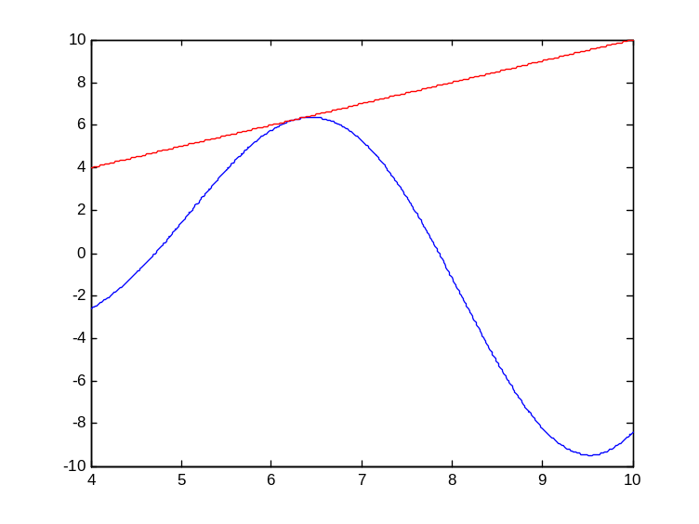
Previously in NM
Introduction to NM
Solving single equation
System of Linear Equations
  Vectors and Matrices
  Solving Upper Triangular Form Matrices

Slide 3
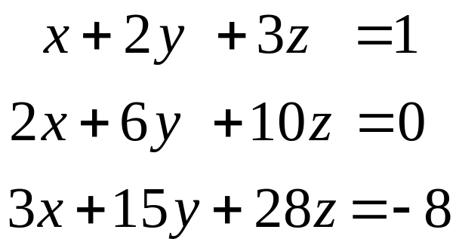
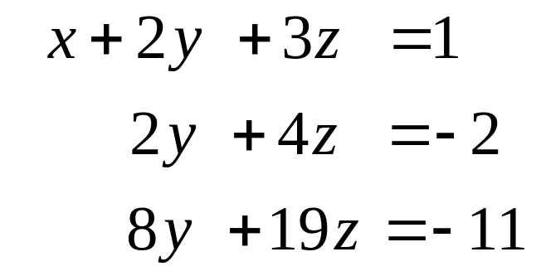
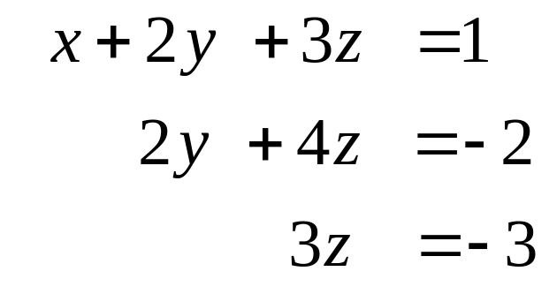
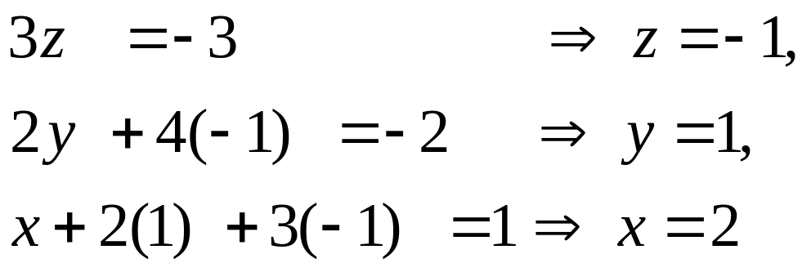
Introduction
Solving three equations in three unknowns

Slide 4
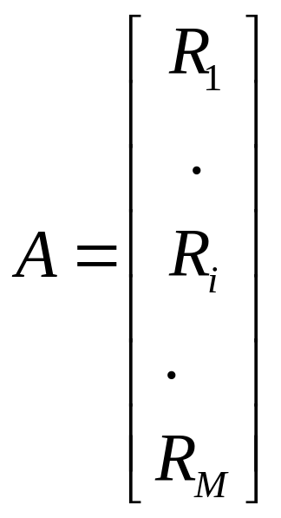
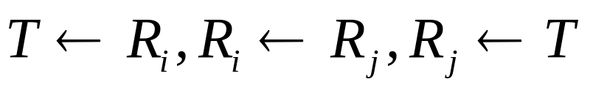
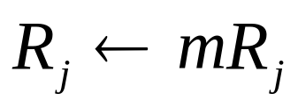
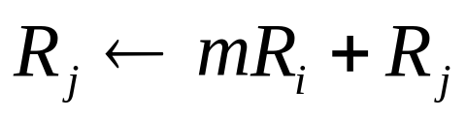
Gauss Elimination (Main Idea)
Convert the system to UTF then solve it
The following operations do not change the system or the solution of (AX=B):
  Interchanges: changing order
  Scaling: Multiplying an equation with a constant
  Replacement: replacing an equation with the sum of itself with a nonzero multiple of another

Slide 5
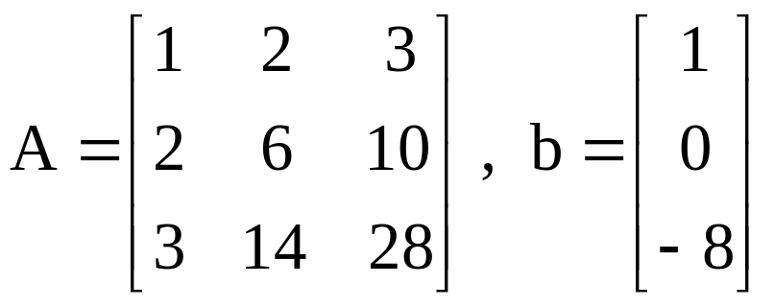
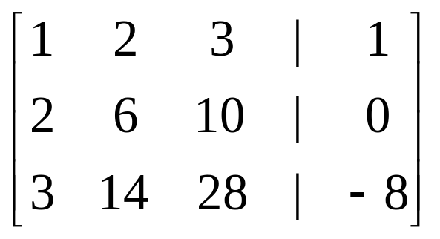
Basic Gauss Elimination Procedure
Write in matrix-vector form : Ax = b
combine in the
augmented matrix
Basic Gaussian elimination procedure

Slide 6
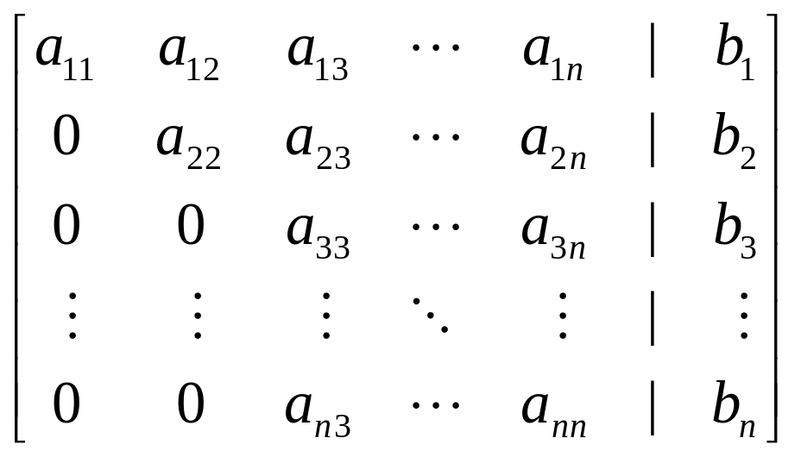
Pivot
  At the kth stage of Gaussian elimination procedure, the appropriate multiple of the kth row is used to reduce each of the entries in the kth column below the kth row to zero
  kth row : pivot row
  kth column : pivot column
  element a_{kk} : pivot element
ex : If at 3rd elimination procedure,

Slide 7

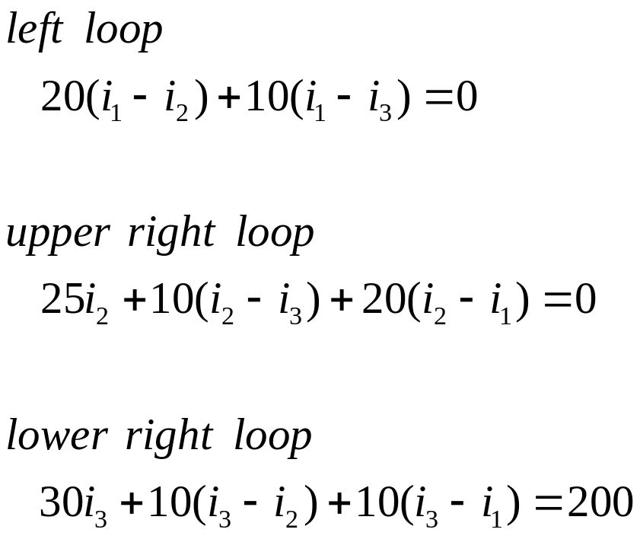










Example
The sum of the voltage drops around a closed loop is zero
V=IR

Slide 8
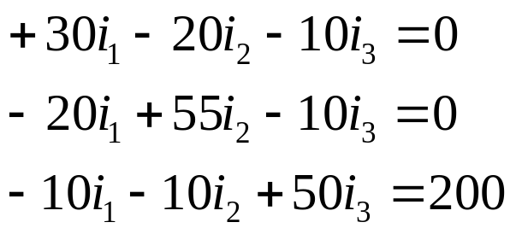
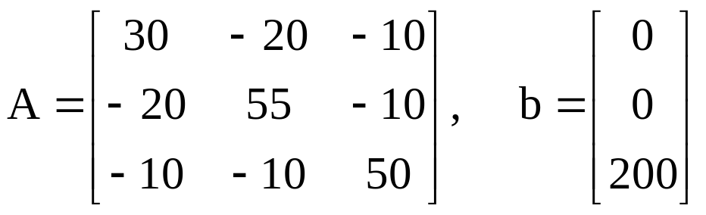
System

Slide 9
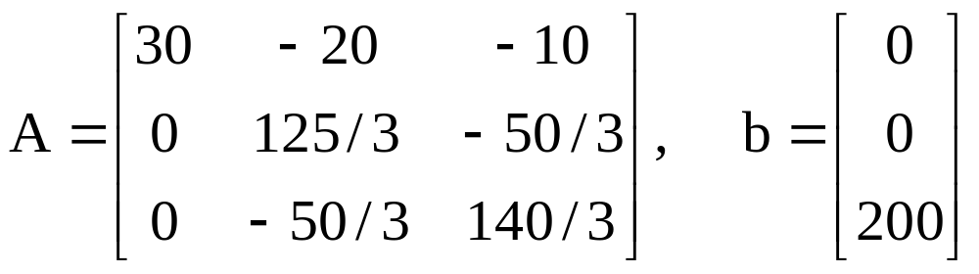
Solution
Step 1
  The pivot is a₁₁ = 30
  Multiply the first row by 20/30 and add it to the second row
  Multiply the first row by 10/30 and add it to the third row

Slide 10
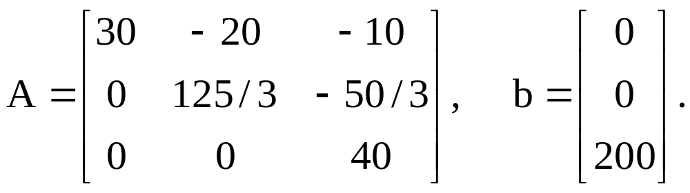
Solution
Step 2
  The pivot is a₂₂ = 125/3
  Multiply the second row by 2/5 and add it to the third row to get

Slide 11
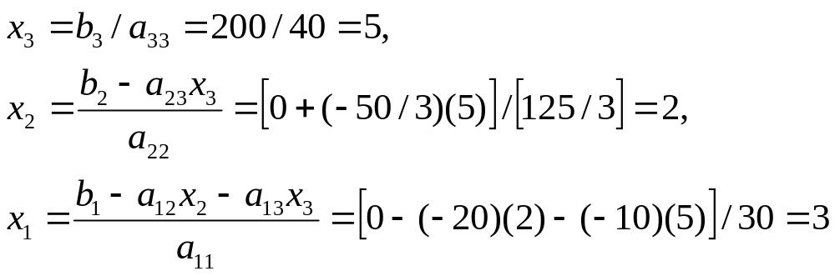
Solution
Step 3: By back substitution,

Slide 12
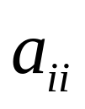
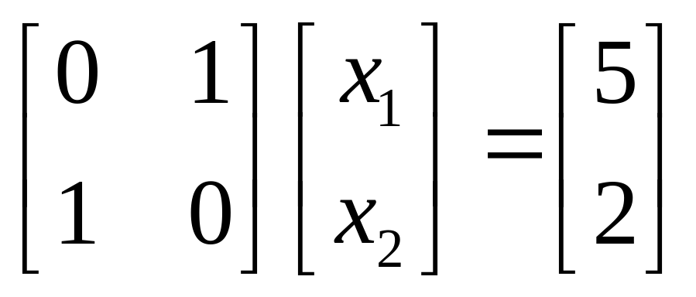
Pivoting Strategies
1. No pivoting
Use as the pivot element in step i.
May fail even if a solution exists

Slide 13
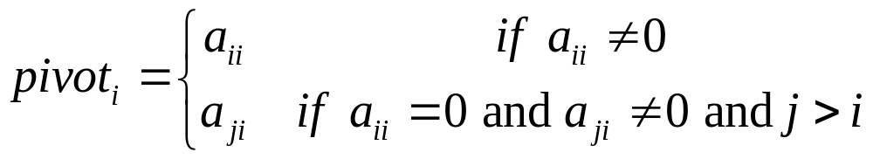
Pivoting Strategies
2. Trivial Pivoting
Will find a solution if one exists
May cause large rounding error if a_{ii} is small

Slide 14
Pivoting Strategies
3. Partial Pivoting
Find the row with maximum value in the pivot column and use it as the pivot row (exchange with current pivot)

Slide 15
Pivoting Strategies
4. Scaled Partial Pivoting
Find the row with the maximum relative value in the pivot column and use it as the pivot row

Slide 16
Matlab: Simplest Implementation
% Gaussian Elimination function which can solve k systems of the form Ax=b₁,....,Ax=b_{k} at the same time
function x = Gauss( A , b )
[n,k1] = size(A); [n1,k] = size(b); x = zeros(n,k);
for i=1 : n-1
m = -A(i+1:n , i) / A(i,i);
A(i+1:n , : ) = A(i+1:n , : ) + m*A(i,:);
b(i+1:n , : ) = b(i+1:n , : ) + m*b(i,:);
end
x(n,:) = b(n,:) ./ A(n,n);
for i=n-1 : -1 : 1
x(i,:) = ( b(i,:) - A(i , i+1:n) * x(i+1:n , : ) ) ./ A(i,i);
end

