Slide 1

Yasser F. O. Mohammad
2010.9.22

Slide 2
Approximations and Round-off Errors

Slide 3
Significant Figures
Numerical methods yield approximate results.
The significant digits or figures of a number are those that can be used with confidence.
They correspond to the number of certain digits plus one estimated digit.

Slide 4
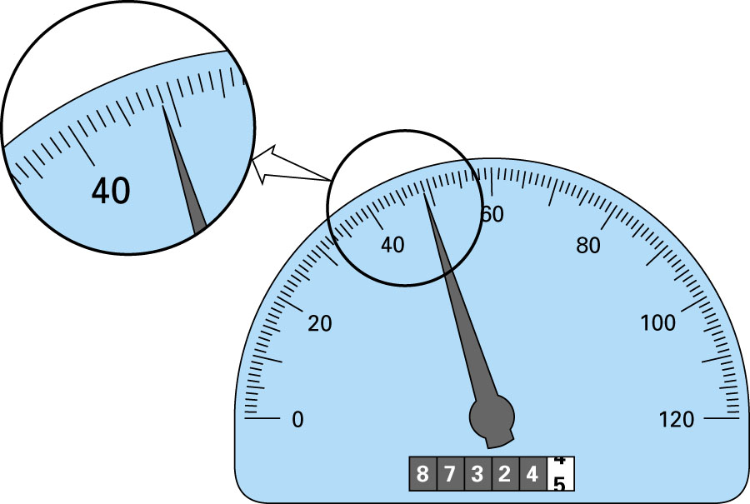
I can say the speed is between 48.5 and 48.9 km/h. Thus, we have a
3-significant figure reading.
One might say the speed is between 48 and 49 km/h. Thus, we have a
2-significant figure reading.

Slide 5
We say the number 4.63±0.01 has 3 significant figures.

Slide 6
Rules regarding the zero:
Zeros within a number are always significant:
5001 and 50.01 have 4 significant figures
Zeros to the left of the first nonzero digit in a number are not significant:
  0.00001845, 0.0001845, 0.001845 have 4 significant figures
45300 may have 3, 4, or 5 sig. figures, we can know if the number is written in the scientific notation:
4.53×10⁴ has 3 sig. figures
4.530×10⁴ has 4 sig. figures
4.5300×10⁴ has 5 sig. figures
Trailing zeros are significant:
6.00 has 3 sig. figures.

Slide 7
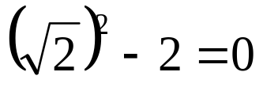
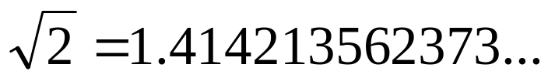

Error Definitions
Truncation errors result when approximations are used to represent exact mathematical procedures.
Round-off errors result when numbers having limited significant figures are used to represent exact numbers.
Example:
We know that
Lets approximate the value of
by 1.41421 (using only 5 decimal places).
Then,
Round-off error

Slide 8
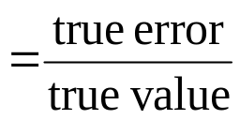
The relationship between the exact (true) result and the approximation is given by
true value = approximation + error
Hence, the error is the difference between the true value and the approximation:
true error = E_{t} = true value - approximation
Most of the time we will use what we call the true fractional relative error

Slide 9
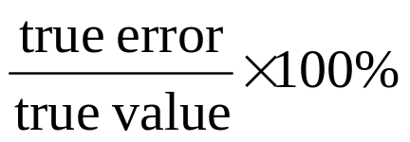
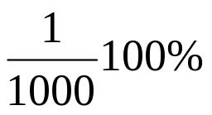
Or we use the true percent relative error
ε_{t} =
Example
your measurement of the length of the bridge is 999.
the true length is 1000.
E_{t} = 1000 - 999 = 1
ε_{t} = = 0.01 %

Slide 10
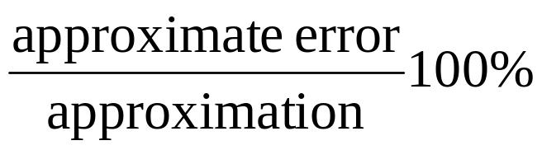

In real world applications, the true value is not known.
Approximate error = ε_{a} =
ε_{a} =
The computation is repeated until |ε_{a}| < ε_{s}
We usually use ε_{s} = (0.5×10^{2-n})% if we want the result to be correct to at least n significant figures.

Slide 11
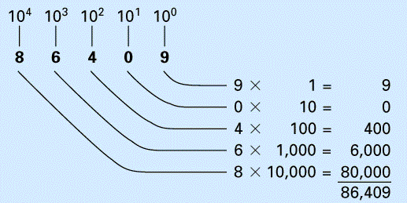
Round-off Errors
Round-off errors occur because computers retain only a fixed number of significant figures.
We use the decimal (base 10) system which uses the 10 digits 0, 1, …, 9.

Slide 12
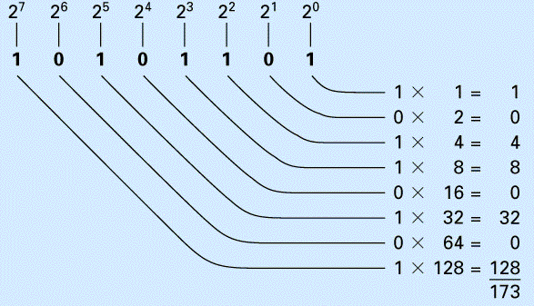
Numbers on the computers are represented with a binary (base 2) system.

Slide 13
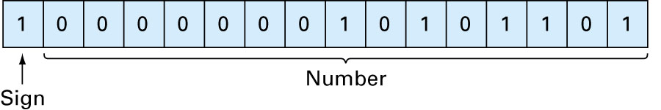
How are numbers represented in computers?
Numbers are stored in what is called ‘word’. A word has a number of bits, each bit holds either 0 or 1.
For example, -173 is presented on a 16-bit computer as
Word

Slide 14
On a 16-bit computer, the range of numbers that can be represented is between -32,768 and 32,767.

Slide 15
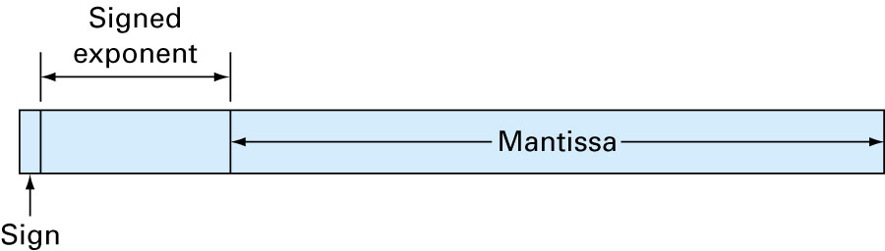
Floating Point Representation
156.78 (normal form) 0.15678×10³ (floating point form)
Word

Slide 16
Conclusion
There is a limited range of numbers that can be represented on computers.

Slide 17
Rounding
Rounding up is to increase by one the digit before the part that will be discarded if the first digit of the discarded part is greater than 5.
If it is less than 5, the digit is rounded down.
If it is exactly 5, the digit is rounded up or down to reach the nearest even digit.
Round 1.14 to one decimal place: 1.1
Round 1.15 to one decimal place: 2.2
Round 21.857 to one decimal place: 21.8

Slide 18
Chopping
Chopping is done by discarding a part of the number without rounding up or down.
Chop 1.15 to one decimal place: 1.1
Chop 0.34 to one decimal place: 0.3
Chop 21.757 to one decimal place: 21.7

Slide 19
Truncation Errors and the Taylor Series

Slide 20
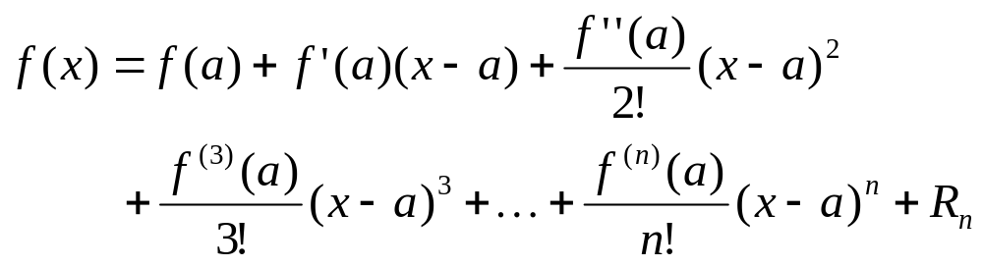
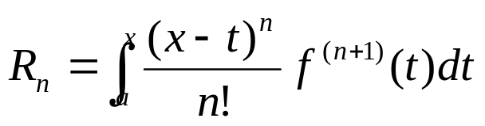
The Taylor Series
Taylor’s Theorem
If the function f and its first n+1 derivatives are continuous on an interval containing a and x, then the value of the function at x is given by:
where the remainder R_{n} is defined as

Slide 21
Using Taylor’s Theorem, we can approximate any smooth function by a polynomial.
The zero-order approximation of the value of f(x_{i+1}) is given f(x_{i+1}) ≈ f(x_{i})
The first-order approximation is given by
f(x_{i+1}) ≈ f(x_{i}) + f '(x_{i})(x_{i+1}-x_{i})

Slide 22
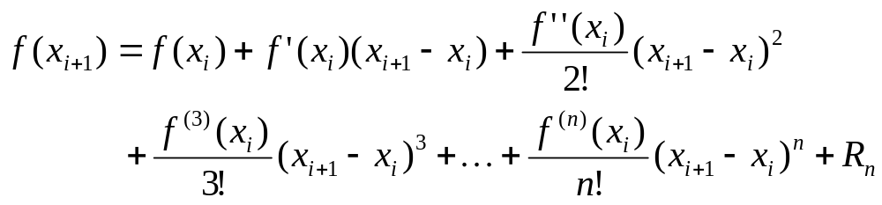
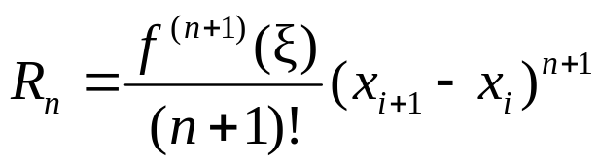
The complete Taylor series is given by
The remainder term is
where ξ is between x_{i} and x_{i+1}

Slide 23
Notes
We usually replace the difference (x_{i+1} - x_{i}) by h.
A special case of Taylor series when x_{i} = 0 is called Maclaurin series.

Slide 24
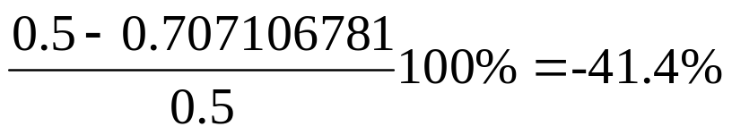
Example
Use Taylor series expansions with n = 0 to 6 to approximate
f(x) = cos x near x_{i} = π/4 at x_{i+1} = π/3.
Solution
h = π/3 - π/4 = π/12
Zero-order approximation: f(π/3) ≈ cos (π/4) = 0.707106781
ε_{t} =
First-order approximation: f(π/3) ≈ cos (π/4) – (π/12) sin (π/4)
= 0.521986659
ε_{t} = -4.4%

Slide 25
To get more accurate estimation of f(x_{i+1}), we can do one or both of the following:
  add more terms to the Taylor polynomial
  reduce the value of h.

Slide 26
Taylor series in MATLAB
Required!
>> syms x;
>> f=cos(x);
>> taylor(f,3,pi/4)
Taylor function in MATLAB
Expansion point
Number of terms in the series

Slide 27
Matlab Basics
  MATrix LABoratory
Based on LAPACK library
  (NOW CLAPACK exists for C programmers)
A high level language and IDE for numerical methods and nearly everything else!!
Easy to use and learn
The most important command in Matlab
  help ANYTHING
  Lookfor ANYTHING

Slide 28
Matlab Screen
Command Window
  type commands
Workspace
  view program variables
  clear to clear
  double click on a variable to see it in the Array Editor
Command History
  view past commands
  save a whole session using diary
Launch Pad
  access tools, demos and documentation

Slide 29
Matlab Files
Use predefined functions or write your own functions
Reside on the current directory or the search path
  add with File/Set Path
Use the Editor/Debugger to edit, run

Slide 30
Matrices
a vector x = [1 2 5 1]
x =
1 2 5 1
a matrix x = [1 2 3; 5 1 4; 3 2 -1]
x =
1 2 3
5 1 4
3 2 -1
transpose y = x.’ y =
1
2
5
1

Slide 31
Matrices
x(i,j) subscription
whole row
whole column
y=x(2,3)
y =
4
y=x(3,:)
y =
3 2 -1
y=x(:,2)
y =
2
1
2

Slide 32
Operators (arithmetic)
+ addition
- subtraction
* multiplication
/ division
^ power
‘ complex conjugate transpose
.* element-by-element mult
./ element-by-element div
.^ element-by-element power
.‘ transpose

Slide 33

Operators (relational, logical)
== equal
~= not equal
< less than
<= less than or equal
> greater than
>= greater than or equal
& AND
| OR
~ NOT
pi 3.14159265…
j imaginary unit,
i same as j

Slide 34
Generating Vectors from functions
x = zeros(1,3)
x =
0 0 0
x = ones(1,3)
x =
1 1 1
x = rand(1,3)
x =
0.9501 0.2311 0.6068
zeros(M,N) MxN matrix of zeros
ones(M,N) MxN matrix of ones
rand(M,N) MxN matrix of uniformly distributed random numbers on (0,1)

Slide 35
Operators
[ ] concatenation
( ) subscription
x = [ zeros(1,3) ones(1,2) ]
x =
0 0 0 1 1
x = [ 1 3 5 7 9]
x =
1 3 5 7 9
y = x(2)
y =
3
y = x(2:4)
y =
3 5 7

Slide 36
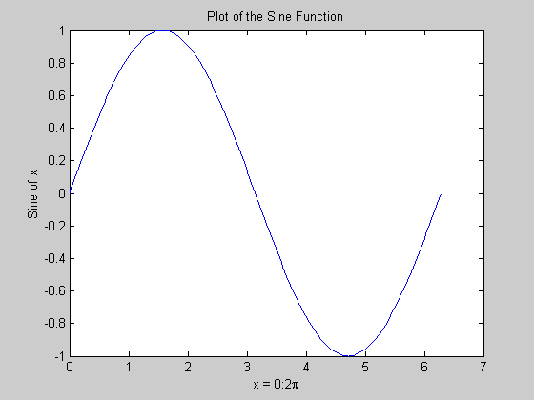
Matlab Graphics
x = 0:pi/100:2*pi;
y = sin(x);
plot(x,y)
xlabel('x = 0:2\pi')
ylabel('Sine of x')
title('Plot of the Sine Function')

Slide 37
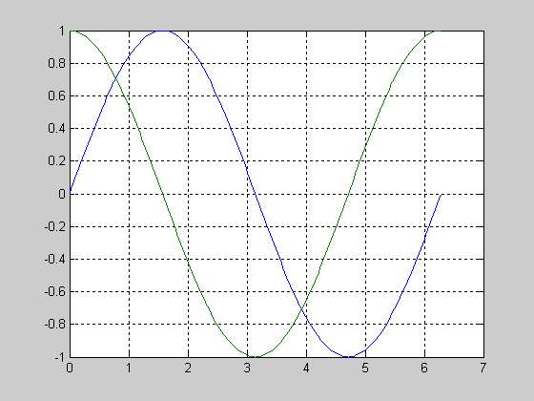
Multiple Graphs
t = 0:pi/100:2*pi;
y1=sin(t);
y2=sin(t+pi/2);
plot(t,y1,t,y2)
grid on

Slide 38
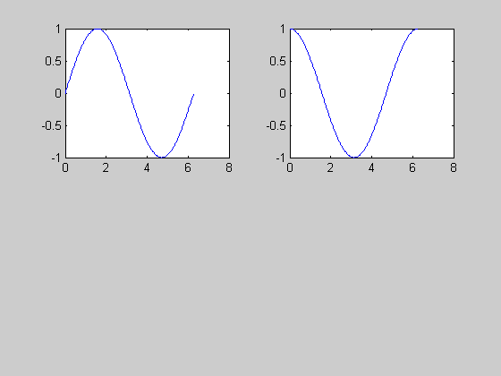
Multiple Plots
t = 0:pi/100:2*pi;
y1=sin(t);
y2=sin(t+pi/2);
subplot(2,2,1)
plot(t,y1)
subplot(2,2,2)
plot(t,y2)

Slide 39
Graph Functions (summary)
plot linear plot
stem discrete plot
grid add grid lines
xlabel add X-axis label
ylabel add Y-axis label
title add graph title
subplot divide figure window
figure create new figure window
pause wait for user response

Slide 40
Math Functions
Elementary functions (sin, cos, sqrt, abs, exp, log10, round)
  type help elfun
Advanced functions (bessel, beta, gamma, erf)
  type help specfun
  type help elmat

Slide 41
Functions
function f=myfunction(x,y)
f=x+y;
save it in myfunction.m
call it with y=myfunction(x,y)

Slide 42
Flow Control
if A > B
'greater'
elseif A < B
'less'
else
'equal'
end
for x = 1:10
r(x) = x;
end
if statement
switch statement
for loops
while loops
continue statement
break statement

Slide 43
Miscellaneous
Loading data from a file
  load myfile.dat
Suppressing Output
  x = [1 2 5 1];

Slide 44
Getting Help
Using the Help Browser (.html, .pdf)
  View getstart.pdf, graphg.pdf, using_ml.pdf
Type
  help
  help function, e.g. help plot
Running demos
  type demos
  type help demos

Slide 45
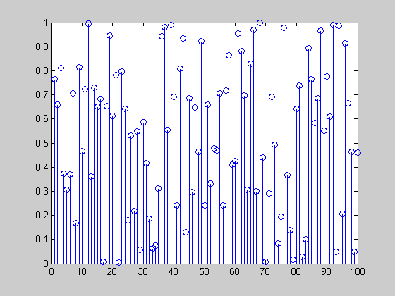
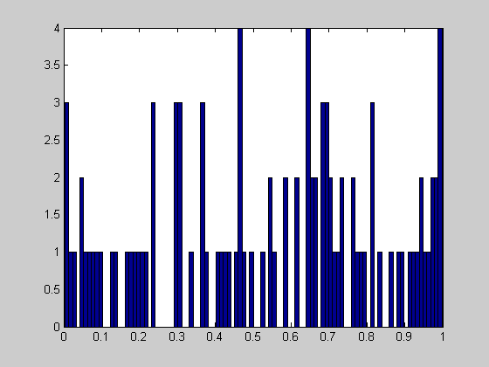
Random Numbers
x=rand(100,1);
stem(x);
hist(x,100)

