Slide 1

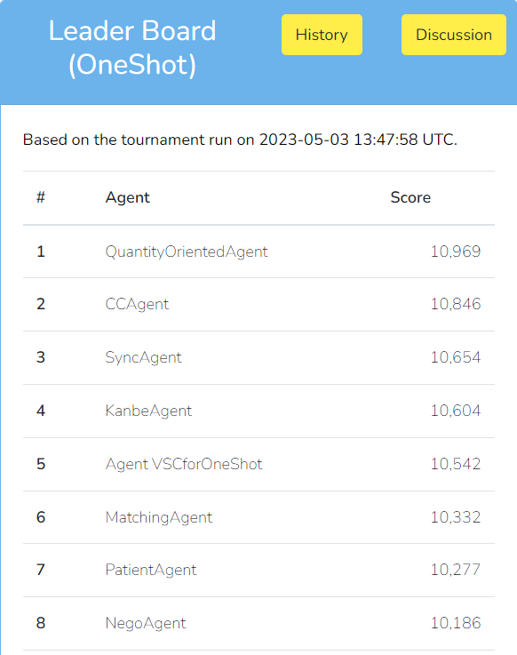
CCAgent for SCML OneShot 2023
Shota Kimata, Yuko Sakurai (Nagoya Institute of Technology)
CCAgent
Quantity: Over-selling/over-buying Price: Bull and bear strategy
SMCL-2023 Oneshot
Our consideration for an agent’s strategy has shifted from price to quantity.
The range of possible prices has narrowed.
It’s now two consecutive integer values (high or low).
The impact of price on utility has decreased.
The points to be considered: quantity
Ideally, the target quantity should be achieved without any shortfall or excess.
However, concurrent negotiations makes it difficult to achieve a perfect balance.
Our preliminary experimental results show that a seller’s utility tends to decrease when there is an excess of products, and a buyer’s utility tends to decrease when there is a shortage of products.
Offer Strategy of CCAgent: cooperative strategy
Accept Strategy of CCAgent: compromising strategy
Quantity:
The smaller of the quantity offered by an opponent and the quantity currently needed is proposed.
CCAgent always offers the quantity offered by an opponent or below.
Price:
CCAgent proposes her best price.
Buyer: she offers a low price.
Seller: she offers a high price.
Quantity:
CCAgent accepts a proposal even if the proposed quantity is one more than currently required.
Price:
She always accepts the trading price proposed by an opponent.
Experimental Results
Agent | Average Score (100 games)
CCAgent | 11,016
Simple Agent | 10,924
CCAgent vs SimpleAgent
CCAgent outperforms SimpleAgent
Last online tournament on May 3rd
CCAgent is ranked second
QuantityOrientedAgent
10,969
CCAgent
10,846
SyncAgent
10,654
Contact
For future information, please contact : clz14048@ict.nitech.ac.jp

