Slide 1
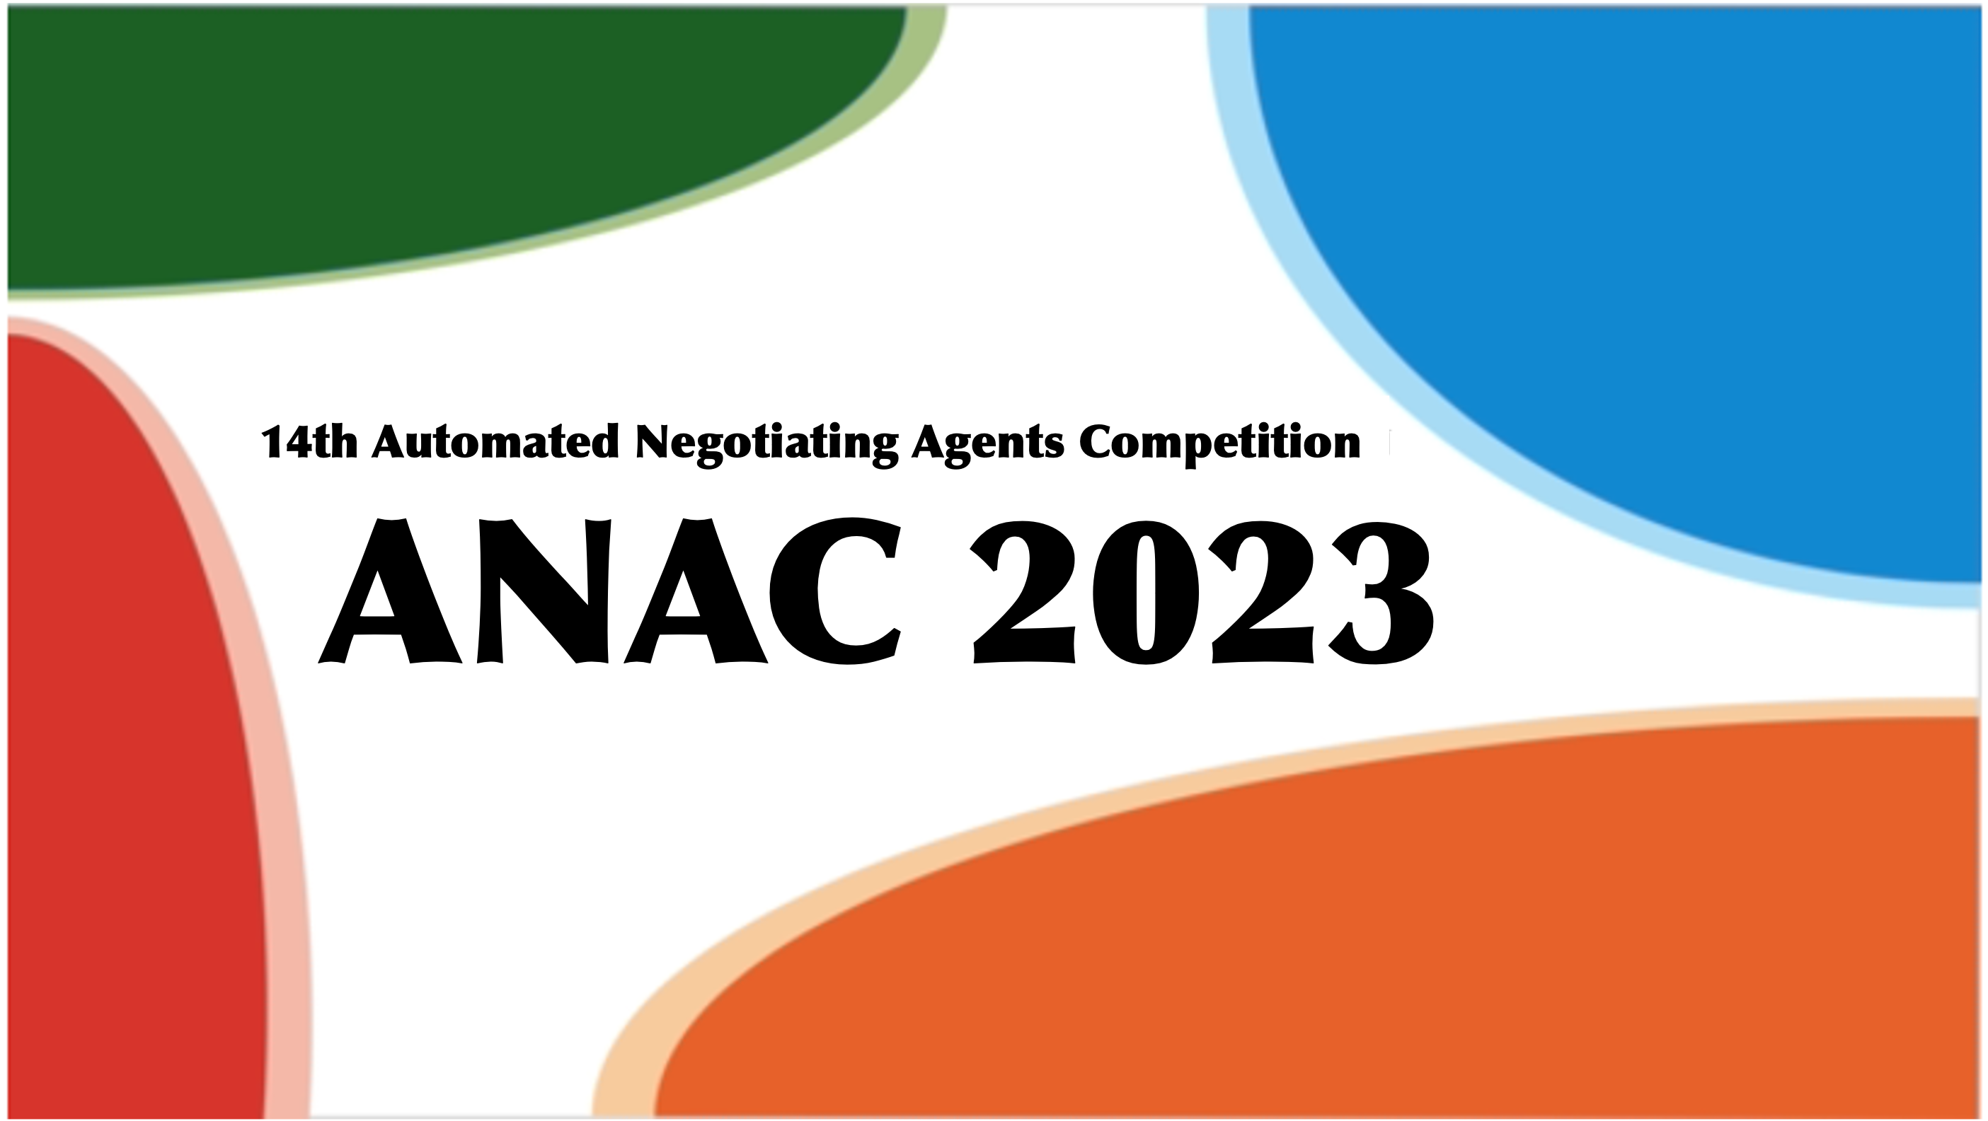



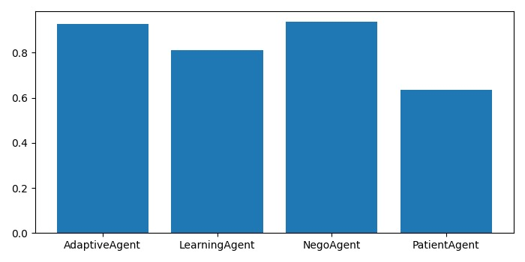
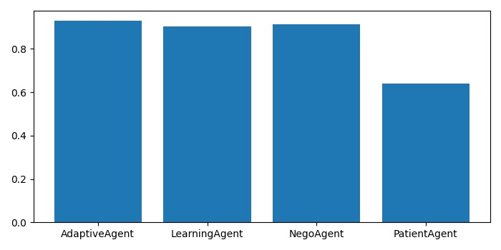

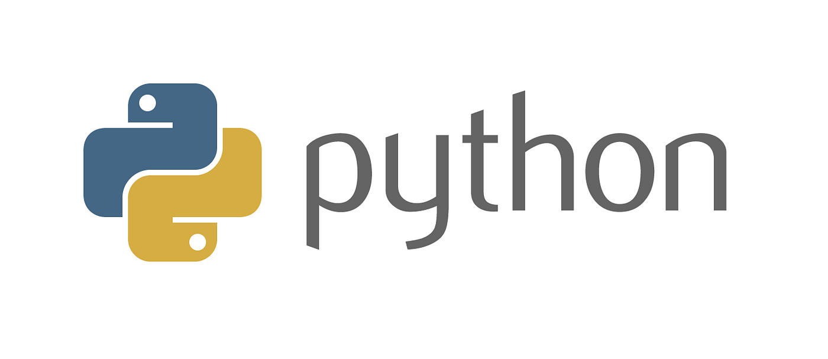
NegoAgent
Michal Rahimi, Opal Peltzman, Tomer Porat
The Department of Computer Science, Bar-Ilan University, Israel
Introduction
The OneShot track is a simpler form of the SCM world in which agents do not need to consider long-term planning or production scheduling and instead emphasize negotiations. NegoAgent was based on the ideas of AdaptiveAgent and LearningAgent.
AdaptiveAgent considers his other negotiations, LearningAgent learns about his different partners.
Design
LearningAgent and AdaptiveAgent, assume price will only improve over time (hard headed). The price range (Pmin, Pmax) is two consecutive values. This constraint, makes agent’s score insensitive to prices of agreements. The importance is to emphasize the match between supply and demand.
Performance
Comparison of NegoAgent to other agents performances- including last year winner (PatientAgent)
Conclusions
The agent behavior take in account the supply and demand in negotiation offers, and response in addition to the price.
NegoAgent succeed in emphasizing the match between supply and demand without compromising on the price.
after 10 steps (days)
after 100 steps (days)

