Slide 1

Yasser F. O. Mohammad
2010.9.22

Slide 2
Teaching Team
Instructor: Yasser F. O. Mohammad
  Computers and Systems section (Intelligent Robotics)
  Email: yasserfarouk@gmail.com
  Web: http://www.ii.ist.i.kyoto-u.ac.jp/~yasser
TA: Eng. George & Eng. Mostafa
Course Website:
  www.ii.ist.i.kyoto-u.ac.jp/~yasser/Courses/Numerical/index.php
Google Group:
  Email: numerical2010@googlegroups.com
  Web: http://groups.google.com/group/numerical2010

Slide 3
Course Philosophy
Programming:
Performance
Encapsulation
Reuse
.
.
Algorithms
Mathematics:
Proofs
Convergence
Error Analysis
.
.
Enhancements
Challenges
Software
Programs
Applications:
Modeling
Simulation
Control
.
.
Problems

Slide 4
Text Books
Main Text
Numerical Methods Using Matlab
  John H. Mathews and Kurtis D. Fink
  More on the mathematics
  Other References
Numerical Methods for Engineers
  Steven Chapra and Raymond Canale
Numerical Methods in Engineers using Matlab
  Jaan Kiusalaas
  More on Matlab
Applied Numerical Methods using Matlab
  Won Y. Yang and others
  More advanced but VERY VERY USEFUL
Numerical Recipes
  William Press and Others
  Best numerical methods book ever!!
  Everything in C++

Slide 5
Course Syllabus
Introduction to Matlab
Systems of Linear Equations
Nonlinear Equations
Interpolation and Curve Fitting
Differentiation and Integration
Ordinary Differential Equations
Optimization
Matrices and Eigenvalues

Slide 6
What is Numerical Methods
Numerical methods are techniques by which mathematical problems are formulated so that they can be solved with arithmetic operations.

Slide 7
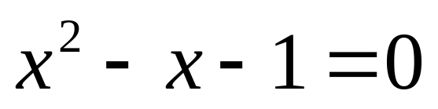
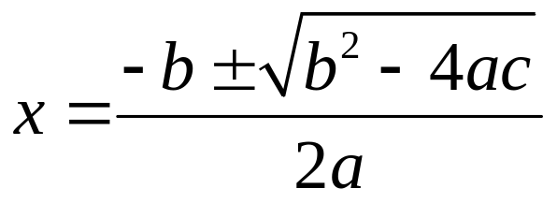

Example
Find the solution to the following equation:
Analytical Solution
Numerical Solution
  Try 1 → 1.2 → 1.8 → 1.6 → 1.62 → 1.628 →
Correct to 4 decimal places

Slide 8
Numerical Versus Analytical
Numerical | Analytical
approximate | exact
more intuitive | less intuitive
easily coded | not so easy
easy to get | not so easy
Finds a solution | Finds the solution
May diverge | Always finds the solution
This course!! | Not in this course!!

Slide 9
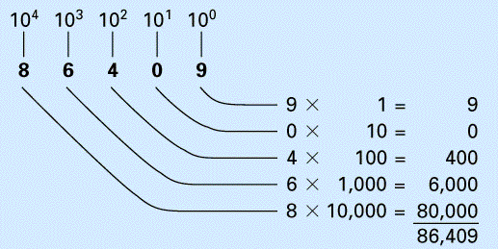
Round-off Errors
Round-off errors occur because computers retain only a fixed number of significant figures.
We use the decimal (base 10) system which uses the 10 digits 0, 1, …, 9.

Slide 10
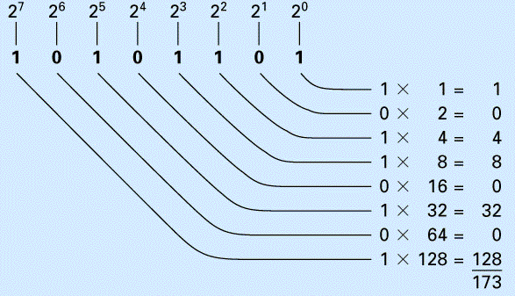
Numbers on the computers are represented with a binary (base 2) system.

Slide 11
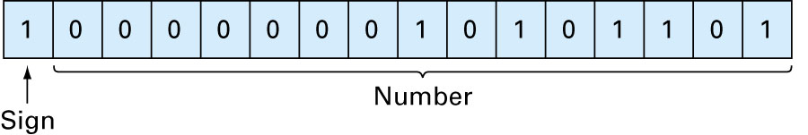
How are numbers represented in computers?
Numbers are stored in what is called ‘word’. A word has a number of bits, each bit holds either 0 or 1.
For example, -173 is presented on a 16-bit computer as
Word

Slide 12
On a 16-bit computer, the range of numbers that can be represented is between -32,768 and 32,767.

Slide 13
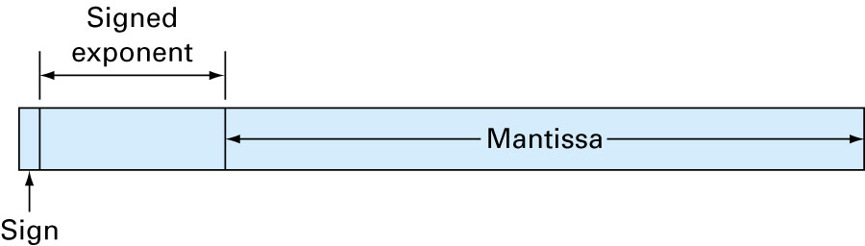
Floating Point Representation
156.78 (normal form) 0.15678×10³ (floating point form)
Word

Slide 14
Conclusion
There is a limited range of numbers that can be represented on computers.

