Slide 1
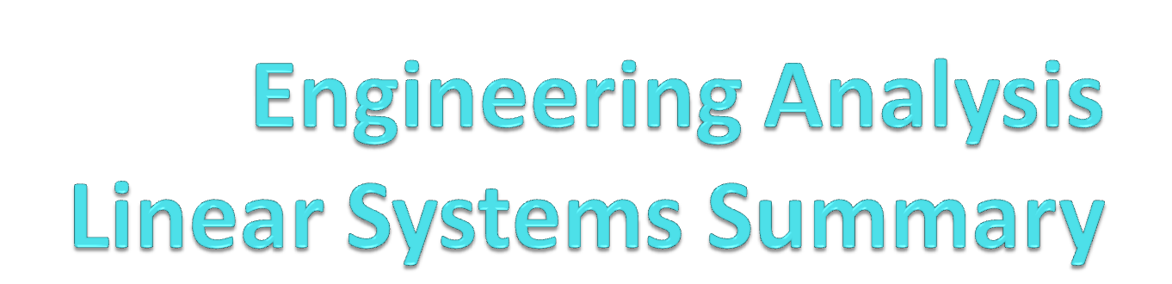
Yasser F. O. Mohammad

Slide 2
Overview
Convergence criteria of iterative methods
Summary of the case M=N
Case M>N
Case M<N

Slide 3
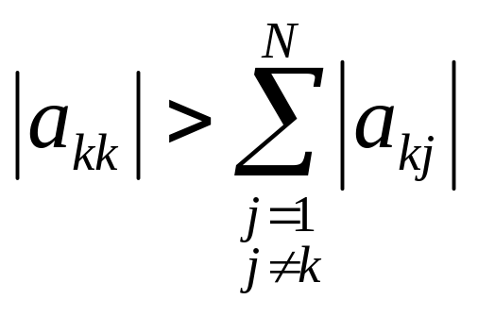
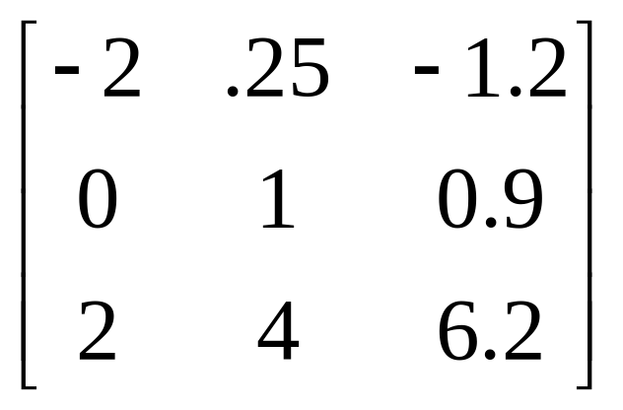
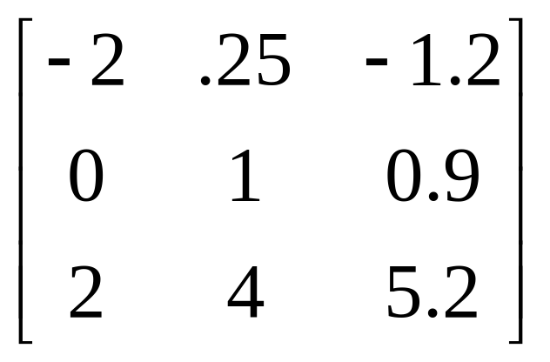
Strictly Diagonal Matrix
A is said to be strictly diagonal iff
Strictly Diagonal
Not Strictly Diagonal

Slide 4
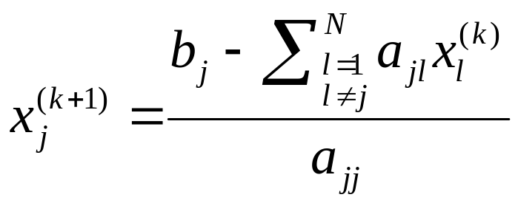
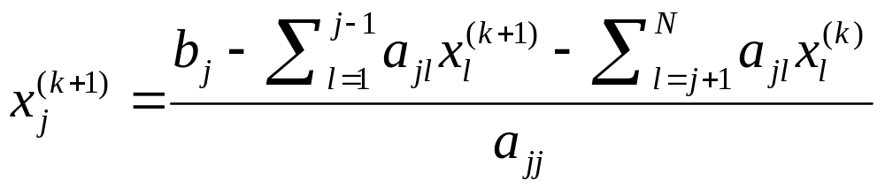
Jacobi and Gauss Seidel
Jacobi:
Gauss-Seidel

Slide 5
Convergence Criteria
Suppose A is strictly diagonal then:
  AX=B has a unique solution X=P
  Jacobi Iteration will converge to the solution
  Gauss-Seidel Iteration will converge to the solution
Is this a necessary or sufficient condition?
In many cases Gauss Seidel will converge FASTER than Jacobi
In some cases Gauss Seidel will NOT converge while Jacobi will

Slide 6
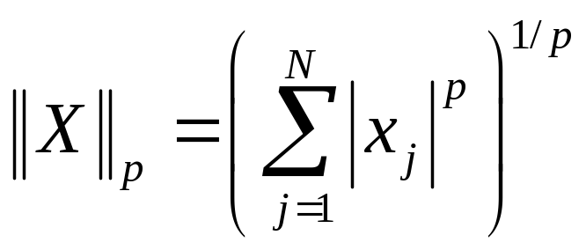
How to determine convergence
Difference between vectors can be measured using metric NORM of the difference vector (X-Y).
Many norms has the form:
P=1 → City Blocks Distance
P=2 → Euclidean Distance
P=∞→Max absolute Difference

Slide 7
How to do it in matlab
Calculating norm p of X:
  (norm(X,p))
  This is defined for p=1,2, …..,∞
  norm(X)==norm(X,2)

Slide 8
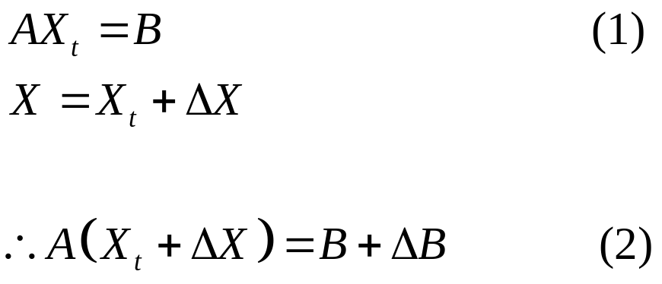


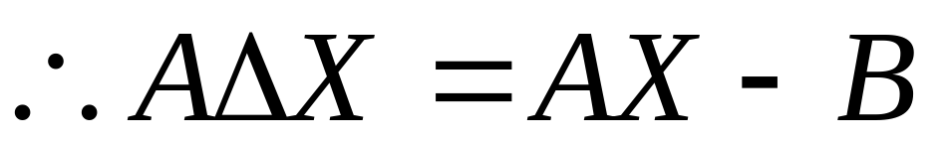
Iterative Correction
Subtracting (2)-(1)
All Known
Solving (2) for ΔB
Substituting (4) into (3)

Slide 9
How to do Iterative Correction
Do LU factorization to solve AX=B and get the solution X1 (with error)
Calculate B1=AX1-B
Solve AX2=B1
Now a better estimation of X is X1-X2

Slide 10
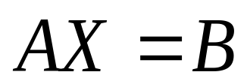
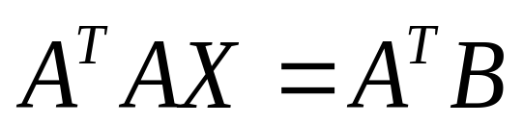
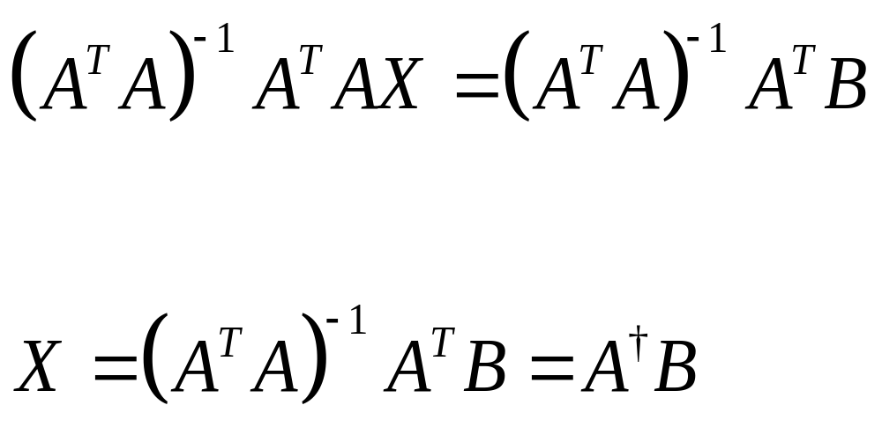
Case M>N (Thin matrix)

Slide 11
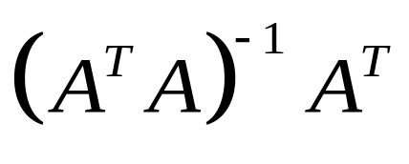
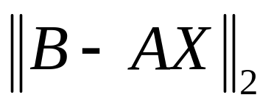
Case M>N (Skinny)
Pseudo inverse =
  Also called left inverse
This gives the least squares solution which is the solution that minimizes (Not in Exam)

Slide 12
Example (IR=V)
Assume that we measured the voltage and current across a resistor and it was tabulated as:
V | I | R | Error
1.83810880488929 1.99127982643865 0.309399042734593 1.97361551736856 1.38336646995853 0.256162443517608 | 0.814723686393179 0.905791937075619 0.126986816293506 0.913375856139019 0.632359246225410 0.0975404049994095 | 2.25611312839901 2.19838546241377 2.43646586130229 2.16079230045706 2.18762748898814 2.62621878101858 | 0.0561131283990091 -0.00161453758623331 0.236465861302293 -0.0392076995429447 -0.0123725110118555 0.426218781018578
True value: 2.2
Average of the error: 0.002235178041072
LS solution: 2.202235178041073
Average of the LS error: 0.002235178041072

Slide 13
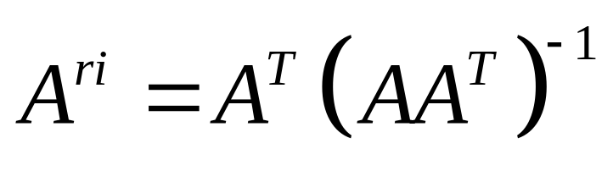
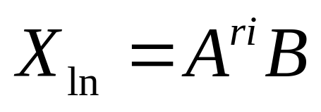
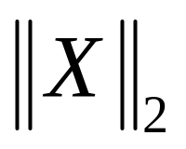
Case M<N (Fat)
AX=B
Cannot have a single solution
Least Norm Solution:
This is the solution with minimum second norm

Slide 14
Summary
 | No solution | Unique Solution | Infinite number of solutions
M=N | √ | √ | √
M>N overdetermined | √ | √ | √
M<N underdetermined | √ | - | √

Slide 15
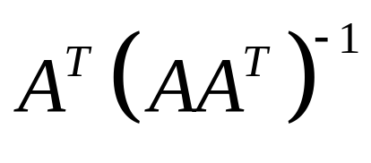
Doing it in matlab
To find left inverse of A
  Ali=inv(A’*A)*A’
  Ali=pinv(A)
To find right inverse of A
  Ari=A’*inv(A*A’)
  Ari=pinv(A)
To solve for X
  X=pinv(A)*B

Slide 16
THE BEST METHOD
Can solve ALL linear systems:
  If there is a unique solution it finds it
  If there is no solution it reports that
  If there are infinite number of solutions it can find them all
Singular Value Decomposition

Slide 17
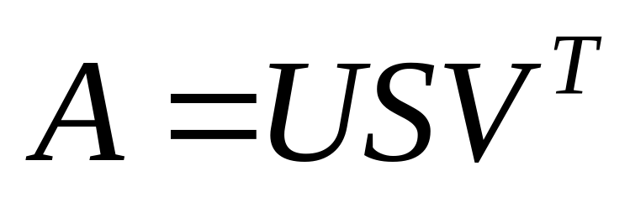
SVD
Any matrix A (M*N) can be decomposed as:
Where:
U is M*M column orthogonal matrix
S is M*N diagonal matrix!!
V is N*N row orthogonal matrix

Slide 18
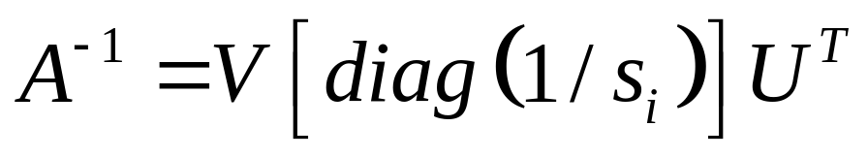
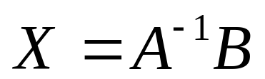

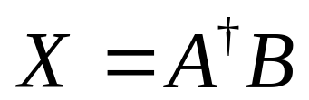

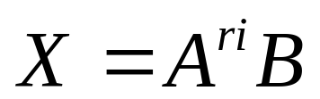
Using SVD
Case 1: N=M (Square)
Case 2: M>N (Skinny)
Case 3: M<N (Fat)

Slide 19
Finding SVD in Matlab
[U,S,V]=svd(A)
U*S*V’ → A

Slide 20
Easiest way to solve AX=B
Matlab
  X=A\B
If N=M → Solution
If M>N → Least Square Solution
If N>M → NOT the Least Norm Solution

