Slide 1

Yasser F. O. Mohammad
Assiut University
Egypt

Slide 2
Previously in NM
Bracketing Methods
  Bisection
  False Position
Fixed Point Iteration
Local Convergence Methods
  Newton Raphson
  Secant

Slide 3
Types of Convergence
Local convergence
  Converges only if the initial approximation is near the root
  Newton-Raphson/Secant
Global Approximation
  Converges as long as some condition holds for the initial approximation (even if it is not near)
  Bracketing methods
    A different initial interval is needed for every root

Slide 4
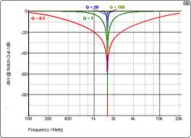
Graphical Initial Approximation
Draw the function
Locate approximate roots
PROBLEM
  What you see may be
  misleading

Slide 5
Heuristics
A heuristic is a rule that works ‘most of times in practice’
Usually better than nothing
Heuristics for initial approximation
  A root exists between points at which the function changes sign (is this a heuristic really?)
  A root may exist near points at which f(x) is small and the derivative changes sign (why?)

Slide 6




Initial Approximation Table
x_{i} | f |  | f'
 | + | -
 | - | +
 |  | ≈0 | + | -
 |  | ≈0 | - | +

Slide 7
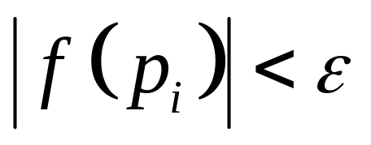
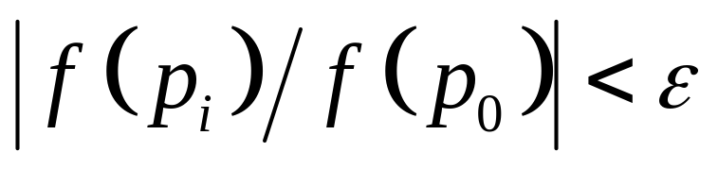
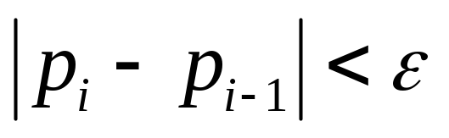
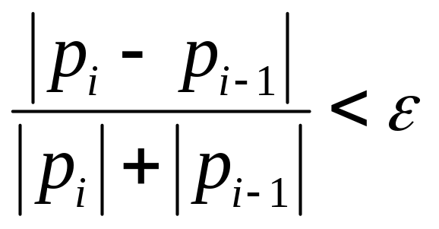
Convergence Checks
What happens if:
Vertical check AND Horizontal check?
Vertical check OR Horizontal check?
Absolute AND Relative check?
Absolute OR Relative check?
Vertical
  Absolute
  Relative
Horizontal
  Absolute
  Relative

Slide 8
Matlab Code
See page 68

