Slide 1
GentleS
Takumu Shimizu
Tokyo University of Agriculture and Technology
Katsuhide Fujita Lab.

Slide 2
Contents
Offering Strategy
Acceptance Strategy
Risk Management

Slide 3






Offering Strategy：Price
When GentleS has no agreement
Concede in the final negotiation round only
Concede according to simulation steps
concession
buyer
$$tp×0.9$$
$$tp×1.3$$
Price range
$$p^{min}$$
$$p^{max}$$
$$tp×0.7$$
$$tp×1.1$$
seller

Slide 4
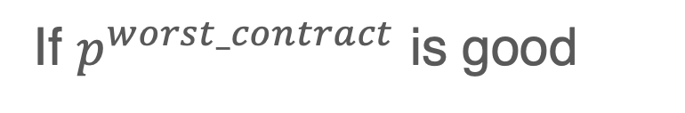

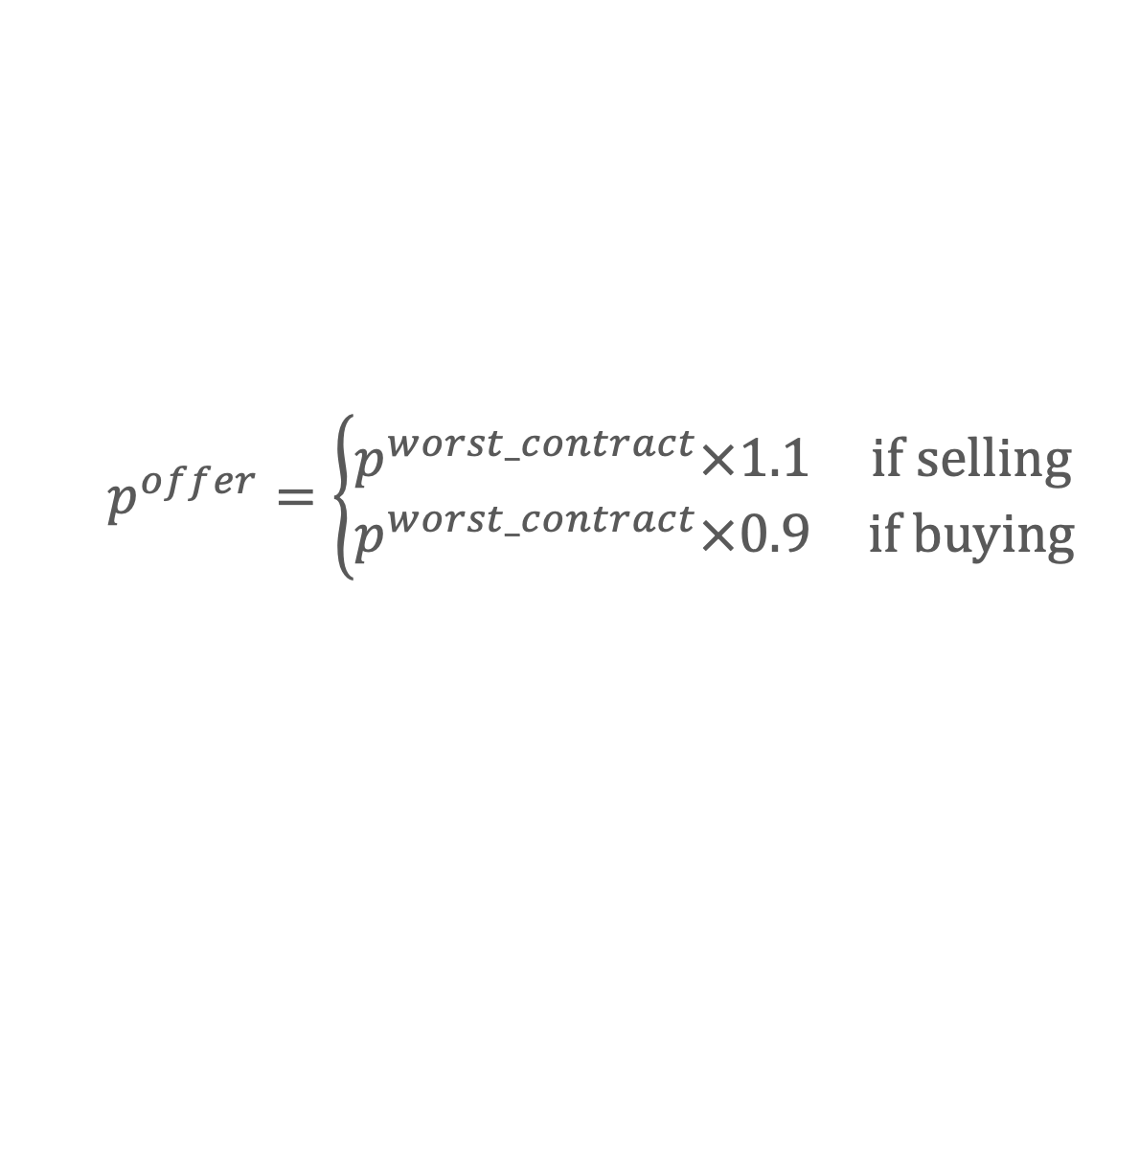

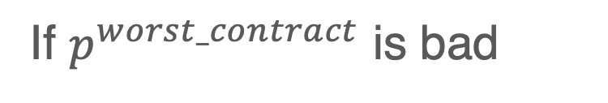
Offering Strategy：Price
When GentleS has some agreements
Concede in the final negotiation round only
The criterion is based on the worst agreed price for GentleS（$p^{worst_contract}$）
If $p^{worst_contract}$ is good
$$p^{offer}=p^{worst_contract}$$
$$p^{offer}=\left\{\begin{matrix}p^{worst_contract}×1.1 & if selling \\ p^{worst_contract}×0.9 & if buying\end{matrix}\right.$$
If $p^{worst_contract}$ is bad

Slide 5
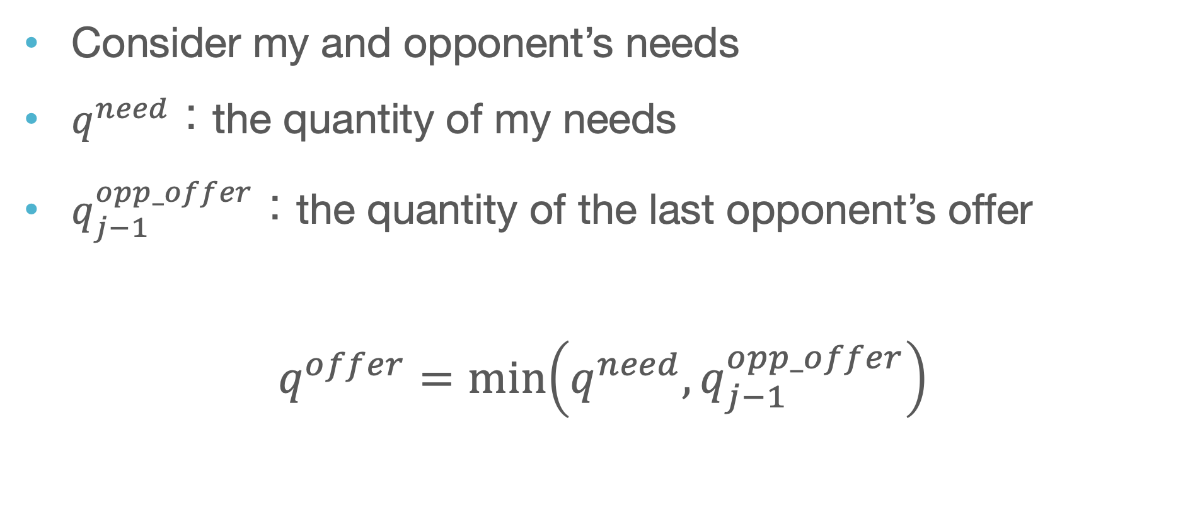
Offering Strategy：Quantity
Consider my and opponent’s needs
$q^{need}：$the quantity of my needs
$q_{j−1}^{opp_offer}$：the quantity of the last opponent’s offer
$$q^{offer}=\min\left(q^{need},q_{j−1}^{opp_offer}\right)$$

Slide 6
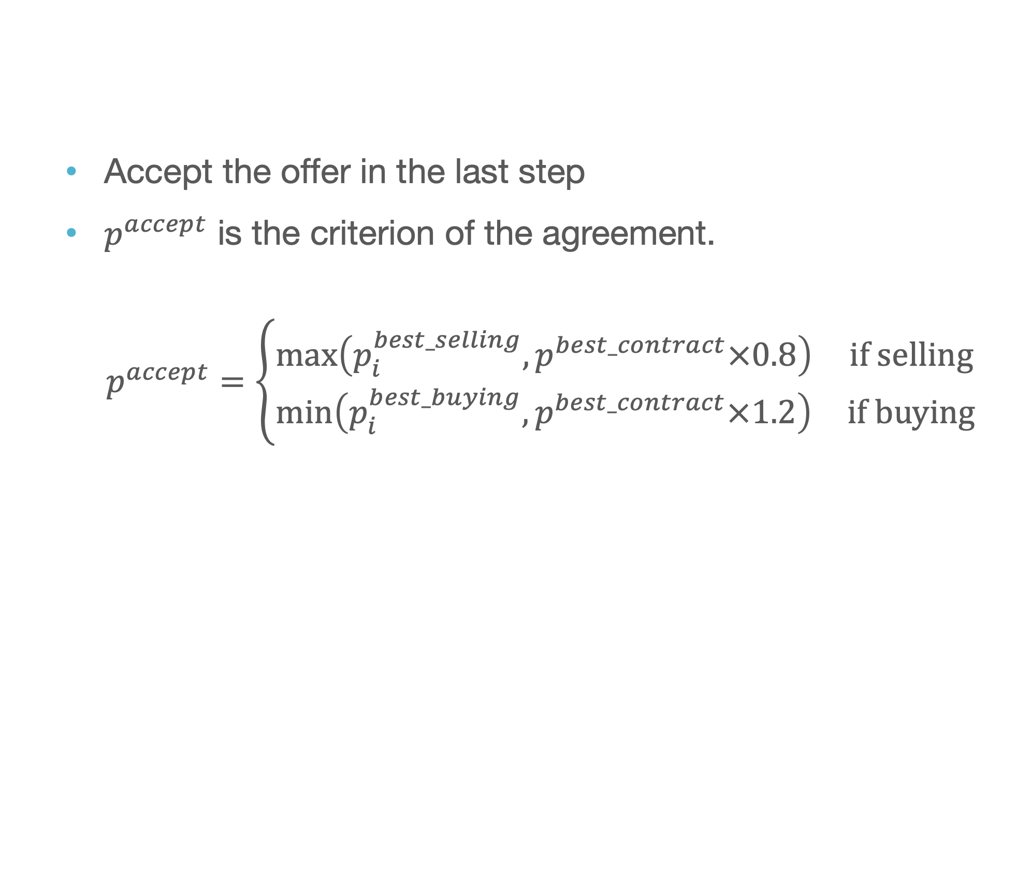
Acceptance Strategy
Accept the offer in the last step
$p^{accept}$ is the criterion of the agreement.
$$p^{accept}=\left\{\begin{matrix}\max\left(p_{i}^{best_selling},p^{best_contract}×0.8\right) & if selling \\ \min\left(p_{i}^{best_buying},p^{best_contract}×1.2\right) & if buying\end{matrix}\right.$$

Slide 7
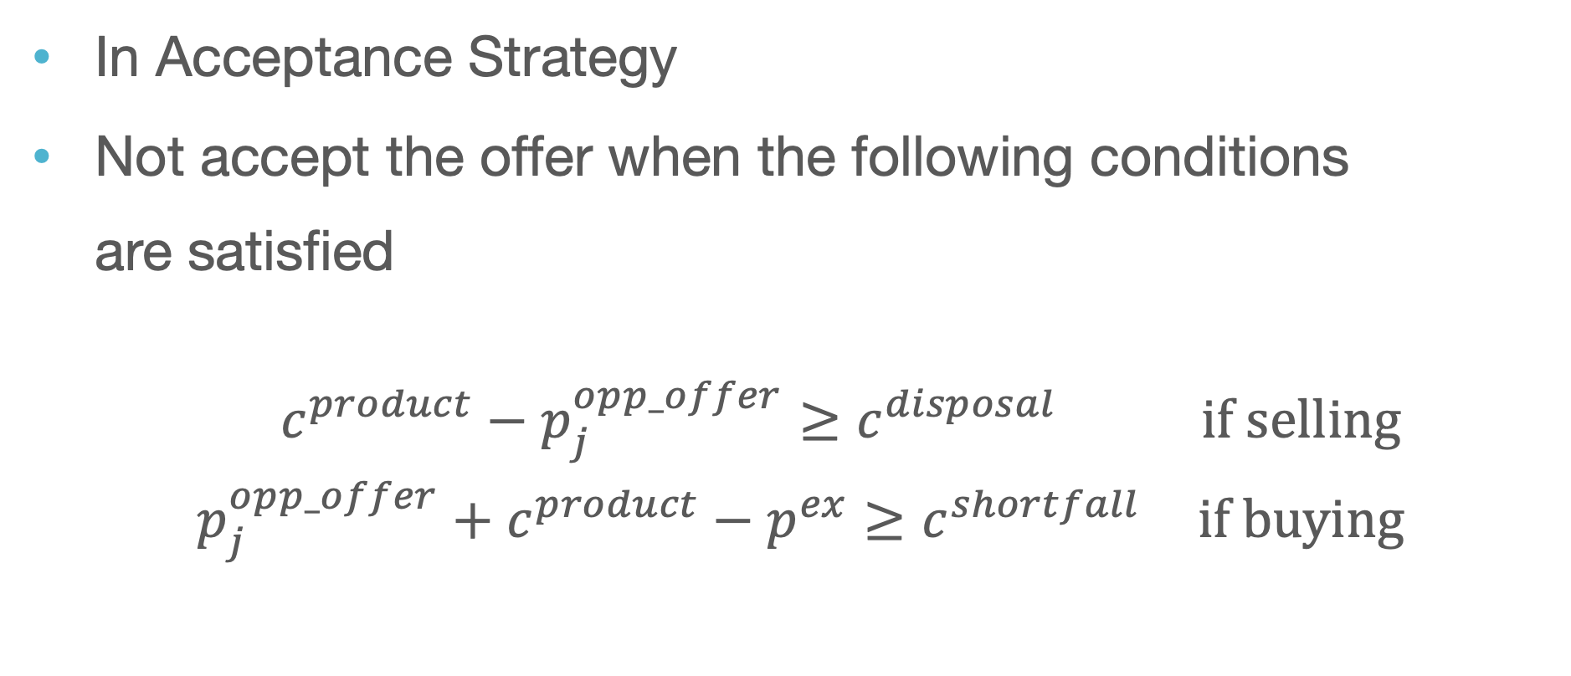
Risk Management
In Acceptance Strategy
Not accept the offer when the following conditions are satisfied
$$\begin{matrix}c^{product}−p_{j}^{opp_offer}≥c^{disposal} & if selling \\ p_{j}^{opp_offer}+c^{product}−p^{ex}≥c^{shortfall} & if buying\end{matrix}$$

Slide 8
Summary
Offering Strategy
Offer considering the other agent’s terms of acceptance
Acceptance Strategy
Accept the opponent’s offer in the last step
Risk management
Check if the minimum requirements are satisfied

Slide 9
Thank you for listening

Slide 10
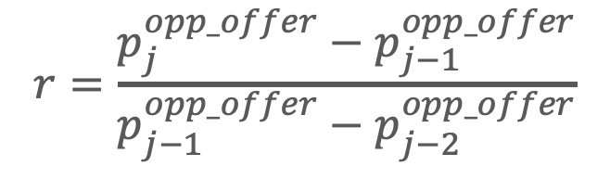



Acceptance Strategy
Judge by the change in the opponent’s concession rate($r$)
$r<3:$Offer before the final step
$r≥3:$Offer in the final step
1
$$r=2$$
2
$$r=5$$
10
$$r=\frac{p_{j}^{opp_offer}−p_{j−1}^{opp_offer}}{p_{j−1}^{opp_offer}−p_{j−2}^{opp_offer}}$$

