Slide 1
Lobster: An agent submitted to the ANAC 2022 SCM league
Nagoya Institute of Technology, Aichi, Japan
Nobuhiro Ito, Takanobu Otsuka

Slide 2

Outline
Introduction
The design of Lobster
Agent Configuration
Production Strategy
Trading and Negotiation Strategy
Negotiation Choices
Experiments
Conclusions

Slide 3
1. Introduction
In the actual supply chain:
Companies have fixed costs such as salary and maintenance.
If we do nothing, we will go bankrupt one day.
In the SCML world:
There are no fixed costs.
If we do nothing, we will have zero loss and zero profit.
There is a penalty for inventory shortages and overstocks.
Our goal is:
To make a small, steady profit
To reduce the penalty to zero.

Slide 4
1. Introduction
Basic Idea
Reduce penalties and earn small, steady profits.
Countermeasures against Penalties
A surplus of input products
Set an upper limit on the amount of inventory.
2. A shortage of Output products
Accept output contracts according to the expected inventory amount.
3. The bankruptcy of another agent
Limit the number of days that we can negotiate
Holding safety stock

Slide 5
Outline
Introduction
The design of Lobster
Agent Configuration
Production Strategy
Trading and Negotiation Strategy
Negotiation Choices
Experiments
Conclusions

Slide 6
2. The design of Lobster
Agent Configuration
Our agent was created based on the std_monolithic template.
SAOSyncController
SCML2020Agent
SAOSyncController
Controller A
Buy side negotiator
Lobster
make strategy
Controller B
Sell side negotiator
Use
information
Set
information
Use
information
Myinfo
Store information used by negotiators

Slide 7
Outline
Introduction
The design of Lobster
Agent Configuration
Production Strategy
Trading and Negotiation Strategy
Negotiation Choices
Experiments
Conclusions

Slide 8
2. The design of Lobster
Production Strategy
When Input Products arrive, our agent schedules the production on the fastest vacant line of the factory.
Day n
Day (n+1)
Day (n+2)
Day (n+3)
・・・
1st line
used
used
used
used
2nd line
used
used
used
used
3rd line
used
used
3
4th line
1
used
4
5th line
2
used
Buy 4 products at (n+1) day

Slide 9
2. The design of Lobster
Production Strategy
When Input Products arrive, our agent schedules the production on the fastest vacant line of the factory.
Day n
Day (n+1)
Day (n+2)
Day (n+3)
・・・
1st line
used
used
used
used
2nd line
used
used
used
used
3rd line
used
used
used
4th line
used
used
used
5th line
used
used
1
Do not buy products that cannot be manufactured within the period.(last_day)
Buy 1 products at (n+1) day

Slide 10
2. The design of Lobster
Production Strategy
When Input Products arrive, our agent schedules the production on the fastest vacant line of the factory.
Day n
Day (n+1)
Day (n+2)
Day (n+3)
・・・
1st line
used
used
used
used
2nd line
used
used
used
used
3rd line
used
used
used
4th line
used
used
used
5th line
used
used
used

Slide 11
Outline
Introduction
The design of Lobster
Agent Configuration
Production Strategy
Trading and Negotiation Strategy
Negotiation Choices
Experiments
Conclusions

Slide 12
2. The design of Lobster
Trading and Negotiation Strategy
When both the price and the quantity/time are satisfied, our negotiator accepts the offer.
Otherwise, we reject it and respond with counteroffer.

Slide 13
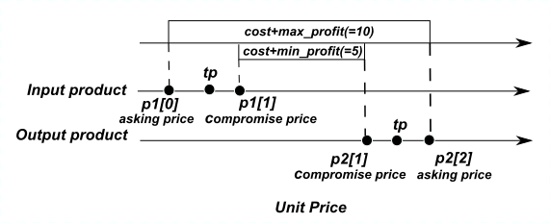
2. The design of Lobster
Trading and Negotiation Strategy(Price)
We set the asking price and the compromise price based on the Trading price.
Adjust the net profit based on the Trading price.
Production cost=＄4
＄10
+1
-2
＄20
+2
-1
＄10

Slide 14
2. The design of Lobster
Trading and Negotiation Strategy(Price)
Our offer is determined based on the asking price except the last two trading negotiation steps.
At the last two trading negotiation steps, our offer is determined based on the compromise price.
If the price of other agents’ offer is better than the price of our offer, the price is OK.
Asking price
compromise price
1
・・・
18
19
20
Negotiation steps

Slide 15
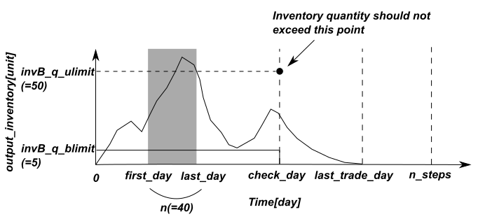
2. The design of Lobster
Trading and Negotiation Strategy(quantity and time)
As explained in Production Strategy, all Input Product are converted to Output Product as soon as possible.
Therefore, we manage only the Output Inventory.
We calculate the expected quantity by reflecting all contracts.

Slide 16
2. The design of Lobster
Trading and Negotiation Strategy(quantity and time)
(first_day, last_day) : We take contracts within this range
first_day = current_step
last_day = first_day + n
n_steps : the number of simulation day
last_trade_day : Last day for the agent
n steps – (number of factory lines on the right side of us)

Slide 17
2. The design of Lobster
Trading and Negotiation Strategy(quantity and time)
Day 97
Day 98
Day 99
Day 100
SELLER
BUYER

Slide 18
2. The design of Lobster
Trading and Negotiation Strategy(quantity and time)
(first_day, last_day) : We take contracts within this range
first_day = current_step
last_day = first_day + n
n_steps : the number of simulation day
last_trade_day : Last day for the agent
n steps – (number of factory lines on the right side of us)

Slide 19
2. The design of Lobster
Trading and Negotiation Strategy(quantity and time)
BUY(INPUT)
The upper limit of the number of stocks (=50) is set in check day (10 days before last trade day).
We buy products as much as we can within the limits.
We don’t accept input offer after check day.
If the production schedule cannot be made within the last day, the offer will be declined.

Slide 20
2. The design of Lobster
Trading and Negotiation Strategy(quantity and time)
SELL(OUTPUT)
We set the lower limit of inventory (=5).
After check day the limit equals zero.
Sell as much as we can within the limits.

Slide 21
Outline
Introduction
The design of Lobster
Agent Configuration
Production Strategy
Trading and Negotiation Strategy
Negotiation Choices
Experiments
Conclusions

Slide 22
2. The design of Lobster
Negotiation Choices
We request negotiations for all parties with following issues .
• Time: (first day , last day)
• Price(BUY)：(min(TP*0.5, asking price) , max(TP*1.5, compromise price))
• Price(SELL)：(min(TP*0.5, compromise price) , max(TP*1.5, asking price))
• Quantity：(1 , n_lines)
We accept negotiation requests from other agents that satisfy all of the following conditions.
• Time: The day between first day and last day should be included.
• Price：The compromise price and asking price are included.
• Quantity：Numbers from 1 to n_lines must be included.

Slide 23
Outline
Introduction
The design of Lobster
Agent Configuration
Production Strategy
Trading and Negotiation Strategy
Negotiation Choices
Experiments
Conclusions

Slide 24
3. Experiments
Evaluating the Performance of Agent
Simulations were done with run() in the template, and compare the scores with the two default agents.
competition=Std
n_steps=80
n_configs=5
competitors=
[Lobster , DecentralizingAgent , BuyCheapSellExpensiveAgent]

Slide 25
3. Experiments
Evaluating the Performance of Agent
The score of Lobster is consistently positive.
The score of default agents are negative.
The score is better than these default agents and the agent who does nothing.
Experiments | Lobster(My Agent) | DecentralizingAgent | BuyCheapSell ExpensiveAgent
1st time | 0.026 | -0.095 | -1.276
2nd time | 0.041 | -0.209 | -1.861
3rd time | 0.025 | -0.541 | -1.149
4th time | 0.032 | -0.110 | -0.619
5th time | 0.052 | -0.136 | -1.328
Average | 0.035 | -0.218 | -1.247

Slide 26
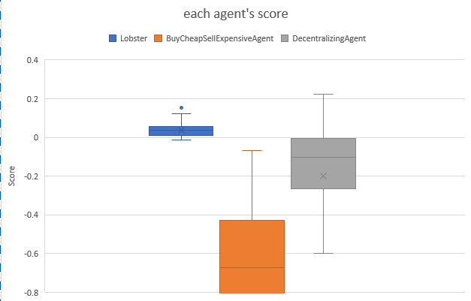
3. Experiments
Evaluating the Performance of Agent
Checking the score of 95 bodies in each world, only 10 times were negative score.
It has been able to earn small profits consistently as intended.

Slide 27
Outline
Introduction
The design of Lobster
Agent Configuration
Production Strategy
Trading and Negotiation Strategy
Negotiation Choices
Experiments
Conclusions

Slide 28
4. Conclusions
Conclusions of Agent
We aim to reduce penalties and earn small, steady profits.
The results were as intended.
There is still room for improvement.
Determine prices dynamically.
Determine inventory limit dynamically.

