Slide 1

’NegoAgent’: An Agent Submitted to The ANAC 2023 SCM League OneShot Track
Michal Rahimi, Opal Peltzman, Tomer Porat
The Department of Computer Science, Bar-Ilan University, Israel

Slide 2
INTRODUCTION
The OneShot track is a simpler form of the SCM world
In OneShot track, the agents emphasize negotiations
Agent utility = number of sets secures on specific day
NegoAgent was based on the ideas of AdaptiveAgent and LearningAgent
AdaptiveAgent considers his other negotiations
LearningAgent learns about his different partners

Slide 3
DESIGN
Both LearningAgent and AdaptiveAgent, assume price will only improve over time (hard headed)
This year, the price range (Pmin, Pmax) is two consecutive values
This constraint, makes agent’s score insensitive to prices of agreements
The importance is to emphasize the match between supply and demand
The agent behavior take in account the supply and demand in negotiation offers, and response in addition to the price

Slide 4
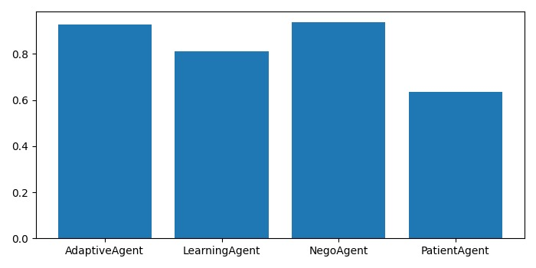
PERFORMANCE
Comparison of NegoAgent to other agents performances- including last year winner (PatientAgent), after 10 steps (days)

Slide 5
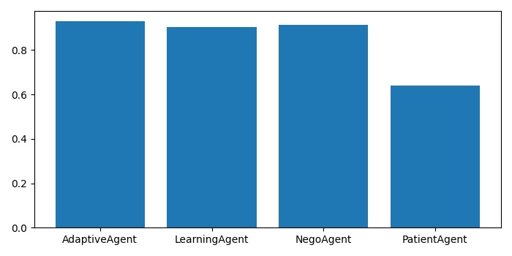
PERFORMANCE
Comparison of NegoAgent to other agents performances- including last year winner (PatientAgent), after 100 steps (days)

Slide 6
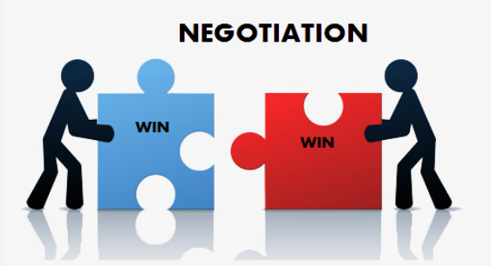
CONCLUSIONS
NegoAgent succeed in emphasizing the match between supply and demand without compromising on the price
NegoAgent superior on other agents, including last year winner
NegoAgent preforms well even after multiple steps (100 steps)

