Slide 1
Quantity Oriented Agent
Pedro Hrosz Turini
Professor: Jaime Simão Sichman
Polytechnic School of the University of São Paulo

Slide 2
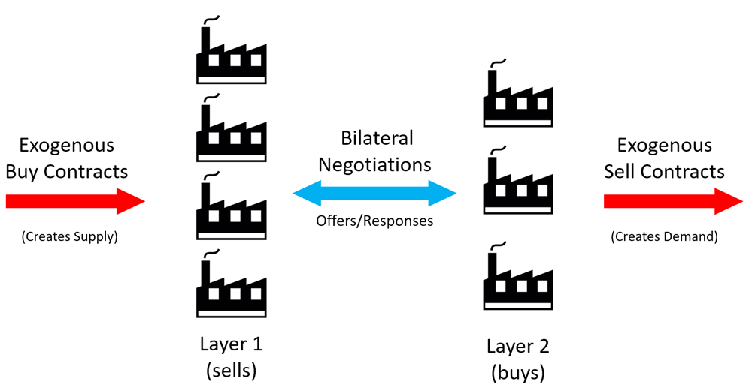
The OneShot Simulation
The simulation replicates a supply chain with 2 layers, and each agent controls a factory.
Each day, the agents are bound to and exogenous contract, that creates the supply and demand.
The agents negotiate the price and quantity of the intermediary products, through contracts.
The negotiations are made through alternating offers, with a time limit of 20 steps.

Slide 3
SCML OneShot 2023 changes
In the SCML 2023 competition, the price range is reduced to 1.
That means that the maximum price is only 1 unit higher than the minimum price:
p_{max}= p_{min}+ 1
This makes the quantity to be negotiated the single most important aspect to be considered.

Slide 4
Definitions: Quantities
Exogenous quantity: the amount established by the exogenous contract, which must be matched during the negotiations:
max{q_{exogenous}}=10
Secured quantity: the total number of products the agent successfully negotiated through all its contracts:
q_{secured}=Σq_{negotiated}
Agent’s needs: the difference between the exogenous amount and the secured amount. (The main objective of the agent is to nullify this value):
q_{needs}=q_{exogenous}-q_{secured}

Slide 5
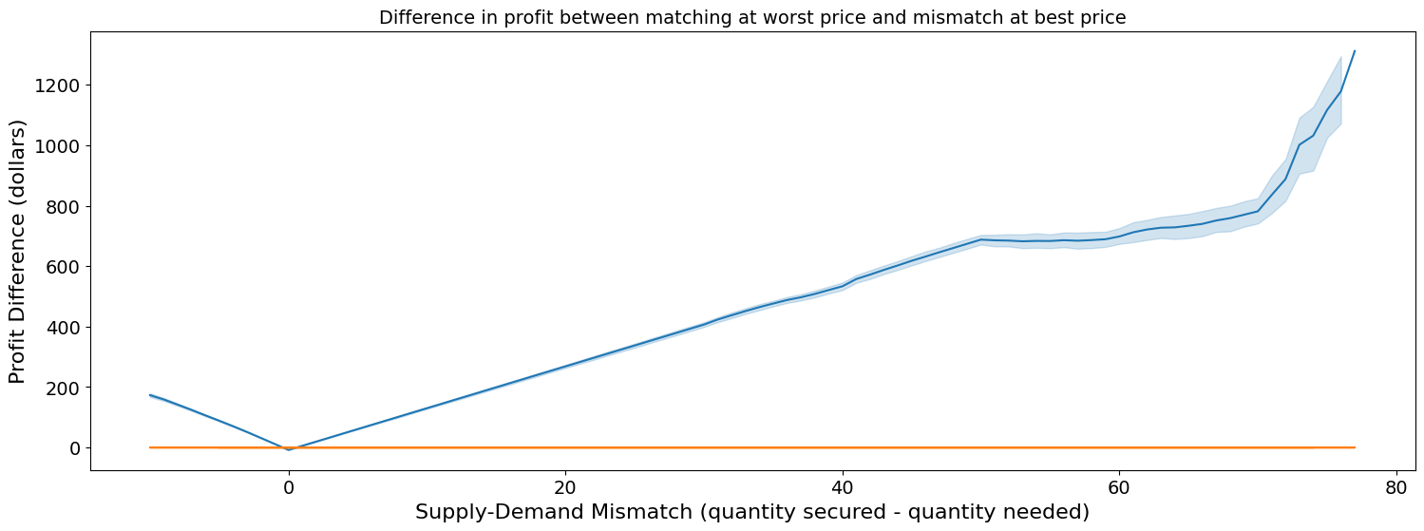
General Strategy
Minimize the difference between the exogenous quantity and the amount of products secured through contracts.
There are penalties are proportional to this difference (in modulus).
The price is not too relevant*

Slide 6
General Strategy
Response Strategy
Proposal Strategy
Price
Qty.

Slide 7
Response Strategy
Quantity Oriented Agent accepts any offers, as long as the amount offered is lower or equal to its needs.
Accepts if: q_{offer}≤q_{needs}
At the last offer it receives, it attempts to minimize the modulus of difference between the quantity determined by the exogenous contract and the number of products negotiated.
Accepts if: |q_{needs}-q_{offer}|<q_{needs}

Slide 8
Proposal Strategy: Prices
Best Price: the price that maximizes the agent’s utility function.
Layer 1: p_{best}=p_{max}
Layer 2: p_{best}=p_{min}
Worst Price: only at the very last offer sent, it is the price that minimizes the agent’s utility function.
Layer 1: p_{worst}=p_{min}
Layer 2: p_{worst}=p_{max}

Slide 9
Proposal Strategy: Quantity
With the objective of minimizing the risks of its offers being turned down based on quantity, the agent divides its needs by two , if its needs are superior, or equal to 5.
Sets: q_{offer}=⌈q_{needs}/2⌉
Otherwise, it simply offers what it currently needs.
Sets: q_{offer}=q_{needs}

Slide 10
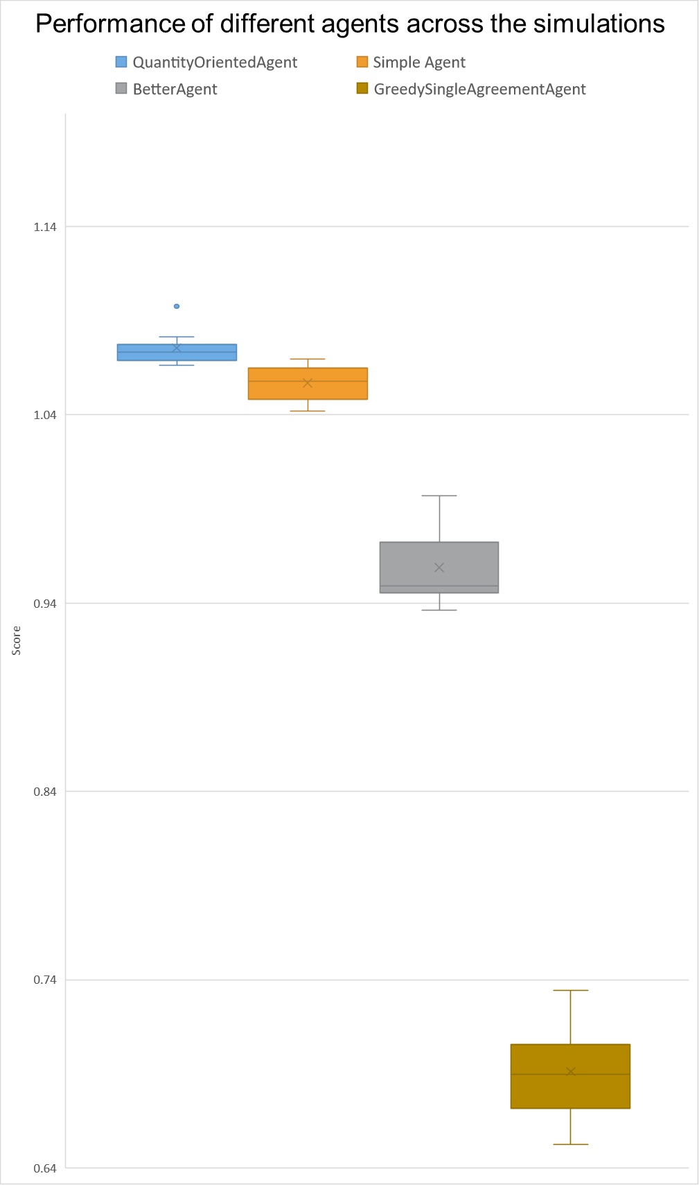
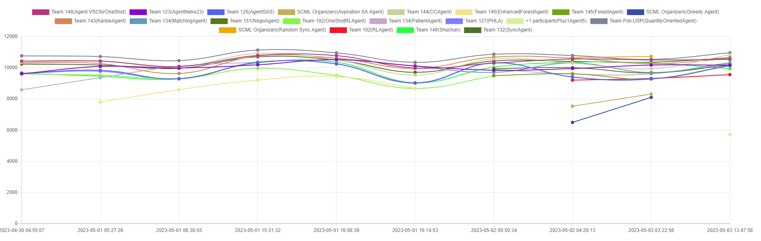
Performance
Higher mean, median and lower variance → Generally more consistent than the competitions’ standard agents.

Slide 11
Thank you!

Slide 12
References:
Y. Mohammad, ”Developing an agent for SCML2023 (OneShot)- OneShotAgent” www.yasserm.com. http://www.yasserm.com/scml/ scml2020docs/tutorials/02.develop_agent_scml2020_oneshot. html#oneshotagent (accessed May 1, 2023).
Y. Mohammad, ”Developing an agent for SCML2023 (OneShot)” www.yasserm.com. http://www.yasserm.com/scml/scml2020docs/ tutorials/02.develop_agent_scml2020_oneshot.html (accessed May 1, 2023).

