Slide 1
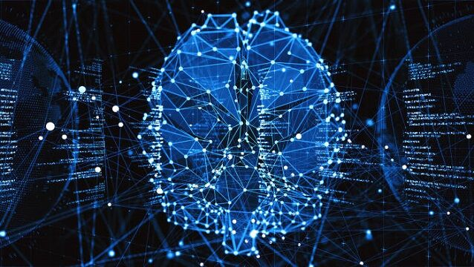
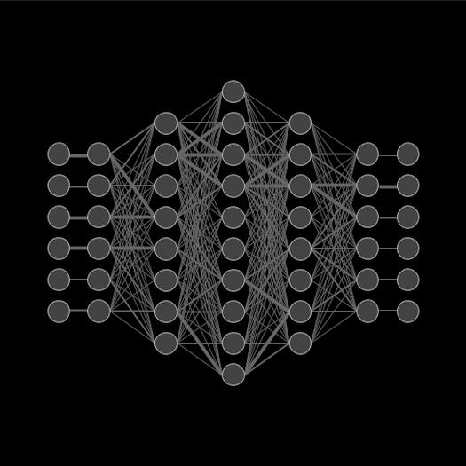
COVID-19 Classification Using Convolutional Neural Network (CNN)
Presenter: Yasir Hussein Shakir

Slide 2
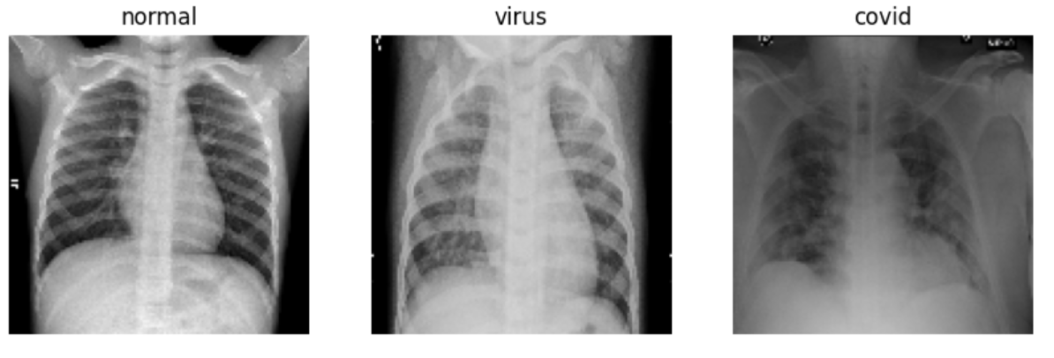
Download the Dataset
The dataset consists:
Covid-19 = 536
Normal = 668
Pneumonia = 619
Link: COVID CXR Image Dataset (Research)

Slide 3

How we can link Data with Drive
Explanation of linking Google Drive with Colab for seamless data access.

Slide 4
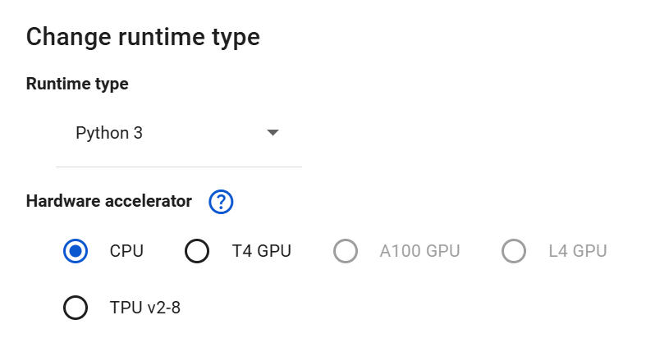
Google Colab
Benefits of using Colab for deep learning projects access ease of collaboration
CPU
T4 GPU
TPU v2-8

Slide 5
Necessary Libraries
  TensorFlow/Keras
  NumPy
  Matplotlib
  Pandas
  OpenCV

Slide 6
Load and Preprocess Data
Resizing images
Converting image formats
Normalizing pixel values.
Data Rescaling

Slide 7
Visualize Images
Brief description of image characteristics and distribution across classes.

Slide 8
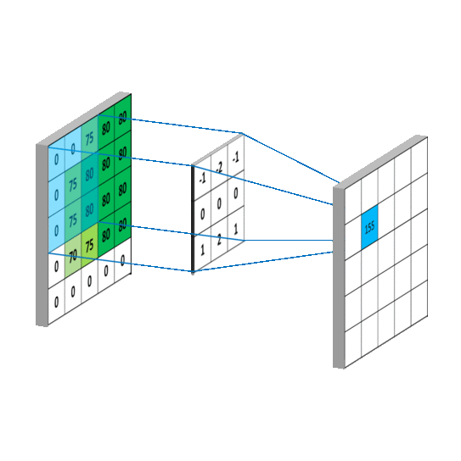
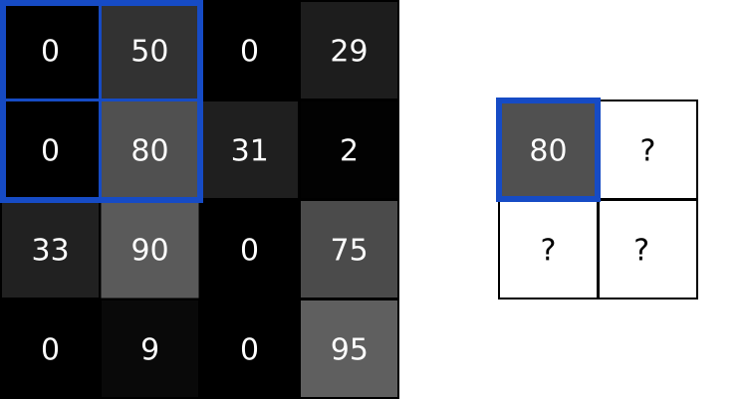
Building the CNN Model
1-This layer applies 32 filters (feature detectors) with a
3x3 kernel size on the input images of shape 128x128 pixels
with 3 color channels (RGB).
The relu activation function introduces non-linearity to the model.
2- maxPooling2D((2, 2)): This reduces the spatial dimensions (height and width) by a factor of 2,
retaining only the most important features and reducing computational complexity.
3-This block applies 64 filters, again with a 3x3 kernel,
followed by a pooling operation to downsample the feature map.
4- This layer randomly sets 50% of the input units to zero during training.
Dropout helps prevent overfitting by reducing co-adaptation of neurons.

Slide 9
Training the Model
Training parameters (batch size, number of epochs).
Loss function used (categorical cross-entropy).
Optimization method (Adam optimizer).
We draw of model training graph (accuracy vs. epochs and loss vs. epochs).

Slide 10
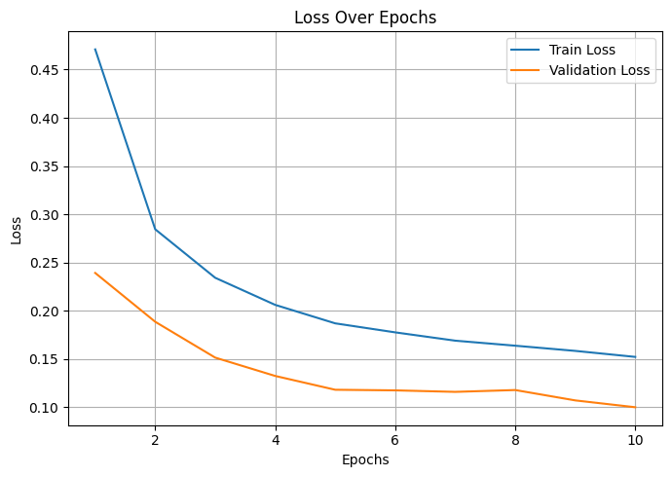
Evaluating the Model
Performance
Accuracy.
Loss.

Slide 11
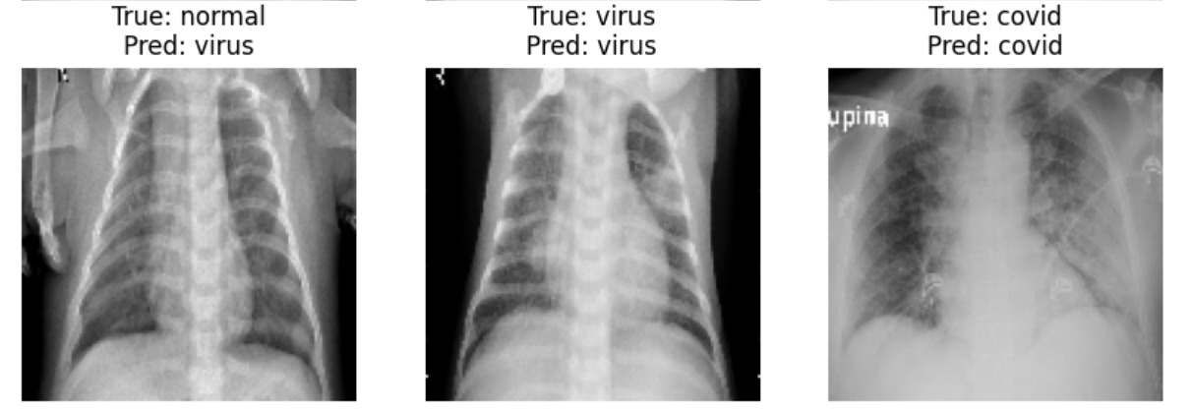
Predict Images
Shown predictions for test images.

Slide 12


