Slide 1
ML project main teps
collect data
analyse data
preprocess data
model selection
fine tuning
deployment

Slide 2
collect data
collect by yourself
search in the main websites
use python libraries to generate datasets

Slide 3
Data Analysis
data cleaning:
visualisation
gain helpful insights for ML modeling

Slide 4
Data Analysis
Data cleaning
handling missing values
handling outliers
feature enginieering
Date and Time Parsing

Slide 5
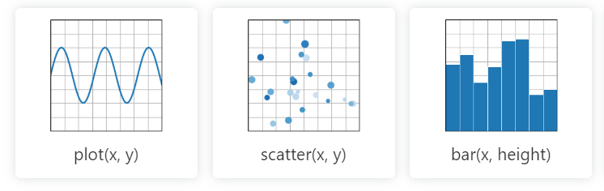
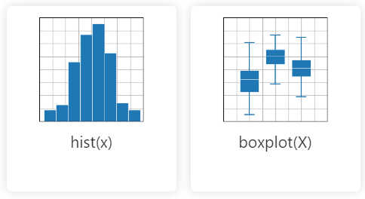
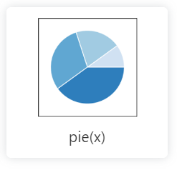
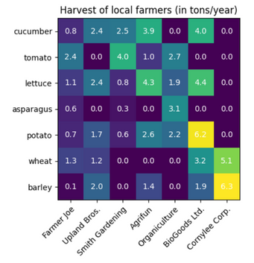
Data Analysis
Visualisation

Slide 6
Data preprocessing
technics
sampling (keep representative data)
features scaling (std, norm)
feature enginieering (add and remove features)
dimentionality reduction (for performance)
handling text attributes (into categories)
encoding categorical attributes (into numeric)
data splitting (trine, test, validation)

Slide 7

model selection

Slide 8
Fine tuning
our goal is to enhance the performance of the model, os enhance the training
each model has learning parameters
find the best combinaison of parameters of the model
many technics used

Slide 9
Deployment
Create ML API using one the the frameworks like:
django rest framework
fast api
flask

Slide 10
Types of learning
Supervised
the system learns from labeled data i.e we have already the input and the output (result) in the training.
Unsupervised
the system doesn’t have input and output, it have just data and the task is to figure out the patterns in the data
Reinforcement
the system learn from the envirement and try to do the best actions within it

Slide 11
Supervised learning

Slide 12

Regression
number bedrooms
dimentions
House Price
number floores
location

Slide 13
Classification
speed
Sport car
weight
Or
height
familial car
oil

Slide 14
TraAInIT

