Slide 1
SQL Project
Yasser Al-Ali

Slide 2
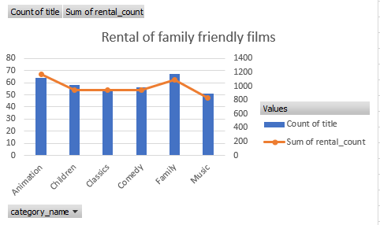
Question 1: Family Friendly films rentals
We want to understand more about the films families are watching based on the categories. As the chart shows, the highest category being watched is the “Family” category followed by the “Animation” category.

Slide 3
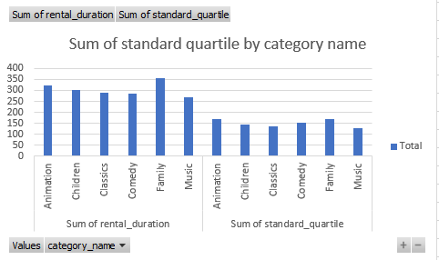
Question 2: Family friend films rental duration
We can see from this chart that the ration to the sum of the standard quartile and the sum of the rental duration is almost doubled for these family friendly films.

Slide 4
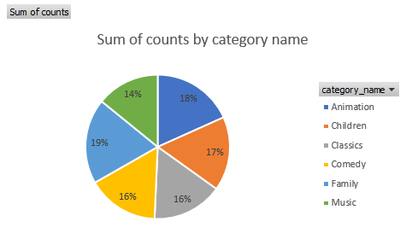
Question 3: Sum of counts for every quartile of the family friendly films
We can see from this pie chart that the “Family” category was rented the most out of these categories across all quartiles.

Slide 5
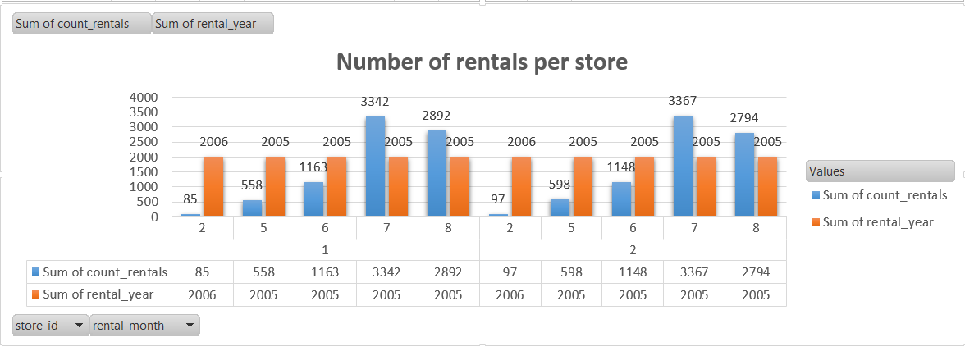
Question 4: Number of rentals for two stores in 2005-2006
We can see from this chart the number of rentals for both stores and how similar their performance was across these two years which could indicate certain trends in those months.

