Slide 1
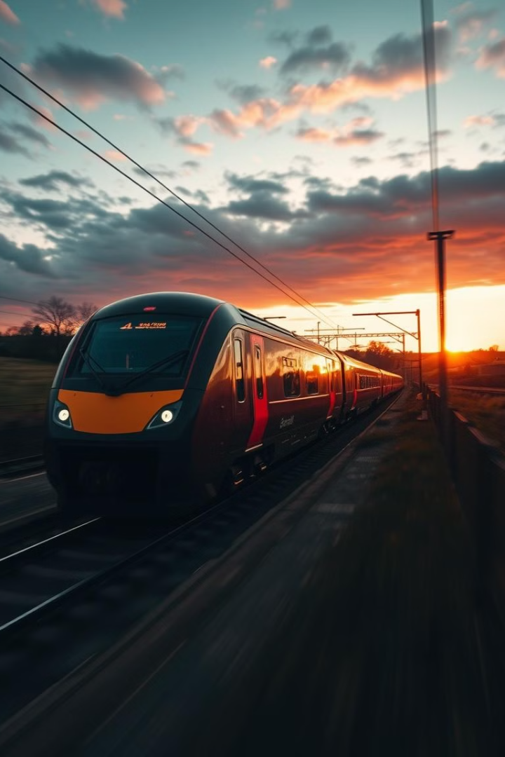
UK Railway Performance Analysis & Insights
This presentation provides a comprehensive analysis of UK railway performance from May to November 2024 and 2023 (excluding December). Our analysis examines key performance indicators, passenger trends, and customer satisfaction metrics to identify actionable insights for improving railway operations and enhancing the overall customer experience.

Slide 2

Introduction & Objectives
The primary objective of this analysis is to evaluate various aspects of the UK railway system to derive insights that drive strategic improvements. We delve into:
Ticket sales and purchasing patterns.
Passenger behaviour across different routes and ticket types.
Punctuality and the causes of delays.
Customer satisfaction through refund requests.
Improve Operations
Enhance Experience
Enhance overall efficiency and service delivery.
Elevate passenger satisfaction and loyalty.

Slide 3



Key Metrics & Overview
Our analysis begins with a high-level overview of key metrics that define the performance of the UK railway system during the analysis period. These metrics serve as the foundation for deeper insights and strategic recommendations.
30K
18K
13K
Total Tickets Sold
Online Purchases
Station Purchases
Reflects overall demand and usage of railway services.
Demonstrates the growing preference for digital ticketing solutions.
Highlights the continued importance of traditional ticketing methods.

Slide 4


Passenger Behaviour & Ticketing Trends
Understanding passenger behaviour and ticketing trends is crucial for optimising service offerings and revenue management. By analysing these trends, railway operators can tailor their services to better meet passenger needs and preferences.
Advance Tickets Dominate
66% Do Not Use Railcard
London → York Frequent Route
Indicates a preference for planning travel ahead of time.
Presents an opportunity to promote Railcard adoption and loyalty.
Highlights key corridors for capacity planning and service enhancements.

Slide 5



Punctuality & Delays Analysis
Punctuality is a critical factor in passenger satisfaction and operational efficiency. A detailed analysis of on-time arrival rates and the causes of delays is essential for identifying areas that require improvement.
90.8% On-Time Arrival
1
Indicates a generally reliable service.
2
Technical Issues
A leading cause of delays, requiring proactive maintenance.
Weather
3
Adverse weather conditions significantly impact punctuality.
4
Signal Failure
Requires investment in modern signalling technology.

Slide 6




Refund Requests & Customer Satisfaction
Refund requests serve as a direct measure of customer dissatisfaction. Analysing refund rates, especially at specific stations, can uncover underlying service issues and areas for targeted improvement.
3.54% Overall Refund Rate
1
2
Oxford at 13.19%
Oxford station's unusually high refund rate (13.19%) signals potential service issues that need investigation. This could include frequent delays, cancellations, or dissatisfaction with station facilities.

Slide 7







Actionable Insights & Strategic Recommendations
Based on the analysis, several actionable insights and strategic recommendations emerge. These recommendations are designed to improve operational efficiency, enhance customer satisfaction, and drive sustainable growth for the UK railway system.
Strengthen Digital Platforms
Capitalise on high online sales.
Promote Railcard Adoption
Target non-users.
Improve Punctuality
Address technical and weather issues.
Optimise Key Routes
Expand capacity.
Investigate Oxford
Address high refund rate.

Slide 8

Conclusion & Next Steps
This analysis provides a foundation for data-driven decision-making in the UK railway system. By leveraging these insights, railway operators and policymakers can work together to create a more efficient, reliable, and customer-centric rail network.
Data-Driven Decisions
Operational Efficiency
Customer Centricity

Slide 9



Thank you
Thank you for your time. Together, we can work towards achieving this vision. These are our key takeaways:
Leverage digital solutions to enhance customer experience.
Proactively address punctuality and reduce delays.
Address Oxford's unusually high refund rates
Next steps include further analysis of Q1 2025 data.

