Slide 1
IBM BOB HACKATHON · DEMO DECK
03
TraceLab
independent
investigations
Evidence-driven debugging
for AI-assisted engineering
04
A multi-agent platform that investigates competing root-cause hypotheses in parallel and verifies fixes with fail-before, pass-after regression evidence.
proof conditions
for every verified fix
01
human decision before PR creation
AGENTIC AI
DEBUGGING
SOFTWARE TESTING
DEVELOPER TOOLS
Notes:
Project summary source: docs/plans/idea and AGENTS.md.
Opening line: TraceLab treats debugging as differential diagnosis, then demands reproducible evidence before recommending a fix.

Slide 2
02
THE PROBLEM
AI debugging often stops at the first plausible answer
TYPICAL AGENT LOOP
A passing suite does not prove the reported bug was fixed.
01 BUG
02 INSPECT CODE
01
Multiple causes
03 ASSUME CAUSE
The same symptom can fit several plausible explanations.
04 PATCH
02
Weak proof
05 TESTS GREEN
Existing tests may pass without reproducing the reported failure.
06 DECLARE FIXED
03
Sequential waste
A wrong hypothesis consumes time before alternatives are considered.
TRACELAB
IBM BOB HACKATHON · DEMO DECK
02
Notes:
Source: docs/plans/idea, sections 2 and 4.
Emphasize that TraceLab addresses proof, not only code generation.

Slide 3
03
THE SOLUTION
TraceLab investigates competing causes before choosing a fix
CODE PATH
Follows execution flow and state changes
ARBITER
VERIFICATION ENGINE
Compares evidence, not confidence
GIT HISTORY
Tests whether recent changes explain the regression
Isolated worktree
Regression test
Before-and-after proof
HUMAN REVIEW
TEST BEHAVIOR
Approval remains mandatory before a PR
Builds reproductions and probes edge conditions
TRACELAB
IBM BOB HACKATHON · DEMO DECK
03
Notes:
Source: docs/plans/idea, sections 3, 8, 10, and AGENTS.md.
The arbiter is constrained by verified evidence; model confidence cannot select the winner.

Slide 4
04
SYSTEM WORKFLOW
One ticket becomes three independent investigations
Each branch produces a hypothesis that must survive the same verification contract.
01
02
03
04
05
BUG INTAKE
PARALLEL INVESTIGATION
ISOLATED EXPERIMENTS
ARBITRATION
HUMAN REVIEW
Normalize symptom, expected behavior and evidence
Code path, Git history and test behavior
One Git worktree per hypothesis
Select only among evidence-qualified hypotheses
Approve or reject before pull-request creation
No auto-merge. PR creation requires prior approval.
TRACELAB
04
Notes:
Source: AGENTS.md architecture and investigation states; docs/plans/idea, section 8.
The platform uses isolated worktrees to prevent one hypothesis from contaminating another.

Slide 5
05
VERIFICATION CONTRACT
A hypothesis is verified only when all four proofs hold
01
02
03
04
REPRODUCE
FAIL BEFORE
PASS AFTER
SUITE PASSES
Original symptom reproduced
Regression test fails on original code
The same test passes after the fix
Relevant existing tests remain green
REQUIRED
REQUIRED
REQUIRED
REQUIRED
VERIFIED = reproduction + fail-before + pass-after + existing tests pass
TRACELAB
IBM BOB HACKATHON · DEMO DECK
05
Notes:
Source: AGENTS.md, Core Verification Contract.
For flaky bugs, TraceLab repeats experiments instead of accepting a single passing run.

Slide 6
06
ILLUSTRATIVE DEMO
Concurrent retries expose an idempotency race
Demo scenario for presentation purposes; results below are illustrative, not production telemetry.
PVS-421
BEFORE FIX
AFTER FIX
37/50
0/50
Duplicate payment records during concurrent retries
reproduction runs failed
reproduction runs failed
H1
Transaction race
VERIFIED
Verified cause
H2
Client retry change
REJECTED
The lookup and insert were not protected by one database transaction or a uniqueness constraint.
H3
Contaminated fixture
REJECTED
Recommended action: approve the verified patch and create a draft pull request.
TRACELAB
IBM BOB HACKATHON · DEMO DECK
06
Notes:
This slide uses an illustrative debugging scenario assembled for the demo deck. The values are not product telemetry.
The workflow and evidence fields match implemented TraceLab entities in backend/app/db/models.py and the dashboard components.

Slide 7
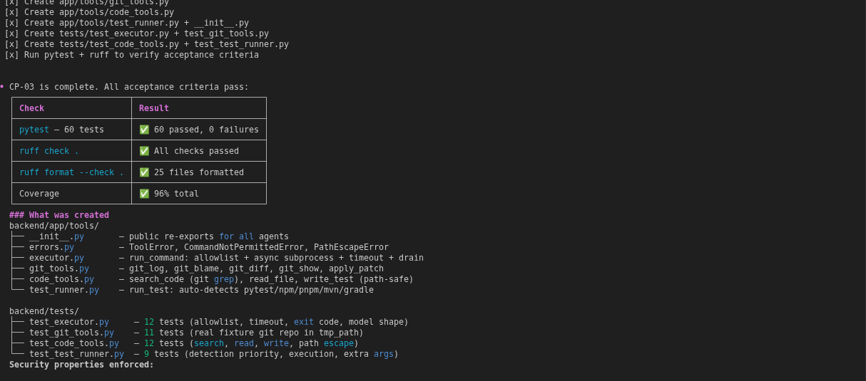
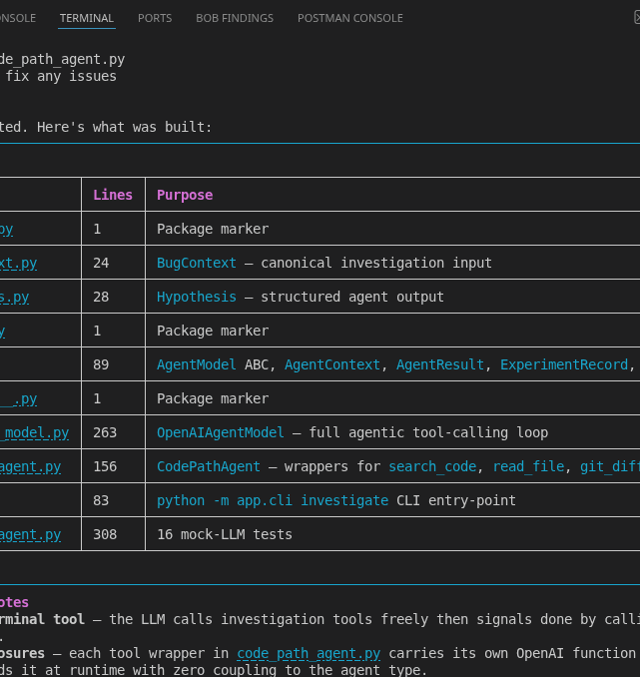
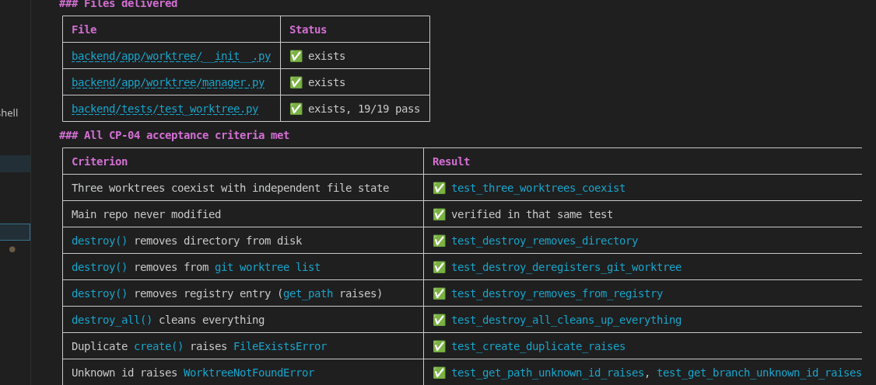
07
IBM BOB USAGE
IBM Bob supported the build from architecture through verification
Bob helped define and implement:
Architecture and implementation plans
Database schema and API contracts
Allowlisted code, Git and test tools
Isolated hypothesis worktrees
Investigation and arbiter agents
Verification engine and review dashboard
14
exported Bob session screenshots
TRACELAB
IBM BOB HACKATHON · DEMO DECK
07
Notes:
Source images: bob_sessions/task3_finish.png, task4_finish.png, and task_finish.png.
Repository contains 14 exported Bob session screenshots. The listed contribution areas map to docs/plans and implemented backend/frontend modules.

Slide 8
TRACE LAB · CLOSING
Evidence decides.
Engineers approve.
PROJECT
TraceLab
PUBLIC REPOSITORY
github.com/
yasshhhraj/tracelab
TraceLab turns a bug report into competing hypotheses, isolated experiments, reproducible proof and a diagnosis an engineer can audit.
TECHNOLOGY
Python · FastAPI · asyncio
Next.js · PostgreSQL · Git worktrees
Hypothesis → Experiment → Evidence → Decision
Agentic AI · Debugging · Testing · Developer Tools
TRACELAB
08
Notes:
Repository URL source: git remote origin in the project workspace.
Close by reinforcing the product principle: Hypothesis, Experiment, Evidence, Decision.

