Slide 1
Online File Management System Team Members: Wei & Yas

Slide 2
Purpose Of The System

Slide 3







Solution Overview
Log out

Slide 4
Solution Overview
Upload
Rename
Delete
Download
Admin only
Edit
View
Delete
Block

Slide 5
Solution Overview
The code we will develop include some URLs.
The list is shown below:
/login
/register
/passwordreset
/logout
No-admin User
/upload
/list
/download/:fileid
/delete/:fileid
/rename/:fileid
Admin
/admin/list
/admin/edit/:userid
/admin/delete/:userid
/admin/block/:userid
/admin/view/:userid

Slide 6
Challenges and Solutions

Slide 7
Challenges and Solutions

Slide 8

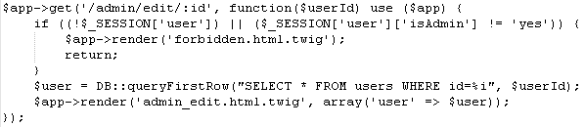
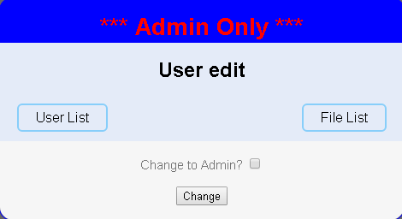
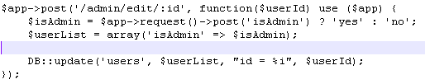

Challenges and Solutions

Slide 9

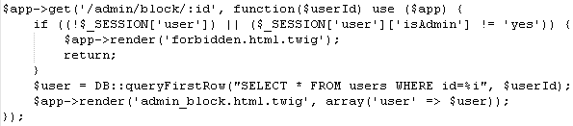
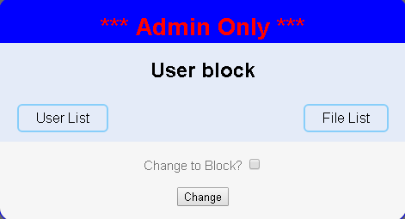


Challenges and Solutions

Slide 10
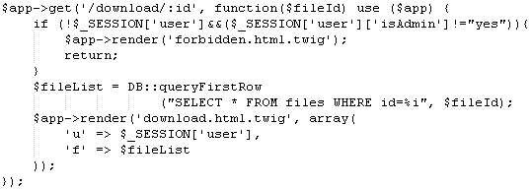
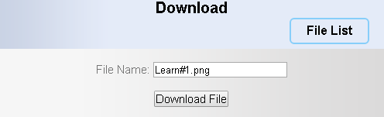
Challenges and Solutions

Slide 11
What we learned

Slide 12
What we learned

Slide 13
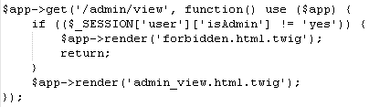
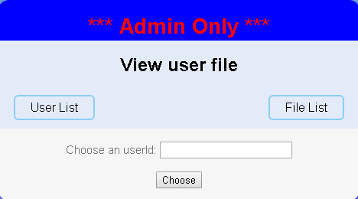
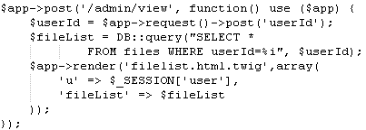
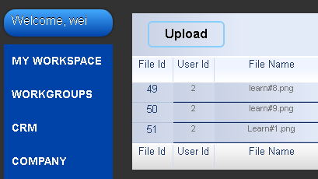
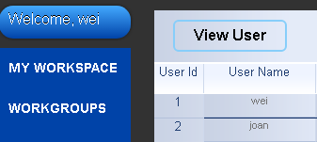
What we learned

Slide 14
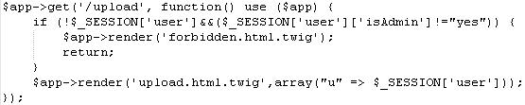
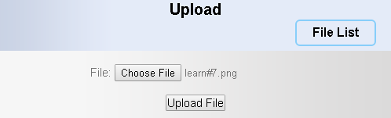
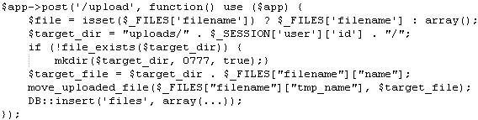
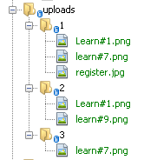
What we learned

Slide 15
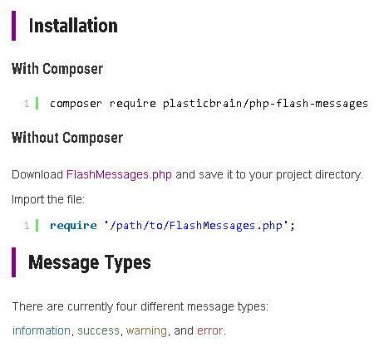
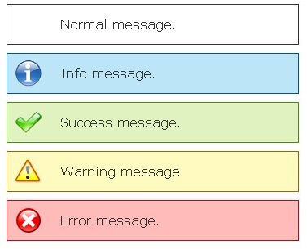
Future Work

Slide 16
Summary

