Slide 1
Online File Management System Team Members: Wei & Yas

Slide 2
What is File Management System?
File Management System is basically a software that manages data files.
It provide the ability to add, delete and modify users’access levels.
Users can view, upload, list, delete, download files.

Slide 3
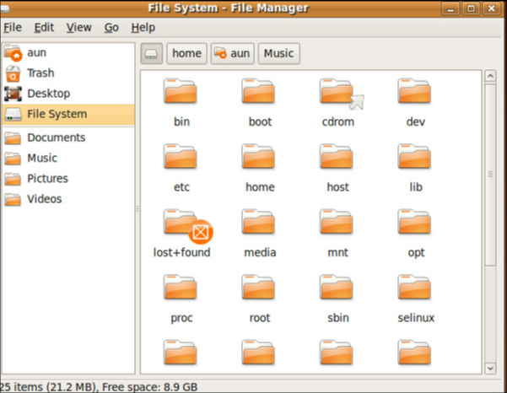
File Management System Examples:

Slide 4
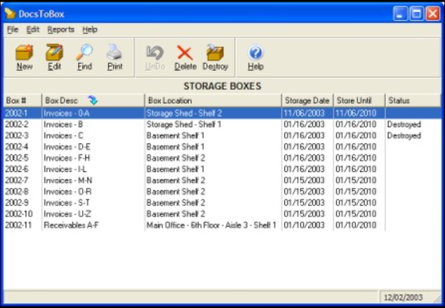
File Management System Examples:

Slide 5
Purpose Of The System
The user has a choice of English or French language.
Regular (non-admin) user can:
Upload, rename, delete, list and download files
Print Reports
Admin user manages other users:
Add, view, delete and block users
Change other users’ access level
Monitor other users’ activities

Slide 6







Solution Overview
Log out

Slide 7
Solution Overview
Upload
Rename
Delete
Download
Admin only
Edit
View
Delete
Block

Slide 8
Solution Overview
The code we will develop include some URLs.
The list is shown below:
/login
/register
/passwordreset
/logout
No-admin User
/upload
/list
/download/:fileid
/delete/:fileid
/rename/:fileid
Admin
/admin/list
/admin/edit/:userid
/admin/delete/:userid
/admin/block/:userid
/admin/view/:userid

Slide 9
Challenges and Solutions
Slim lets you assign conditions to route parameters.
\Slim\Route::setDefaultConditions(array(
'lang' => '(en|fr)'
));
$app->get('(/:lang)/', function($lang = 'en') use ($app) {
$app->render($lang . '/register.html.twig');
});

Slide 10
Challenges and Solutions
<button type="submit" class="btn">Sign in!</button>
(Login button not working)
<input type="submit" class="btn" style="height: 50px; width: 505px; margin: auto; font-size: 20px; background-color: lightskyblue" value="Sign in!"></input>

Slide 11

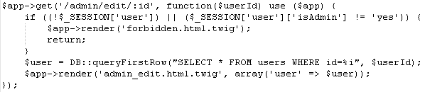
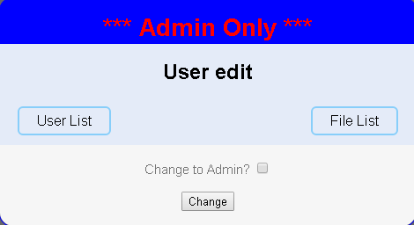
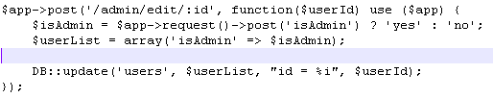

Challenges and Solutions

Slide 12

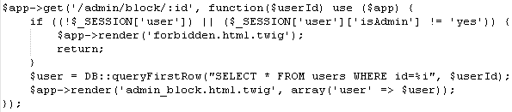
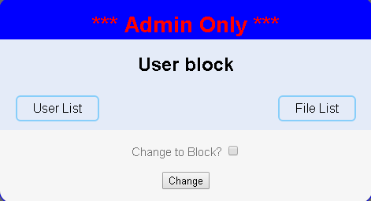


Challenges and Solutions

Slide 13
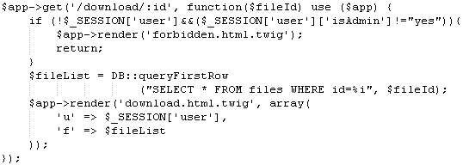
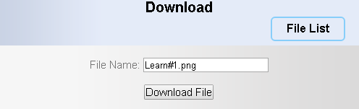
Challenges and Solutions

Slide 14
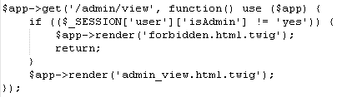
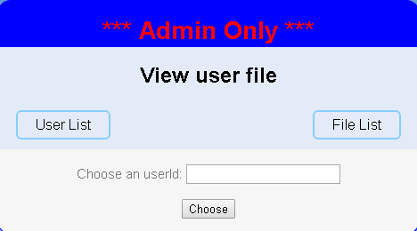
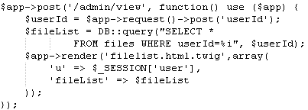
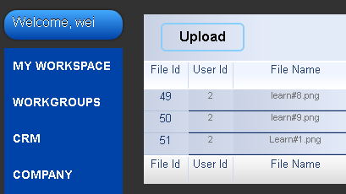

What we learned

Slide 15
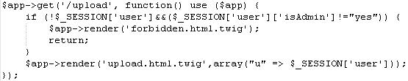
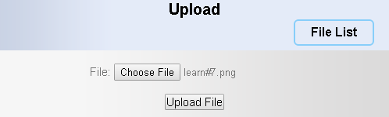
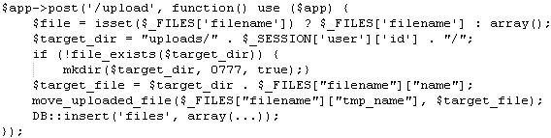
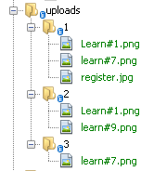
What we learned

Slide 16
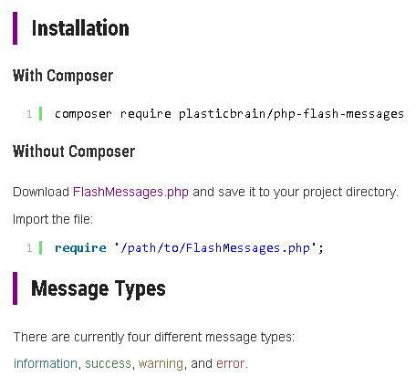
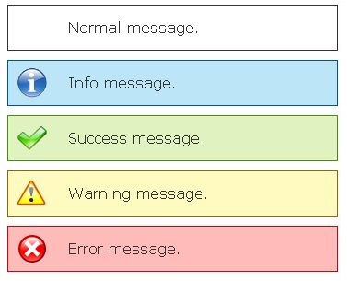
Future Work

Slide 17
Summary
Online File Management System uses the following:
Technologies:
Bootstrap
Multiple Languages
Jquery
Libraries:
Twig
Slim/Slim and Slim/Views
Simotod/Slim-download

