Slide 1


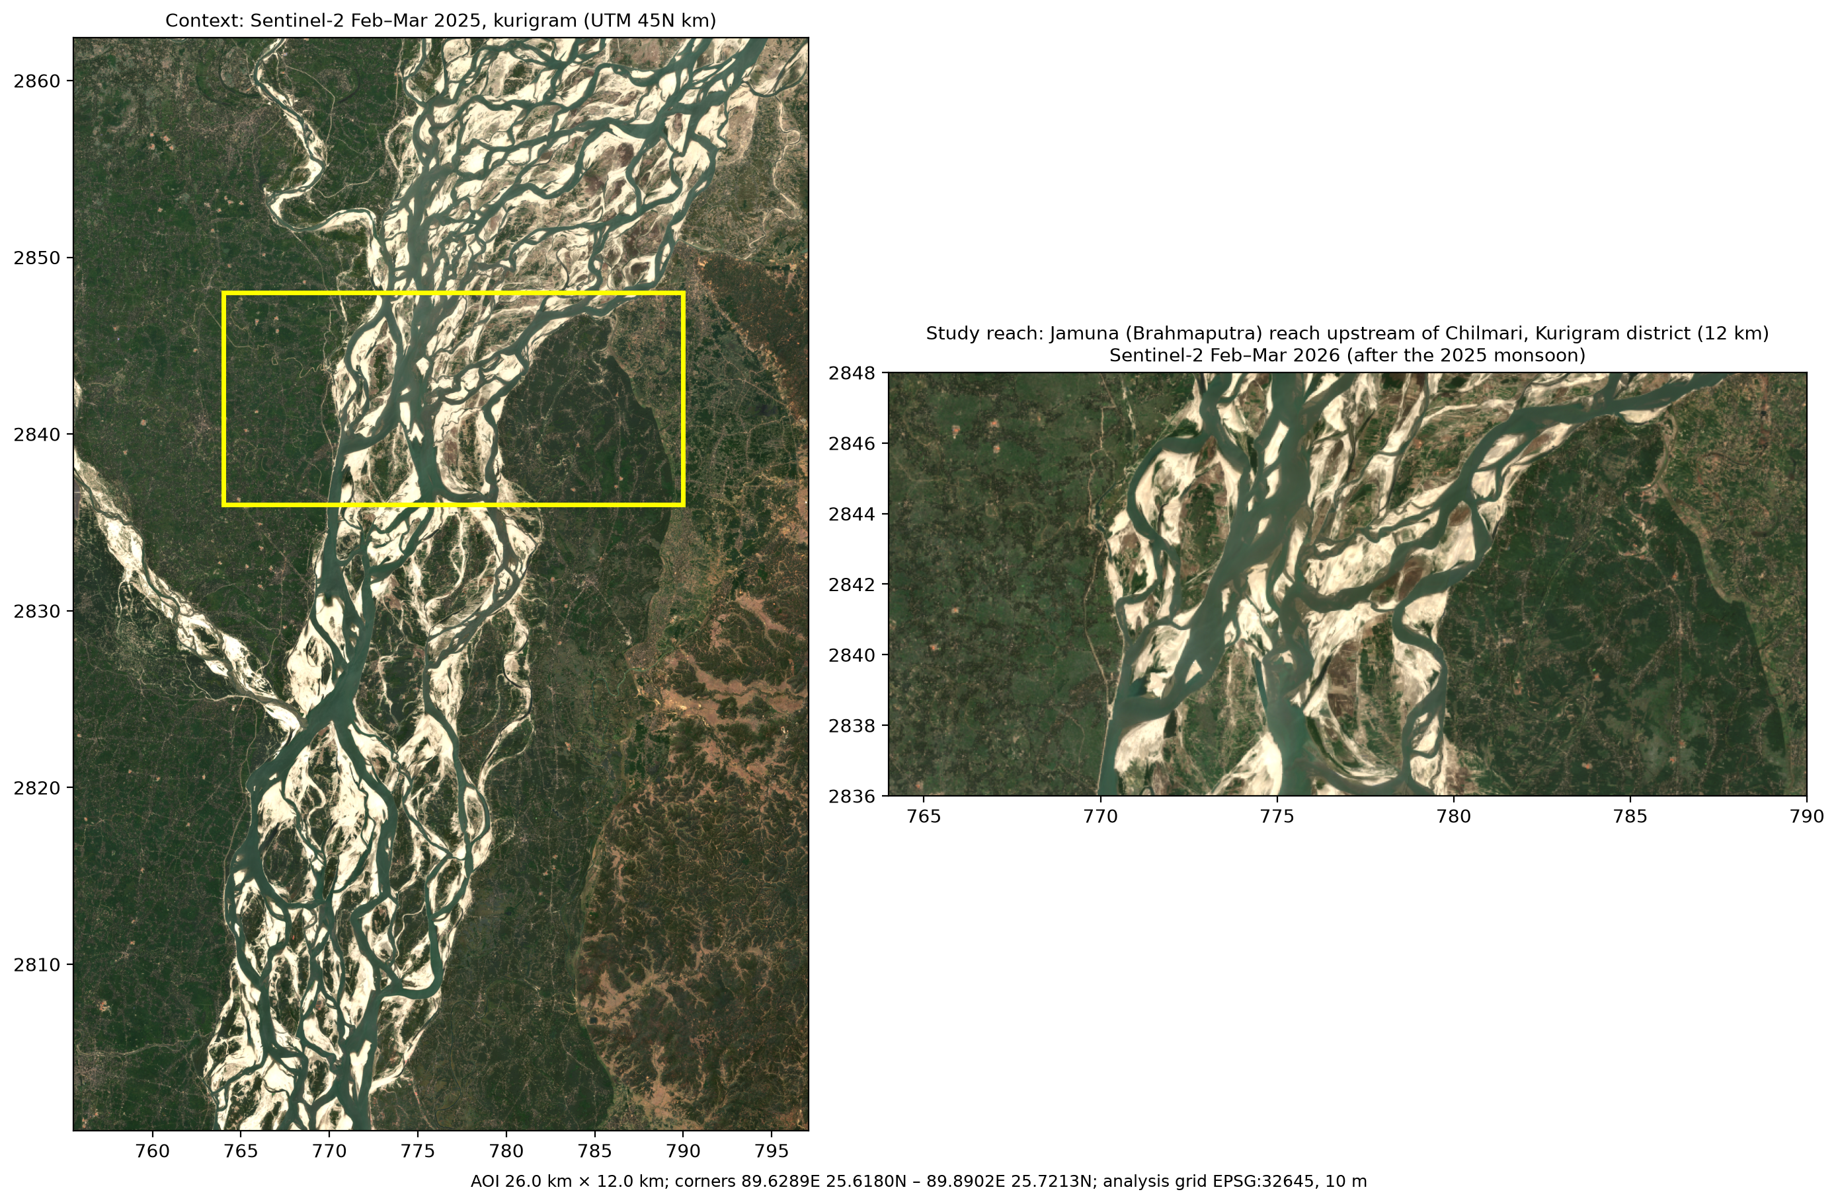
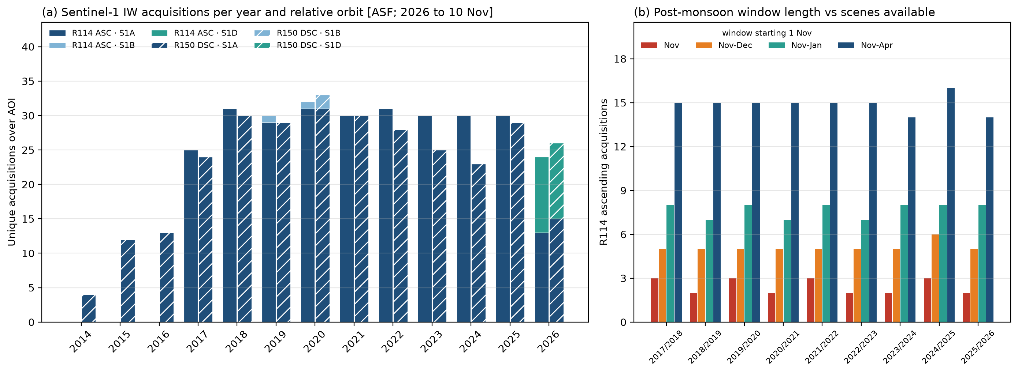
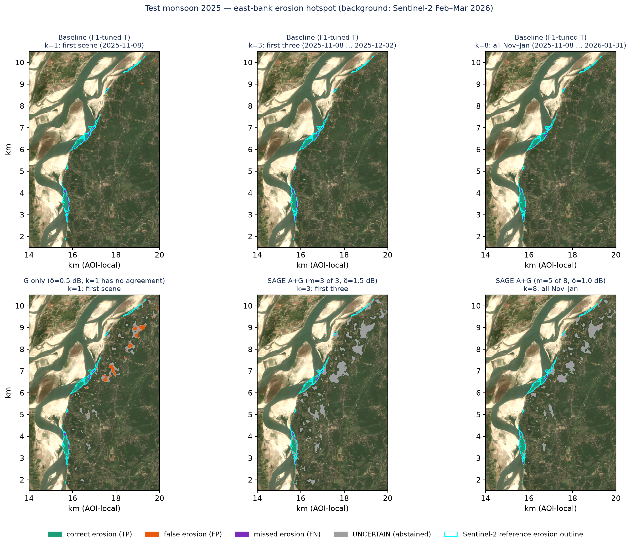
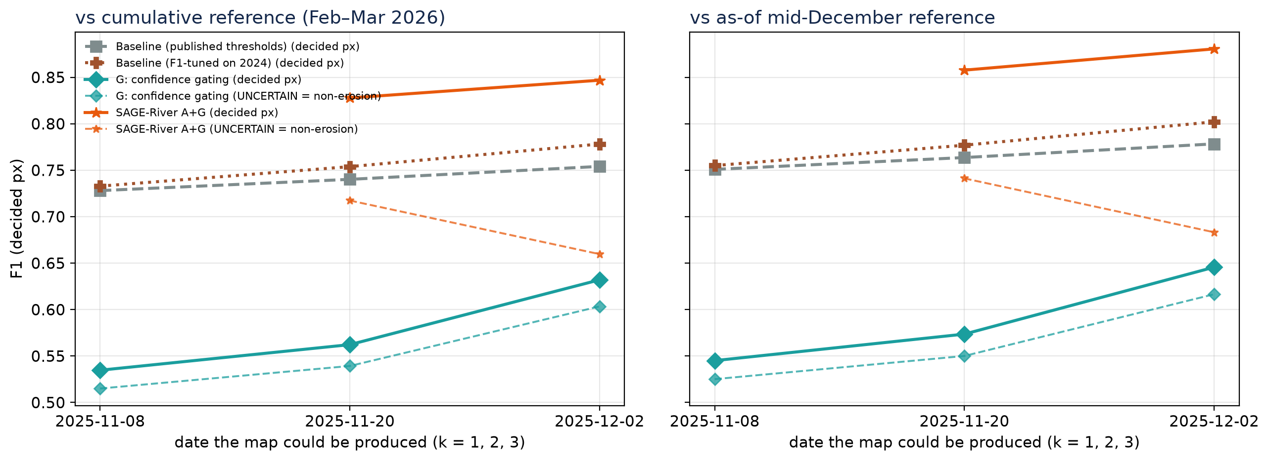
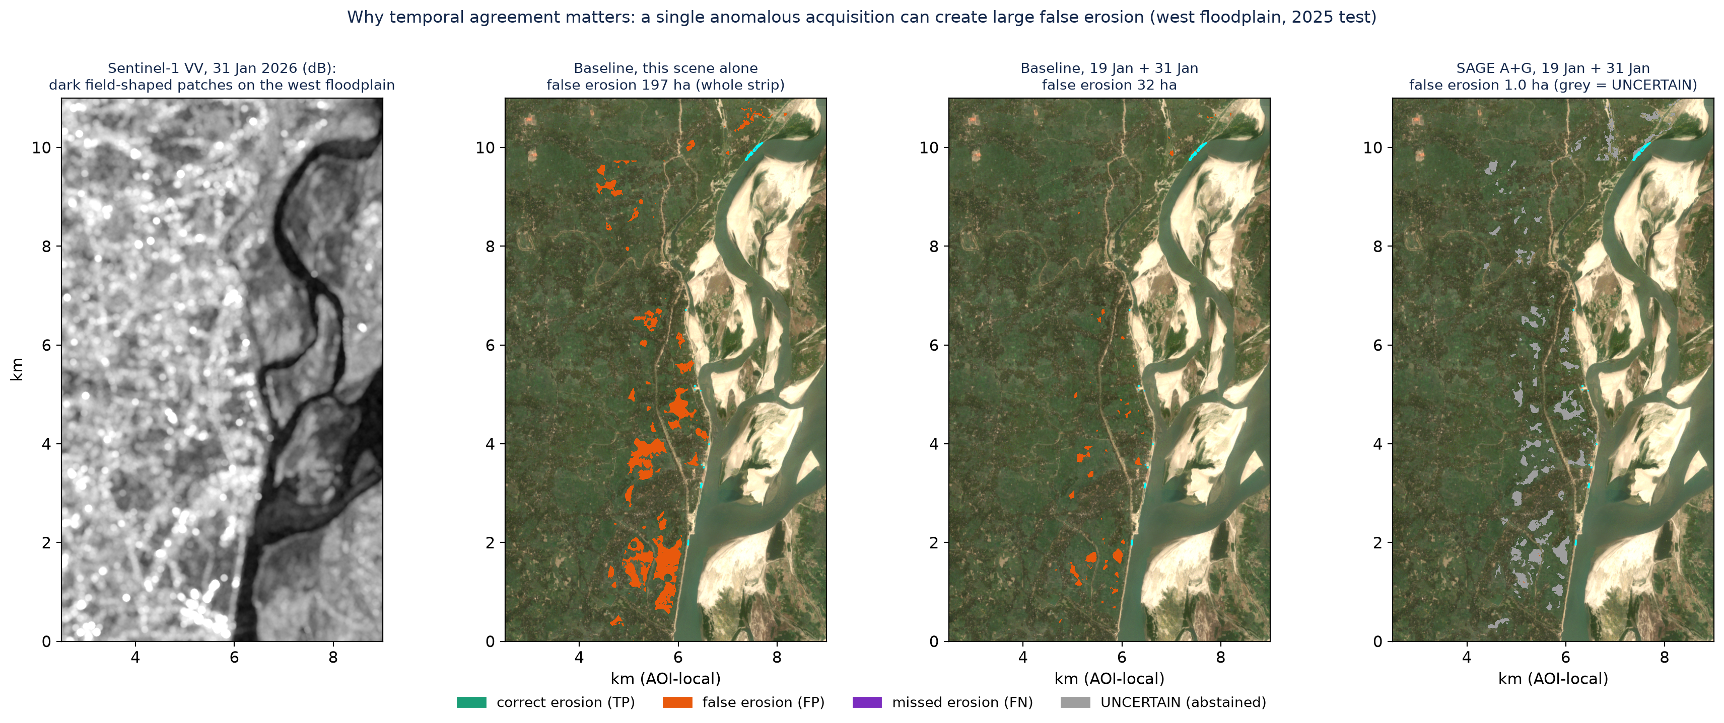
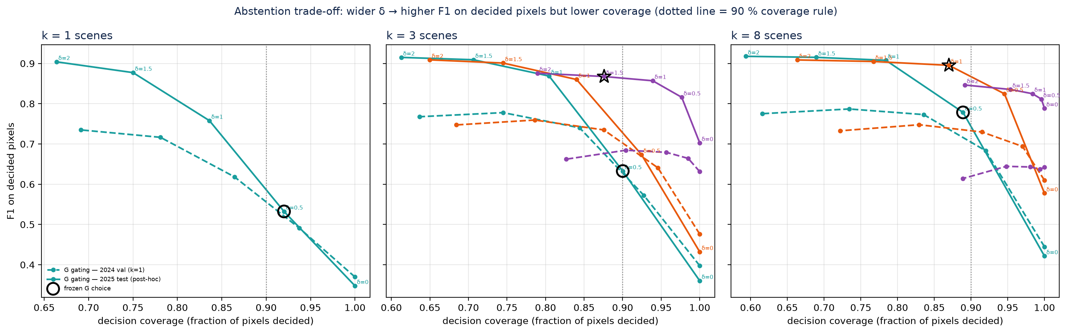
IEEE BUBT ACADEMIC RESEARCH SHOWCASE 2026 · 13–14 NOVEMBER · TRACK 1: INTELLIGENT COMPUTING, AI & DATA TECHNOLOGIES
How Many Sentinel-1 Scenes Are Enough?
Scene-Count Sensitivity and Agreement-Gated Reliability of Post-Monsoon Riverbank Erosion Maps — Jamuna River, Bangladesh
Yassin Bhuyan Alindo [+ team members] · Department of CSE, [University] · alindobhuyan60@gmail.com
KEY MESSAGE 2–3 Sentinel-1 scenes already give stable erosion maps; agreement + abstention removes almost all false erosion and survives a bad scene — but abstains on ~12 % of the bank strip, where 23–36 % of the true erosion lies.
01 ABSTRACT
06 STUDY AREA & DATA
11 RESULTS — TEST MONSOON 2025 (PARAMETERS FROZEN ON 2024)
Sentinel-1 radar maps riverbank erosion through clouds, but a quick post-monsoon map has few comparable scenes: over our 12-km Jamuna reach (Kurigram) only 2–3 ascending scenes each November. We reproduced the Freihardt & Frey (2023) threshold rule and scored every subset of 1–8 post-monsoon scenes (121 maps per method) for the 2025 monsoon against an independent Sentinel-2 reference (58.8 ha of outer-bank erosion), with all thresholds and rules tuned on 2024 only. For the best baselines, mean F1 rose from 0.67–0.70 with one scene to 0.77–0.80 with 3–8 scenes, and false erosion dropped sharply after 2–3 scenes. Adding m-of-k agreement and a ±δ abstention band (SAGE-River) raised F1 on decided pixels to 0.86–0.90 with ≤ 2.4 ha false erosion and resisted an anomalous scene, but left 9–13 % of pixels UNCERTAIN, containing 23–36 % of the true erosion; counting those as non-erosion, it did not consistently beat the tuned baseline. Reliability gains carry a coverage cost that must be reported.
• 12 km Jamuna reach upstream of Chilmari, Kurigram — AOI 26 × 12 km, 25.67°N 89.76°E
• SAR: Sentinel-1 RTC γ⁰ (Microsoft Planetary Computer); VV, IW, orbit 114 ascending, 10 m
• Reference: Sentinel-2 L2A
• Validation monsoon 2024 · test monsoon 2025
07 SENTINEL-1 SCENE AVAILABILITY (FIG. A)
k | Rule | Precision | Recall | F1 | F1 (U = non) | IoU | Coverage | False ha | Missed ha | Abstained ha
1 | Baseline (published T) | 0.81 | 0.64 | 0.70 | 0.70 | 0.55 | 100% | 22.5 | 21.0 | 0.0
1 | Baseline (F1-tuned T) | 0.72 | 0.68 | 0.67 | 0.67 | 0.53 | 100% | 34.1 | 18.8 | 0.0
1 | Baseline (calibrated T) | 0.23 | 0.78 | 0.35 | 0.35 | 0.21 | 100% | 172.7 | 12.8 | 0.0
3 | Baseline (published T) | 0.95 | 0.64 | 0.77 | 0.77 | 0.62 | 100% | 1.9 | 21.0 | 0.0
3 | Baseline (F1-tuned T) | 0.88 | 0.70 | 0.78 | 0.78 | 0.64 | 100% | 5.7 | 17.7 | 0.0
3 | Baseline (calibrated T) | 0.23 | 0.80 | 0.36 | 0.36 | 0.22 | 100% | 162.1 | 11.6 | 0.0
3 | A: unanimous | 0.70 | 0.72 | 0.70 | 0.70 | 0.55 | 100% | 20.6 | 16.4 | 0.0
3 | SAGE-River A+G | 0.98 | 0.78 | 0.87 | 0.66 | 0.77 | 88% | 0.5 | 8.4 | 21.2
8 | Baseline (published T) | 0.96 | 0.64 | 0.77 | 0.77 | 0.62 | 100% | 1.7 | 21.1 | 0.0
8 | Baseline (F1-tuned T) | 0.86 | 0.75 | 0.80 | 0.80 | 0.67 | 100% | 7.5 | 14.5 | 0.0
8 | Baseline (calibrated T) | 0.28 | 0.81 | 0.42 | 0.42 | 0.27 | 100% | 119.8 | 11.1 | 0.0
8 | A: unanimous | 0.96 | 0.67 | 0.79 | 0.79 | 0.65 | 100% | 1.5 | 19.6 | 0.0
8 | SAGE-River A+G | 0.97 | 0.83 | 0.90 | 0.77 | 0.81 | 87% | 1.2 | 7.6 | 13.8
02 REAL-WORLD PROBLEM
• The Jamuna erodes farmland and homesteads every monsoon — CEGIS monitored ~348 ha of Jamuna bank erosion in 2025.
• Post-monsoon maps of lost land help agencies prepare before the next monsoon.
• Radar sees through clouds, but a quick map has few comparable scenes: only 2–3 ascending Sentinel-1 scenes per November (2017–2025) over our reach.
• Speckle, wet sand, flooded fields and lingering floodwater can create false erosion — or hide real erosion.
Means over all C(8,k) subsets (overlapping, not independent). Reference erosion = 58.8 ha. Precision/recall on decided pixels; 'F1 (U = non)' counts UNCERTAIN as non-erosion. Source: outputs/tables/experiment_A_summary_pc.csv
03 EXISTING RESEARCH → GAP
Unique acquisitions over the AOI (ASF catalogue, cross-checked with Planetary Computer). Few scenes = orbit geometry and time window, not clouds. Sentinel-1B added only 4 scenes; Sentinel-1D replaced 1A in July 2026.
12 MAPS (EAST-BANK HOTSPOT) AND EARLY MAPS
Study | What it did | Missing for our question
Freihardt & Frey 2023 (NHESS) | Sentinel-1 + GEE threshold erosion maps, Jamuna; window & filter effects on backscatter; land-cover OA 87.5–90.6 % | Erosion-map accuracy vs scene count; erosion checked visually only
Shampa et al. 2025 (Front. Earth Sci.) | Delft3D erosion early warning, Brahmaputra–Jamuna | Forecasting task; no SAR
CEGIS (annual report) | Operational erosion prediction from Landsat | 30 m; not a SAR reliability test
MCDWD · RADD · GFM · Li et al. 2026 | m-of-k confirmation / abstention in flood & forest products | Not tested for riverbank erosion maps
08 BASELINE & SAGE-RIVER
Sentinel-1 VV · R114 asc
angle 30–45° · circle r=7 (linear) → dB
Pre composite
mean Nov–Apr (dry season)
Post scenes
k of 8 (Nov–Jan)
Early maps (Exp. B): maps possible on 8 Nov, 20 Nov and 2 Dec 2025 reached F1 0.73, 0.75 and 0.78 (tuned baseline, full coverage). A+G reached 0.83–0.85 on decided pixels but only 0.66–0.72 with UNCERTAIN counted as non-erosion. 95 % of the reference erosion was already visible by mid-December, so later erosion barely affected early maps.
BASELINE
(F&F 2023)
pre > T_pre AND
mean(post) < T_post
A: AGREEMENT
≥ m of k scenes
below T_scene
G: GATING
|value − T| ≤ δ dB
→ UNCERTAIN
SAGE A+G
per-scene ±δ votes
+ m-of-k
Output per pixel: EROSION · NON-EROSION · UNCERTAIN (abstained — always counted in coverage)
Gap: to our knowledge, no reviewed study measured erosion-map accuracy across Sentinel-1 scene budgets with agreement + abstention + coverage reporting, against an independent optical reference.
Sentinel-2 reference
veg → sand/water, channel-connected
Score on outer-bank strip
P, R, F1, IoU on decided px + coverage
13 WHY AGREEMENT MATTERS: ONE ANOMALOUS SCENE
S (season matching) is part of the baseline — a common control, not claimed as new. Gating is an abstention rule, not a calibrated probability.
04 RESEARCH QUESTIONS
09 EXPERIMENTAL DESIGN & INTEGRITY
RQ1 How do Precision, Recall, F1, IoU change as scenes decrease (k = 8 → 1)?
RQ2 Does m-of-k agreement cut false erosion, and at what recall cost?
RQ3 Does abstaining near the threshold raise precision — and how much coverage is lost?
RQ4 Timeliness vs reliability of maps from the first 1–3 scenes after 1 Nov.
• All tuning on 2024 only (thresholds; m and δ by F1 with coverage ≥ 90 %), frozen with a timestamp, then ONE test on 2025
• Fairness control: a baseline whose thresholds are tuned on the same 2024 erosion F1
• Exp. A: all C(8,k) subsets of the Nov–Jan pool, k = 1, 2, 3, 6, 8 (121 maps per rule)
• Exp. B: first 1, 2, 3 scenes after 1 Nov — no future scenes; same reference & domain for every rule
05 INDEPENDENT REFERENCE & CHECK
10 ABSTENTION TRADE-OFF (FIG. F)
14 KEY FINDINGS · CONTRIBUTIONS · LIMITATIONS
• Sentinel-2 L2A (different sensor): vegetated (NDVI ≥ 0.30) in Feb–Mar before → water (MNDWI ≥ 0) or bare sand (NDVI < 0.20) in the next Feb–Mar, connected to the channel, in a 1.5 km outer-bank strip.
• Visual check of 120 stratified points (blind to label): 36/39 reference-erosion points truly eroded (92 %); 47/47 near-bank non-erosion points correct (100 %). AI-interpreted; team spot-check pending.
• An optical reference — NOT field ground truth.
Findings
More scenes → fewer false alarms: published-rule false erosion fell from 22 ha (1 scene) to 2 ha (3 scenes); F1 plateaued (0.77) after 3 scenes.
SAGE A+G: decided-pixel F1 0.86–0.90, ≤ 2.4 ha false erosion — but 9–13 % abstained, holding 23–36 % of true erosion.
UNCERTAIN counted as non-erosion: A+G 0.66–0.77 vs tuned baseline 0.73–0.80 → no consistent full-coverage gain (only k=2: 0.74 vs 0.73).
One anomalous scene (31 Jan) gave 197 ha false erosion with the tuned baseline (150 ha published); 2-scene A+G maps containing it stayed at ~1 ha.
Contributions
Erosion-map-level scene-budget benchmark (121 scene subsets, up to 7 decision rules) of the published Sentinel-1/GEE method against an independent Sentinel-2 reference.
Agreement + abstention rules reported with coverage and abstained-erosion area — no hidden pixels.
Threshold choice dominates: class-separability thresholds gave F1 0.35–0.42; erosion-tuned or published ones 0.67–0.80.
Open, reproducible pipeline (Python + GEE scripts, CSVs, frozen parameters).
Limitations
One 12-km reach and one test monsoon; Sentinel-2 is an optical reference, not field truth (visual point check: 92 % / 100 % agreement, AI-interpreted, team spot-check pending).
SAR from Planetary Computer RTC γ⁰ (Earth Engine σ⁰ not run: no project ID); 2024 pool had 6 of 8 scenes.
Coverage target (≥ 90 %, set on 2024) fell to 87–88 % in 2025 for k ≥ 3; overlapping subsets are not independent samples.
Historical mapping only — no forecasting, no PINN.
REFERENCES [1] Freihardt & Frey (2023) NHESS 23:751–770, doi:10.5194/nhess-23-751-2023 · [2] Freihardt & Frey (2022) code, doi:10.5281/zenodo.7253121 · [3] Shampa et al. (2025) Front. Earth Sci. 13:1570577, doi:10.3389/feart.2025.1570577 · [4] Aishi & Fahim (2024) GNHR 15:2399668, doi:10.1080/19475705.2024.2399668 · [5] Langhorst & Pavelsky (2023) JGR-ES 128:e2022JF006774 · [6] CEGIS (2026) Prediction of Riverbank Erosion 2026, cegisbd.com/news/3011 · [7] Reiche et al. (2021) ERL 16:024005 · [8] Krullikowski et al. (2023) IEEE JSTARS 16:6917 · [9] Li, Matgen & Chini (2026) IEEE TGRS 64:4202520 · [10] Peña-Luque et al. (2021) Remote Sens. 13:3279 · Data: Copernicus Sentinel-1/2 (ESA) via Microsoft Planetary Computer, ASF.
Corresponding author: Yassin Bhuyan Alindo · alindobhuyan60@gmail.com
Code, data & CSVs: SAGE-River/ (README)
Sentinel-2 is an optical reference, not field ground truth.

