Slide 1
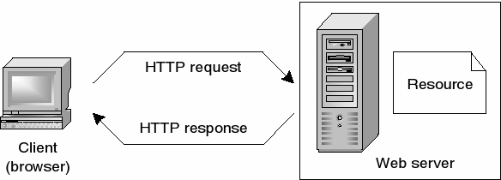
How does the web work? What do you need to be a web developer? To become a Web Developer, you should have an understanding of HTML, CSS, and JavaScript. It's also recommended to learn about CSS and CSS frameworks. Developing these fundamental web development skills will give you the foundation and logic for communicating with programming languages. Why did you choose to learn web development? I chose to learn web development because I looked at it on the Internet and liked it. I told myself that I could study it and succeed in it and work because it is a field that is in great demand in the labor market and my friends are in the same field and they advised me about it
checkpoint

