Slide 1

KAKATIYA INSTITUTE OF TECHNOLOGY& SCIENCE (An Autonomous Institute under Kakatiya University, Warangal) DEPARTMENT OF COMPUTER SCIENCE AND ENGINEERING (NETWORKS) U18EI312(FUNDEMENTALS OF INTERNET OF THINGS) PROJECT
SMART BIOMETRIC DOOR LOCK USING ARDUINO
PRESENTED BY :
G.BANTI(B21IN056)
SRI SAI RAO(B21IN022)
K.SRI VAISHNAVI(B21IN053)
YASSIN(B21IN060)
S.PRANITHA(B21IN063)
SHARFUDDIN(B21IN069L)

Slide 2
01
OBJECTIVES
INTRODUCTION
02
EXPERIMENTAL WORK
03
MERITS & DEMERITS
04
CONCLUSIONS
05

Slide 3
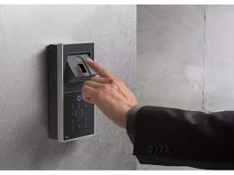
OBJECTIVES
To implement a system with biometrics .
To develop a smart door lock system using a fingerprint sensor to open and close the door.
To implement smart door lock using a normal and simple door lock which is fitted in every home so as to minimize the cost of the device as a product.

Slide 4

02
INTRODUCTION
.

Slide 5
Security has become the primary concerned of most individual in this new era. This paper is about solving the problem regarding security of unauthorized people trespassing in our home, shops or offices. Security issues can be fixed using traditional locks but there is always possibility of someone opening the lock even without breaking it with the use of duplicate key So, in this project we will implement a system using biometrics. In case of biometrics, the pattern which will be used as key will be unique. Here, to implement the project we will use fingerprint as the key. This arduino project will make use of different devices for the implementation of the security lock where there will be different features to increase the security level. In simple words, we can say that we are implementing a door access system using arduino which make use of fingerprints to identify whom to allow and who not to allow inside our homes, offices, shops, etc. We are trying to implement it using a normal and simple door lock which is fitted in every home so as to minimize the cost of the device as a product.

Slide 6
EXPERIMETAL WOKS
01
03
02
04
Experimental procedure
Components
Methodology
Circuit diagram

Slide 7
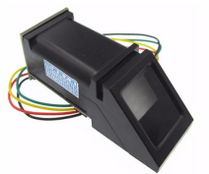
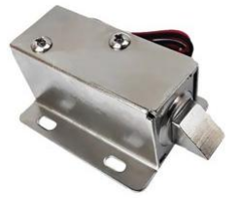
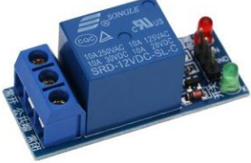
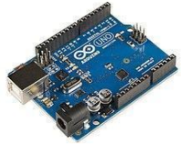
COMPOMENTS
SOFTWARE
FINGER PRINT SENSOR
ARDUINO IDE
SOLENOIDAL LOCK
HARDWARE
ARDUINO UNO
REALY MODULE
JUMPER WIRES

Slide 8
Experiment procedure
STEP 1: Take a cardboard as the body or base for the project
STEP 2: Place solenoidal, Arduino uno fingerprint sensor,relay module and fix them on the cardboard
STEP 3: Connect the fingerprint sensor wires to the Arduino uno.
Connect red wire of sensor to 5v on Arduino and black to ground yellow to D2 pin and green to D3 pin on Arduino uno . STEP 4: connect relay module signal pin to D4, relay module positive pin to 5volts , realy module ground to ground on Arduino uno. STEP 5:connect solenoid lock and battery to relay module as per the circuit diagram.

Slide 9
HARDWARE IMPLEMENTATION
FINGERPRINT SENSOR(R305)
fingerprint sensor, R305 uses unique biological features to take images and can store up to 128 images which reduces fraud and saves time. This device provides better security by raising alarm and indication for an emergency condition. This system can be installed in Defence offices, intensive care units (ICUs), childcare units (CCUs) and research laboratories.
The design of security door lock using the fingerprint technology was built around ARDUINO UNO, which reads in fingerprints from fingerprint scanner and grant access, to a protected compartment, only to pre-registered fingerprints. The fingerprint scanner serves as the main input into this embedded security system. Fingerprints read are compared to those ones pre-programmed into the memory of the microcontroller. When a match is made, the microcontroller outputs a HIGH which activates the transistor-relay switching stage that controls opening and closing of the modelled motorized door granting access into the protected building.

Slide 10

METHODOLOGY
First the fingerprint is enrolled on the sensor then the sensor processes the data if the enrolled finger print is already stored and if id matches then the door unlocks. If not the door remains locked.
In this project fingerprint processing includes two parts finger point enrolment and finger print matching. when enrolling, user needs to enter the finger image two time. The system will process the finger images, generate a template of the finger images based on processing results and store the template. When matching user enters the finger through optical sensor and system will generate a template of the finger image and compare it with templates present in the finger library.

Slide 11
BLOCK DIAGRAM
FINGERPRINT SENSOR
ARDUINO UNO
SOLENOID LOCK
SINGLE CHANNEL RELAY MODULE
DOOR LOCK

Slide 12

ALOGORITHM
FINGERPRINT SENSOR
PLACE BIOMETRIC
Send fingerprint id to Arduino
If biometric match
Yes
No
Send command to solenoid lock
Remains locked
Lock unlocks

Slide 13
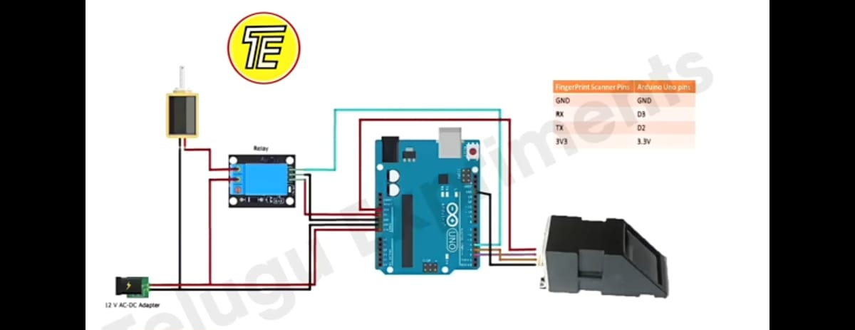
CIRCUIT DIAGRAM

Slide 14
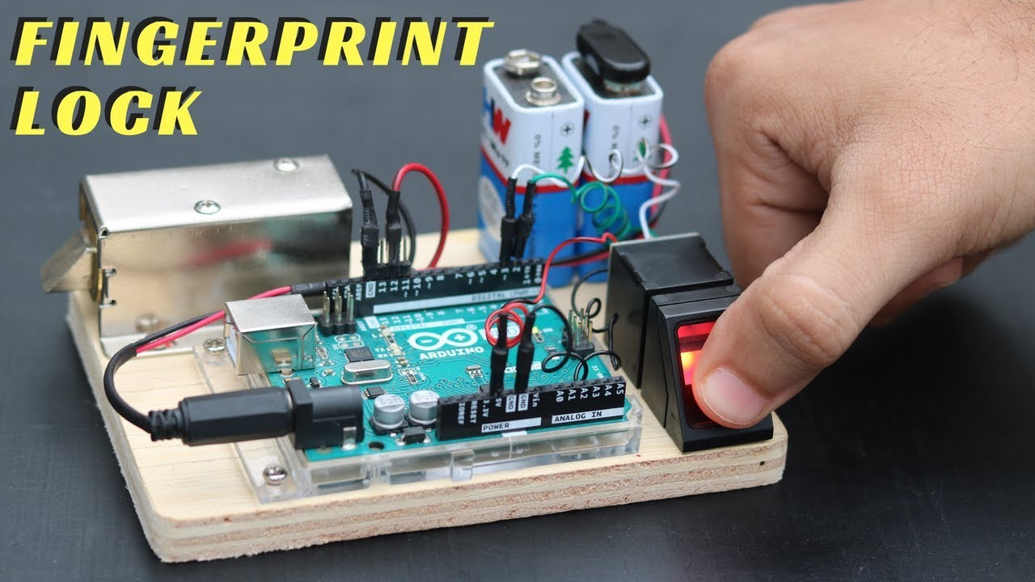
Implementation of biometric door lock

Slide 15
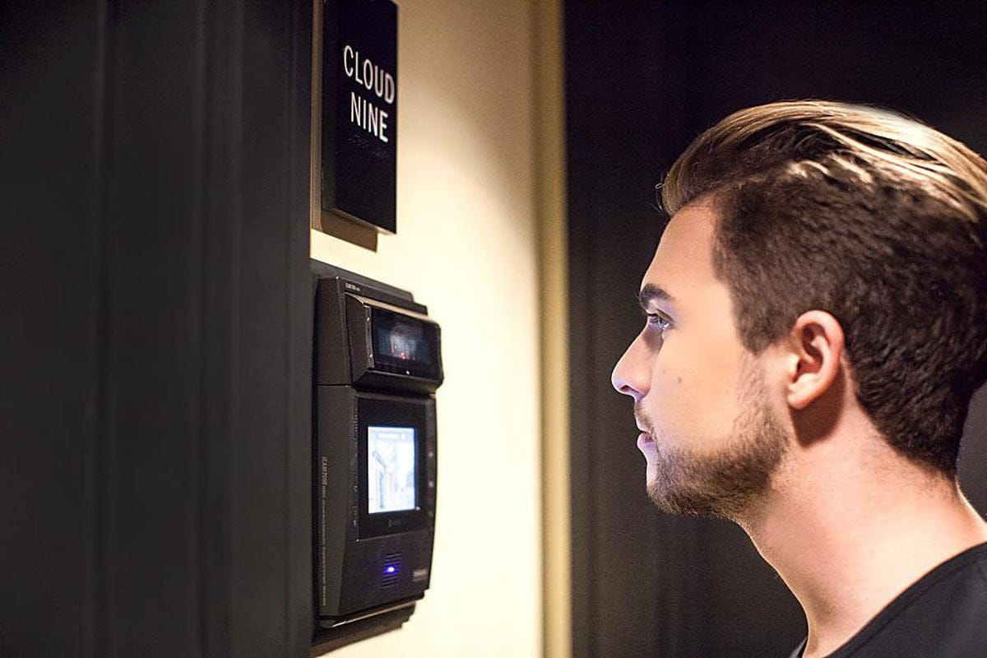
Extensions…
For future work, some extension can be made like, addition of cameras for taking a snapshot for a negative match result.
A GSM module can be added which enables the user to operate the system through mobile and can also unlock the door using mobile.
Retina scan security system can also be added for better security purpose.

Slide 16

MERITS & DEMERITS
DEMERITS
SECURITY
REPLACEMENT WILL BE A PAIN
USER FRIENDLY
MERITS
NO RISK OF MISPLACING
POWER FAILURE
FALSE POSITIVES ARE COMMON
COST EFFECTIVE
EVERYONE CAN ENROLL
POSSIBLE DANGER TO USER
DIFFICULTY IN OVERRIDING
AESTHETICS

Slide 17

CONCLUSION
The biometric fingerprint system provides good solution to the security. This project demonstrates to detect the fingerprint using R305, Arduino Uno and Arduino (IDE). The cost of this technology is very economical. The overall implementation cost is affordable by a common person. This system is designed to improve the security system. It provides accurate finger recognition results eliminating the error where possible. The whole system can be fabricated as economic commercial hardware package.

Slide 18
REFERENCES
[1] Malabika Sarma has presented the Fingerprint Based Door Acess using Arduino.
[2] Sai K Yashwant has presented the iLock: State-of-the-art Sophisticated Door Lock for Wireless Devices
[3]Anu, Bhatia D. A smart door access system using finger print biometric system. International Journal of Medical Engineering and Informatics 2. 2014 Jan 1;6(3):274-80.

Slide 19
THANKYOU…

