Slide 1


Quantum Maxwell decoder for CSS codes
Bruno Costa Alves Freire^{1,2}, François-Marie LE RÉGENT¹, Anthony LEVERRIER²
¹Pasqal - QEC team
²COSMIQ - Inria Paris
arXiv:2601.10713

Slide 2
Outline
Motivation
qLDPC, erasure channel, iterative decoding
Key takeaways:
Tunable decoder:
Reproduce ML performance, or
Approximate ML with linear complexity
Background
ML decoding (Gauss. elim.)
Peeling, (bonus: pruned-peeling, VH)
Tanner graphs, Stopping sets, Dangling checks & bits
Maxwell decoder
Guessing mechanism (symbolic, branching)
Guess validation (pivot demotion, branch cutting)
Example execution
Numerical results
HGP, BB, QT, pruning, strategy, regularity (?)
Theoretical results
Complexity O(|E| G² d_{v} d_{c})
Guessing budget vs distribution gap

Slide 3
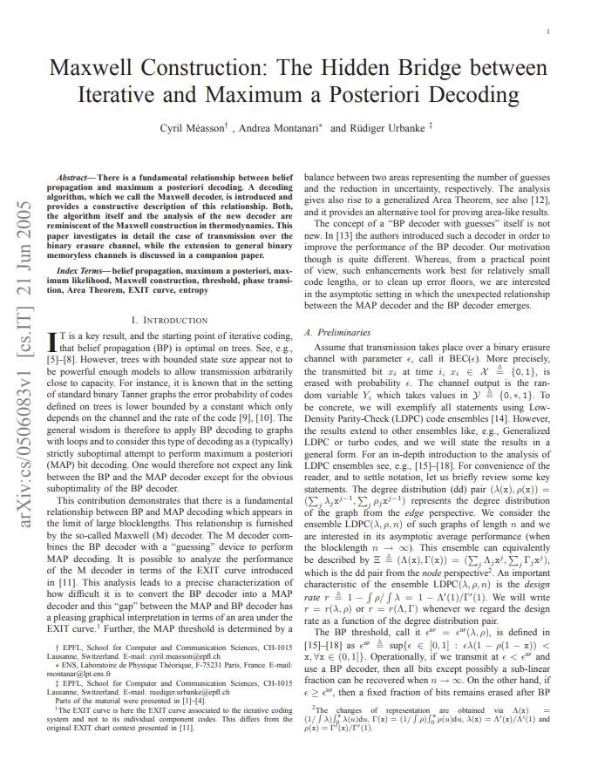
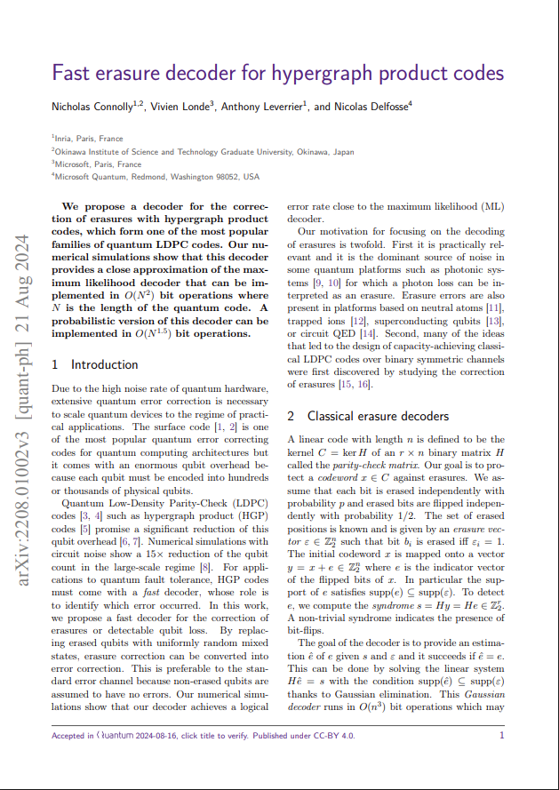
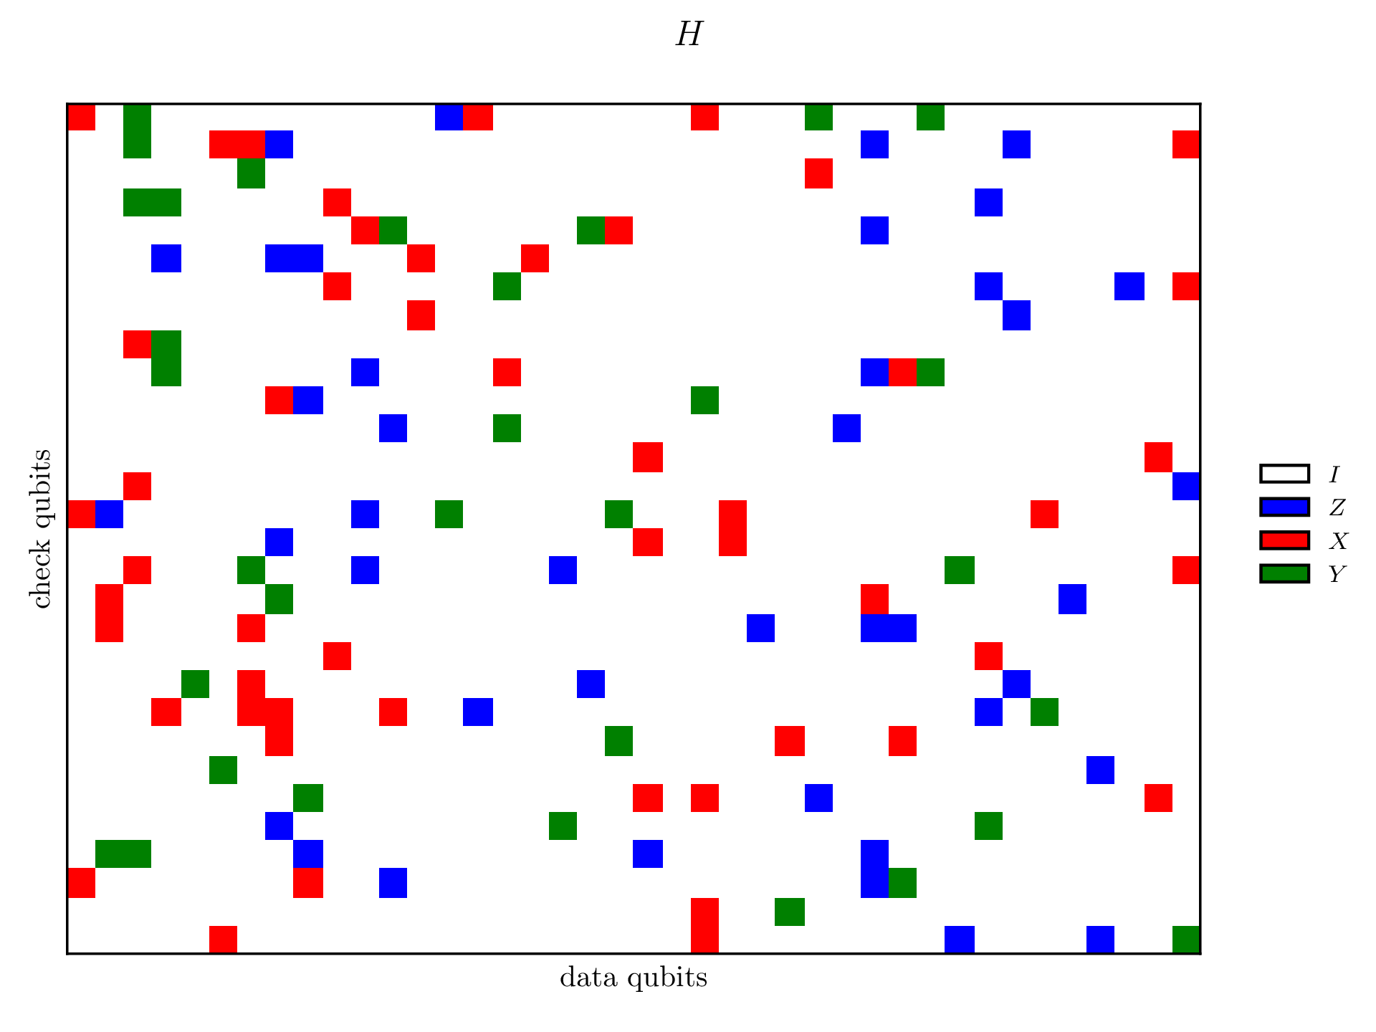
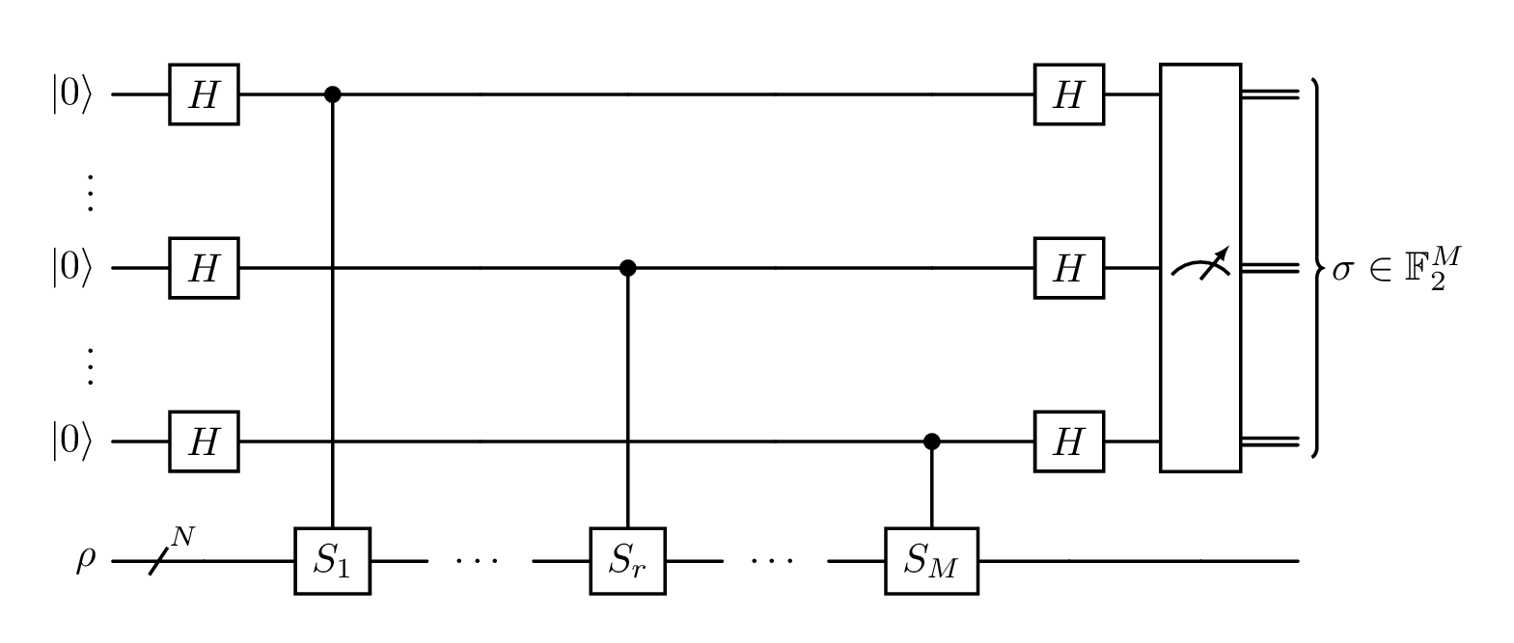
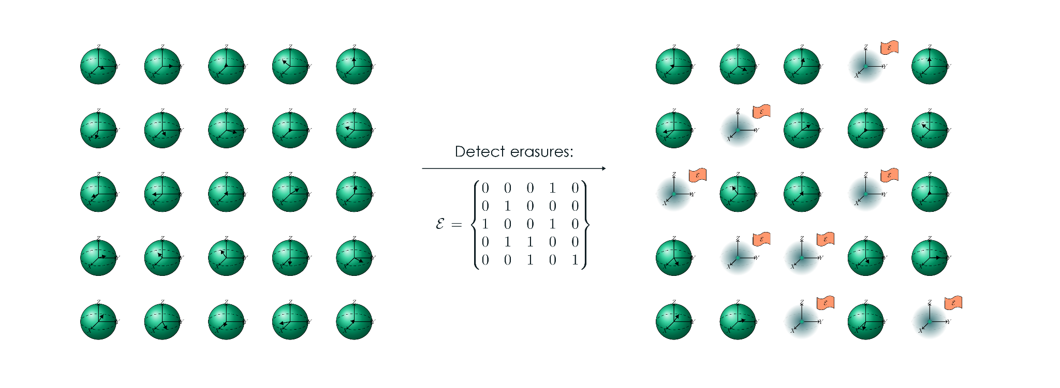
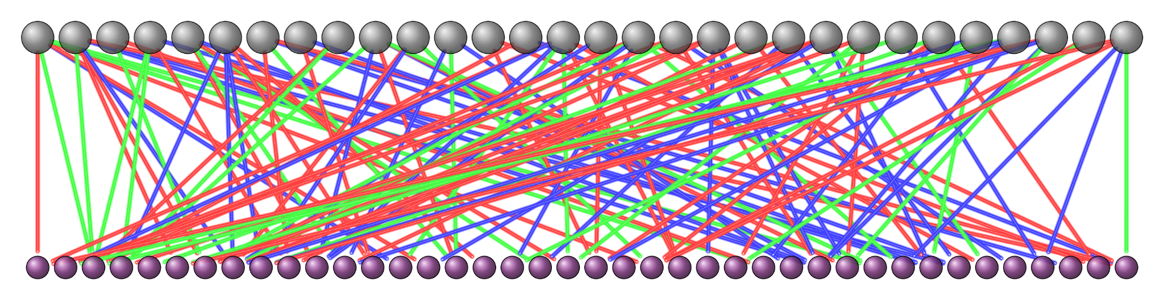
Motivation
Quantum LDPC codes for the quantum erasure channel
qLDPC -> low overhead QEC -> Gottesman's FTQC
Erasure channel
Toy model: proxy for more realistic models
Erasure conversion: relevant for neutral atoms
Iterative decoding
Fast erasure decoder for hypergraph product codes¹
Many ideas + VH decoder
Gap between iterative and ML decoder
Key takeaway:
Tunable decoder interpolating BP and ML
Trade-off between linear complexity and optimal performance
Our new algorithm
Based on the classical Maxwell decoder²
Adapted to the quantum CSS case

Slide 4

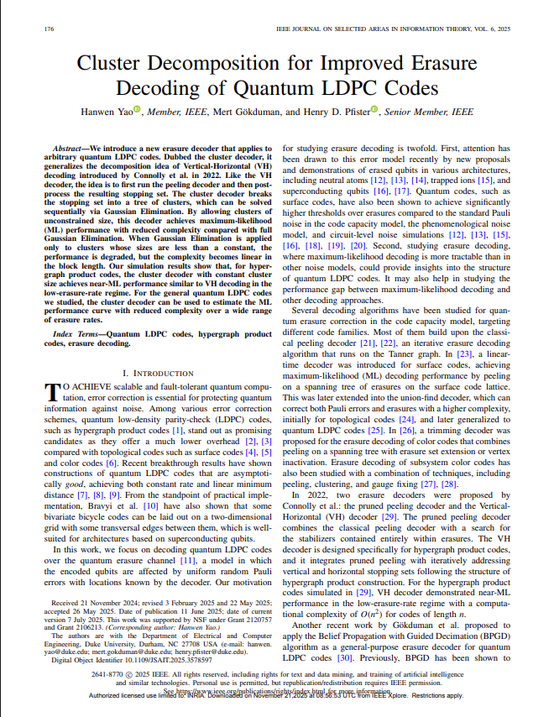
Classical setting: source material

Slide 5
Algorithm description

Slide 6
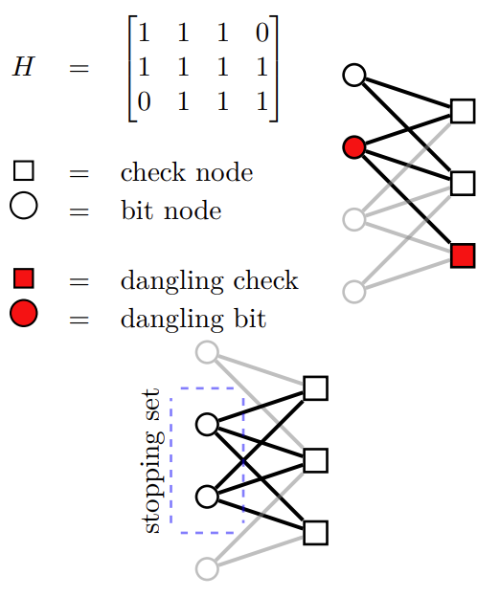
Core concepts
Tanner graphs and stopping sets
Dangling checks and bits
Guessing
Guess validation

Slide 7
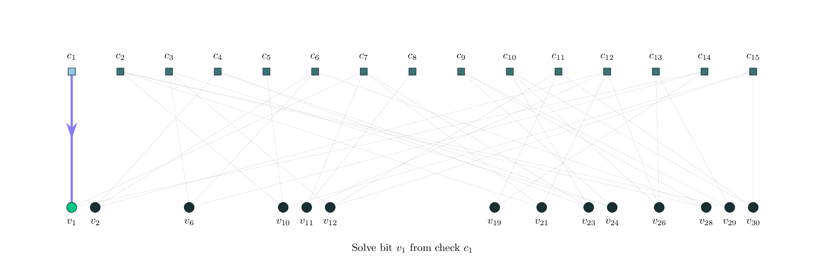
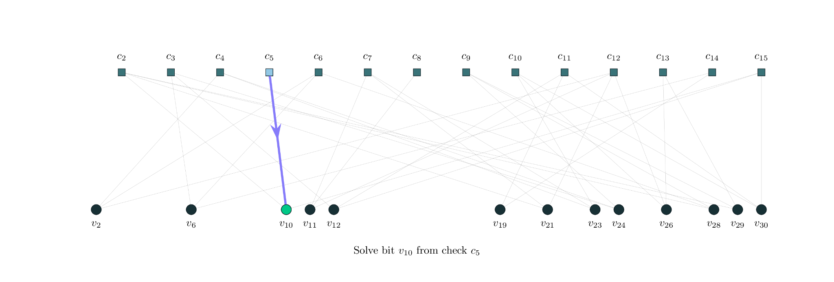
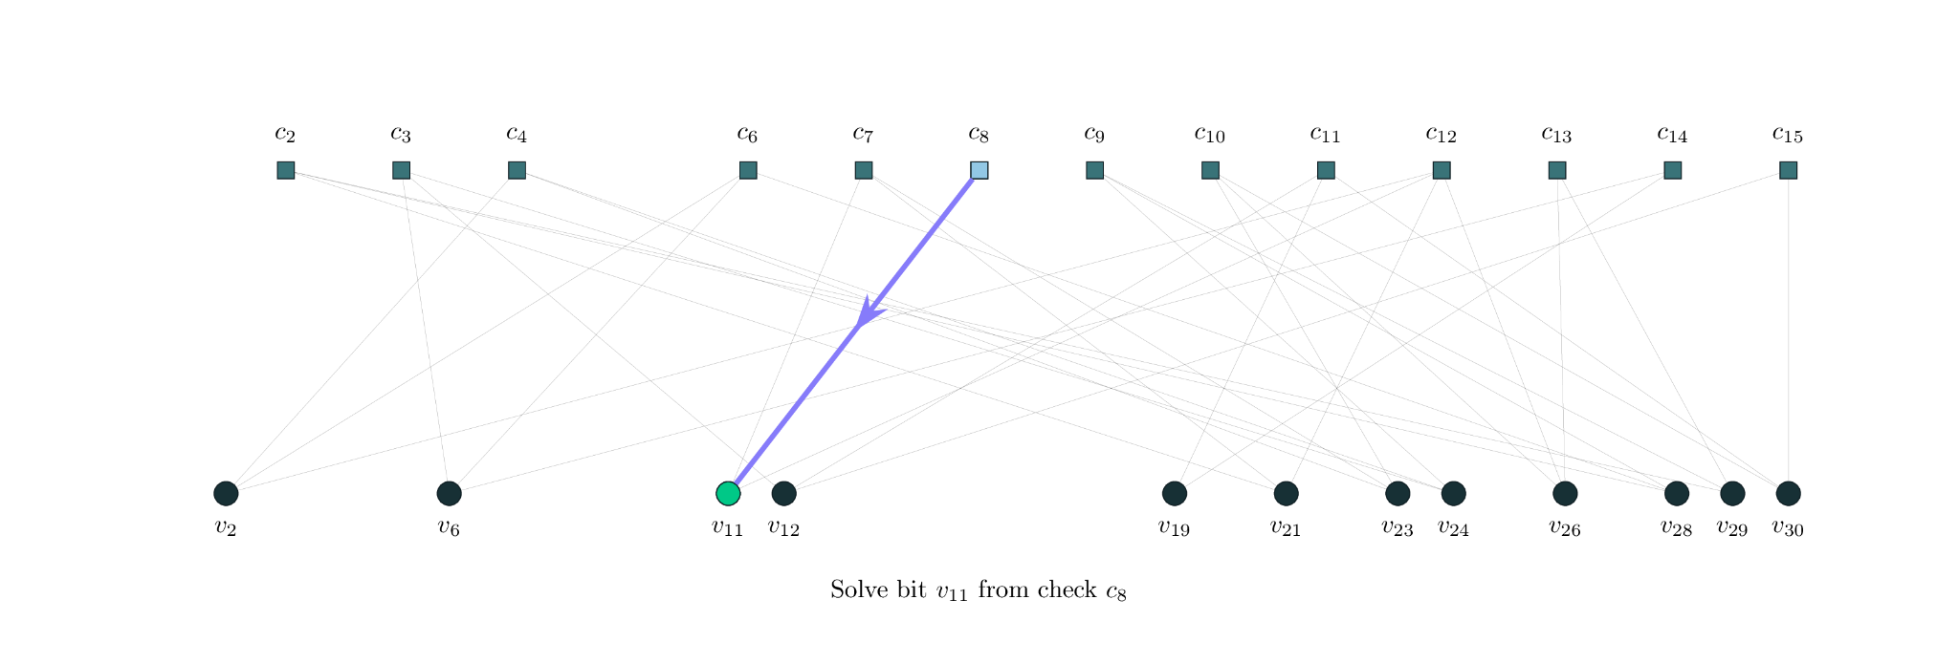
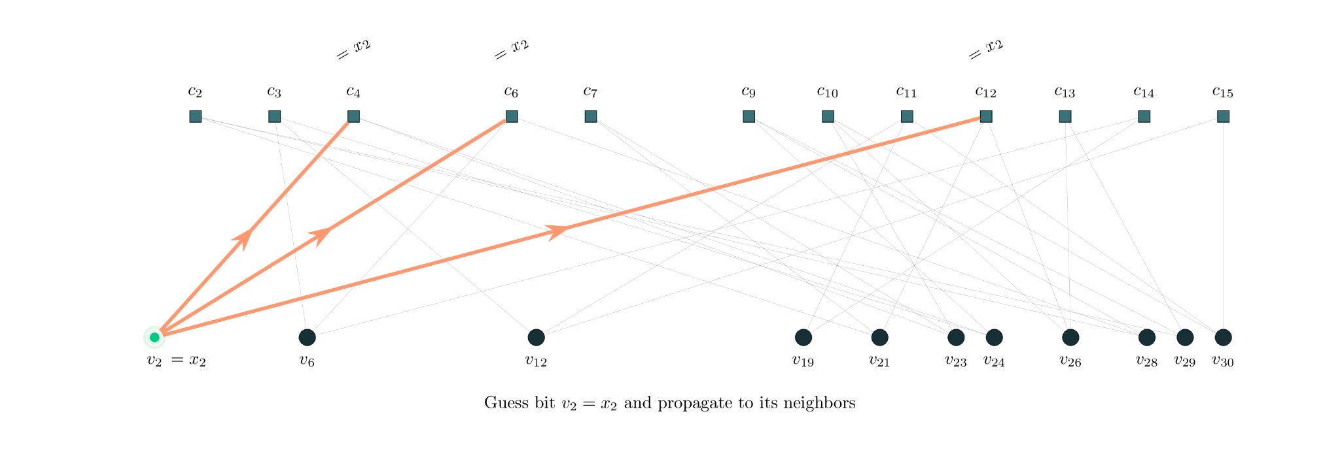
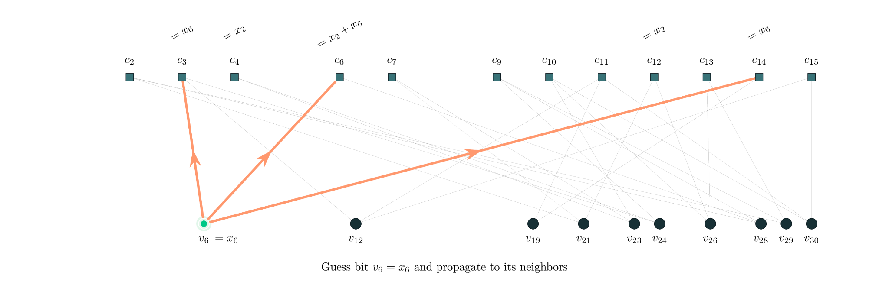
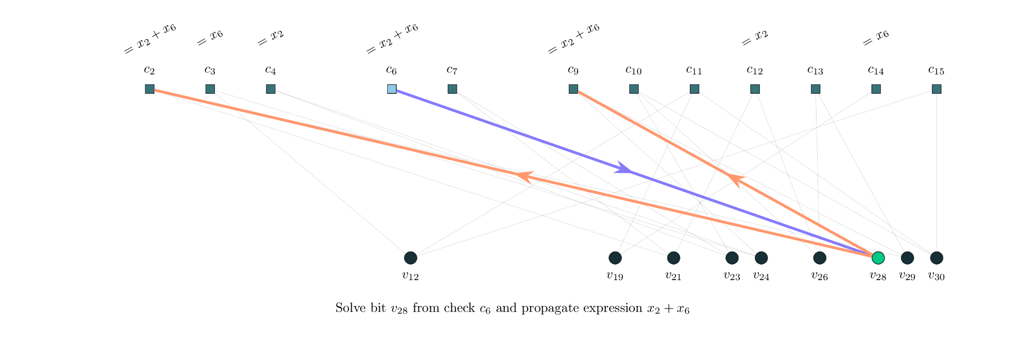
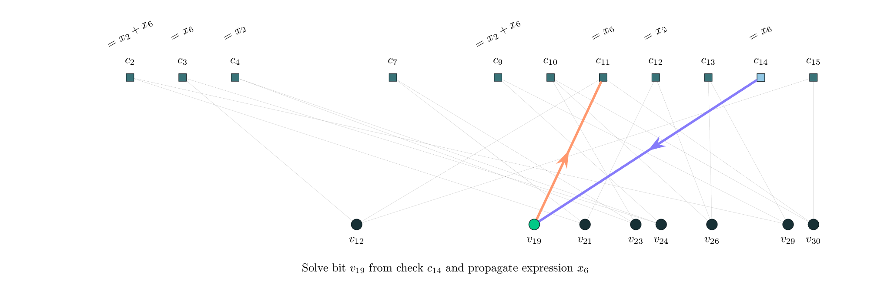
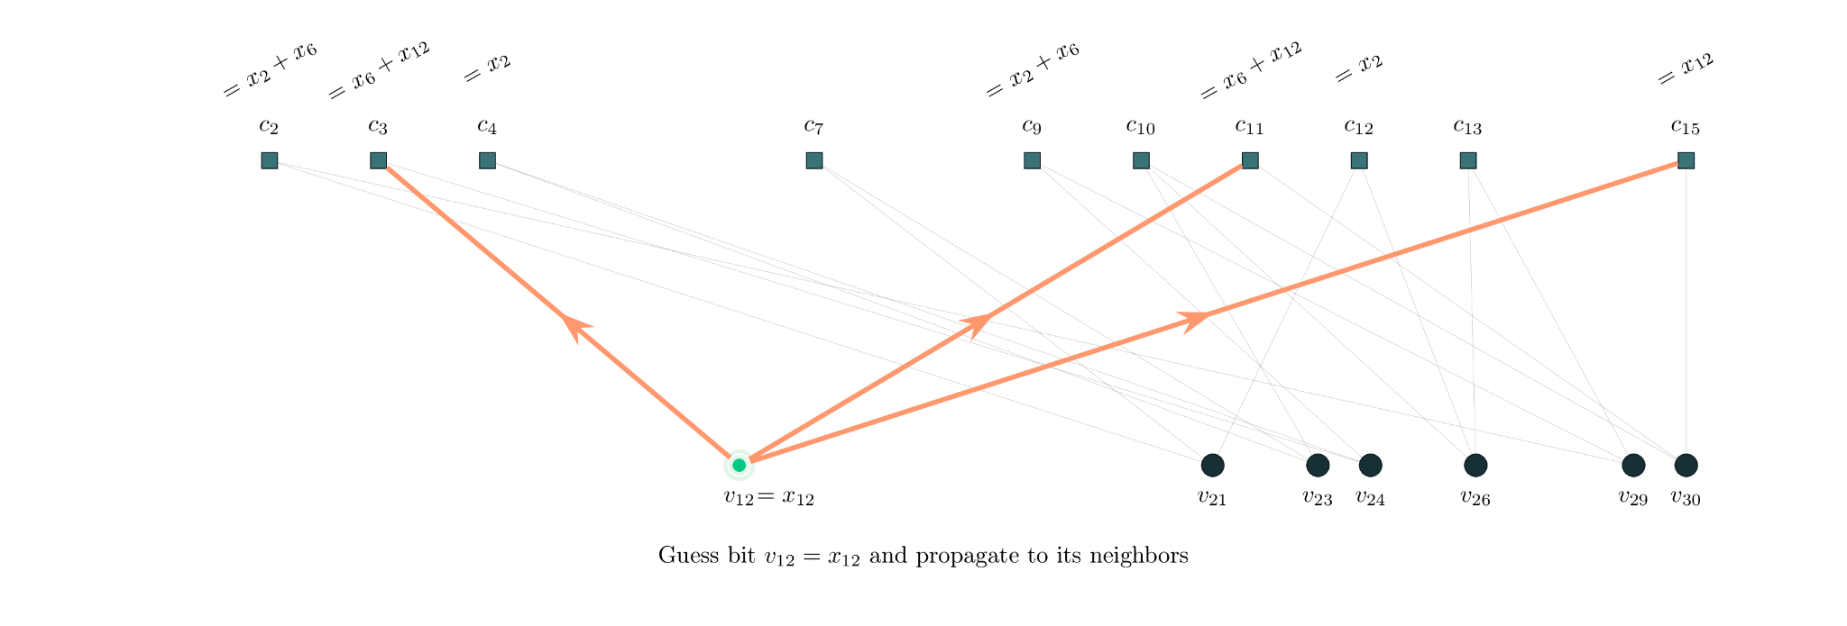
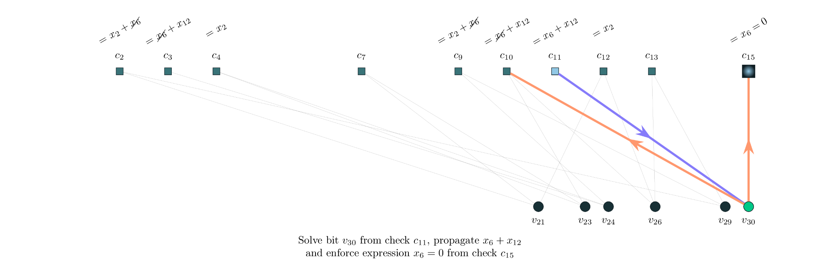
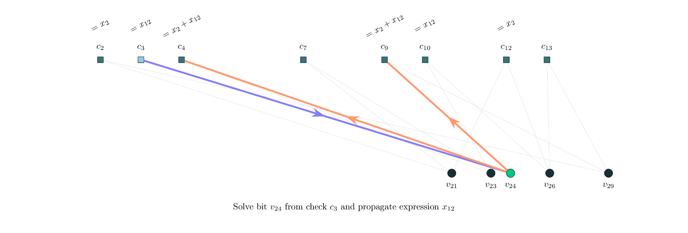
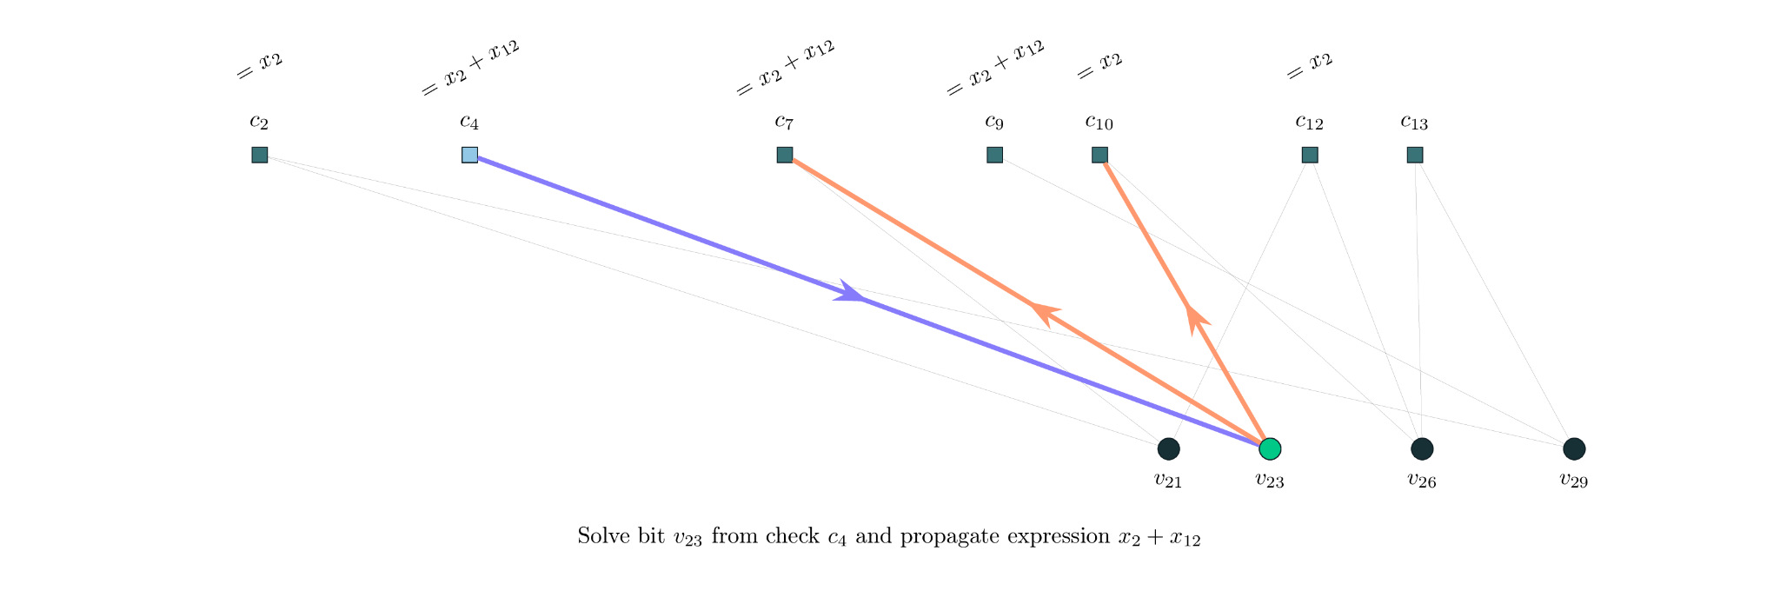
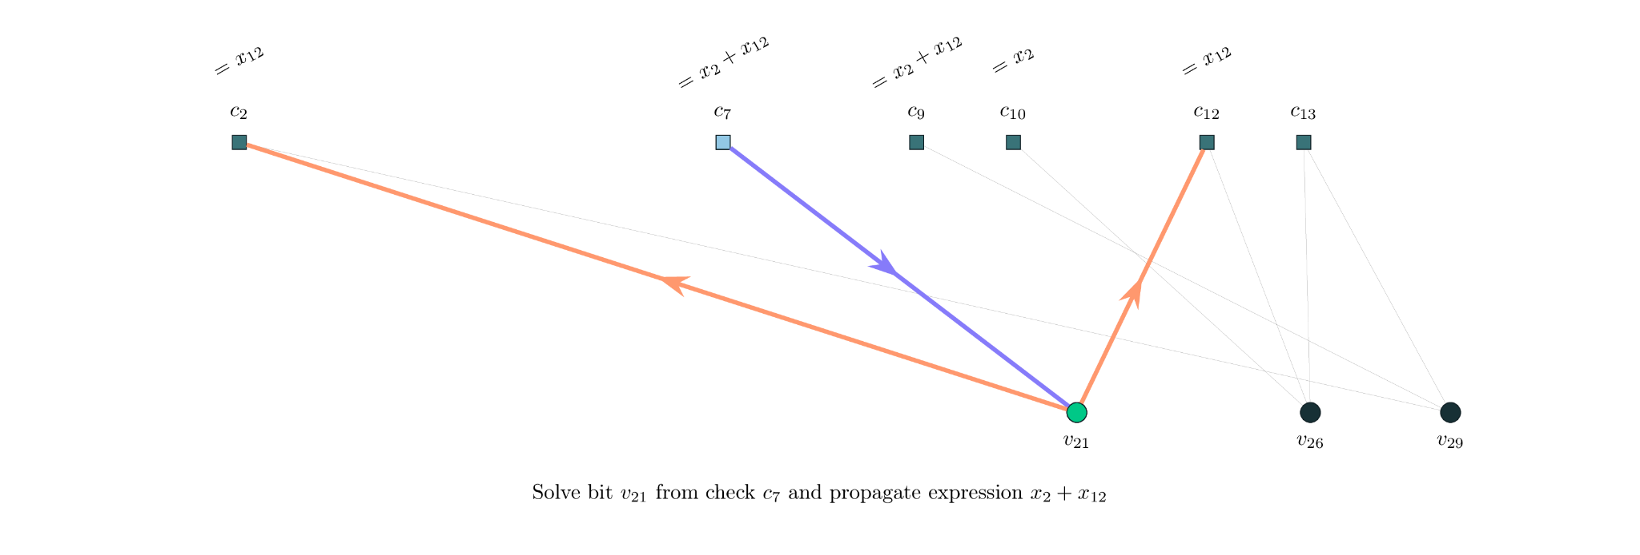
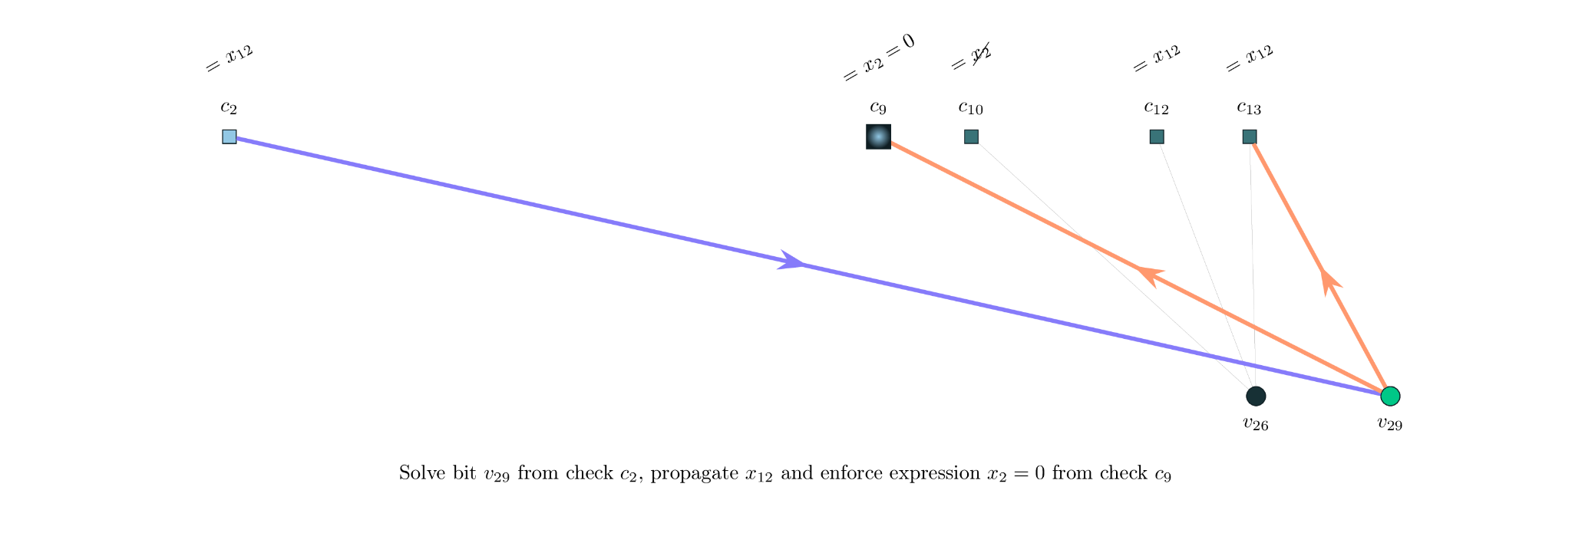
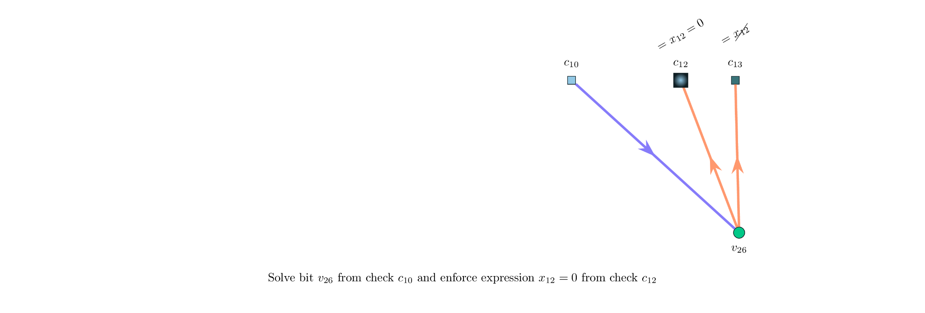

Classical Maxwell decoder - example

Slide 8
Quantum setting: CSS Maxwell decoder
Basic idea:
Apply the classical Maxwell decoder to Hx and Hz
Post-process the list decoding to remove degeneracy

Slide 9
Numerical results

Slide 10
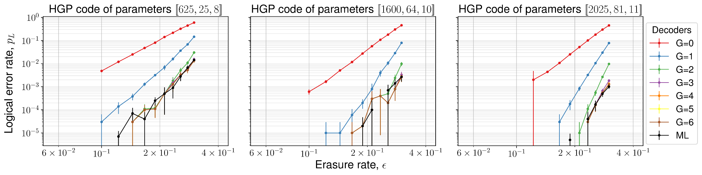
Benchmark on HGP codes

Slide 11
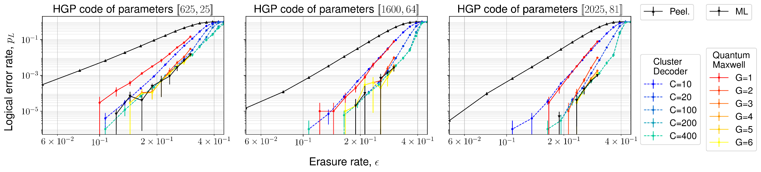
Comparison to cluster decoder⁴

Slide 12
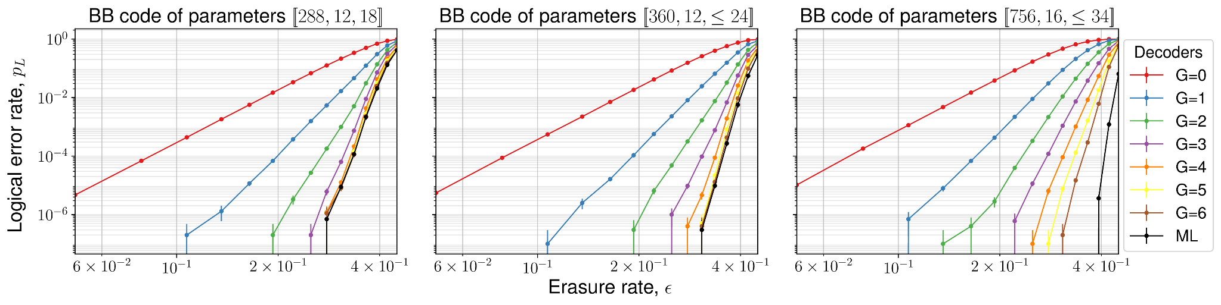
Benchmark on BB codes

Slide 13
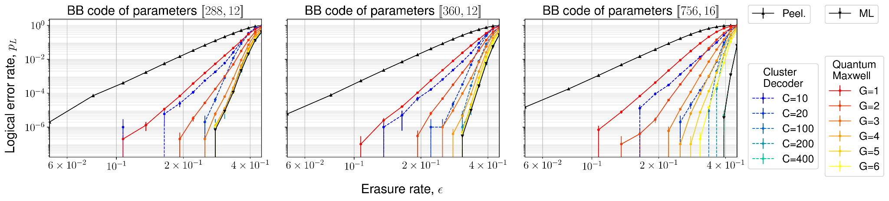
Comparison to cluster decoder⁴

Slide 14
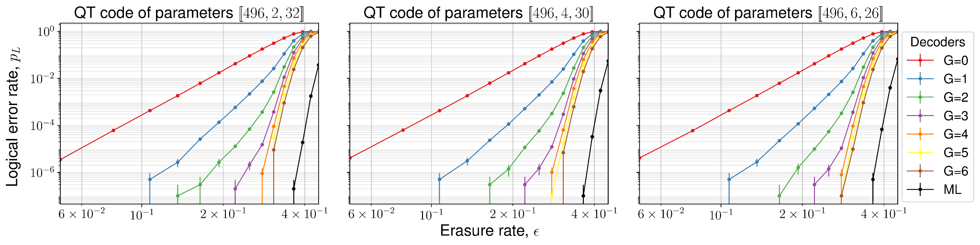
Benchmark on QT codes

Slide 15
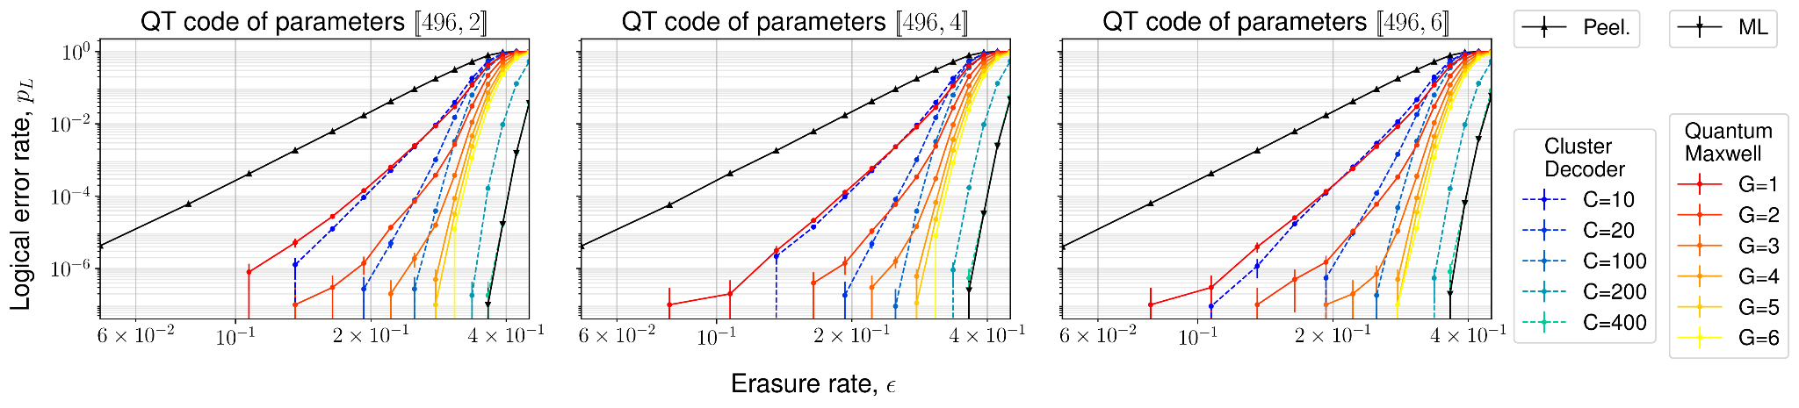
Comparison to cluster decoder⁴

Slide 16
Theoretical results

Slide 17
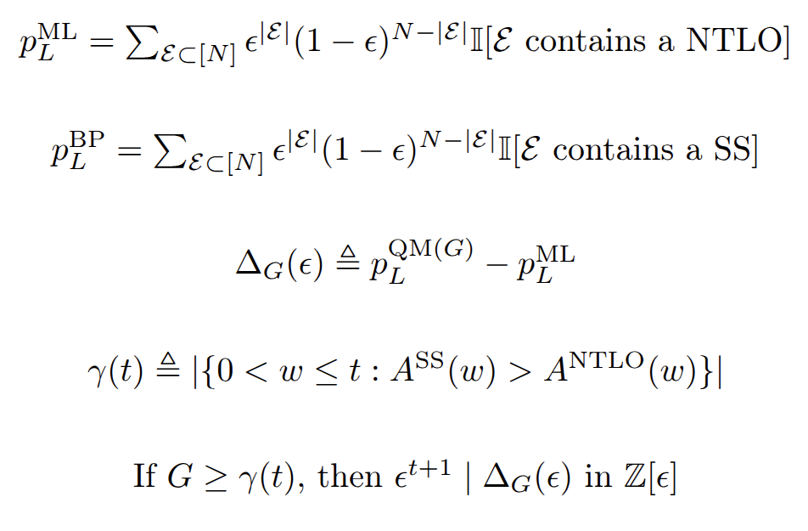
Performance gap vs guessing budget
Logical Error Rate (LER)
NTLO/SS weight distributions
Guessing budget vs distribution gap

Slide 18
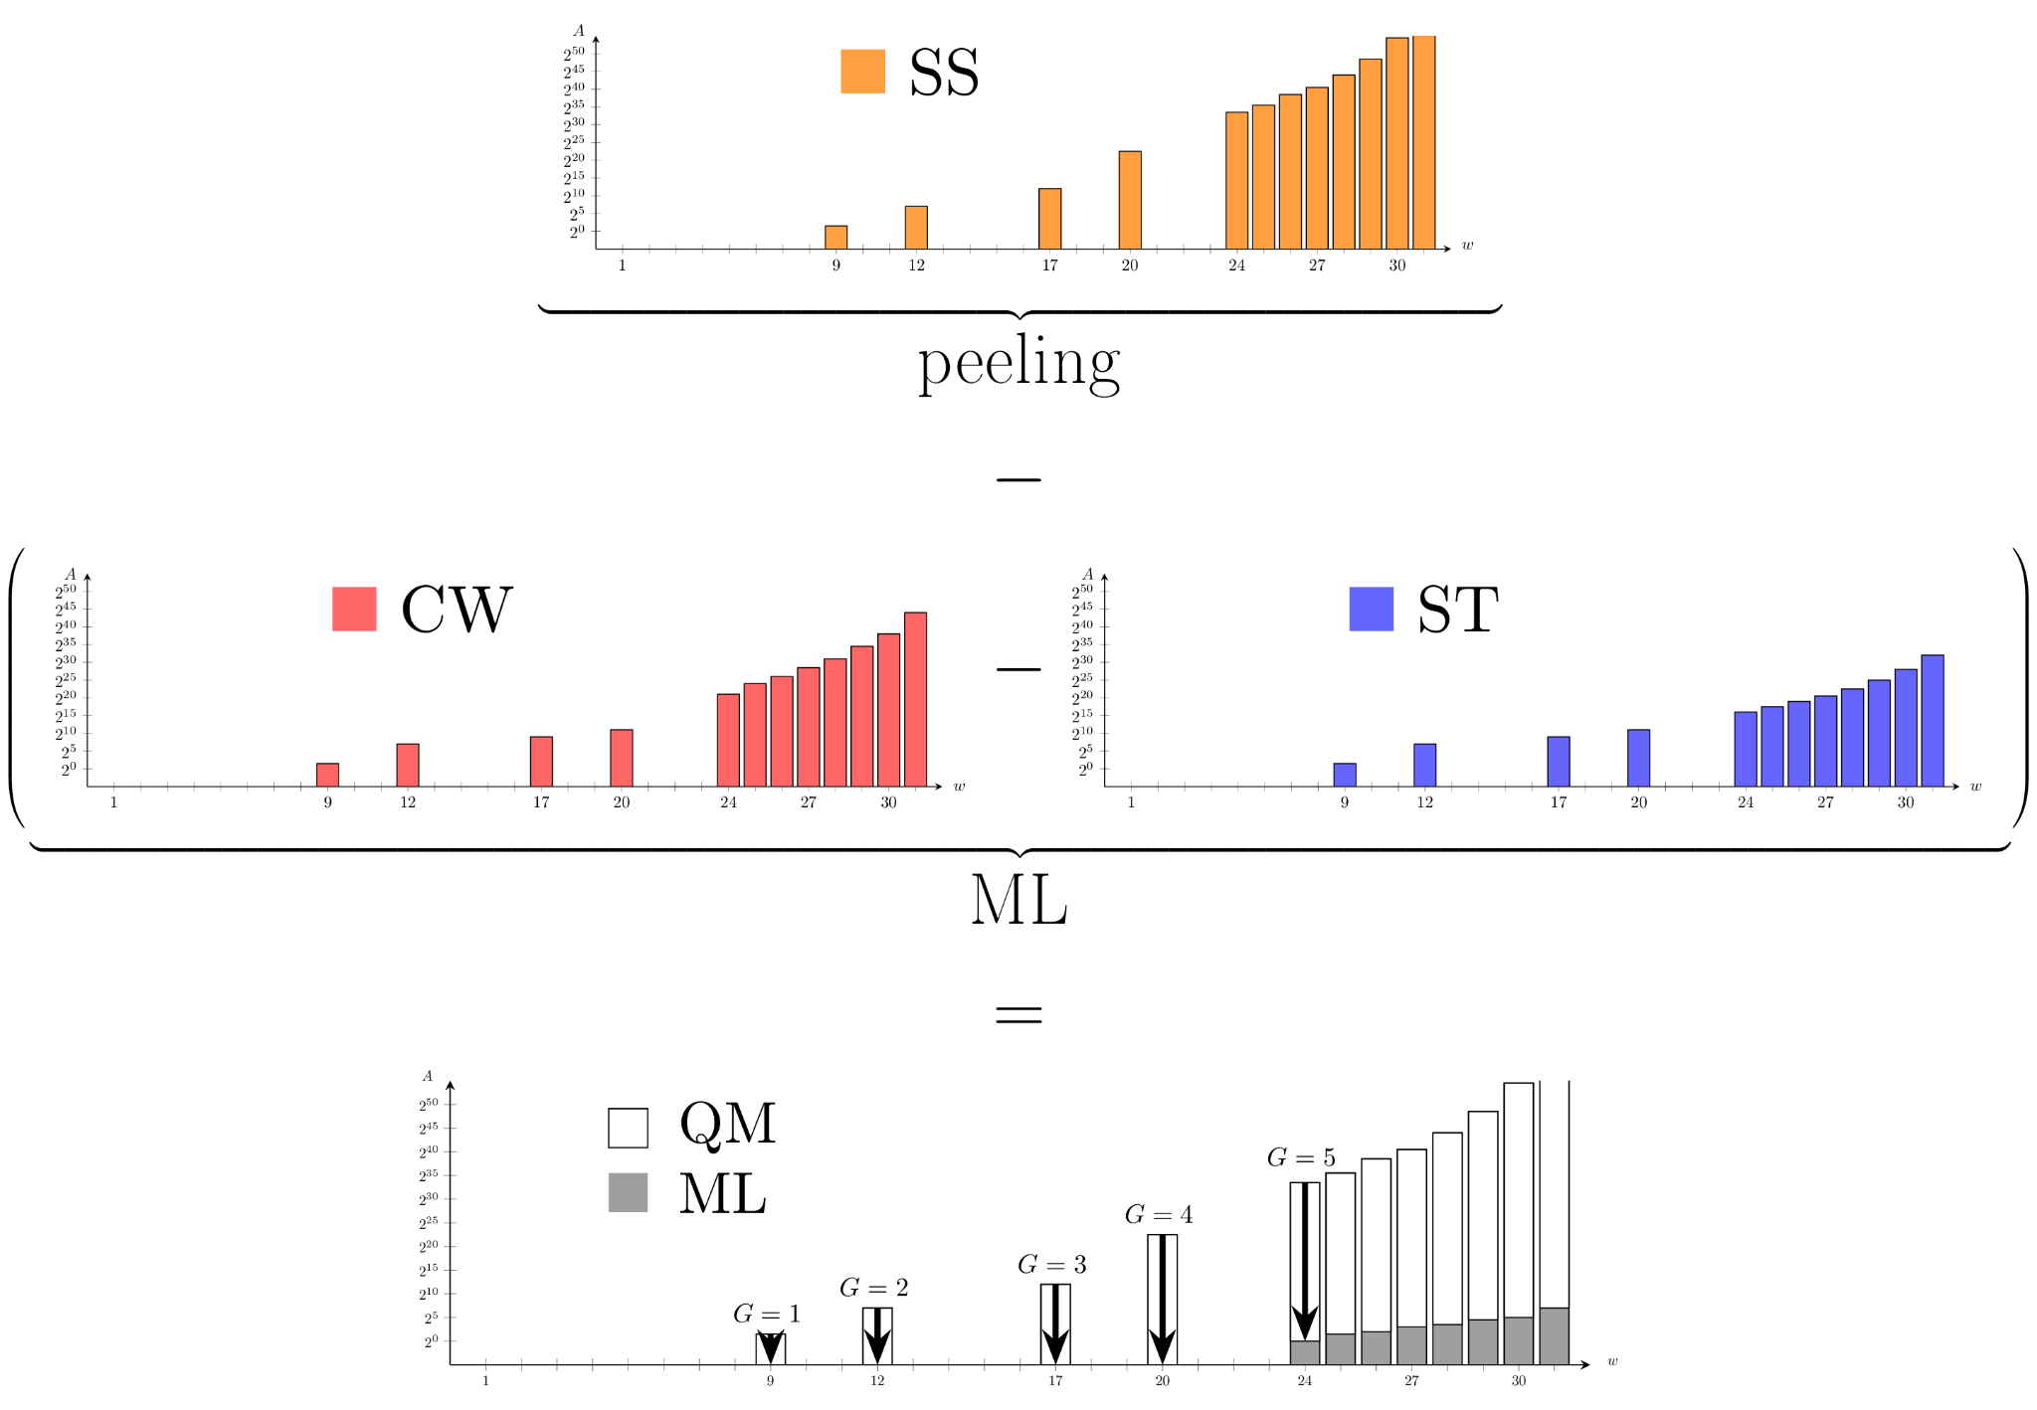
Weight distributions

Slide 19
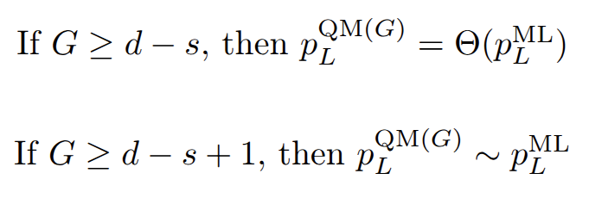
Performance gap vs guessing budget
Corollary:
Performance with constant guessing budget
Interpolate between BP and ML
Required budget to asymptotically match ML performance given by distribution gap
Linear time complexity

Slide 20
Thank you!
Questions?

