Slide 1

Exploratory Data Analysis
Bank Marketing compaign

Slide 2
Internship Batch : LISUM04
project by : Lazghan Yassine
Country: Morroco
Email: volubilisx7@gmail.com
Specialization: Data Science

Slide 3

Agenda
Executive Summary
Problem Statement
Approach
EDA
EDA Summary
Recommendations

Slide 4
Problem Statement
ABC bank wants to sell it’s product to it’s client, so it started ad campaigns, but the bank want to target only clients that are susceptible to bye the product.
Thus, the wants a machine learning system that predicts if clients will bye the product or not based on personal information.
Objective : Provide insights to help ABC bank decide which people to focus it’s marketing campaign on.

Slide 5
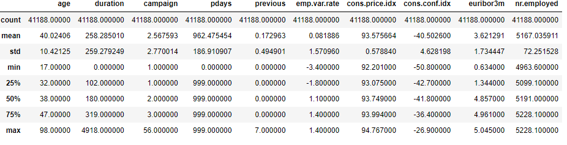
Data Summary

Slide 6
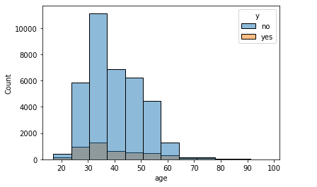
Gender wise customer analisis
we see that most calls were adressed to people between 25 and 58

Slide 7
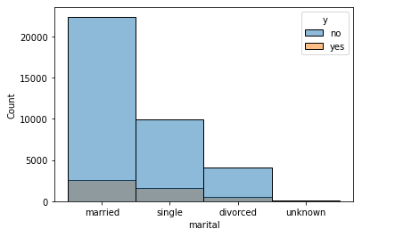
Income wise customer analysis
married people were the ones that got the most number of calls

Slide 8
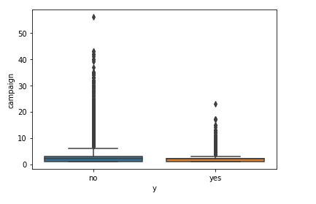
Profit analysis
we see that people who bought the product were the ones who got the most number of calls during the last compaign

Slide 9
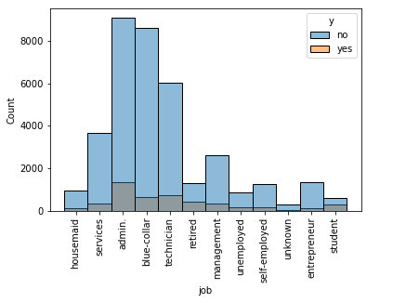
City wise customer analysis
admin, blue_collar and technicians were the most contacted

Slide 10
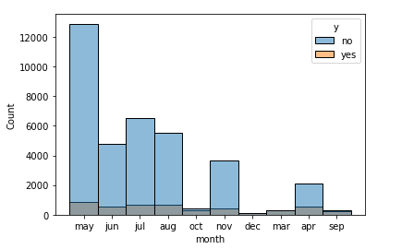
Customer analysis based on ride distance
we see that may was the month that saw the most number of calls, its also remarquable that months like october and december where there was much less calls, were the ones that saw highest acceptance rate.

Slide 11
Recommendation
Based on the analysis conducted above we recommend that :
the bank should focus more on the elderly
Should make less call per person
Should focus on the months that have the highest acceptance rate like December, mars and September
Should make efforts to attract students

Slide 12
Modeling approach
We propose the Following models for our classification task :
Logisstic regression
Random forest classifier
Adaboost classifier

Slide 13
Thank You

