Slide 1

Exploratory Data Analysis
Cab investement company

Slide 2

Agenda
Executive Summary
Problem Statement
Approach
EDA
EDA Summary
Recommendations

Slide 3
Problem Statement
XYZ is a private equity firm in US. Due to remarkable growth in the Cab Industry in last few years and multiple key players in the market, it is planning for an investment in Cab industry.
Objective : Provide insights to help XYZ firm in deciding on the right company to invest in.

Slide 4
Approach
The analysis has been divided into four parts:
Data summary
Analyzing each cab company in light of different factors,
Finding the most profitable Cab company
Recommendations for investment

Slide 5
Data Summary
14 features
Timeframe of the data: 2016-01-31 to 2018-12-31
Total data points :355,032
Assumptions:
Outliers are present in every feature
Users feature of city dataset is treated as number of cab users in the city.
we have assumed that this can be other cab users as well(including Yellow and
Pink cab)

Slide 6
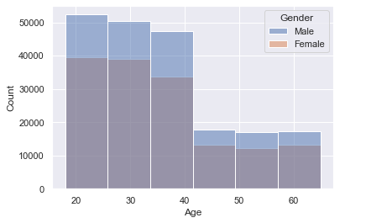
Gender wise customer analisis
the majority of the companies clients are aged between 20 and 40 with a clear predominace of females.

Slide 7
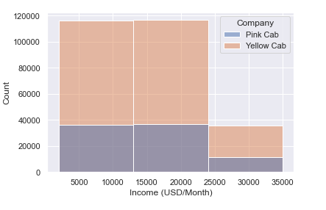
Income wise customer analysis
most of the 2 cab companies clients belong to the midlle class.

Slide 8
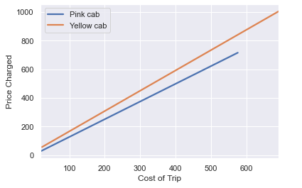
Profit analysis
yellow cab company seems to charge extra for the same trip, wich leads us to conclude that it got a bigger margin of profit.

Slide 9
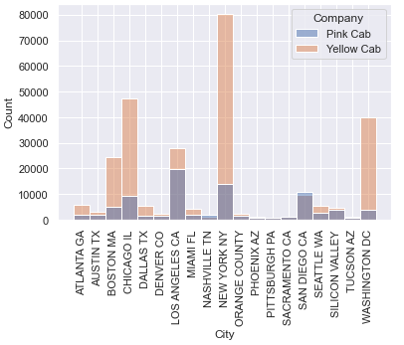
City wise customer analysis
pink cab company has more customers in cities like 'los angeles' and 'san diego', but in most cities yellow cab company is doing better.

Slide 10
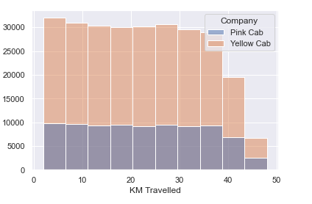
Customer analysis based on ride distance
5-35 KM trips are contributing
more In both the cabs profit
Yellow cab has better customer reach for long and short ride distance,

Slide 11
Recommendation
We have evaluated both the cab companies on following points and found Yellow cab better than Pink cab:
Customer Reach : Yellow cab has higher customer reach in 25 cities while Pink cab has higher customer reach in 4 cities. We have also observed that Yellow cab is doing good in covering other cab users as compared to Pink cab.
Age wise Reach : Yellow cab has customer in all age group and it’s been observed that it’s even popular in 60+ age group as equally as its in 18-25 age group.
Average Profit per KM: Yellow cab’s average profit per KM is almost three times the average profit per KM of the Pink cab.
Income wise Reach :Both the cabs are very popular in high and medium income class but here also Yellow cab is performing better than Pink cab in offering their services to all the three income class group (low, medium and high)
On the basis of above point , we will recommend Yellow cab for investment.

Slide 12
Thank You

