Slide 2
Survival Data Project

Slide 3
Datasets
Logistic : effect of AZT (azidothymidine) on slowing the development of AIDS symptoms.
ACTG320 : placebo-controlled trial that compared a three-drug treatment with a standard two-drug treatment in HIV-infected patients.

Slide 4
Logistic

Slide 5
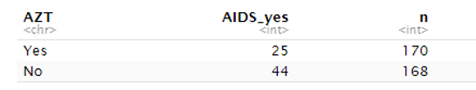
Data Description
338 patients
69 AIDS cases

Slide 6
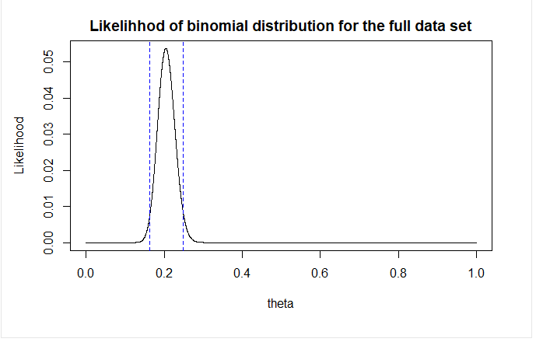



Binomial distribution : Full dataset
n = 338
k = 69
CI :

Slide 7
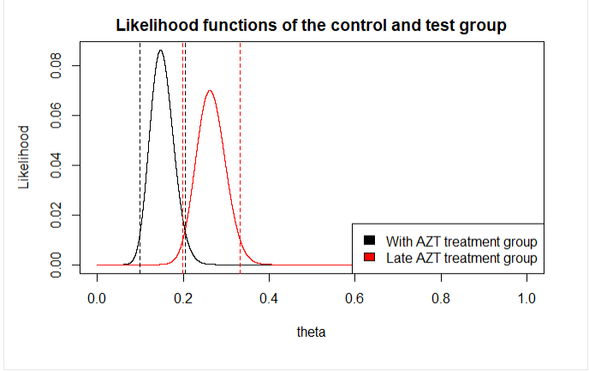
Likelihood for the 2 groups
No treatment : n = 168, k = 44
Treatment : n = 170, k = 25
Comment : MLE of control group is higher than treatment

Slide 8
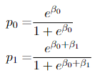
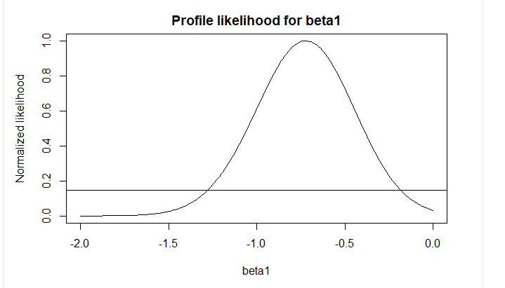

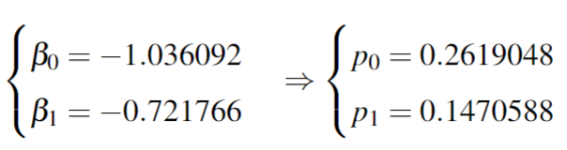

Estimating p0 and p1
p0 probability of AIDS in control group
p1 probability of AIDS in treatment group
Confidence Interval : 0 is not included, meaning significant difference between success parameter.

Slide 9


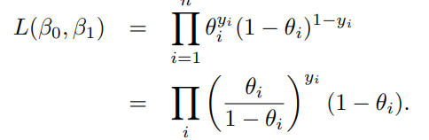
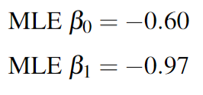
Logistic Regression model

Slide 10
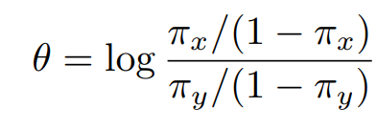
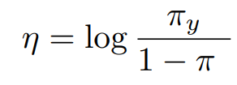
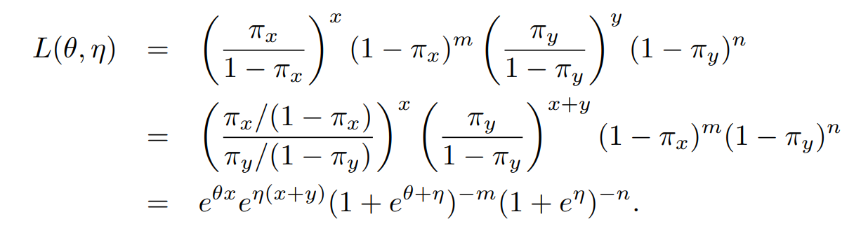
Odd ratio
Compare the relative odds of the occurrence of the outcome of interest (death/AIDS in our project), given exposure to the variable of interest

Slide 11
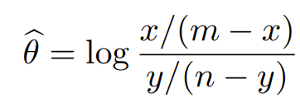
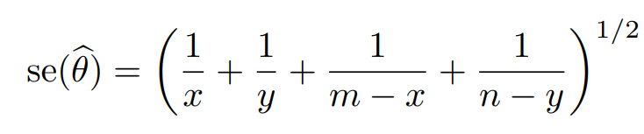
MLE of log odds-ratio
Odds-ratio: 0.49
95% Wald CI: [0.28, 0.84]

Slide 12
Test the hypothesis of no effect of AZT on AIDS
 | Wald chi-square | Likelihood Ratio
Statistics value | 11.26 | 11.72
Critical value alpha = 5% | 3.84 | 3.84
Conclusion | Reject | Reject

Slide 13
ACTG320

Slide 14
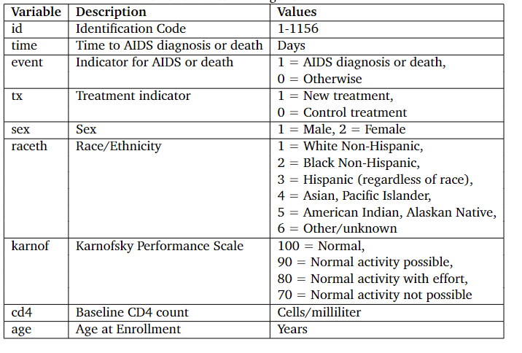
Total patients = 1151

Slide 15
Data Description
Total follow up = 363 days
Treatment | AIDS or Death | Number | Proportion
Yes | Yes | 33 | 0,028
Yes | No | 541 | 0,470
No | Yes | 63 | 0,055
No | No | 514 | 0,446

Slide 16
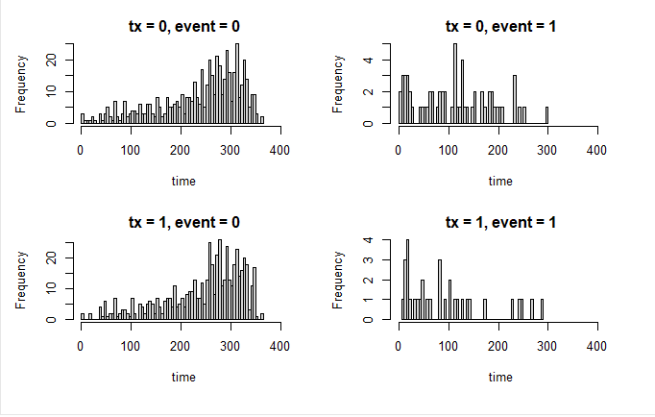

Slide 17
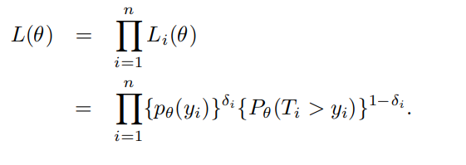
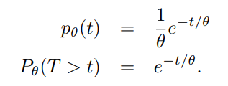

Exponential Distribution : full dataset

Slide 18
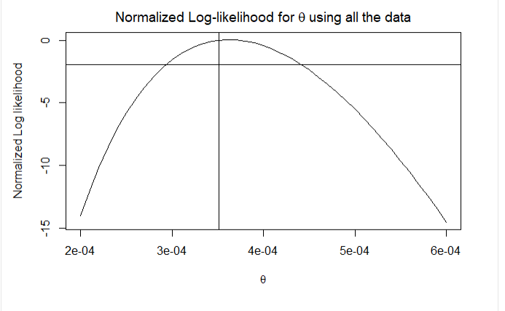
Normalized log likelihood

Slide 19
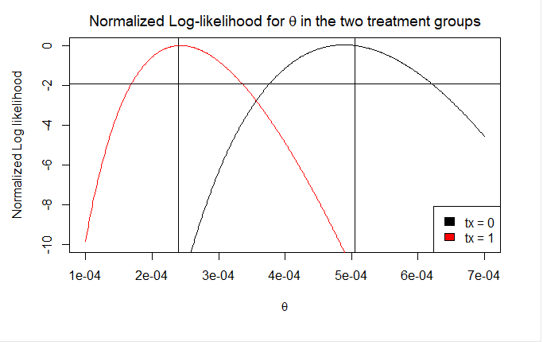
Log likelihood for the two groups

Slide 20
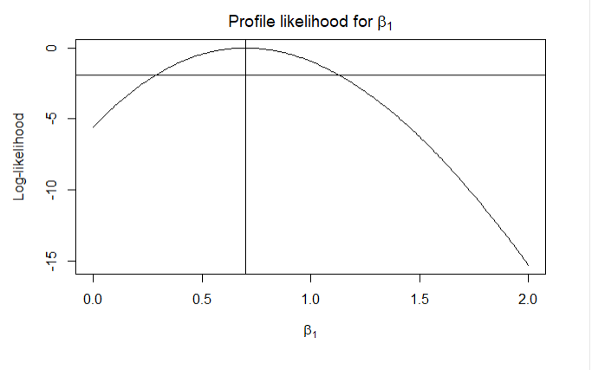


Profile likelihood Beta1
Exponential model with
Mean of control group:
Mean for treatment group:
MLE: 0.7
Profile likelihood CI: [0.29, 1.13]
95% Wald CI of beta1: [0.36, 1.04]

Slide 21
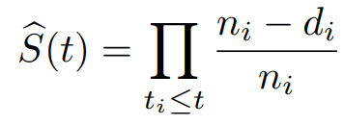

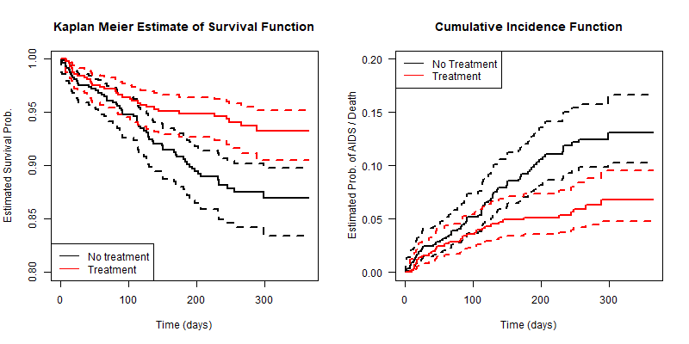
Kaplan Meier

Slide 22
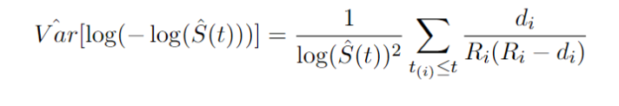


CI of KM estimator

Slide 23
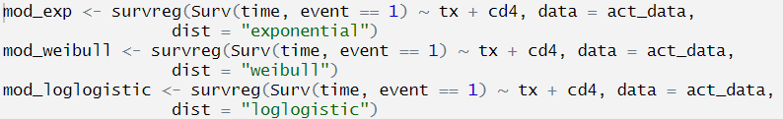
Fit Parametric Survival Model
Model | Exponential | Weibull | Loglogistic
AIC | 1646 | 1641 | 1640

Slide 24
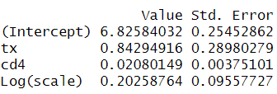
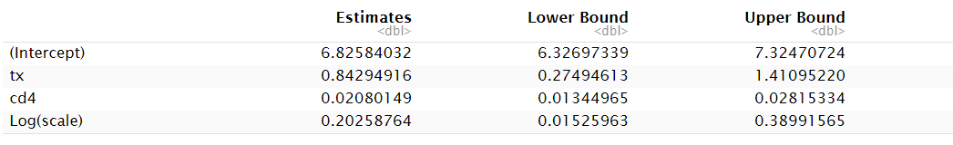
Summary of Log Logistic model with 95% CI

Slide 25




Time ratio (using Log Logistic model)
 | TR | Lower Bound | Upper Bound
tx | 2.32 | 1.32 | 4.1
50*CD4 | 2.82 | 1.96 | 4.09
The median time to event (t50) is 2.32 higher in the treatment group.
The median time to even (t50) is 2.82 higher with an increase of 50 in cd4.

Slide 26
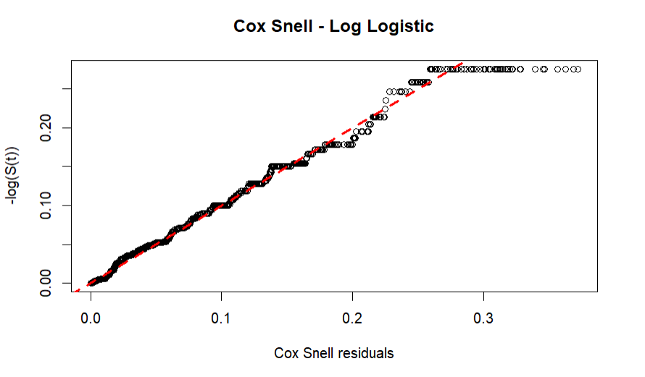
Cox Snell Residual

