Slide 2
Wind power forecast

Slide 3
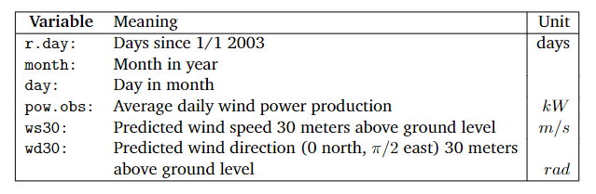
Data
Data set from Tunø Knob wind power plant

Slide 4
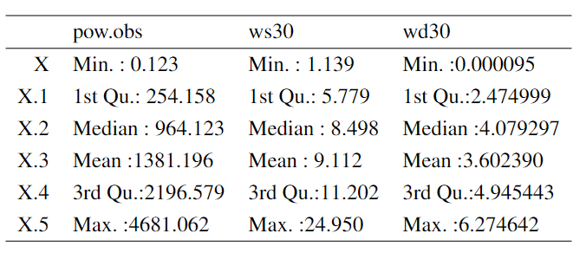
Descriptive Statistics

Slide 5
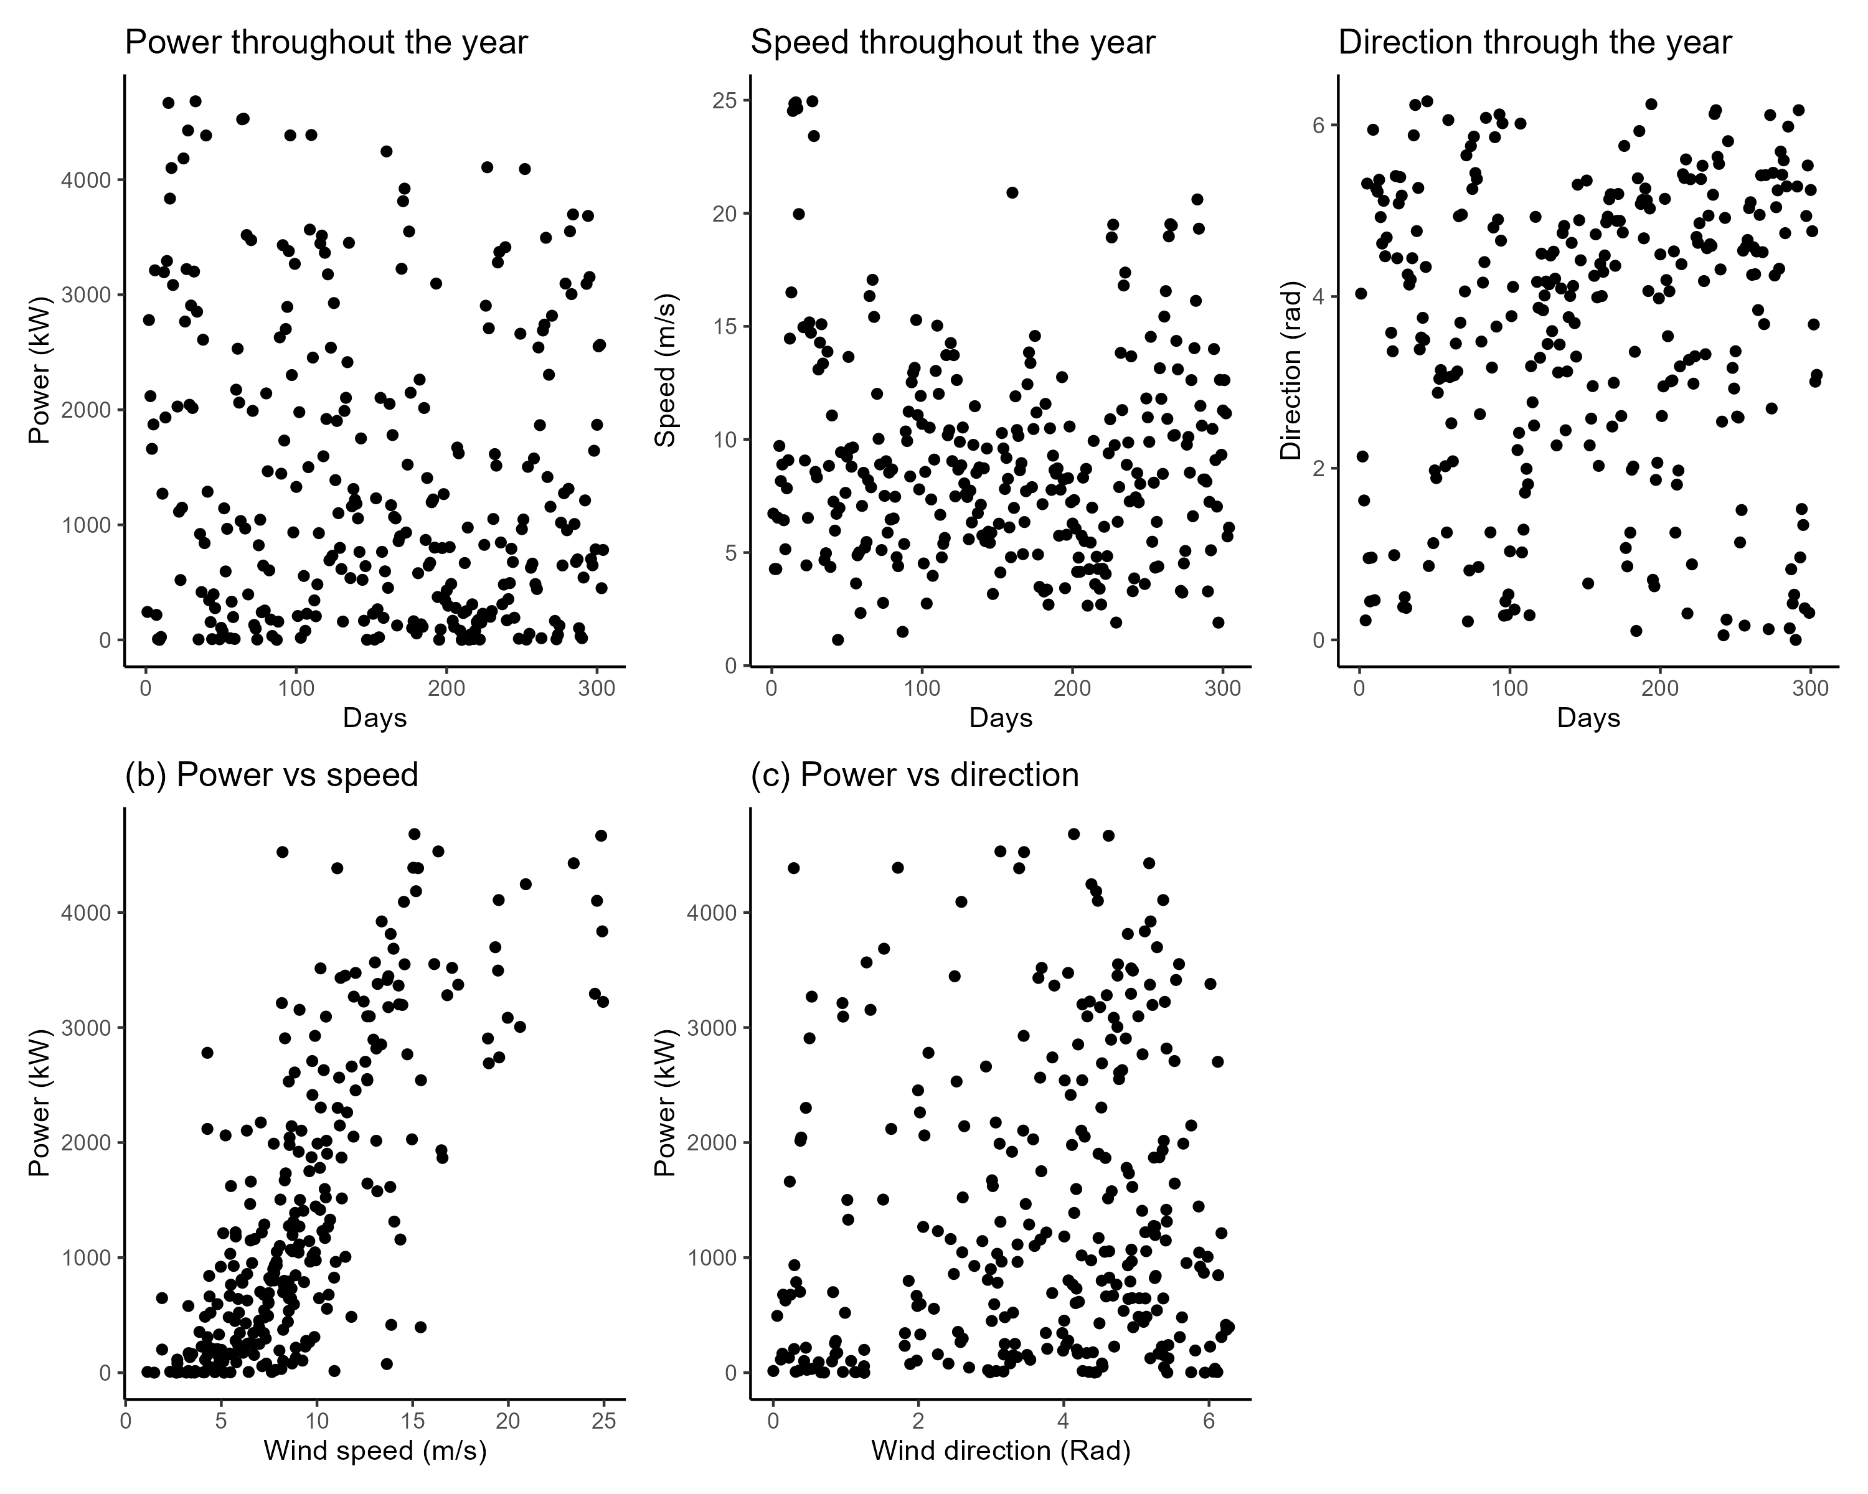
Descriptive Statistics

Slide 6
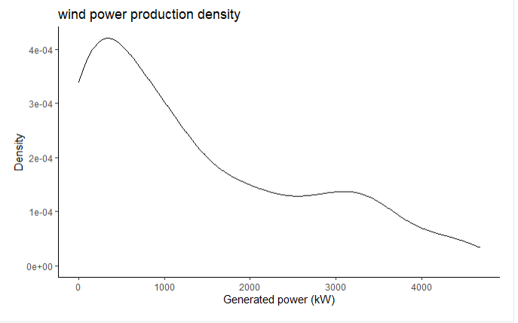
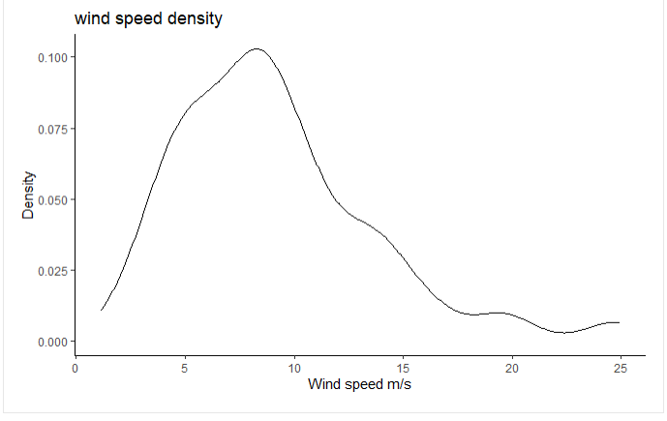
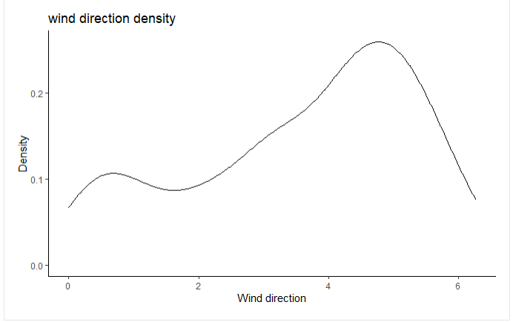
Descriptive Statistics

Slide 7
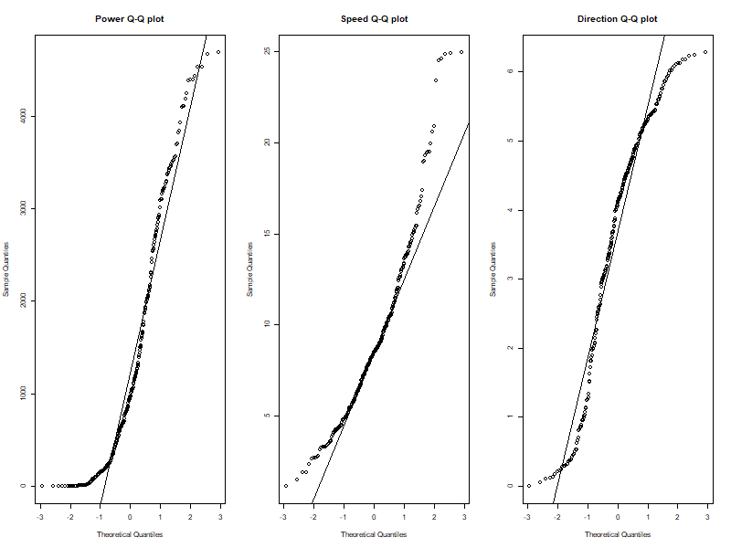

Checking normality

Slide 8
Modelling

Slide 9
Non-normal models
Pipeline
Data transformation
Evaluation
Gamma
Log-normal
Beta
Box-Cox
Transformation 1
Transformation 2
=> Normal distribution
Parameter estimation (MLE)
AIC

Slide 10

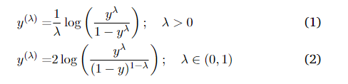
Transformations
Box-Cox
Transformation 1
Transformation 2

Slide 11
Wind power

Slide 12
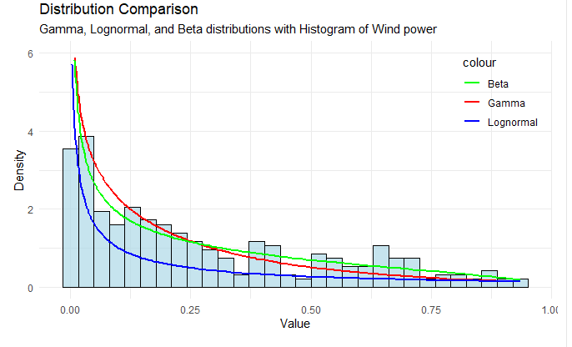
Distribution comparison for wind power
Variables | Beta | Gamma | Lognorm
Param1 | 0.557 | 0.692 | 0.00
Conf Int | [0.5,0.62] | [0.62,0.76] | [-0.33,0.33]
Param2 | 1.491 | 2.507 | 2.888
Conf Int | [1.29,1.7] | [2.16,2.86] | [2.65,3.12]

Slide 13
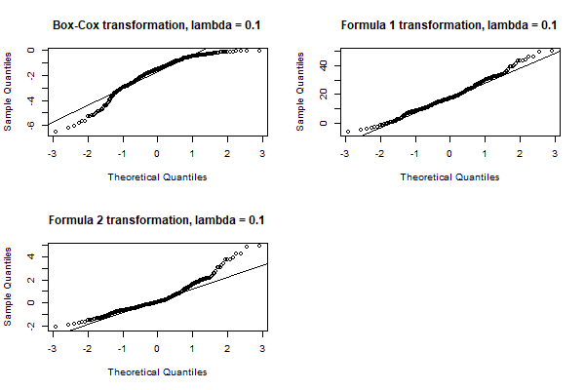
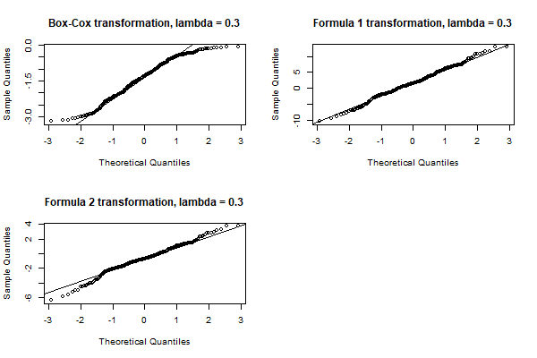
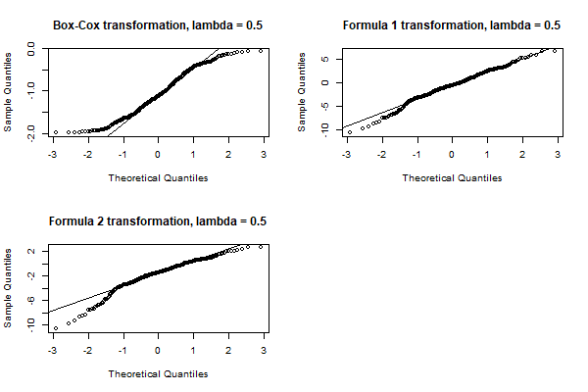
Transformations
We continued with transformation 1 with lambda = 0.3

Slide 14
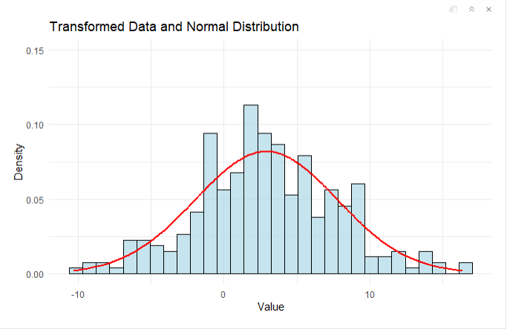
Wind power

Slide 15
Wind speed

Slide 16
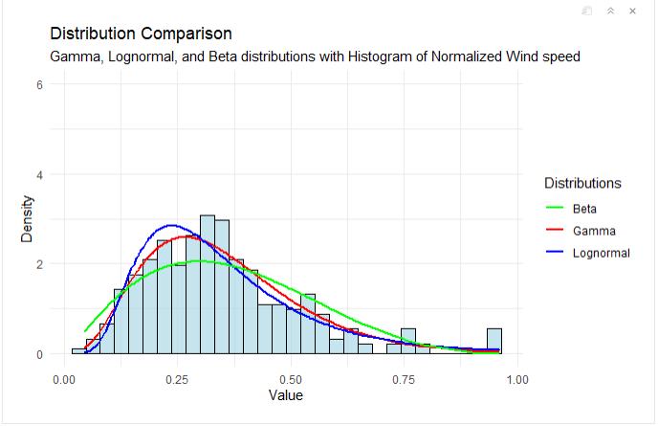
Normalized Wind speed
Variables | Beta | Gamma | Lognorm
Param1 | 0.51 | 2.006 | 1.012
Conf Int | [0.48,0.62] | [1.92,2.47] | [0.94,1.56]
Param2 | 0.12 | 0.557 | 1.063
Conf Int | [0.06,0.35] | [0.43,071] | [0.87,1.32]

Slide 17
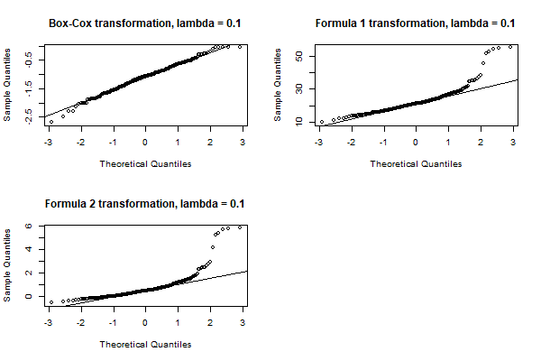
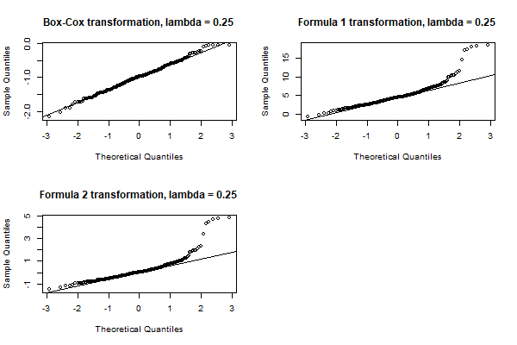
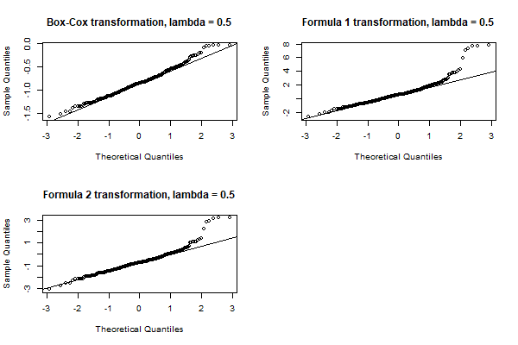
We decide to continue with Box Cox and lambda = 0.25

Slide 18
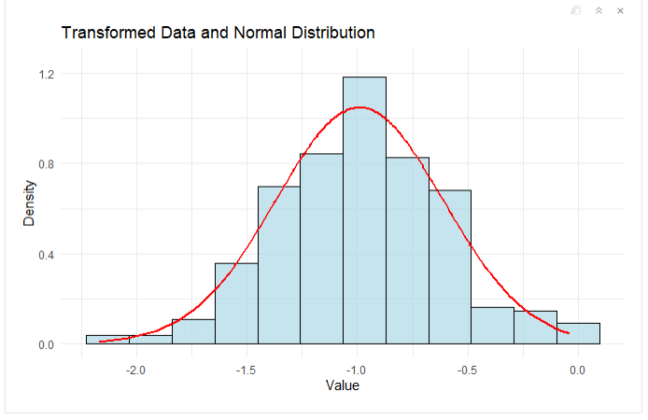
Wind speed

Slide 19
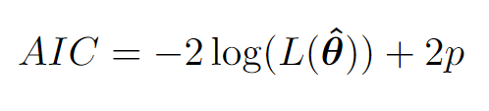
AIC
Model | Wind power | Wind speed
Gamma | -190.7635 | -240.9103
Log normal | 187.8728 | -232.9599
Beta | -239.3236 | -191.0635
Box - Cox | NA | 9.52
Transformation 1 | 10.8 | NA
Transformation 2 | NA | NA

Slide 20
Fitting GLM models

Slide 21
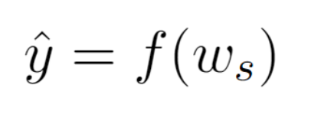

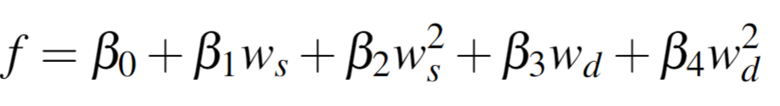
Formulated models

Slide 22
GLM models AIC
Model | Without wind direction | With wind direction
Gamma Inverse | -302.6271 | -340.17
Gamma Logit | -334.4009 | -300.42
Gaussian with transformed data | 1484.3 | 1484.2
Beta | -480.2231 | -484.3728

Slide 23
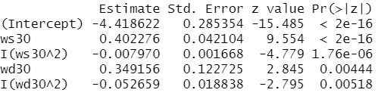
Final model : Beta
P-value of all experiment parameters < 5% -> We should include all in our final model

Slide 24
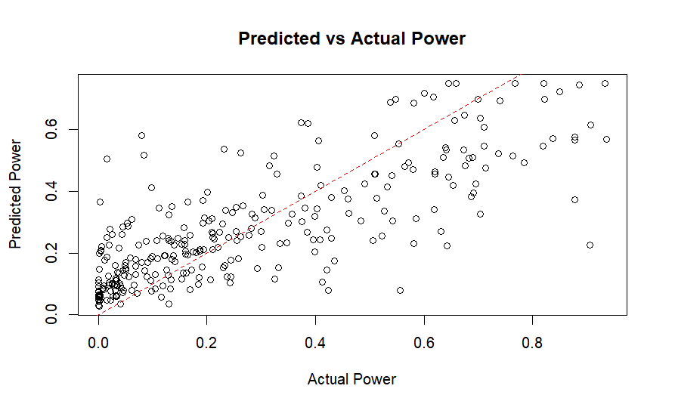
Plots

Slide 25
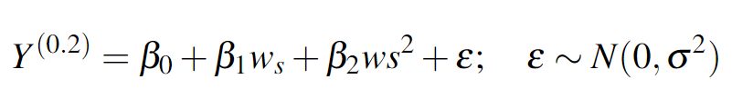
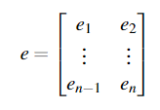

Analysis of auto-correlation :
0.3

Slide 26
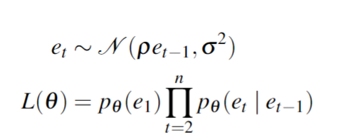
AR(1) model

Slide 27


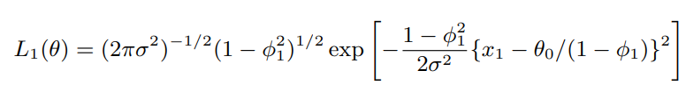




AR(1) model

Slide 28
Estimating parameters
Parameter | MLE | Lower Bound | Upper Bound
ρ | 0.32417 | 0.22568 | 0.42266
σ^2 | 9.8117 | 8.67655 | 10.9468
Parameter | MLE | Lower Bound | Upper Bound
ρ | 0.324211 | 0.22572 | 0.422699
σ^2 | 9.8132 | 8.678216 | 10.94833

Slide 29
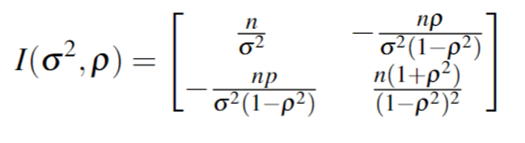

Fisher information

Slide 30


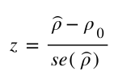

Test if
From both tests, P-value < 5% -> Reject null hypothesis that

Slide 31

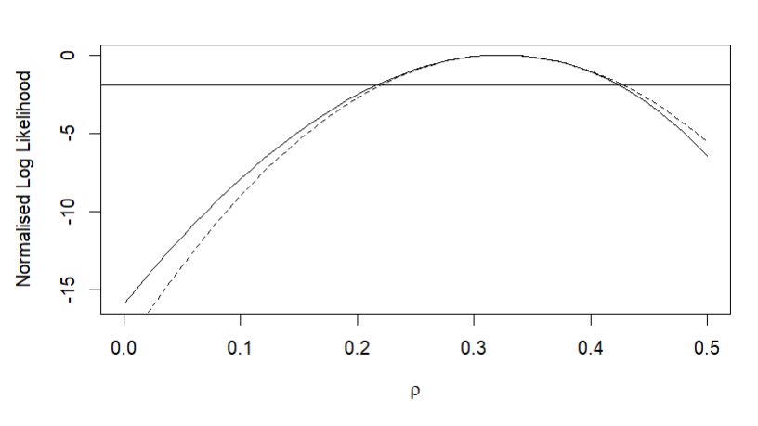
Quadratic Approximation of Profile Likelihood

Slide 32

Model combination
Combined model
AIC Combined model : 1421.32
AIC normal model : 1484.3

