Slide 1


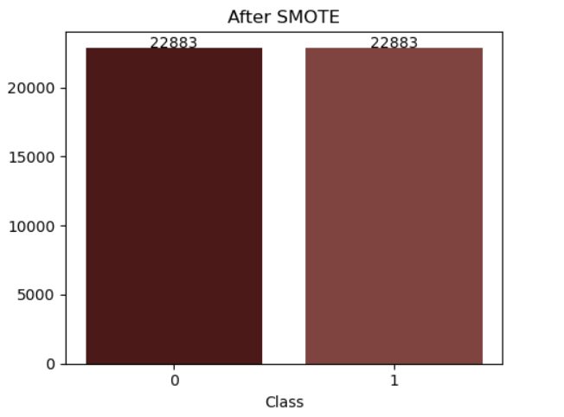
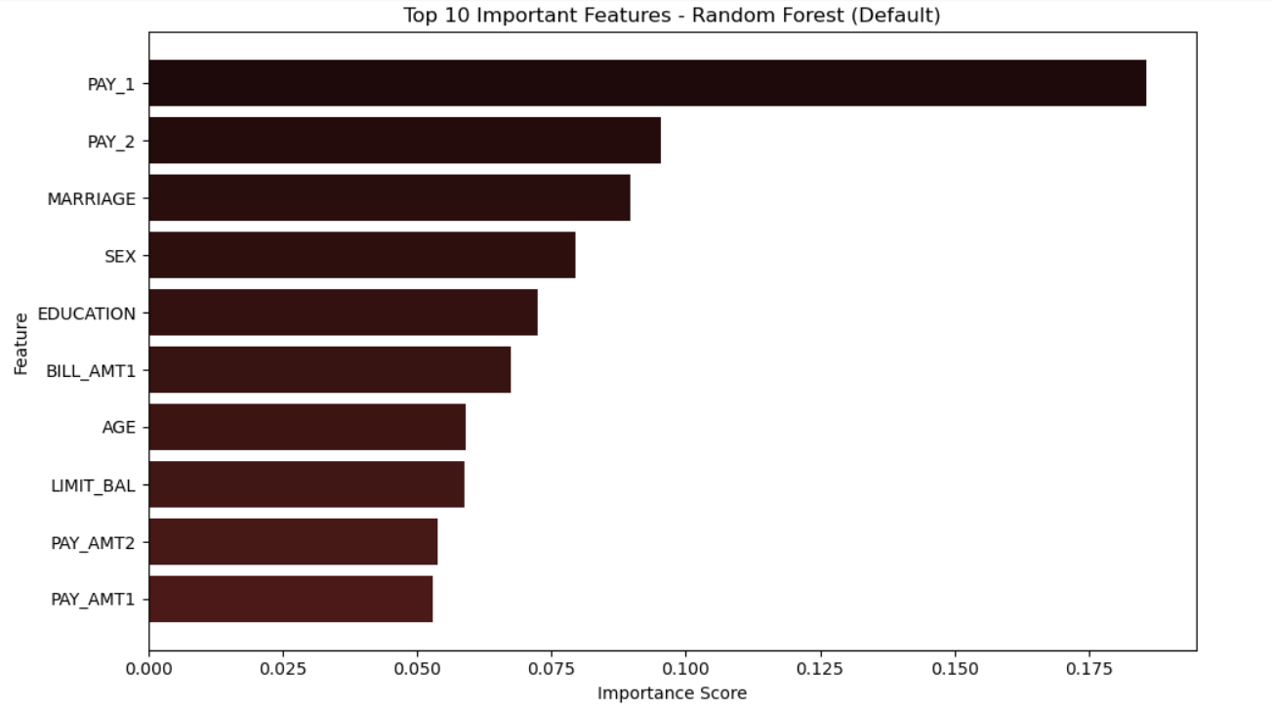

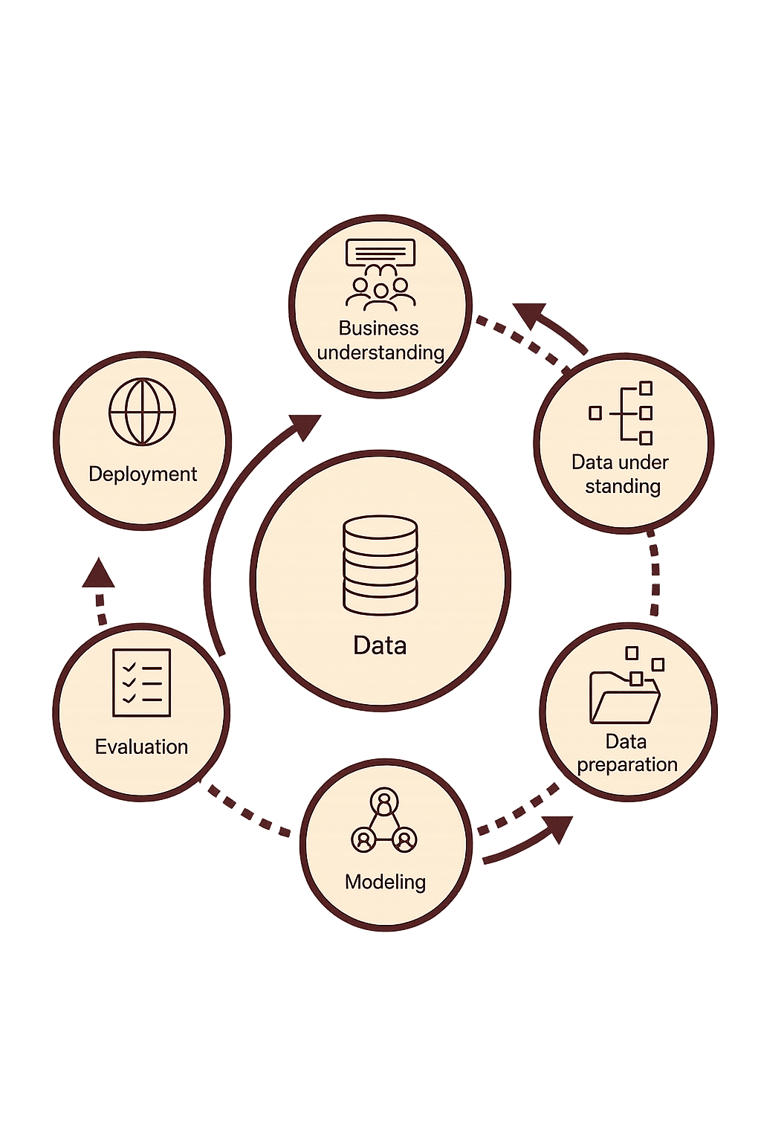



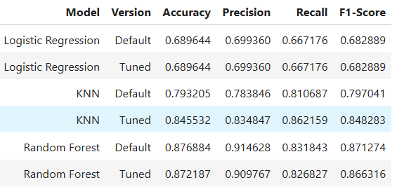
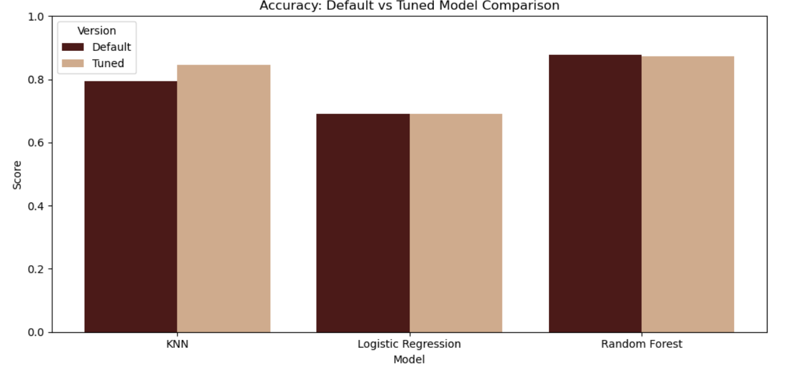

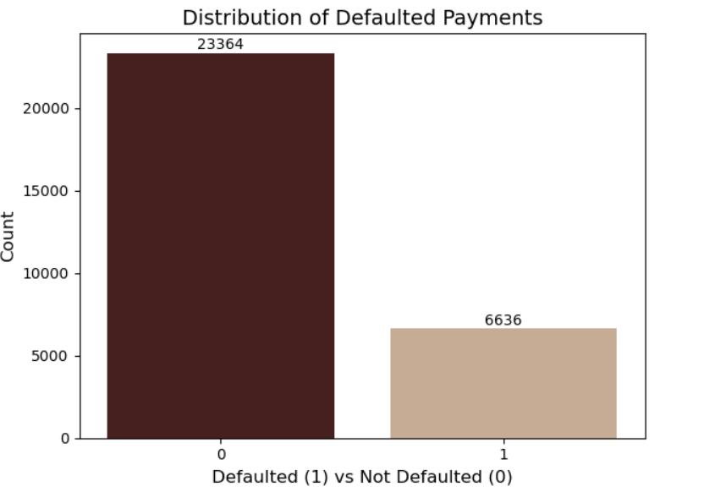
INTRODUCTION
DATA PREPARATION
Credit Card Default Prediction Using Machine Learning
Data Cleaning: No missing values and 35 duplicates were identified and removed. Outliers were treated using the Interquartile Range (IQR) and clipping method, and unrealistic negative bill amounts were removed to ensure data consistency.
Feature Selection: Key predictors such as payment history, bill amounts, and credit limit were examined through correlation analysis to identify the most influential variables for modeling.
Balancing the Data: The target variable was highly imbalanced, so SMOTE was applied to generate synthetic samples for the minority class and create a more balanced dataset for training.
Feature Engineering: Categorical variables such as sex, education level, and marital status were encoded into numerical formats for compatibility with machine learning algorithms. Numerical features were standardized using StandardScaler to ensure equal weighting across models. (Kohavi, 1995)
In predictive modeling, the Random Forest Classifier delivered the strongest overall performance, achieving the highest balance between precision, recall, and F1-score after hyperparameter tuning. K-Nearest Neighbors (KNN) also performed well with k=5, reaching strong recall scores, while Logistic Regression provided stable but lower predictive performance. These results highlight Random Forest as the most reliable model for identifying customers likely to default.
Feature importance analysis from the Random Forest model showed that recent payment behavior particularly PAY_1 and PAY_2 was the most influential predictor of default. Demographic attributes such as marriage status, sex, and education level also played a significant role. These insights highlight the importance of payment history and customer characteristics in identifying clients at high risk of default.
Credit card default prediction plays a crucial role in helping financial institutions manage risk and make informed lending decisions. When customers fail to pay their credit card bills, banks face financial losses and increased operational challenges. By analyzing customer behavior and financial patterns, machine learning models can support early identification of high-risk clients and improve overall credit management. This project applies data analytics and supervised learning techniques to understand which factors influence default behavior and to build a model that can accurately support decision-making in real financial environments. (Yeh, I-Cheng & Lien, Che-hui 2009)
OBJECTIVES
Authors
For this project, the objectives are:
Perform an Exploratory Data Analysis (EDA) to understand customer characteristics
Prepare the dataset using cleaning, outlier handling, encoding, and scaling..
Address class imbalance using SMOTE.
Build and compare three supervised ML models: Logistic Regression, KNN, Random Forest.
Tune hyperparameters using GridSearchCV.
Visualize the results to make them easy to understand.
.
Yassine Zohair
Abstract
This project aims to predict credit card default using machine learning. Using the UCI “Default of Credit Card Clients” dataset, we cleaned the data, handled outliers, balanced the classes with SMOTE, and prepared features for modeling. Three algorithms : Logistic Regression, KNN, and Random Forest were evaluated. Random Forest delivered the best overall performance, while KNN achieved the highest recall for identifying high-risk customers. Shapash was used to explain feature importance and model decisions. The results show that machine learning can help financial institutions detect potential defaults more effectively. (Chen & Zhang, 2021)
METHODOLOGY
Project Description
CRISP-DM Methodology:
MODELLING
TECHNIQUES
ETHICAL CONSIDERATIONS
This project aims to predict whether a credit card customer will default on their payment using supervised machine learning. The workflow includes data exploration, cleaning, outlier handling, feature engineering, scaling, and balancing the dataset with SMOTE. Three models :Logistic Regression, KNN, and Random Forest were trained and optimized. Model explainability tools were then used to identify the features that most influence default risk. (Kubat, 2017)
Prevent Bias: Avoid unfair predictions linked to demographic features (sex, education, marriage).
Fair Decisions: Ensure the model does not disadvantage specific customer groups.
Data Privacy: Protect sensitive financial data such as bill amounts, payment history, and credit limits.
Transparency: Use interpretability tools (Feature Importance, SHAP) to explain how predictions are made. (Kubat, 2017)
Three supervised Machine Learning models : Logistic Regression, K-Nearest Neighbors (KNN), and Random Forest Classifier were developed to predict credit card default using the cleaned, balanced, and scaled dataset. Each model was first trained with default hyperparameters to establish baseline performance, followed by 5-fold stratified cross-validation to obtain more reliable accuracy estimates. GridSearchCV was then applied to tune the hyperparameters and improve model performance. Finally, the models were evaluated and compared using key metrics such as Accuracy, Precision, Recall, and F1-score to identify the best-performing approach.
Research Question
The following research questions guide the focus of this study:
Can we accurately predict credit card default using machine learning?
Which features are the most important predictors of default?
Which algorithm performs best in this task Logistic Regression, KNN, or Random Forest?
How can these results support better financial risk management?
Designed by Fraunhofer IST
Edited by Yassine Zohair
This project follows the CRISP-DM (Cross-Industry Standard Process for Data Mining) methodology. This includes steps like data understanding, preparation, modeling, and evaluation.
The CRISP-DM method provides a structured approach to analyzing and modeling the wage gap, focusing on discovering key patterns and making reliable predictions. (Shearer, 2000)
Logistic Regression
K-Nearest Neighbors (KNN)
Random Forest
Achieved highest recall after tuned the model, the best for identifying defaulters.
best overall performance compared to KNN and Logistic Regression.
Provided stable but lower scores compared to the others models
CONCLUSION
The results from the analysis provide clear insights into credit card default behavior:
Machine learning can accurately predict credit card default, especially after balancing the dataset with SMOTE.
Random Forest performed the best among the three models (Logistic Regression, KNN, Random Forest), showing the strongest overall performance.
Key predictors of default include payment history (PAY_1–PAY_6), bill amounts, credit limit, sex, education, and marital status..
Feature importance confirmed that past payment behavior is the most critical factor.
These results can help banks identify high-risk customers earlier, reduce financial losses, and support more responsible credit risk management. (Yeh, I-Cheng & Lien, Che-hui 2009)
DATA COLLECTION
Banks need to identify customers who may fail to pay their credit card bills so they can reduce financial risk. By analyzing past payment behavior and client characteristics, we aim to support better decision-making and help financial institutions manage credit more effectively. (Kubat, 2017)
DATA UNDERSTANDING
We conducted an Exploratory Data Analysis (EDA) to better understand the structure of the dataset. Key features such as age, credit limit, bill amounts, and payment history were visualized to examine their distributions. The plots showed skewed values and several extreme observations. We also analyzed the target variable and found a strong class imbalance, with many more non-defaulting customers than defaulting ones an important issue to address before modeling.
References
Shearer, C. (2000). The CRISP-DM model: the new blueprint for data mining. Journal of Data Warehousing, 5(4), 13–22.
Chen, Y. & Zhang, R. (2021). Research on Credit Card Default Prediction Based on k-Means SMOTE and BP Neural Network. Complexity, 2021, Article ID 6618841.
Yeh, I.-C. & Lien, C.-H. (2009). The comparisons of data mining techniques for the predictive accuracy of probability of default of credit card clients. Expert Systems with Applications, 36(2), pp. 2473–2480.
Kohavi, R. (1995). A Study of Cross-Validation and Bootstrap for Accuracy Estimation and Model Selection. IJCAI.
Kubat, M. (2017). An Introduction to Machine Learning. 2nd ed. Cham: Springer.

