Slide 1
Topic Modeling for Archives: LDA vs NMF
PROJECT 19 · NLP · SDIA
Can we automatically discover the themes of text archives without using their categories for training?
Yassine Elhattab · ENSA El Jadida · 20 Newsgroups corpus
Notes:
0 min 30. Research question: group posts by theme without using the categories. We compare interpretable topics, not a classifier.

Slide 2
Dataset: 20 Newsgroups
18,028
17,902
4,560
posts acquired (official splits)
kept: 10,756 train · 7,146 test
vocabulary terms after vectorization
English forum messages, 20 categories; headers, footers and quotes removed
Categories held out: used only for external evaluation
Limitation: 17,902 documents, below the 50,000 minimum → exploratory results
Project 19 · LDA vs NMF · 2/10
Notes:
0 min 30. Source, size, language, nature. State the size limitation right away.

Slide 3
Preprocessing and Representation
1 · Cleaning
2 · Lemmatization
3 · BoW
4 · TF-IDF
HTML, lowercasing, URLs, emails, numbers, non-alphabetic characters
spaCy en_core_web_sm; stop words and generic terms filtered
Unigrams + bigrams, min_df=20, max_df=0.35, fitted on train
Same counts and same vocabulary, weighted
126 short or empty documents and 10 highly repetitive ones removed
Why: Shared BoW = controlled LDA/NMF comparison; TF-IDF down-weights common terms
Project 19 · LDA vs NMF · 3/10
Notes:
1 min 30. Justify each choice: the vocabulary is fitted on train only to avoid leakage.

Slide 4
Modeling: 3 Configurations, 20 Topics
LDA + BoW
NMF + BoW
NMF + TF-IDF
Generative probabilistic model, baseline.
Online, batch 2,048, 40 iterations (limit reached).
Scores = topic probabilities.
Non-negative factorization, nndsvda init, KL loss, mu solver.
150 iterations run (max 400).
Same NMF on the weighted matrix.
110 iterations run.
Measures the effect of weighting.
Seed 42. NMF activations are not calibrated probabilities. Labels are never passed to the models.
Project 19 · LDA vs NMF · 4/10
Notes:
1 min 30. Controlled LDA vs NMF duel on BoW; practical comparison of NMF-BoW vs NMF-TF-IDF.

Slide 5
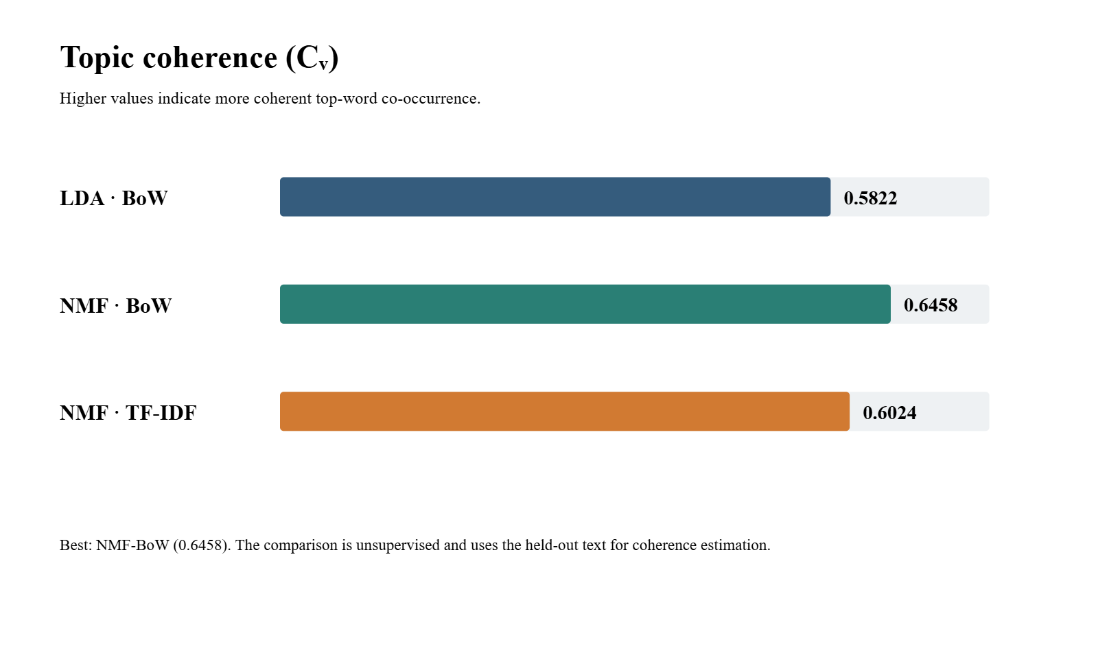
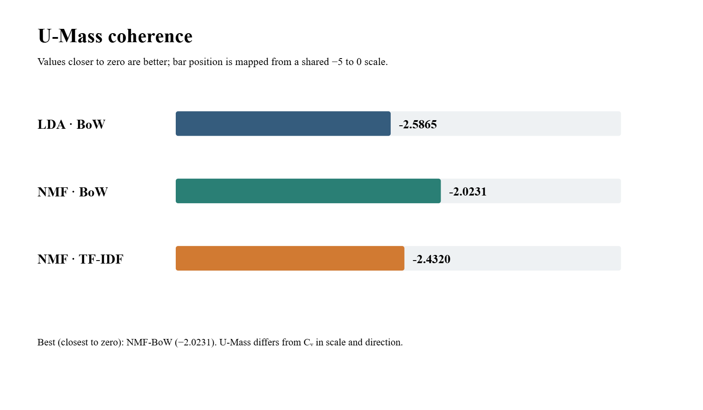
Coherence: NMF-BoW Leads
Cᵥ : NMF-BoW 0.646, NMF-TF-IDF 0.602, LDA-BoW 0.582.
U-Mass : NMF-BoW closest to zero (-2.02); different scale from Cᵥ.
Project 19 · LDA vs NMF · 5/10
Notes:
First chart: NMF-BoW wins on both coherence measures; its top words co-occur best. Keep Cᵥ and U-Mass separate, as their scales differ.

Slide 6
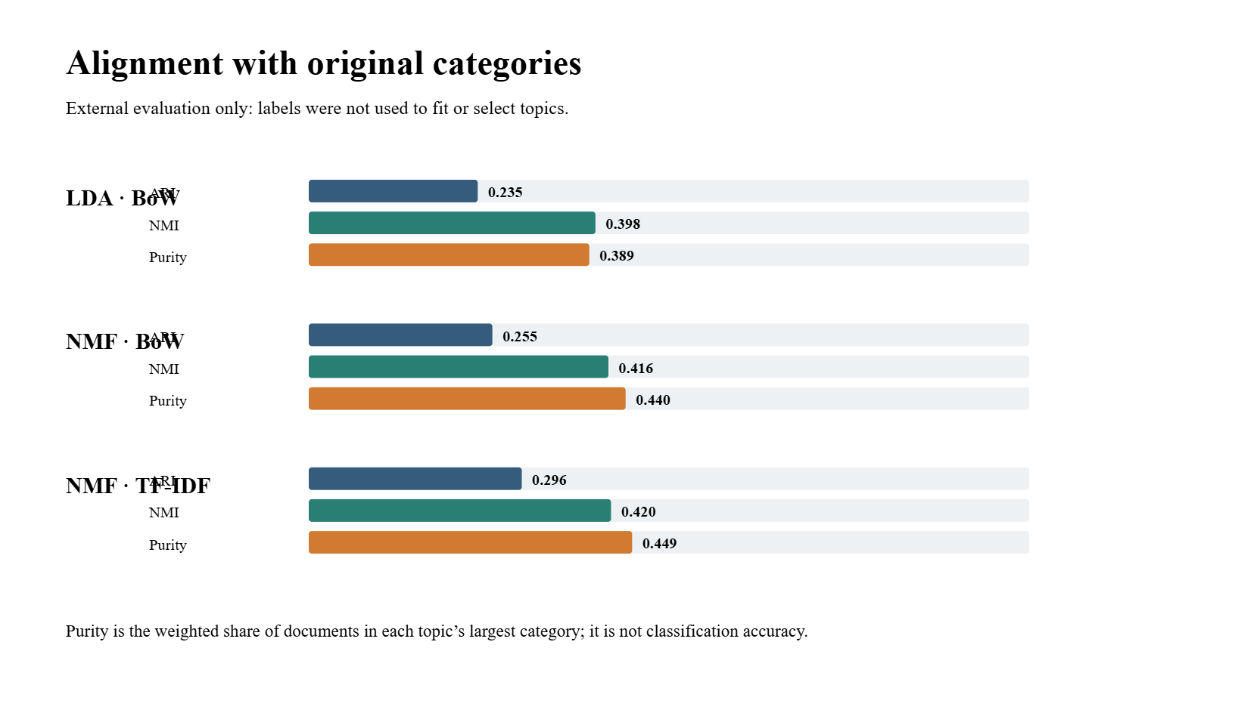
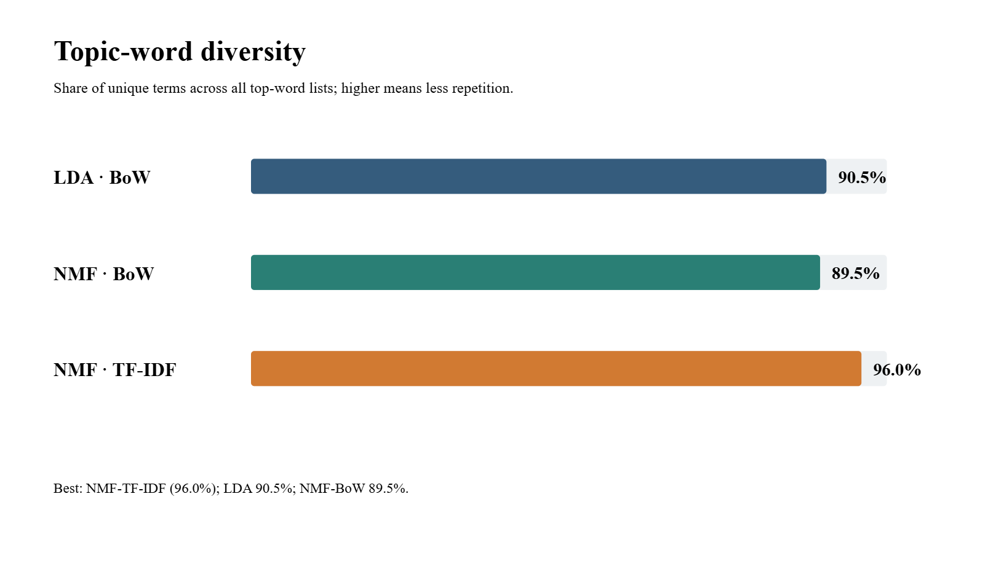
Alignment and Diversity: TF-IDF Leads
NMF-TF-IDF : ARI 0.296, NMI 0.420, purity 44.9%. Moderate agreement; this is not accuracy.
Diversity: 96.0% vs 89.5% (NMF-BoW) and 90.5% (LDA): less redundancy, but lower Cᵥ.
Project 19 · LDA vs NMF · 6/10
Notes:
TF-IDF improves category alignment and diversity, but not coherence: this is the central trade-off. Remind the audience that purity is not accuracy.

Slide 7
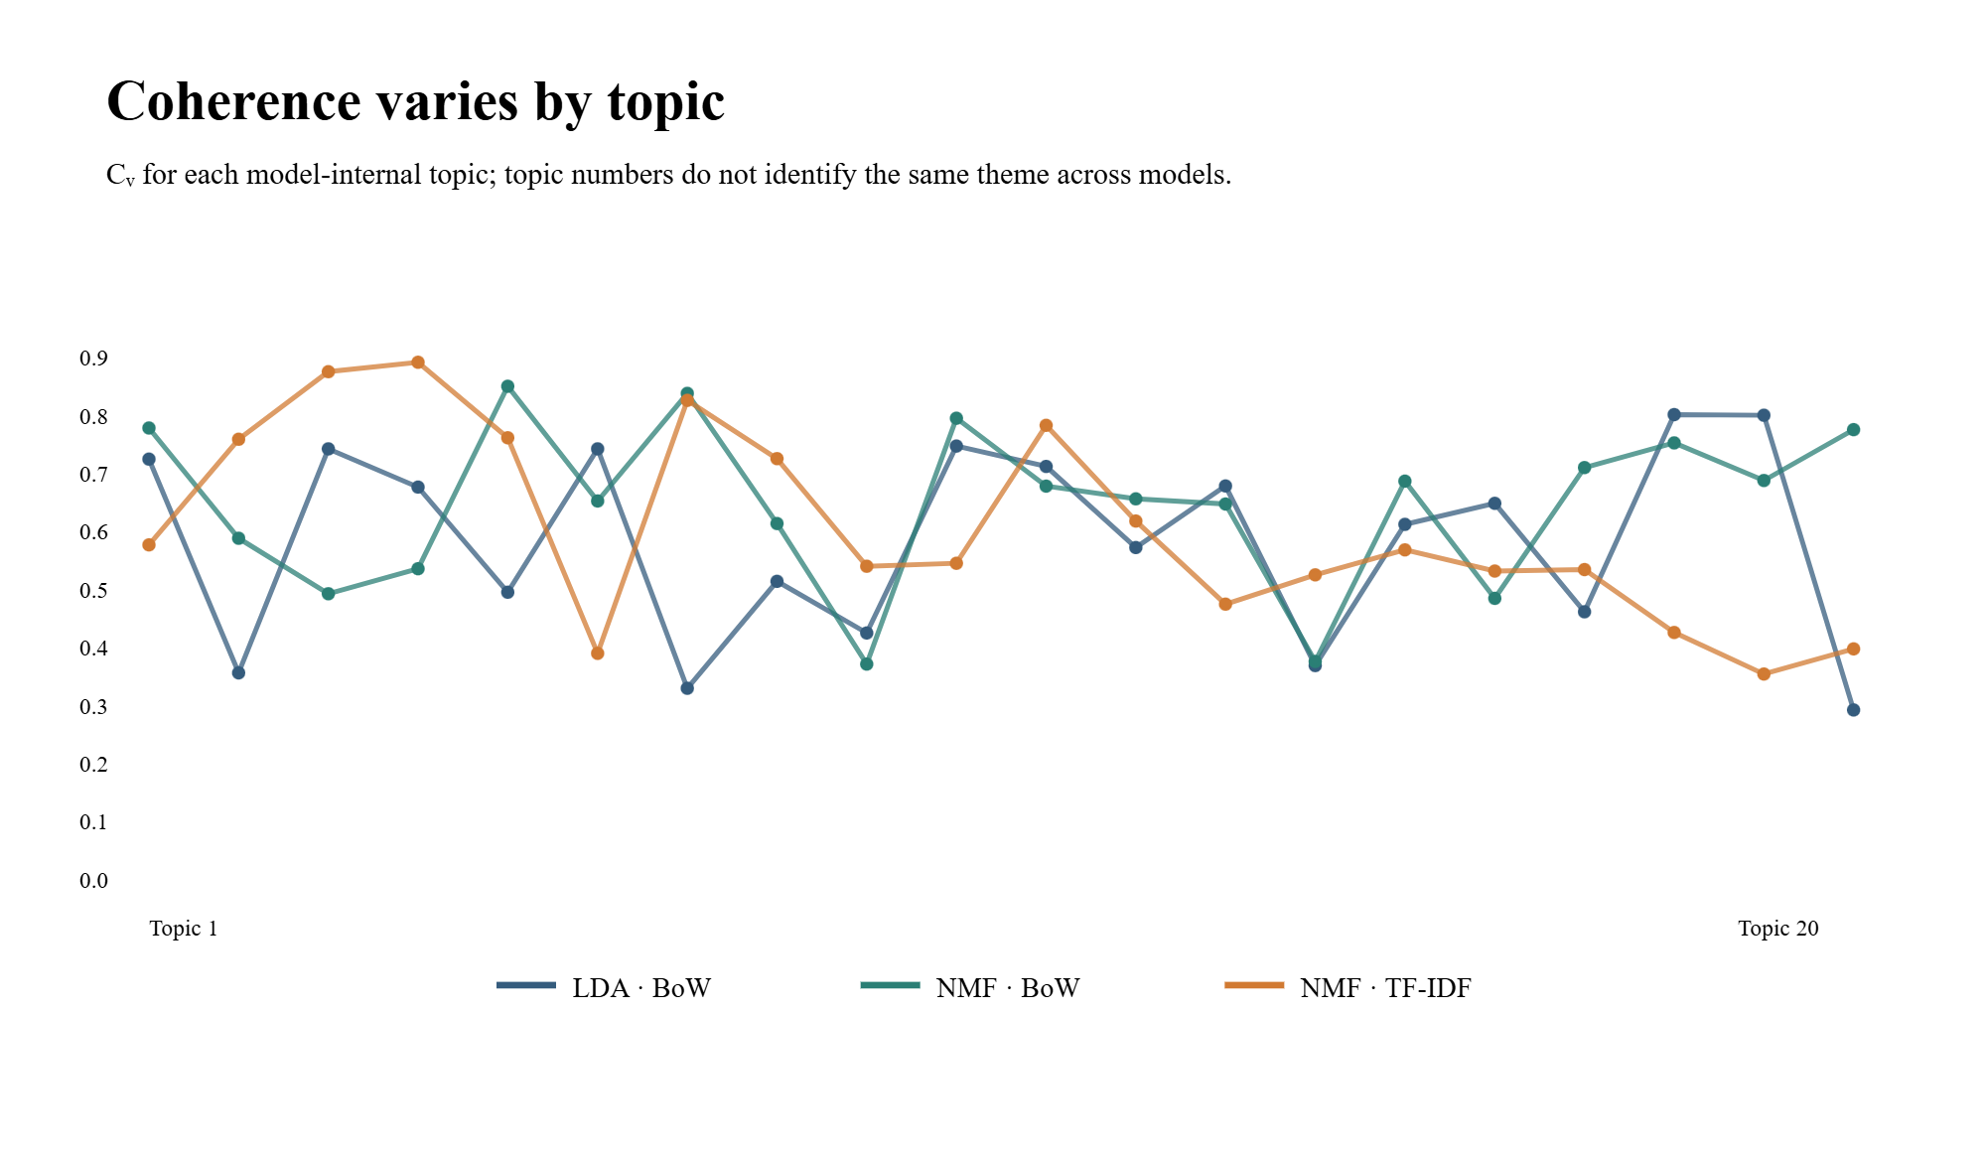
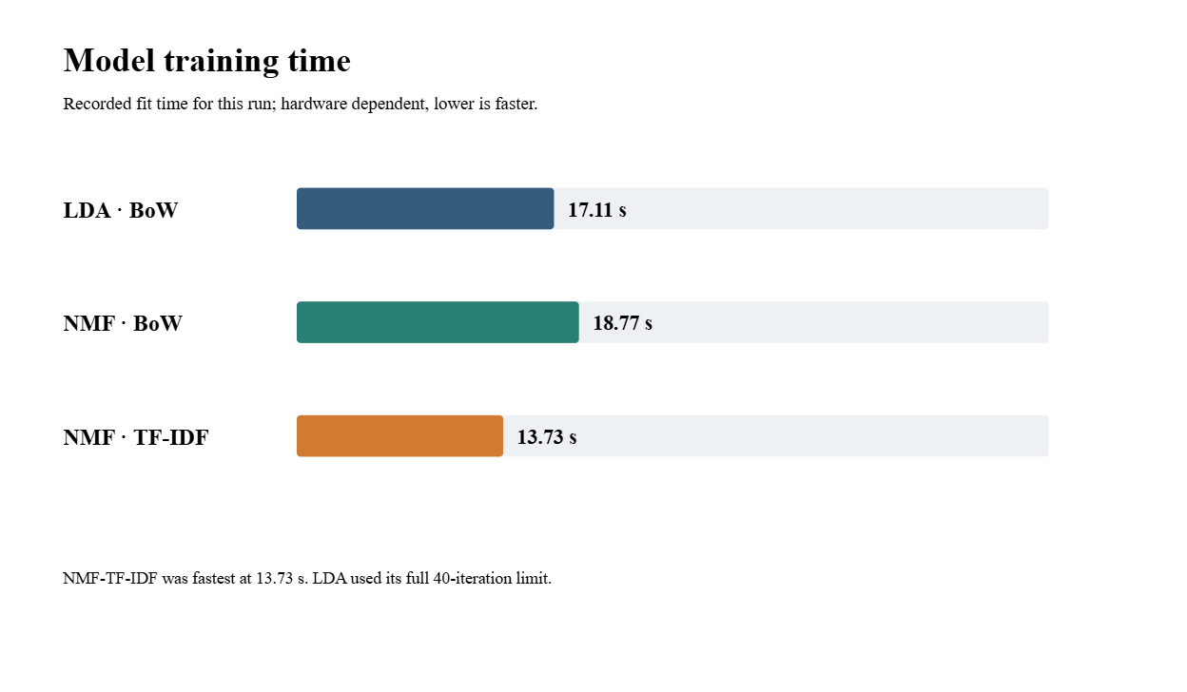
Per-Topic Variation and Time
Time: TF-IDF 13.7 s, LDA 17.1 s, NMF-BoW 18.8 s; hardware-dependent.
Good and poor topics coexist: Cᵥ ranges from 0.889 (storage, NMF-TF-IDF) to 0.289 (photo, LDA). The average alone is not enough.
Project 19 · LDA vs NMF · 7/10
Notes:
Show that a good average score hides weak or mixed topics (electricity, classifieds, photo). Times are indicative and hardware-dependent.

Slide 8
Summary: The Best Model Depends on the Criterion
Model | Cᵥ | U-Mass | Diversity | ARI | NMI | Purity | Time
LDA-BoW | 0.582 | -2.587 | 90.5% | 0.235 | 0.398 | 38.9% | 17.1 s
NMF-BoW | 0.646 | -2.023 | 89.5% | 0.255 | 0.416 | 44.0% | 18.8 s
NMF-TF-IDF | 0.602 | -2.432 | 96.0% | 0.296 | 0.420 | 44.9% | 13.7 s
Strengths
Weaknesses
Limitations
NMF-BoW: most coherent words. TF-IDF: less redundant topics (4% repetition) and better aligned.
Moderate alignment (purity < 45%; this is not accuracy). Weak topics: Cᵥ from 0.29 to 0.39 (electricity, classifieds, photo).
Corpus < 50,000 docs; test set reused for selection; LDA not converged (40/40); old Usenet data.
Project 19 · LDA vs NMF · 8/10
Notes:
3 min. 2 min on the charts (coherence_cv, coherence_umass, category_alignment, topic_diversity, training_time, per_topic_coherence), 1 min on limitations. Cᵥ and alignment measure different properties, hence different winners.

Slide 9
Demo Application
1 · Load
2 · Preprocess
3 · Infer
A .txt file from test_documents/ in the Streamlit app
Same rules as training
Dominant topics for all 3 models, with keywords and interpretation
Short or out-of-vocabulary texts: unstable results. NMF scores = activations, not probabilities.
Project 19 · LDA vs NMF · 9/10
Notes:
0 min 30. Launch the demo; if running late, show a screenshot to preserve the conclusion.

Slide 10
Conclusion and Outlook
NMF-BoW
NMF-TF-IDF
Prioritizes word coherence
Prioritizes diversity, alignment and speed
Reach 50,000 documents and keep a final test set untouched
More iterations for LDA, a study of the number of topics, contextual embeddings
The model proposes groupings that metrics and human analysis must verify.
Notes:
0 min 30. Takeaway: model choice depends on the criterion; inspecting topics complements the metrics.

