Slide 1
SMALL PRECISION TOOLS
Wedge Auto-Draw Rules
Small Wire (SW) Wedge Series – VM Series – Rules
DOCUMENT NO.
DATE
PREPARED BY
STATUS
VM_REL_Rev1_09272026
2026-09-27
Youssef
Draft

Slide 2

VM Series – Overview & Construction
VM Series – Autobonding:
The VM series combines all standard wedge features with a cavity-guide design, widely used for small aluminum wire bonding. Its elliptical back radius keeps the wire centered in the tool for more accurate bond placement.
VM Series – Construction:
Shank style: STYLE_STD, with the optional SLB feature.
All 3D models are built from the sketches below, which hold every dimension needed for the 3D models and drawings.
Never suppress these features!
foot_depth depends on the foot type:}
{VG groove: foot_depth = GD}
{C groove: foot_depth = CD}
{G groove: foot_depth = GD}
{Flat W: foot_depth = 0
funnel_gap is driven by an equation. When the SLB feature is active, set BA = 0° in that equation.
SMALL PRECISION TOOLS
Confidential

Slide 3
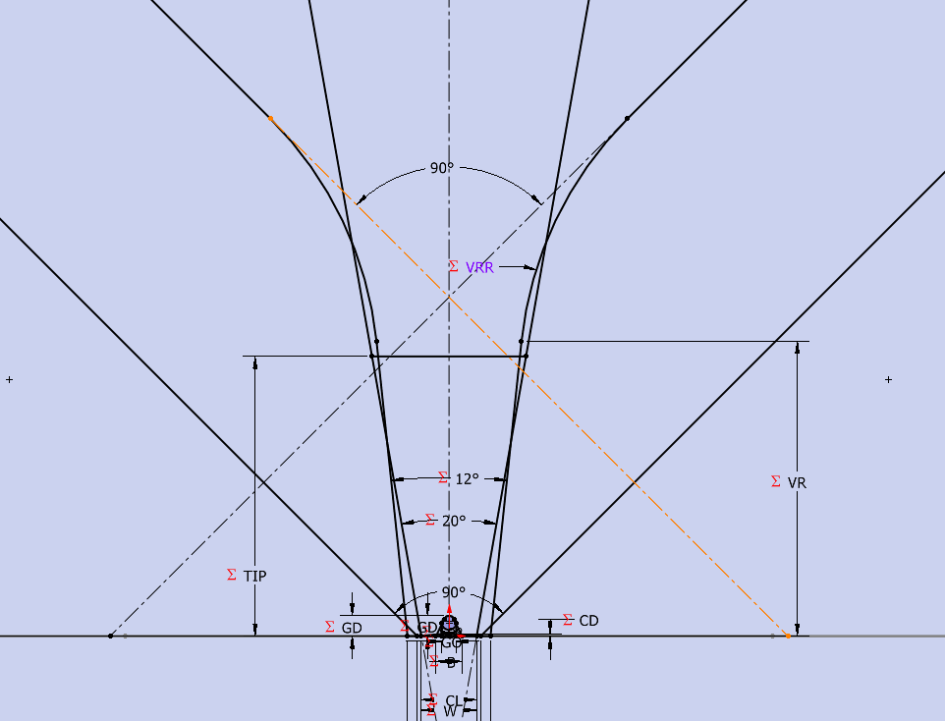
VM Series – VRA Angle Rule
VM Series – VRA angle:
Additional VRA angle rules, per the latest update from SPT.
The arrow shows where the VRA angle is placed.
If the database gives VRA = 90°, the program must enter 0°.
Otherwise, use the VRA value from the database.
The 90° angle at the top is fixed – do not change it.
The annotation name is unchanged, so drawing positioning still works.
For the VR option, also see the overlay changes on the last slides.
SMALL PRECISION TOOLS
Confidential

Slide 4
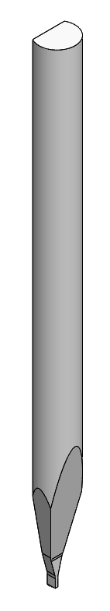
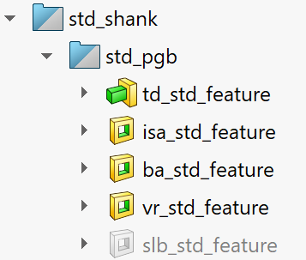

PGB 3D Model – Features
VM Series – PGB 3D model (Customer / Production drawings):
Features for the standard shank case:
Always ON – requires TD, TDF
Always ON – requires W, ISA
Always ON – requires FD, T, RA, BA
Optional – requires VR, VRA, VW, VRR
Optional – requires VBL, VBLR, T
Always ON – requires C, ND, NR, NA, FTA
SMALL PRECISION TOOLS
Confidential

Slide 5
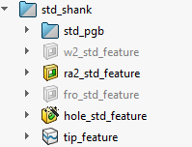
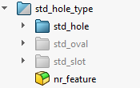
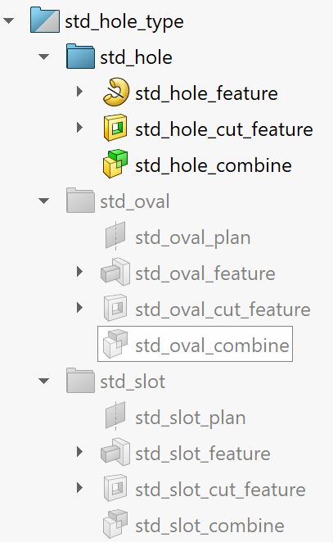
FG 3D Model – Features & Wire Exit
VM Series – FG 3D model (Customer / Production drawings):
Features for the standard shank case:
Optional – requires W2
Optional – requires RA2, RA2H
Optional – requires FRO
Always ON – requires ID, IDTD, IDFA
Optional – only if TIP is in the DB
Always ON – requires NR
Standard hole wire exit (optional): activate all these features – requires H, HA, Y, FNA, funnel_gap
Oval hole wire exit (optional): activate all these features – requires HW, HH, HA, Y, FNA, funnel_gap
Slot wire exit (optional): activate all these features – requires SW, ST, Y, FNA, funnel_gap
SMALL PRECISION TOOLS
Confidential

Slide 6
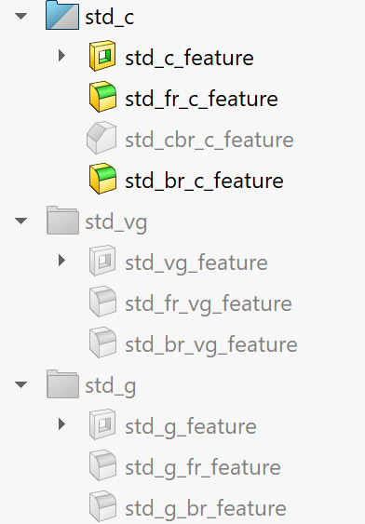
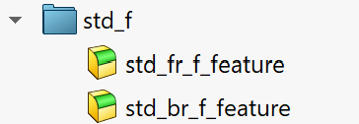
FG 3D Model – Groove Features
VM Series – FG 3D model (Customer / Production drawings):
Groove features for the standard shank case:
C groove (optional): activate std_c_feature, then:
– FRO = FR: activate std_br_c_feature
– FRO ≠ FR: activate std_br_c_feature + std_c_fr_feature
C + CBR: activate std_cbr_c_feature + std_cbr_c_core_feature,
or std_cbr_c_feature + std_c_fr_feature, depending on FRO vs FR.
CBR requires CBRL and CBRD.
VG groove (optional): activate all these features – requires GA, GD
G groove (optional): activate all these features – requires GO, GD
F groove (optional): activate all these features – requires FR, BR; FRO must be OFF
SMALL PRECISION TOOLS
Confidential

Slide 7

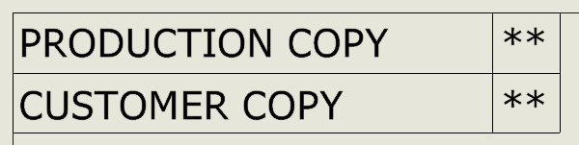
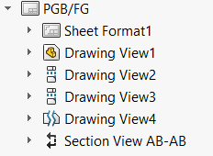
Drawings – Drawing Type & Views
VM Series – Customer / Production drawings:
Pick the drawing type in the Properties Manager (not needed for PGB).
Front view
Right view
Top view
Detail view
Section view
SMALL PRECISION TOOLS
Confidential

Slide 8
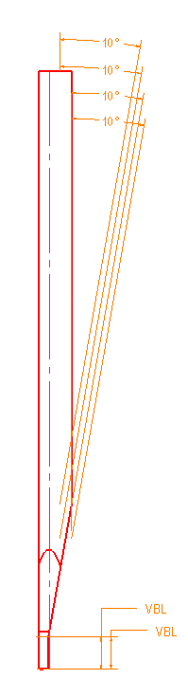
PGB Drawing – Front View
VM Series – PGB Customer / Production drawings:
Front view (PGB)
All annotations in this view come from annotation_std_front_plan.
For STYLE_STD, show only:
BA@annotation_std_front_plan
VBL@annotation_std_front_plan – only with the SLB feature
BA_SLB@annotation_std_front_plan – only with the SLB feature
The view can be placed wherever you prefer.
SMALL PRECISION TOOLS
Confidential

Slide 9
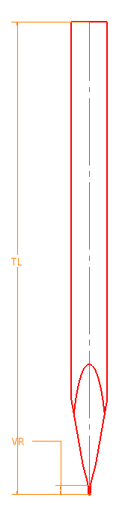
PGB Drawing – Right View
VM Series – PGB Customer / Production drawings:
Right view (PGB)
All annotations in this view come from annotation_right_plan.
TL@annotation_right_plan
VR@annotation_right_plan – optional
The view can be placed wherever you prefer.
SMALL PRECISION TOOLS
Confidential

Slide 10
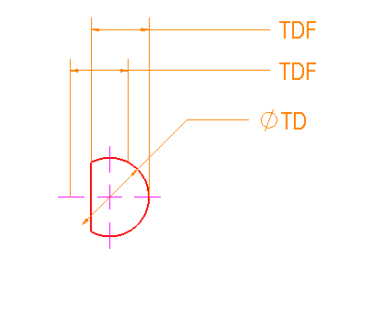
PGB Drawing – Top View
VM Series – PGB Customer / Production drawings:
Top view (PGB)
All annotations in this view come from annotation_top_plan.
TD@annotation_top_plan
TDF_STD@annotation_top_plan – standard shank only
The view can be placed wherever you prefer.
SMALL PRECISION TOOLS
Confidential

Slide 11
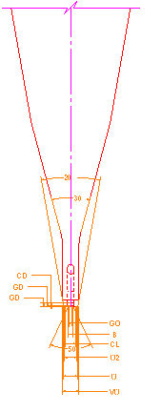
PGB Drawing – Detail View
VM Series – PGB Customer / Production drawings:
Detail view (PGB)
All annotations in this view come from annotation_right_plan.
W@annotation_right_plan
ISA@annotation_right_plan
VW@annotation_right_plan – optional
VRA@annotation_right_plan – optional
The view can be placed wherever you prefer.
SMALL PRECISION TOOLS
Confidential

Slide 12
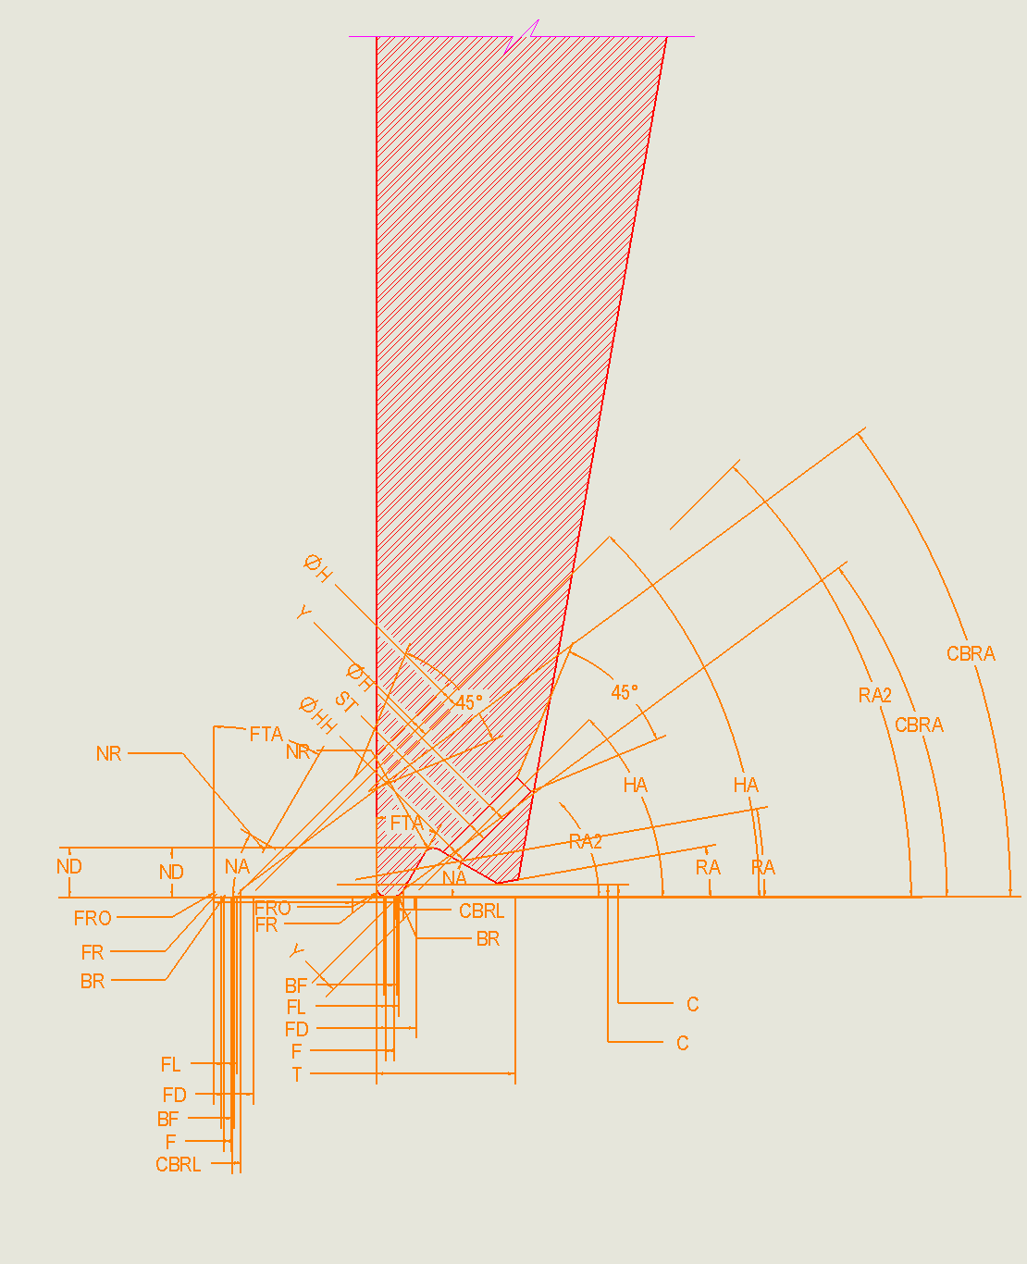
PGB Drawing – Section View
VM Series – PGB Customer / Production drawings:
Section view (PGB)
All annotations in this view come from annotation_std_front_plan.
For STYLE_STD, show only:
FL@annotation_std_front_plan
T@annotation_std_front_plan
The view can be placed wherever you prefer.
SMALL PRECISION TOOLS
Confidential

Slide 13
FG Drawing – Front View
VM Series – FG Customer / Production drawings:
Front view (FG)
All annotations in this view come from annotation_std_front_plan.
For STYLE_STD, show only:
BA@annotation_std_front_plan
VBL@annotation_std_front_plan – only with the SLB feature
BA_SLB@annotation_std_front_plan – only with the SLB feature
The view can be placed wherever you prefer.
SMALL PRECISION TOOLS
Confidential

Slide 14
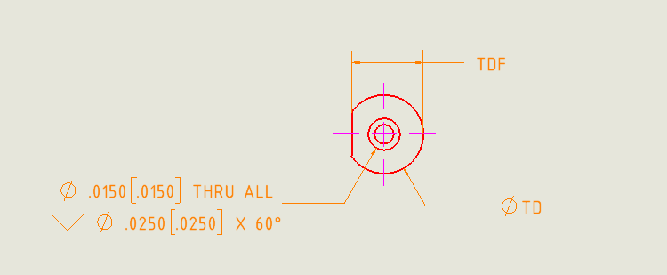
FG Drawing – Top View
VM Series – FG Customer / Production drawings:
Top view (FG)
All annotations in this view come from annotation_top_plan.
TD@annotation_top_plan
TDF_STD@annotation_top_plan
RD1@Drawing View3 – hole annotation
The view can be placed wherever you prefer.
SMALL PRECISION TOOLS
Confidential

Slide 15
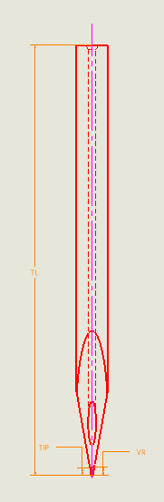
FG Drawing – Right View
VM Series – FG Customer / Production drawings:
Right view (FG)
All annotations in this view come from annotation_right_plan.
TL@annotation_right_plan
VR@annotation_right_plan – optional
TIP@annotation_right_plan – optional
The view can be placed wherever you prefer.
SMALL PRECISION TOOLS
Confidential

Slide 16
FG Drawing – Detail View
VM Series – FG Customer / Production drawings:
Detail view (FG)
All annotations in this view come from annotation_right_plan.
W@annotation_right_plan
ISA@annotation_right_plan
W2@annotation_right_plan – W2 option only
VW@annotation_right_plan – VR option only
VRA@annotation_right_plan – VR option only
B@annotation_right_plan – VG groove only
GA@annotation_right_plan – VG groove only
GD@annotation_right_plan – VG groove only
GD_G@annotation_right_plan – G groove only
GO@annotation_right_plan – G groove only
CL@annotation_right_plan – C groove only
CD@annotation_right_plan – C groove only
The view can be placed wherever you prefer.
SMALL PRECISION TOOLS
Confidential

Slide 17
FG Drawing – Section View
VM Series – FG Customer / Production drawings:
Section view (FG, standard shank)
Annotations come from annotation_std_front_plan,
except the production-only ones.
Always show (@annotation_std_front_plan):
FL, T, RA, C, NA, FTA, ND, NR, FNA, HA, FRO
Show only when it applies (@annotation_std_front_plan):
RA2 – RA2 option
H – standard hole
HH – oval hole
ST – slot
FR – hide when FRO = FR
BR – hide when CBR is present
Production drawing only (@annotation_front_plan):
BF, F, Y, CBRL, CBRA
The view can be placed wherever you prefer.
SMALL PRECISION TOOLS
Confidential

Slide 18
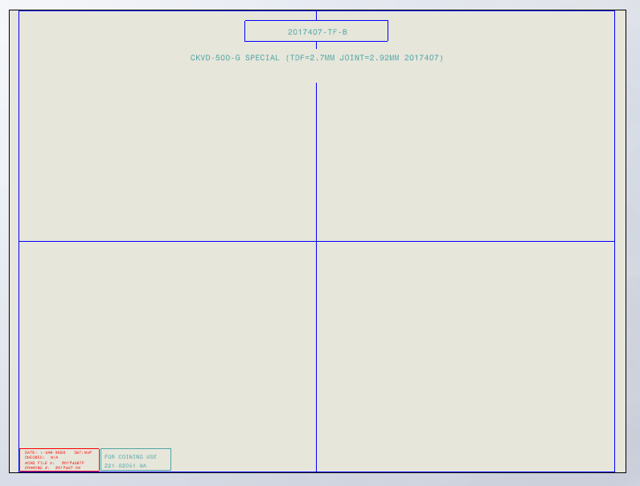
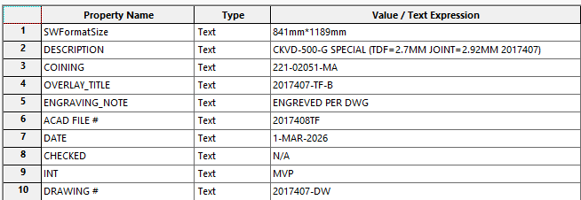
Overlays – Layout
VM Series – Overlays:
How an overlay is built
Every overlay follows this layout:
Right and left views
Auxiliary view (optional)
Annotation
Overlay metadata – set in the Properties Manager (below)
Annotation
Left view
Auxiliary view
Right view
SMALL PRECISION TOOLS
Confidential

Slide 19
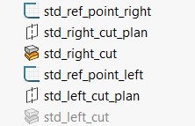

Overlays – Reference Points (Std Shank)
VM Series – Overlays:
Overlay construction, std_shank case
Views are positioned using reference points:
std_ref_point_right controls where the right view is cut in the overlay (the right view uses the right_view configuration).
The programmer sets the cut for each case by changing std_ref_point_right@std_ref_point_right.
Previous rule, based on the view scale:
std_ref_point_right@std_ref_point_right = 2.01175 in / scale
OK for most standard cases, but not OK for VR cases – the programmer must set the correct value.
std_ref_point_left controls where the left view is cut in the overlay (the left view uses the left_view configuration).
The programmer sets the cut for each case by changing std_ref_point_left@std_ref_point_left.
Previous rule, based on the view scale:
std_ref_point_left@std_ref_point_left = 2.01175 in / scale
OK for most standard cases.
SMALL PRECISION TOOLS
Confidential

Slide 20
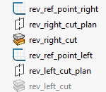
Overlays – Reference Points (Rev Shank)
VM Series – Overlays:
Overlay construction, rev_shank case
Views are positioned using reference points:
rev_ref_point_right controls where the right view is cut in the overlay (the right view uses the right_view configuration).
The programmer sets the cut for each case by changing rev_ref_point_right@rev_ref_point_right.
Previous rule, based on the view scale:
rev_ref_point_right@rev_ref_point_right = 2.01175 in / scale
OK for most standard cases, but not OK for VR cases – the programmer must set the correct value.
rev_ref_point_left controls where the left view is cut in the overlay (the left view uses the left_view configuration).
The programmer sets the cut for each case by changing rev_ref_point_left@rev_ref_point_left.
Previous rule, based on the view scale:
rev_ref_point_left@rev_ref_point_left = 2.01175 in / scale
OK for most standard cases.
SMALL PRECISION TOOLS
Confidential

Slide 21
Overlays – Scale Selection
VM Series – Overlays:
Scale selection
Right and left views use the same scale, chosen from the FL value.
Limits per scale:
x400: T ≤ 0.0134 in (0.3403 mm)
x300: T ≤ 0.0180 in (0.4572 mm)
x200: T ≤ 0.0272 in (0.6908 mm)
x100: T ≤ 0.0542 in (1.3766 mm)
Scale values:
S100 = 1:60.8
S200 = 1:121.1
S300 = 1:183.0
S400 = 1:246.0
SMALL PRECISION TOOLS
Confidential

Slide 22
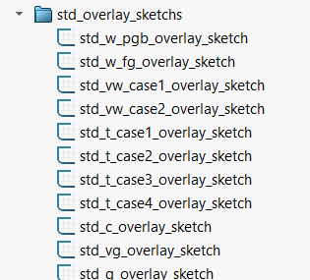
PGB Overlay – Sketch Settings
VM Series – Overlays:
PGB overlay sketches, std_shank
W → MAX. Sketch: W_MIN
Turn off
If VW = W: VW, VRA → MAX; VR → MIN. Sketch: VW_MIN, VRA_MIN, VRA_MAX
If VW ≠ W: VW, VRA, W, ISA → MAX; VR → MIN. Sketch: VW_MIN, VRA_MIN, VRA_MAX, W_MIN, ISA_MIN
Standard case: T, FL → MAX; ND, C → MIN. Sketch: T_MIN, FL_MIN, C_MAX, ND_MAX
If SLB: T, FL → MAX; ND, C → MIN. Sketch: T_MIN, FL_MIN, C_MAX, ND_MAX
If RA2: T, FL → MAX; ND, RA2H → MIN. Sketch: T_MIN, FL_MIN, RA2H_MAX, ND_MAX
If RA2 + SLB: T, FL → MAX; ND, RA2H → MIN. Sketch: T_MIN, FL_MIN, RA2H_MAX, ND_MAX
Turn off
Turn off
Turn off
Note: the programmer must apply these values both in the equations and inside the sketches.
SMALL PRECISION TOOLS
Confidential

Slide 23
FG Overlay – Sketch Settings
VM Series – Overlays:
FG overlay sketches, std_shank
Turn off
W → NOM. Sketch: W_MIN, W_MAX
If VW = W: VW, VRA → MAX; VR → MIN. Sketch: VW_MIN, VRA_MIN, VRA_MAX
If VW ≠ W: VW, VRA, W, ISA → MAX; VR → MIN. Sketch: VW_MIN, VRA_MIN, VRA_MAX, W_MIN, ISA_MIN
Standard case: T, FL → MAX; ND, C → MIN. Sketch: T_MIN, FL_MIN, C_MAX, ND_MAX
If SLB: T, FL → MAX; ND, C → MIN. Sketch: T_MIN, FL_MIN, C_MAX, ND_MAX
If RA2: T, FL → MAX; ND, RA2H → MIN. Sketch: T_MIN, FL_MIN, RA2H_MAX, ND_MAX
If RA2 + SLB: T, FL → MAX; ND, RA2H → MIN. Sketch: T_MIN, FL_MIN, RA2H_MAX, ND_MAX
If C groove: CL, CD → MIN. Sketch: CL_MAX, CD_MAX
If VG groove: GA, GD, B → MIN. Sketch: GA_MAX, GD_MAX, B_MAX
If G groove: GO, GD → MIN. Sketch: GO_MAX, GD_MAX
Note: the programmer must apply these values both in the equations and inside the sketches.
SMALL PRECISION TOOLS
Confidential

