Slide 1
SMALL PRECISION TOOLS
Wedge Auto-Draw Rules
Large Wire (LW) Wedge Series – CKVD Series – Rules
DOCUMENT NO.
DATE
PREPARED BY
STATUS
CKVD_REL_Rev2_07262026
2026-26-07
Youssef
Draft

Slide 2


Rules
CKVD Series - 70° V-Groove : the CKVD series has a 70° deep V-groove design for Cho-onpa heavy wire bonder. Typically, with symmetrical front and back radii around 30% of the wire diameter. Also available with larger back radius to help guide the wire through the groove.
CKVD Series – Construction : CVKD has two shank style : STYLE_A & SYLE_B , I don’t know if we have in database these, but we can select which type by values , if we don’t have X or FX values it means it’s STYLE_A , else its STYLE_B All the 3D models is based on the bellow sketches; these sketch has all the required dimension to construction the 3D models and drawings
annotation_top_plan | TD - TDF
annotation_right_plan | W – ISA – VW – VR – VRR – VRA – TL
style_a_annotation_front_plan | E – ER – BA – FL – F – FRX – BRX – FR – BR
style_b_annotation_front_plan | X – FX – FA - E – ER – BA – FL – F – FRX – BRX – FR – BR
For FRX/BRX if exist in database we push to the equation file, if they don’t have values, we calculate them based on the equation
For CKVD we consider FA and BA = 0° just for the equation !
For X/FX, we always input X , But in some cases X value is missing so we use this equation :
X = TDF - (FL+FX)
SMALL PRECISION TOOLS
Confidential

Slide 3
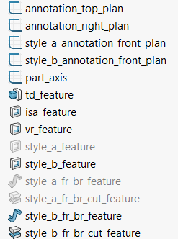
Rules
CKVD Series – PGB 3D for Customer / Production Drawings : PGB 3D has the following feature :
Always ON
Always ON
Always ON
Always ON
Always ON
Always ON
Always ON
Optional if : VR/VW/VRR/VRA exist
Based on shank style
Based on shank style
Always OFF
Always OFF
Always OFF
Always OFF
SMALL PRECISION TOOLS
Confidential

Slide 4
Rules
CKVD Series – FG 3D for Customer / Production Drawings: PGB 3D has the following feature :
Always ON
Always ON
Always ON
Always ON
Always ON
Always ON
Always ON
Optional if : VR/VW/VRR/VRA exist
Based on shank style
Based on shank style
Based on shank style_A
Based on shank style_A
Based on shank style_B
Based on shank style_B
SMALL PRECISION TOOLS
Confidential

Slide 5

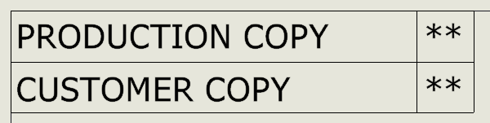
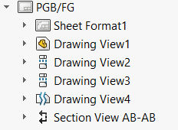
Rules
CKVD Series – Customer / Production Drawings: We can select the type of drawing from drawings properties manager, PGB no need to fill these properties
Front view
Right view
Top view
Detail view
Section view
SMALL PRECISION TOOLS
Confidential

Slide 6
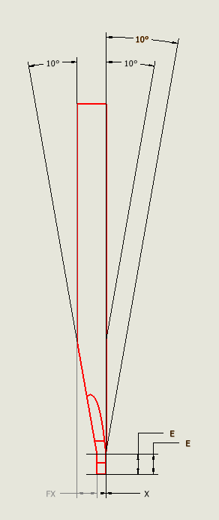
Rules
CKVD Series – PGB Customer / Production Drawings: Front view in case of PGB :
Front view have many annotation, all the annotation are from style_a_annotation_front_plan or style_a_annotation_front_plan In case of SYLE_A we show only : BA@ style_a_annotation_front_plan E@ style_a_annotation_front_plan In case of STYLE_B we show only: FA@ style_a_annotation_front_plan BA@ style_a_annotation_front_plan E@ style_a_annotation_front_plan X@ style_a_annotation_front_plan if it's given in DB FX@ style_a_annotation_front_plan if it’s given in DB The view can be positioned based on your preference
SMALL PRECISION TOOLS
Confidential

Slide 7
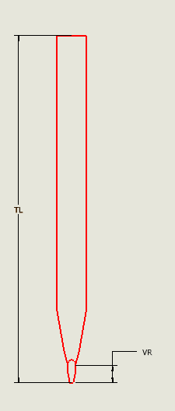
Rules
CKVD Series – PGB Customer / Production Drawings: Right view in case of PGB :
Right view have many annotation, all the annotation are from annotation_right_plan
TL@annotation_right_plan
VR@annotation_right_plan Optional
The view can be positioned based on your preference
SMALL PRECISION TOOLS
Confidential

Slide 8
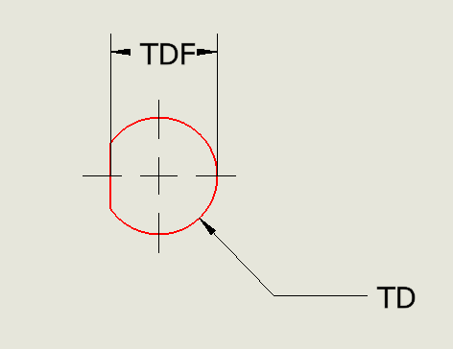
Rules
CKVD Series – PGB Customer / Production Drawings: Top view in case of PGB :
Top view have many annotation, all the annotation are from annotation_top_plan TD@annotation_top_plan TDF@annotation_top_plan The view can be positioned based on your preference
SMALL PRECISION TOOLS
Confidential

Slide 9
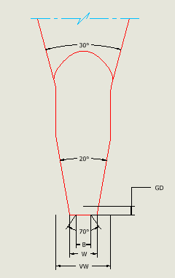
Rules
CKVD Series – PGB Customer / Production Drawings: Detail view in case of PGB :
Detail view have many annotation, all the annotation are from annotation_right_plan W@annotation_right_plan ISA@annotation_right_plan VW@annotation_right_plan Optional VRA@annotation_right_plan Optional The view can be positioned based on your preference
SMALL PRECISION TOOLS
Confidential

Slide 10
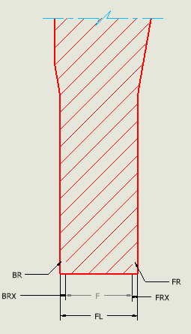
Rules
CKVD Series – PGB Customer / Production Drawings: Section view in case of PGB :
Section view have many annotation, all the annotation are from style_a_annotation_front_plan or style_a_annotation_front_plan In case of SYLE_A we show only : FL@style_a_annotation_front_plan In case of STYLE_B we show only: FL@style_b_annotation_front_plan The view can be positioned based on your preference
SMALL PRECISION TOOLS
Confidential

Slide 11
Rules
CKVD Series – FG Customer / Production Drawings: Front view in case of FG :
Front view have many annotation, all the annotation are from style_a_annotation_front_plan or style_a_annotation_front_plan In case of SYLE_A we show only : BA@ style_a_annotation_front_plan E@ style_a_annotation_front_plan In case of STYLE_B we show only: FA@ style_a_annotation_front_plan BA@ style_a_annotation_front_plan E@ style_a_annotation_front_plan X@ style_a_annotation_front_plan if it's given in DB FX@ style_a_annotation_front_plan if it’s given in DB The view can be positioned based on your preference
SMALL PRECISION TOOLS
Confidential

Slide 12
Rules
CKVD Series – FG Customer / Production Drawings: Right view in case of FG :
Right view have many annotation, all the annotation are from annotation_right_plan
TL@annotation_right_plan
VR@annotation_right_plan Optional
The view can be positioned based on your preference
SMALL PRECISION TOOLS
Confidential

Slide 13
Rules
CKVD Series – FG Customer / Production Drawings: Top view in case of FG :
Top view have many annotation, all the annotation are from annotation_top_plan TD@annotation_top_plan TDF@annotation_top_plan The view can be positioned based on your preference
SMALL PRECISION TOOLS
Confidential

Slide 14
Rules
CKVD Series – FG Customer / Production Drawings: Detail view in case of FG :
Detail view have many annotation, all the annotation are from annotation_right_plan W@annotation_right_plan ISA@annotation_right_plan GD@annotation_right_plan
B@annotation_right_plan
GA@annotation_right_plan VW@annotation_right_plan Optional VRA@annotation_right_plan Optional The view can be positioned based on your preference
SMALL PRECISION TOOLS
Confidential

Slide 15
Rules
CKVD Series – FG Customer / Production Drawings: Section view in case of FG:
Section view have many annotation, all the annotation are from style_a_annotation_front_plan or style_a_annotation_front_plan In case of SYLE_A we show only : FL@style_a_annotation_front_plan F@style_a_annotation_front_plan BR@style_a_annotation_front_plan FR@style_a_annotation_front_plan BRX@style_a_annotation_front_plan if given in DB FRX@style_a_annotation_front_plan if given in DB In case of STYLE_B we show only: FL@style_b_annotation_front_plan F@style_b_annotation_front_plan BR@style_b_annotation_front_plan FR@style_b_annotation_front_plan BRX@style_b_annotation_front_plan if given in DB FRX@style_b_annotation_front_plan if given in DB The view can be positioned based on your preference
SMALL PRECISION TOOLS
Confidential

Slide 16
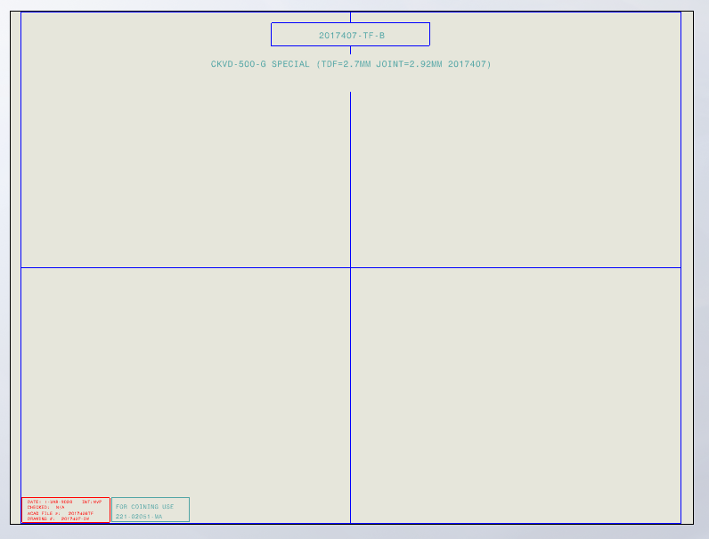
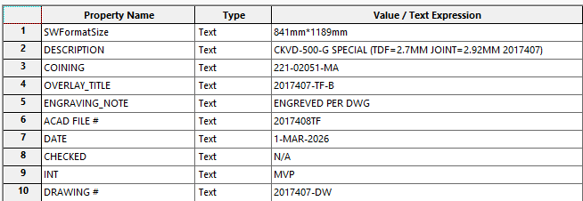
Rules
CKVD Series –Overlay : Construction of overlays
In general, overlays respect the following shape : Right and Left view. Axillary view Optional Annotation Overlay Metadata controlled by properties manager's bellow
Annotation
Left view
Axillary view
Right view
SMALL PRECISION TOOLS
Confidential

Slide 17



Rules
CKVD Series –Overlay : Construction of overlays
View will pe positioned based on reference points :
Standard cases : Right & Left views will have by default Overlay configuration Use ref_point to position the right view Use ref_point_a or ref_point_b to position the left view based on wedge style In 3D model turn ON these features
ref_point is positioned by the scale of the view
ref_point_non_std_cut is controlled by parameters called "non_std_cut“, the programmer will give its value
ref_point_a & ref_point_b are positioned automatically using sketches
Non Standard cases : When we have VR/VW Right view will have Overlay_non_std_cut configuration
Left view will have by default Overlay configuration Use ref_point_non_std_cut to position the right view Use ref_point_a or ref_point_b to position the left view based on wedge style In 3D model turn ON these features
Right view
Left view
SMALL PRECISION TOOLS
Confidential

Slide 18
Rules
CKVD Series –Overlay : Construction of overlays
Right & Left view will have the same scale; the scale is chosen based on FL values
Numerical Limits:
x400 : FL ≤ 0.0134 in or 0.3403 mm
x300 : FL ≤ 0.0180 in or 0.4572 mm
x200 : FL ≤ 0.0272 in or 0.6908 mm
x100 : FL ≤ 0.0542 in or 1.3766 mm The scales : S100 = 1:60.8
S200 = 1:121.1
S300 = 1:183.0
S400 = 1:246.0
SMALL PRECISION TOOLS
Confidential

Slide 19

Rules
CKVD Series – PGB Overlay : Construction of PGB overlays
PGB Overlay :
Respect all instruction in slide 3 Activate these overlay feature see note 1 Choose the scale based on FL value Activate the correspond cut Position the view using the reference points Add Auxiliary views
Add annotations
Add metadata By default, these sketch are on ! Make sure to rebuild before saving to tif
Note 1 : In most of standard cases with no VR/VW
Change the values of
W parameter will have W_MAX
W_MIN@w_pgb_overlay_sketch with W_MIN = W_UTOL - W_LTOL
FL parameter will have FL_MAX
FL_MIN@style_a_fl_pgb_overlay_sketch with FL_MIN = FL_UTOL – FL_LTOL
FL parameter will have FL_MAX
FL_MIN@style_b_fl_pgb_overlay_sketch with FL_MIN = FL_UTOL – FL_LTOL
SMALL PRECISION TOOLS
Confidential

Slide 20

Rules
CKVD Series – PGB Overlay : Construction of PGB overlays
Note 2 : Cases with VR/VW
PGB Overlay :
Respect all instruction in slide 3 Activate these overlay feature see note 2 Choose the scale based on FL value Activate the correspond cut Position the view using the reference points Add Auxiliary views
Add annotations
Add metadata By default, these sketch are on ! Use the the configuration for VR/VW for right view and use the ref point to position it ! Make sure to rebuilt before saving to tif
If VW = W its case1 If VW > W its case2
Change the values of
FL parameter will have FL_MIN
FL_MIN@style_a_fl_pgb_overlay_sketch
FL parameter will have FL_MIN
FL_MAX@style_b_fl_pgb_overlay_sketch VW_MIN@vw_case1_pgb_overlay_sketch VW parameter will have VW_MAX
VR_MIN@vw_case1_pgb_overlay_sketch VR parameter will have VR_MAX
VRA_MIN@vw_case1_pgb_overlay_sketch VRA parameter will have VRA_MAX
Change the values of
FL parameter will have FL_MIN
FL_MIN@style_a_fl_pgb_overlay_sketch
FL parameter will have FL_MIN
FL_MAX@style_b_fl_pgb_overlay_sketch VW_MIN@vw_case2_pgb_overlay_sketch VW parameter will have VW_MAX
VR_MIN@vw_case2_pgb_overlay_sketch VR parameter will have VR_MAX
VRA_MIN@vw_case2_pgb_overlay_sketch VRA parameter will have VRA_MAX W_MIN@vw_case2_pgb_overlay_sketch W parameter will W_MAX
ISA_MIN@vw_case2_pgb_overlay_sketch ISA parameter will ISA_MAX
SMALL PRECISION TOOLS
Confidential

Slide 21
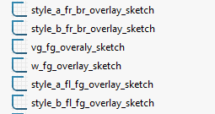
Rules
CKVD Series – FG Overlay : Construction of FG overlays
Note 3 : In most of standard cases with no VR/VW
PGB Overlay :
Respect all instruction in slide 3 Activate these overlay feature see note 3 Choose the scale based on FL value Activate the correspond cut Position the view using the reference points Add Auxiliary views
Add annotations
Add metadata By default, these sketch are on ! Make sure to rebuild before saving to tif
Based on style chose :
style_a_fr_br_overlay_sketch or style_b_fr_br_overlay_sketch no need to change any dimension ! Show vg_fg_overlay_sketch change the values : B parameter will have B_MIN
B_MAX@vg_fg_overlay_sketch GA parameter will have GA_MIN
GA_MAX@vg_fg_overlay_sketch
GD parameter will have GD_MIN
GD_MAX@vg_fg_overlay_sketch
Show w_fg_overlay_sketch change the values :
W_MIN@w_fg_overlay_sketch
W_MAX@w_fg_overlay_sketch
Based on style chose :
style_a_fl_overlay_sketch or style_b_fl_overlay_sketch change the values : FL_MIN@style_a_fl_overlay_sketch
FL_MAX@style_a_fl_overlay_sketch
FL_MIN@style_b_fl_overlay_sketch
FL_MAX@style_b_fl_overlay_sketch
SMALL PRECISION TOOLS
Confidential

Slide 22

Rules
CKVD Series – FG Overlay : Construction of PGB overlays
Note 2 : Cases with VR/VW
PGB Overlay :
Respect all instruction in slide 3 Activate these overlay feature see note 2 Choose the scale based on FL value Activate the correspond cut Position the view using the reference points Add Auxiliary views
Add annotations
Add metadata By default, these sketch are on ! Use the the configuration for VR/VW for right view and use the ref point to position it ! Replicate the same as the slide before, with out showing w_fg_overlay_sketch Make sure to rebuilt before saving to tif
If VW = W its case1 If VW > W its case2
VW_MIN@vw_case1_fg_overlay_sketch VW parameter will have VW_MAX
VR_MIN@vw_case1_fg_overlay_sketch VR parameter will have VR_MAX
VRA_MIN@vw_case1_fg_overlay_sketch VRA parameter will have VRA_MAX
VW_MIN@vw_case2_fg_overlay_sketch VW parameter will have VW_MAX
VR_MIN@vw_case2_fg_overlay_sketch VR parameter will have VR_MAX
VRA_MIN@vw_case2_fg_overlay_sketch VRA parameter will have VRA_MAX W_MIN@vw_case2_fg_overlay_sketch W parameter will W_MAX
ISA_MIN@vw_case2_fg_overlay_sketch ISA parameter will ISA_MAX
SMALL PRECISION TOOLS
Confidential

