Slide 1
SMALL PRECISION TOOLS
Wedge Auto-Draw Rules
Small Wire (SW) Wedge Series – 45CK Series – Rules
DOCUMENT NO.
DATE
PREPARED BY
STATUS
45CK_REL_Rev1_08182026
2026-18-08
Youssef
Draft

Slide 2

Rules
45CK Series - 70° V-Groove with integrated feed hole : The 45CK design has a 70° V-groove with 45° feed hole. This style has symmetrical front and back radius around 50% of the wire diameter. This style is available for wire sizes from 75 microns to 250 microns (3mils to 10mils).
45CK Series – Construction : 45CK has one shank style : STYLE_STD , with SLB feature All the 3D models is based on the bellow sketches; these sketch has all the required dimension to construction the 3D models and drawings
annotation_top_plan | TD - TDF
annotation_right_plan | W–ISA–VW–VR–VRR–VRA–TL–B-GA-GD
annotation_front_plan | BA-T-FD-RA-RA2-RA2H-CA-ERL-ERD-FL-C-BR-FR-H-HA-FNA-F-BF-Y-G-CGR-CGD-VBL-VBLR-funnel_gap – foot_depth
Never delete those sketches
For foot_depth we need to calculate it based on with foot type we have : VG groove , foot_depth = GD For funnel_gap we have the equation , just in case of SLB feature make in the equation that BA = 0deg
SMALL PRECISION TOOLS
Confidential

Slide 3
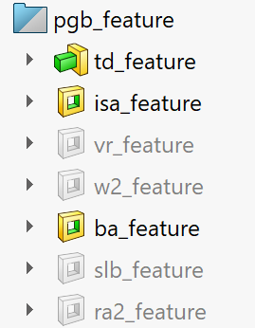
Rules
45CK Series – PGB 3D for Customer / Production Drawings : PGB 3D has the following feature :
Always ON
Always ON
Optional if we have VR, VRA, VRR, VW
Optional if we have W2
Always ON
Optional if we have VBLR, VBL
Optional if we have RA2, RA2H
SMALL PRECISION TOOLS
Confidential

Slide 4
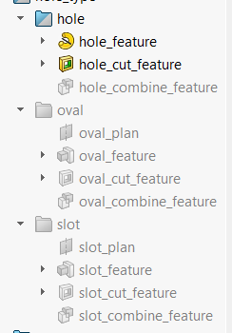
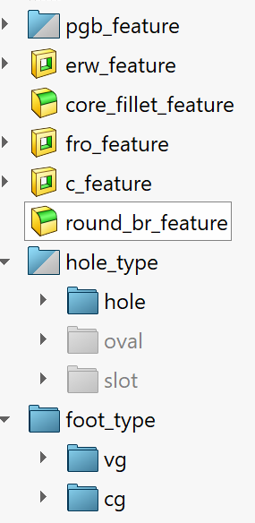
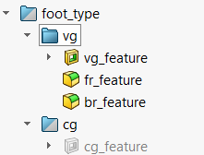
Rules
45CK Series – FG 3D for Customer / Production Drawings: FG 3D has the following feature, We respect the rule of PGB but adding the bellow
Respect the PGB rules
Always ON
Always ON
Always ON
Always ON
Always ON
Optional , based on hole type , we need to have H
Optional , based on hole type , we need to have HH, HW , you need to change H = HH
Optional , based on hole type , we need to have ST, SW, you need to change H=ST
Always ON , we need B, GA, GD
Optional , if we have CGO, CGR, G
SMALL PRECISION TOOLS
Confidential

Slide 5

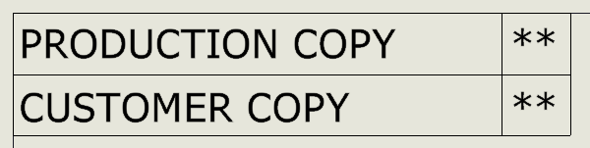
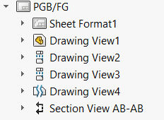
Rules
45CK Series – Customer / Production Drawings: We can select the type of drawing from drawings properties manager, PGB no need to fill these properties
Front view
Right view
Top view
Detail view
Section view
SMALL PRECISION TOOLS
Confidential

Slide 6
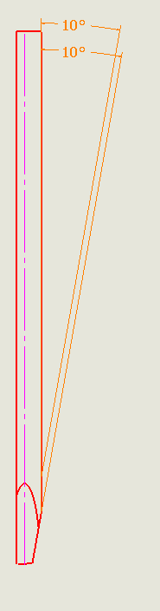
Rules
45CK Series – PGB Customer / Production Drawings: Front view in case of PGB :
Front view have many annotation, all the annotation are from annotation_front_plan BA@annotation_front_plan BA_VBL@annotation_front_plan in case we have SLB feature The view can be positioned based on your preference
SMALL PRECISION TOOLS
Confidential

Slide 7
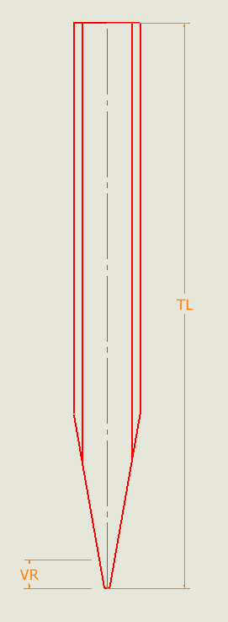
Rules
45CK Series – PGB Customer / Production Drawings: Right view in case of PGB :
Right view have many annotation, all the annotation are from annotation_right_plan
TL@annotation_right_plan
VR@annotation_right_plan Optional
The view can be positioned based on your preference
SMALL PRECISION TOOLS
Confidential

Slide 8
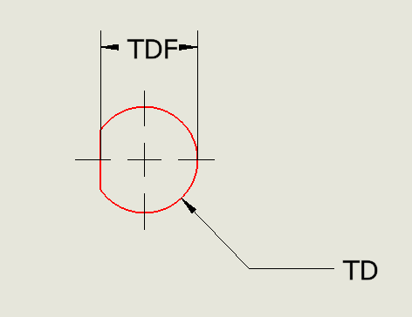
Rules
45CK Series – PGB Customer / Production Drawings: Top view in case of PGB :
Top view have many annotation, all the annotation are from annotation_top_plan TD@annotation_top_plan TDF@annotation_top_plan The view can be positioned based on your preference
SMALL PRECISION TOOLS
Confidential

Slide 9
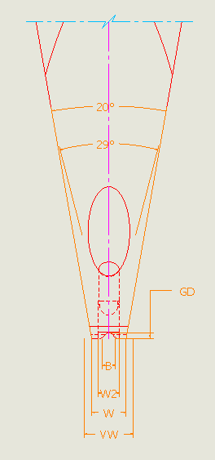
Rules
45CK Series – PGB Customer / Production Drawings: Detail view in case of PGB :
Detail view have many annotation, all the annotation are from annotation_right_plan W@annotation_right_plan ISA@annotation_right_plan VW@annotation_right_plan Optional VRA@annotation_right_plan Optiona W2@annotation_righ_plan Optional l The view can be positioned based on your preference
SMALL PRECISION TOOLS
Confidential

Slide 10
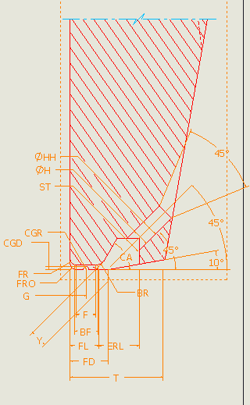
Rules
45CK Series – PGB Customer / Production Drawings: Section view in case of PGB :
Section view have many annotation, all the annotation are from annotation_front_plan In case of SYLE_A we show only : FL@annotation_front_plan
T@annotation_front_plan The view can be positioned based on your preference
SMALL PRECISION TOOLS
Confidential

Slide 11
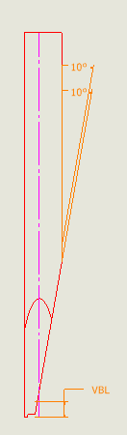
Rules
45CK Series – FG Customer / Production Drawings: Front view in case of FG :
Front view have many annotation, all the annotation are from annotation_front_plan BA@annotation_front_plan BA_VBL@annotation_front_plan in case we have SLB feature The view can be positioned based on your preference
SMALL PRECISION TOOLS
Confidential

Slide 12
Rules
45CK Series – FG Customer / Production Drawings: Right view in case of FG :
Right view have many annotation, all the annotation are from annotation_right_plan
TL@annotation_right_plan
VR@annotation_right_plan Optional
The view can be positioned based on your preference
SMALL PRECISION TOOLS
Confidential

Slide 13
Rules
45CK Series – FG Customer / Production Drawings: Top view in case of FG :
Top view have many annotation, all the annotation are from annotation_top_plan TD@annotation_top_plan TDF@annotation_top_plan The view can be positioned based on your preference
SMALL PRECISION TOOLS
Confidential

Slide 14
Rules
45CK Series – FG Customer / Production Drawings: Detail view in case of PGB :
Detail view have many annotation, all the annotation are from annotation_right_plan W@annotation_right_plan W2@annotation_right_plan Optional ISA@annotation_right_plan VW@annotation_right_plan Optional VRA@annotation_right_plan Optional B@annotation_right_plan
GA@annotation_right_plan
GD@annotation_right_plan
The view can be positioned based on your preference
SMALL PRECISION TOOLS
Confidential

Slide 15
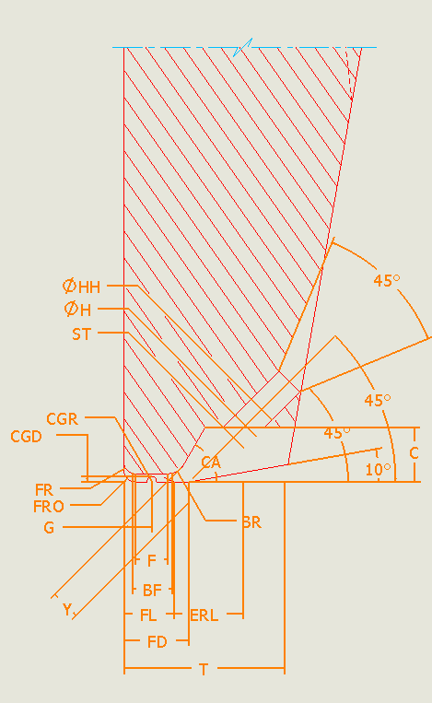
Rules
45CK Series – FG Customer / Production Drawings: Section view in case of PGB :
Section view have many annotation, all the annotation are from annotation_front_plan FL@annotation_front_plan
T@annotation_front_plan
FNA@annotation_front_plan C@annotation_front_plan
HA@annotation_front_plan
H@annotation_front_plan HH@annotation_front_plan Optional if oval hole ST@annotation_front_plan Optional if slot hole
FR@annotation_front_plan
BR@annotation_front_plan
BF@annotation_front_plan only in production drawing
F@annotation_front_plan only in production drawing
Y@annotation_front_plan only in production drawing CGD@annotation_front_plan
CGR@annotation_front_plan only in production drawing
G@annotation_front_plan The view can be positioned based on your preference
SMALL PRECISION TOOLS
Confidential

Slide 16
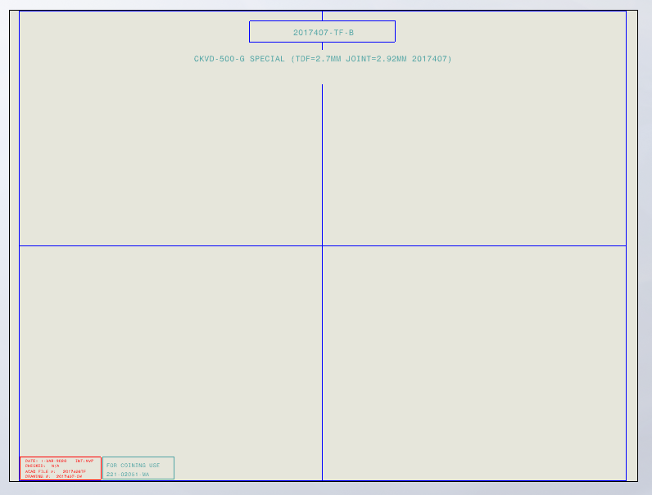
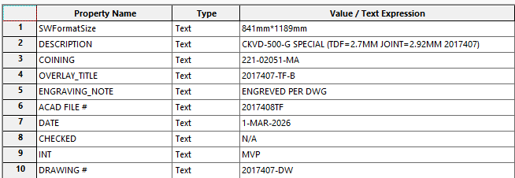
Rules
45CK Series –Overlay : Construction of overlays
In general, overlays respect the following shape : Right and Left view. Axillary view Optional Annotation Overlay Metadata controlled by properties manager's bellow
Annotation
Left view
Axillary view
Right view
SMALL PRECISION TOOLS
Confidential

Slide 17
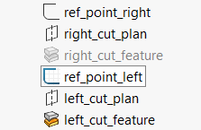

Rules
45CK Series –Overlay : Construction of overlays std_shank case :
View will pe positioned based on reference points :
std_ref_point_right will control the cut of the right view in the overlay; the right view is already assigned the righ_view configuration . The control of the cut is done by the programmer based by changing the value of std_ref_point_right@std_ref_point_right based on the cases we have . The old cut was based on the scale of the view was : std_ref_point_right@std_ref_point_right = 2.01175in/ "scale“ this is OK for most of standard cases but for cases with VR its no OK the programmer will need to give the appropriate value
std_ref_point_left will control the cut of the right view in the overlay; the right view is already assigned the left_view configuration . The control of the cut is done by the programmer based by changing the value of std_ref_point_left@std_ref_point_left based on the cases we have . The old cut was based on the scale of the view was : std_ref_point_left@std_ref_point_left = 2.01175in/ "scale“ this is OK for most of standard cases
SMALL PRECISION TOOLS
Confidential

Slide 18
Rules
45CK Series –Overlay : Construction of overlays
Right & Left view will have the same scale; the scale is chosen based on FL values
Numerical Limits:
x400 : T ≤ 0.0134 in or 0.3403 mm
x300 : T ≤ 0.0180 in or 0.4572 mm
x200 : T ≤ 0.0272 in or 0.6908 mm
x100 : T ≤ 0.0542 in or 1.3766 mm The scales : S100 = 1:60.8
S200 = 1:121.1
S300 = 1:183.0
S400 = 1:246.0
SMALL PRECISION TOOLS
Confidential

Slide 19
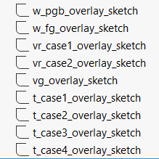
Rules
45CK Series – PGB Overlay : Construction of PGB overlays std_shank
Change W to MAX values & W_MIN inside the sketch
Turn off
If VW=W , Change VW , VRA to MAX & VR to MIN & VW_MIN , VRA_MIN, VRA_MAX inside the sketch
If VW≠W , Change VW , VRA, W, ISA to MAX & VR to MIN & VW_MIN , VRA_MIN, VRA_MAX, W_MIN, ISA_MIN
Turn off
Change T, FD to MAX & T_MIN. FD_MIN inside sketch this the standard case
If SLB, Change T, FD to MAX & T_MIN. FD_MIN inside sketch
If RA2, Change T, FD,RA2H to MAX & T_MIN. FD_MIN, RA2H_MIN inside sketch
If RA2 & SLB, Change T, FD,RA2H to MAX & T_MIN. FD_MIN, RA2H_MIN inside sketch
Note 1 : The programmer need to change the values of the parameters in equation & inside the sketches based of above
SMALL PRECISION TOOLS
Confidential

Slide 20
Rules
45CK Series – FG Overlay : Construction of FG overlays std_shank
Change W to MAX values & W_MIN inside the sketch
Change inside the sketch W_MIN, W_MAX , W parameter remain nominal
If VW=W , Change VW , VRA to MAX & VR to MIN & VW_MIN , VRA_MIN, VRA_MAX inside the sketch
If VW≠W , Change VW , VRA, W, ISA to MAX & VR to MIN & VW_MIN , VRA_MIN, VRA_MAX, W_MIN, ISA_MIN
B, GA, GD to MIN values & B_MAX, GA_MAX, GD_MAX
Change T, FD to MAX & T_MIN. FD_MIN inside sketch this the standard case
If SLB, Change T, FD to MAX & T_MIN. FD_MIN inside sketch
If RA2, Change T, FD,RA2H to MAX & T_MIN. FD_MIN, RA2H_MIN inside sketch
If RA2 & SLB, Change T, FD,RA2H to MAX & T_MIN. FD_MIN, RA2H_MIN inside sketch
Note 1 : The programmer need to change the values of the parameters in equation & inside the sketches based of above
SMALL PRECISION TOOLS
Confidential

