Slide 1
SMALL PRECISION TOOLS
Wedge Auto-Draw Rules
Large Wire (LW) Wedge Series – 4516/3016 Series – Rules
DOCUMENT NO.
DATE
PREPARED BY
STATUS
4516_REL_Rev1_07302026
2026-30-07
Youssef
Draft

Slide 2

Rules
4516 Series - 60° V-Groove with integrated feed hole : The 4516, also known as an L-notch tool, has a 60° V-groove with 45° wire feed. This style is available for wire sizes from 75 microns to 500 microns (3mils to 20mils).
4516 Series – Construction : CVKD has two shank style : STYLE_STD , with SLB feature All the 3D models is based on the bellow sketches; these sketch has all the required dimension to construction the 3D models and drawings
annotation_top_plan | TD - TDF
annotation_right_plan | W–ISA–VW–VR–VRR–VRA–TL–B-GA-GD-GO-CL-CD
annotation_front_plan | BA-T-FL-C-NR-BR-FR-H-HA-FNA-F-BF-Y-G-CGR-CGD-VBL-VBLR-funnel_gap – foot_depth
For NR its doesn’t exit in DB yet give it standard value 0.002in For foot_depth we need to calculate it based on with foot type we have : VG groove , foot_depth = GD C groove , foot_depth = CD G groove, foot_depth = GD
Flate W, foor depth = 0
For funnel_gap we have the equation , just in case of SLB feature make in the equation that BA = 0deg
SMALL PRECISION TOOLS
Confidential

Slide 3
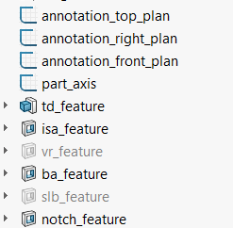
Rules
4516 Series – PGB 3D for Customer / Production Drawings : PGB 3D has the following feature :
Always ON
Always ON
Always ON
Always ON
Always ON
Always ON
Optional, This need VR, VRR, VRA, VW
Always ON
Optional, This need to have VBL and VBLR
Always ON,
SMALL PRECISION TOOLS
Confidential

Slide 4
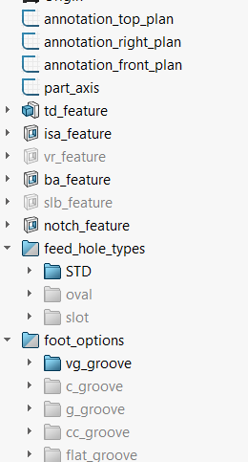
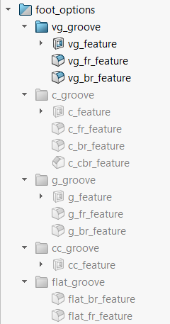
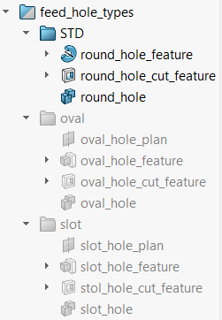
Rules
4516 Series – FG 3D for Customer / Production Drawings: FG 3D has the following feature :
Always ON
Always ON
Always ON
Always ON
Always ON
Always ON
Optional
Always ON
Optional
Always ON
Based on DB this is standard
Based on DB
Based on DB
Based on DB this is standard
Based on DB
Based on DB
Based on DB
Based on DB
SMALL PRECISION TOOLS
Confidential

Slide 5
Rules
4516 Series – FG 3D for Customer / Production Drawings: FG 3D has the following feature :
In case we have oval hole H = HH , and HW from the DB
In case we have slot hole H = ST , and SW from the DB
SMALL PRECISION TOOLS
Confidential

Slide 6
Rules
4516 Series – FG 3D for Customer / Production Drawings: FG 3D has the following feature :
If not mentioned in DB , this need H value
If not mentioned in DB , this need HH and HW value
If not mentioned in DB , this need ST and SW value
SMALL PRECISION TOOLS
Confidential

Slide 7
Rules
4516 Series – FG 3D for Customer / Production Drawings: FG 3D has the following feature :
If not mentioned in DB , this need GA, B and GD values
If not mentioned in DB , this need CL and CD values
in case fo CBL this feaure need to ON, but c_br_feature should be off, CBRD and CBRL parameters
If not mentioned in DB , this need GD and GO values
If not mentioned in DB , if we G, CGR and CGD values
If not mentioned in DB , if we don’t have non above
SMALL PRECISION TOOLS
Confidential

Slide 8

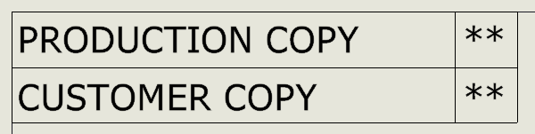
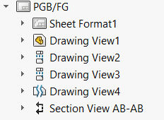
Rules
4516 Series – Customer / Production Drawings: We can select the type of drawing from drawings properties manager, PGB no need to fill these properties
Front view
Right view
Top view
Detail view
Section view
SMALL PRECISION TOOLS
Confidential

Slide 9
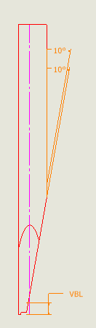
Rules
4516 Series – PGB Customer / Production Drawings: Front view in case of PGB :
Front view have many annotation, all the annotation are from annotation_front_plan In case of SYLE_A we show only : BA@annotation_front_plan VBL@ style_a_annotation_front_plan in case we have SLB feature BA_VBL@annotation_front_plan in case we have SLB feature The view can be positioned based on your preference
SMALL PRECISION TOOLS
Confidential

Slide 10
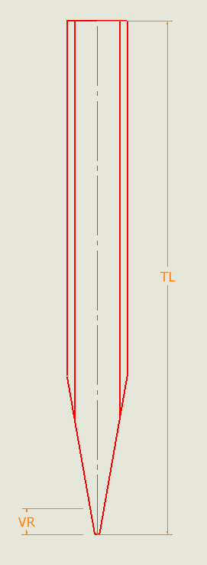
Rules
4516 Series – PGB Customer / Production Drawings: Right view in case of PGB :
Right view have many annotation, all the annotation are from annotation_right_plan
TL@annotation_right_plan
VR@annotation_right_plan Optional
The view can be positioned based on your preference
SMALL PRECISION TOOLS
Confidential

Slide 11
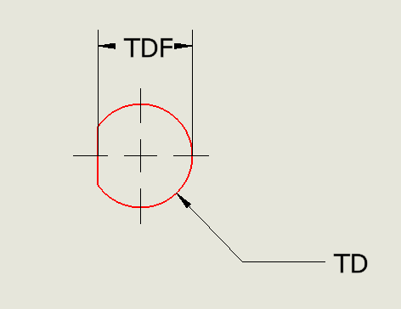
Rules
4516 Series – PGB Customer / Production Drawings: Top view in case of PGB :
Top view have many annotation, all the annotation are from annotation_top_plan TD@annotation_top_plan TDF@annotation_top_plan The view can be positioned based on your preference
SMALL PRECISION TOOLS
Confidential

Slide 12
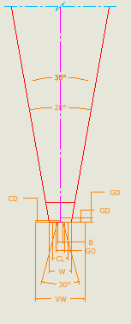
Rules
4516 Series – PGB Customer / Production Drawings: Detail view in case of PGB :
Detail view have many annotation, all the annotation are from annotation_right_plan W@annotation_right_plan ISA@annotation_right_plan VW@annotation_right_plan Optional VRA@annotation_right_plan Optional The view can be positioned based on your preference
SMALL PRECISION TOOLS
Confidential

Slide 13
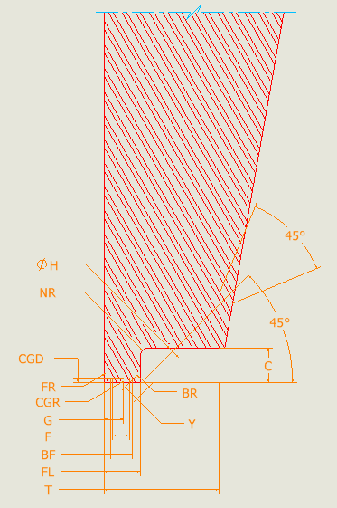
Rules
4516 Series – PGB Customer / Production Drawings: Section view in case of PGB :
Section view have many annotation, all the annotation are from annotation_front_plan In case of SYLE_A we show only : FL@annotation_front_plan
T@annotation_front_plan
The view can be positioned based on your preference
SMALL PRECISION TOOLS
Confidential

Slide 14
Rules
4516 Series – FG Customer / Production Drawings: Front view in case of FG :
Front view have many annotation, all the annotation are from annotation_front_plan BA@annotation_front_plan VBL@ style_a_annotation_front_plan in case we have SLB feature BA_VBL@annotation_front_plan in case we have SLB feature The view can be positioned based on your preference
SMALL PRECISION TOOLS
Confidential

Slide 15
Rules
4516 Series – FG Customer / Production Drawings: Right view in case of FG :
Right view have many annotation, all the annotation are from annotation_right_plan
TL@annotation_right_plan
VR@annotation_right_plan Optional
The view can be positioned based on your preference
SMALL PRECISION TOOLS
Confidential

Slide 16
Rules
4516 Series – FG Customer / Production Drawings: Top view in case of FG :
Top view have many annotation, all the annotation are from annotation_top_plan TD@annotation_top_plan TDF@annotation_top_plan The view can be positioned based on your preference
SMALL PRECISION TOOLS
Confidential

Slide 17
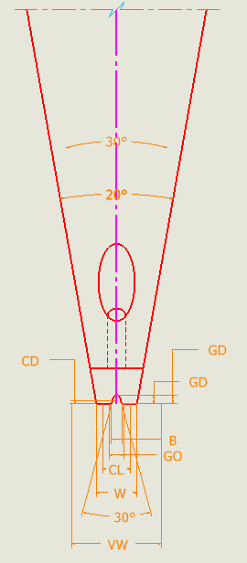
Rules
4516 Series – PGB Customer / Production Drawings: Detail view in case of PGB :
Detail view have many annotation, all the annotation are from annotation_right_plan W@annotation_right_plan ISA@annotation_right_plan VW@annotation_right_plan Optional VRA@annotation_right_plan Optional B@annotation_right_plan if VG groove
GA@annotation_right_plan if VG groove
GD@annotation_right_plan if GV groove
GD_G@annotation_right_plan if G groove
GO@annotation_right_plan if G groove
CL@annotation_right_plan if C groove
CD@annotation_right_plan if C groove The view can be positioned based on your preference
SMALL PRECISION TOOLS
Confidential

Slide 18
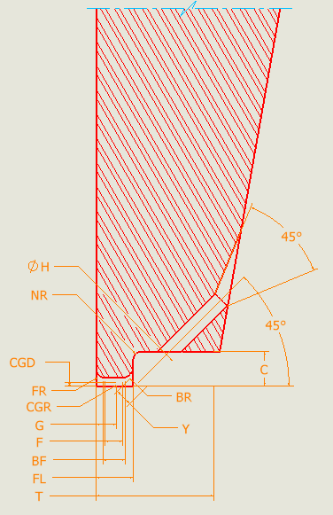
Rules
4516 Series – PGB Customer / Production Drawings: Section view in case of PGB :
Section view have many annotation, all the annotation are from annotation_front_plan FL@annotation_front_plan
T@annotation_front_plan
C@annotation_front_plan only in production drawing
NR@annotation_front_plan only in production drawing
FNA@annotation_front_plan
HA@annotation_front_plan
H@annotation_front_plan
FR@annotation_front_plan
BR@annotation_front_plan
BF@annotation_front_plan only in production drawing
F@annotation_front_plan only in production drawing
Y@annotation_front_plan only in production drawing CGD@annotation_front_plan
CGR@annotation_front_plan only in production drawing
G@annotation_front_plan The view can be positioned based on your preference
SMALL PRECISION TOOLS
Confidential

Slide 19
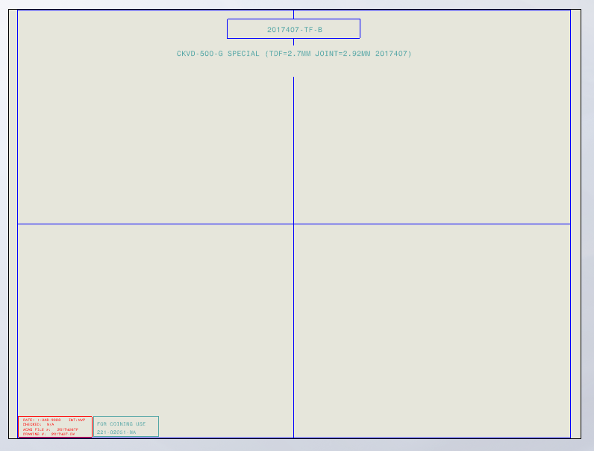
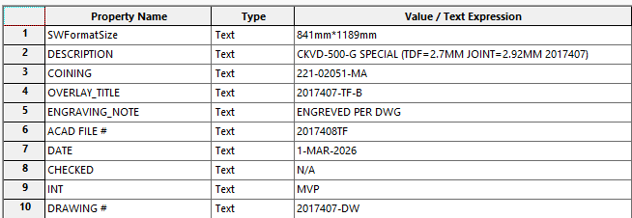
Rules
4516 Series –Overlay : Construction of overlays
In general, overlays respect the following shape : Right and Left view. Axillary view Optional Annotation Overlay Metadata controlled by properties manager's bellow
Annotation
Left view
Axillary view
Right view
SMALL PRECISION TOOLS
Confidential

Slide 20



Rules
4516 Series –Overlay : Construction of overlays
View will pe positioned based on reference points :
Standard cases : Right & Left views will have by default overlay_std_cut configuration Use ref_point_1 to position the right view Use ref_point_2 to position the left view In 3D model turn ON these features
ref_point_1 is positioned by the scale of the view
ref_point_non_std_cut is controlled by parameters called "non_std_cut“, the programmer will give its value
ref_point_2 will be positioned automatically using sketches
Non-Standard cases : When we have VR/VW Right view will have overlay_non_std_cut configuration
Left view will have by default Overlay configuration Use ref_point_non_std_cut to position the right view Use ref_point_2 to position the left view In 3D model turn ON these features
Right view
Left view
SMALL PRECISION TOOLS
Confidential

Slide 21
Rules
4516 Series –Overlay : Construction of overlays
Right & Left view will have the same scale; the scale is chosen based on FL values
Numerical Limits:
x400 : T ≤ 0.0134 in or 0.3403 mm
x300 : T ≤ 0.0180 in or 0.4572 mm
x200 : T ≤ 0.0272 in or 0.6908 mm
x100 : T ≤ 0.0542 in or 1.3766 mm The scales : S100 = 1:60.8
S200 = 1:121.1
S300 = 1:183.0
S400 = 1:246.0
SMALL PRECISION TOOLS
Confidential

Slide 22

Rules
4516 Series – PGB Overlay : Construction of PGB overlays
PGB Overlay :
Respect all instruction in slide 3 Activate these overlay feature see note 1 Choose the scale based on T value Activate the correspond cut Position the view using the reference points Add Auxiliary views
Add annotations
Add metadata By default, these sketch are on ! Make sure to rebuild before saving to tif
Note 1 : In standard cases with no VR/VW
Change the values of
W parameter will have W_MAX
W_MIN@w_pgb_overlay_sketch
FL parameter will have FL_MAX
FL_MIN@fl_pgb_overlay_sketch
T parameter will have T_MAX
T_MIN@fl_pgb_overlay_sketch C parameter will have C_MIN
C_MAX@fl_pgb_overlay_sketch In case of SLB : do the same as above just sketch name rather them fl_pgb_overlay_sketch will be
slb_pgb_overlay_sketch
SMALL PRECISION TOOLS
Confidential

Slide 23
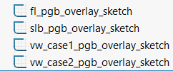
Rules
4516 Series – PGB Overlay : Construction of PGB overlays
Note 2 : Cases with VR/VW
PGB Overlay :
Respect all instruction in slide 3 Activate these overlay feature see note 2 Choose the scale based on FL value Activate the correspond cut Position the view using the reference points Add Auxiliary views
Add annotations
Add metadata By default, these sketch are on ! Use the the configuration for VR/VW for right view and use the ref point to position it ! Make sure to rebuilt before saving to tif
If VW = W its case1 If VW > W its case2
Change the values of
FL parameter will have FL_MAX
FL_MIN@fl_pgb_overlay_sketch
T parameter will have T_MAX
T_MIN@fl_pgb_overlay_sketch C parameter will have C_MIN
C_MAX@fl_pgb_overlay_sketch VW_MIN@vw_case1_pgb_overlay_sketch VW parameter will have VW_MAX
VR_MAX@vw_case1_pgb_overlay_sketch VR parameter will have VR_MIN
VRA_MIN@vw_case1_pgb_overlay_sketch VRA parameter will have VRA_MAX
Change the values of
Change the values of
FL parameter will have FL_MAX
FL_MIN@fl_pgb_overlay_sketch
T parameter will have T_MAX
T_MIN@fl_pgb_overlay_sketch C parameter will have C_MIN
C_MAX@fl_pgb_overlay_sketch VW_MIN@vw_case2_pgb_overlay_sketch VW parameter will have VW_MAX
VR_MAX@vw_case2_pgb_overlay_sketch VR parameter will have VR_MIN
VRA_MIN@vw_case2_pgb_overlay_sketch VRA parameter will have VRA_MAX W_MIN@vw_case2_pgb_overlay_sketch W parameter will have ISA_MAX ISA_MIN@vw_case2_pgb_overlay_sketch ISA parameter will have ISA_MAX
SMALL PRECISION TOOLS
Confidential

Slide 24

Rules
4516 Series – FG Overlay : Construction of FG overlays
FG Overlay :
Respect all instruction in slide 3 Activate these overlay feature see note 1 Choose the scale based on T value Activate the correspond cut Position the view using the reference points Add Auxiliary views
Add annotations
Add metadata By default, these sketch are on ! Make sure to rebuild before saving to tif
Note 1 : In standard cases with no VR/VW
Change the values of
W parameter will have W_MAX
W_MIN@w_fg_overlay_sketch
FL parameter will have FL_MAX
FL_MIN@fl_fg_overlay_sketch
T parameter will have T_MAX
T_MIN@fl_fg_overlay_sketch C parameter will have C_MIN
C_MAX@fl_fg_overlay_sketch In case of SLB : do the same as above just sketch name rather them fl_fg_overlay_sketch will be
slb_fg_overlay_sketch
SMALL PRECISION TOOLS
Confidential

Slide 25

Rules
4516 Series – FG Overlay : Construction of FG overlays
Note 2 : Cases with VR/VW
PGB Overlay :
Respect all instruction in slide 3 Activate these overlay feature see note 2 Choose the scale based on FL value Activate the correspond cut Position the view using the reference points Add Auxiliary views
Add annotations
Add metadata By default, these sketch are on ! Use the the configuration for VR/VW for right view and use the ref point to position it ! Make sure to rebuilt before saving to tif
If VW = W its case1 If VW > W its case2
Change the values of
FL parameter will have FL_MAX
FL_MIN@fl_fg_overlay_sketch
T parameter will have T_MAX
T_MIN@fl_fg_overlay_sketch C parameter will have C_MIN
C_MAX@fl_fg_overlay_sketch VW_MIN@vw_case1_fg_overlay_sketch VW parameter will have VW_MAX
VR_MAX@vw_case1_fg_overlay_sketch VR parameter will have VR_MIN
VRA_MIN@vw_case1_fg_overlay_sketch VRA parameter will have VRA_MAX
Change the values of
FL parameter will have FL_MAX
FL_MIN@fl_fg_overlay_sketch
T parameter will have T_MAX
T_MIN@fl_fg_overlay_sketch C parameter will have C_MIN
C_MAX@fl_fg_overlay_sketch VW_MIN@vw_case2_fg_overlay_sketch VW parameter will have VW_MAX
VR_MAX@vw_case2_fg_overlay_sketch VR parameter will have VR_MIN
VRA_MIN@vw_case2_fg_overlay_sketch VRA parameter will have VRA_MAX W_MIN@vw_case2_fg_overlay_sketch W parameter will have ISA_MAX ISA_MIN@vw_case2_fg_overlay_sketch ISA parameter will have ISA_MAX
SMALL PRECISION TOOLS
Confidential

Slide 26

Change the values of
B will have B_MIN B_MAX@vg_fg_overlay_sketch
GD will have GD_MIN GD_MAX@vg_fg_overlay_sketch
GA will have GD_MIN GA_MAX@vg_fg_overlay_sketch
Rules
4516 Series – FG Overlay : Construction of FG overlays
FG Overlay :
The second part is the groove tolerance based on what groove type we have VG groove C groove G groove W flat We only shoose one sketch to show in case of W flat no need to show any sketch By default, these sketch are on ! Make sure to rebuild before saving to tif
Change the values of
CL will have CL_MIN
CL_MAX@c_fg_overlay_sketch
CD will have CD_MIN
CD_MAX@c_fg_overlay_sketch
Change the values of
GD will have GD_MIN
GD_MAX@g_fg_overlay_sketch
GO will have GO_MIN
GO_MAX@c_fg_overlay_sketch
SMALL PRECISION TOOLS
Confidential

