Slide 1
SMALL PRECISION TOOLS
Wedge Auto-Draw Requirements
Large Wire (LW) Wedge Series – 4516/3016 Requirements
DOCUMENT NO.
DATE
PREPARED BY
STATUS
4516_REQ_Rev0_07152026
2026-15-07
Youssef
Draft

Slide 2
Scope
This document defines the production drawing, customer drawing, and overlay requirements for the 4516 series, covering both the finished wedge and the Pre-Ground Blank (PGB).Including 4516 , 4510, 4515
SMALL PRECISION TOOLS
Confidential
04

Slide 3
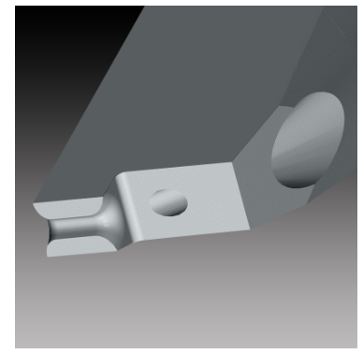
Tool Overview
4516 Series — 60° V-Groove with integrated feed hole (L-notch tool)
Wire feed angle: 45°
Wire size range: 75–500 microns (3–20 mils)
SMALL PRECISION TOOLS
Confidential
04

Slide 4
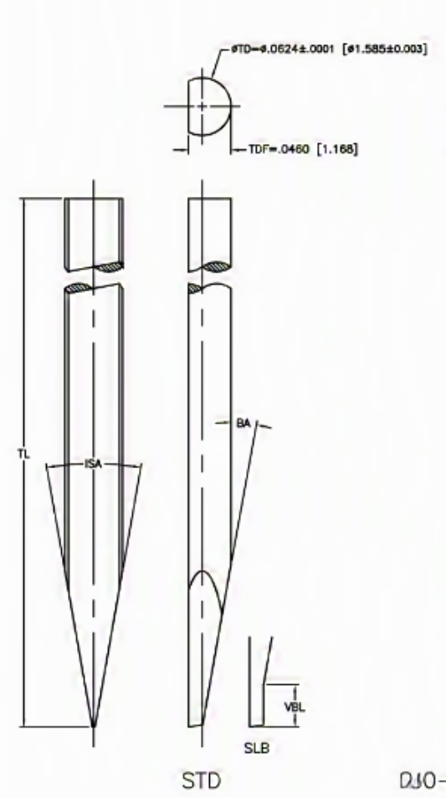
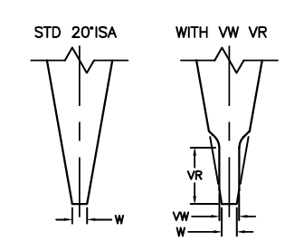
Configuration Options
Shank: SW_STD with SLB feature
For Tip detail we have STD 20°ISA , WITH VW VR
SMALL PRECISION TOOLS
Confidential
04

Slide 5
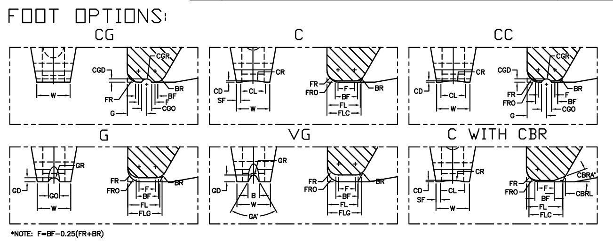
Configuration Options
Foot options: SW_C, SW_F, SW_CG, SW_G, SW_VG, SW_CC
SMALL PRECISION TOOLS
Confidential
04

Slide 6
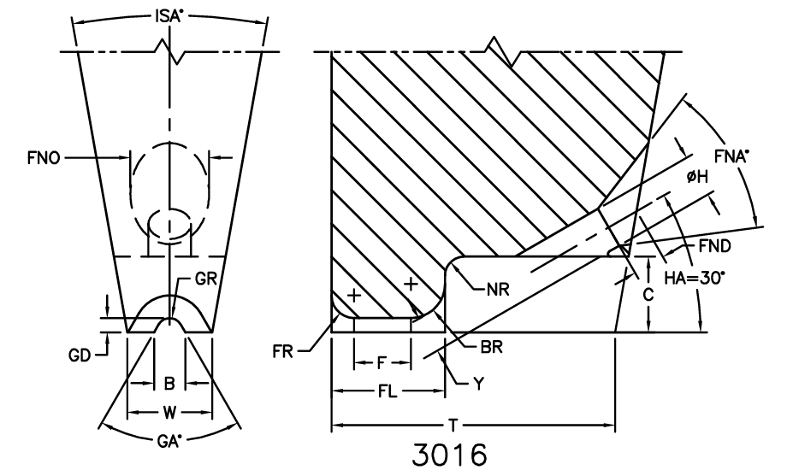
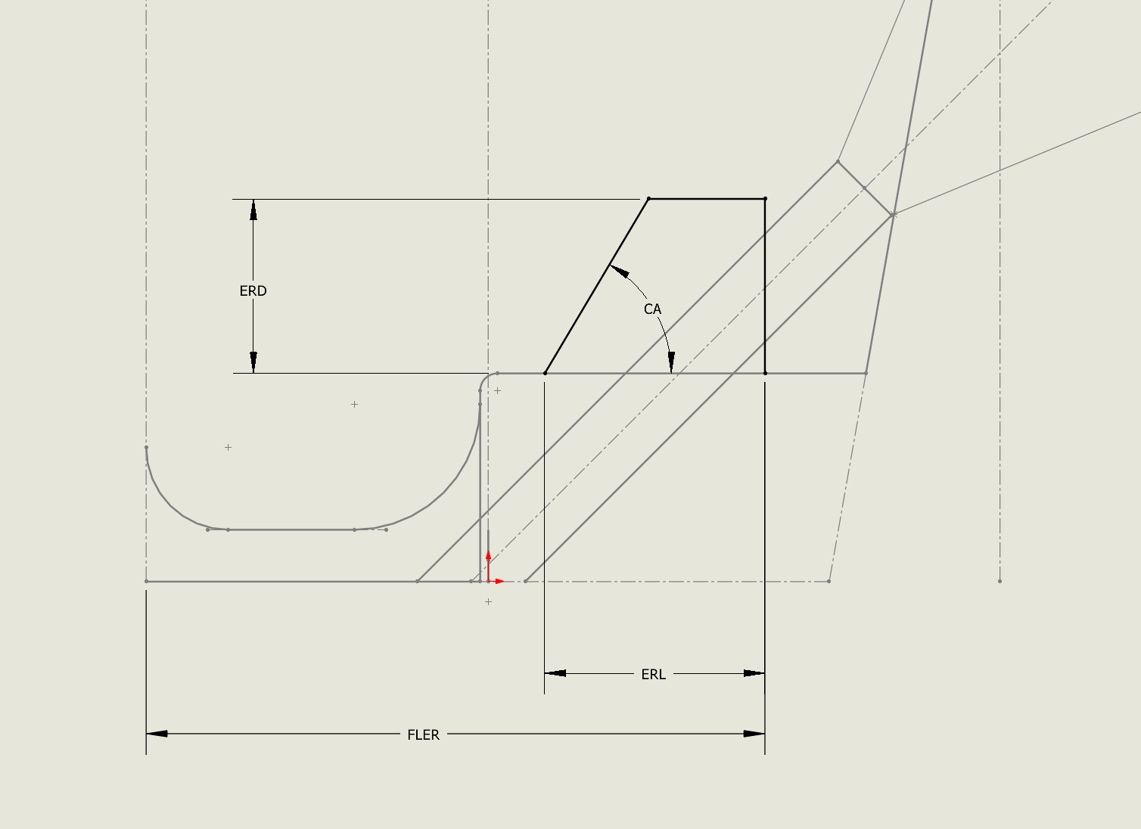
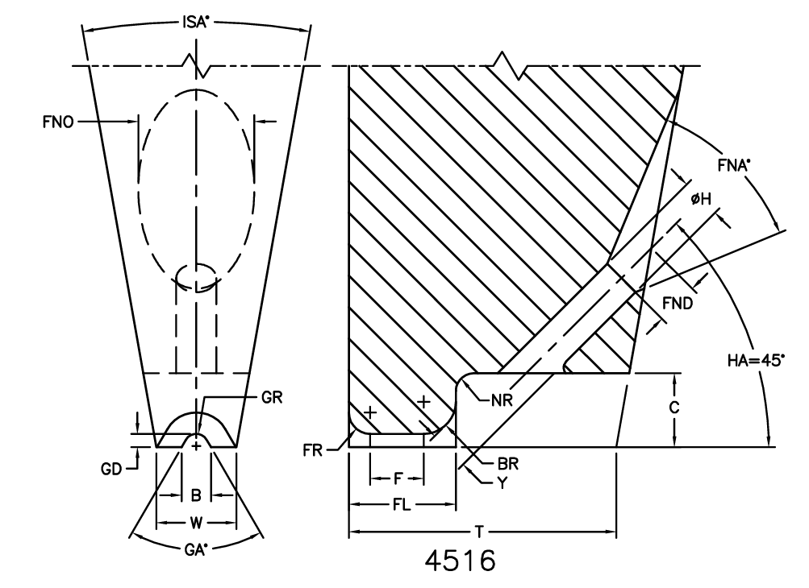
Configuration Options
Notch type: SW_Notch
Note : Some cases we may have ERW, ERD, FLER & CA
SMALL PRECISION TOOLS
Confidential
04

Slide 7
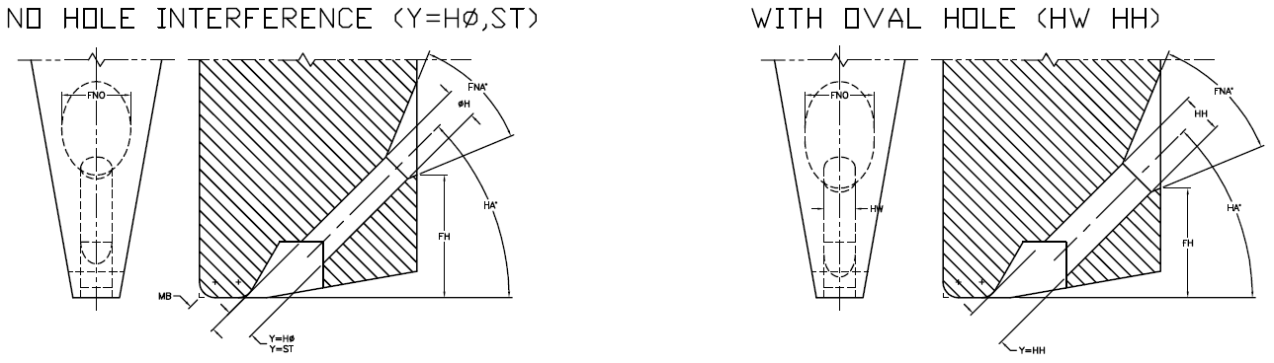
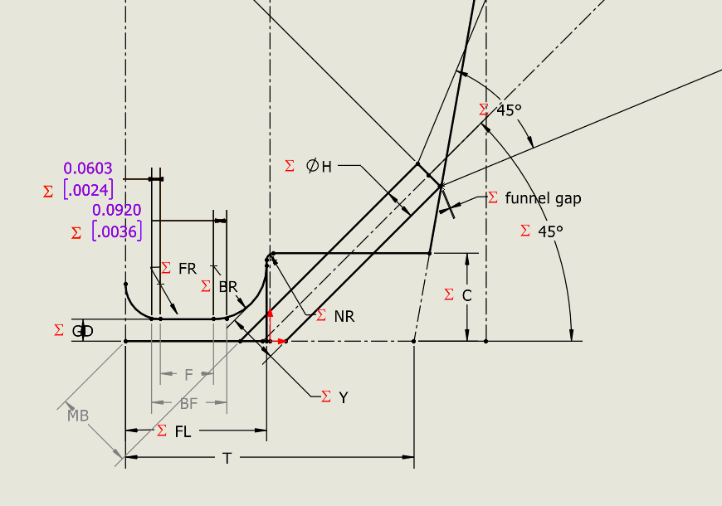
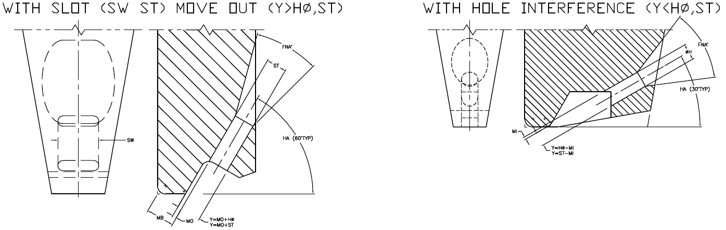
Configuration Options
Feed hole types: STD (Round), Oval, Slot
Note : Y will be used to position the hole
SMALL PRECISION TOOLS
Confidential
04

Slide 8


Configuration Options
BR feature: Round BR
Note : Round BR only used in case when we have ERW, ERD, FLER & CA
SMALL PRECISION TOOLS
Confidential
04

Slide 9
Database Requirements
Schema is largely consistent with the COB tool family.Additional fields required, including NR.TBD: full list of new/changed fields pending.
Part_Spec | PN | Filter | Drawing_Number | Description_2 | Wed-Type | Wed-Foot_Option | Wed-Wire_Exit | Wed-Feed_H/Slot | Wed-FG-Style
116823 | 3112854 |  | 22000042 | 4516-10L-W-3MM-1.00-G | LW_std_HOLE | LW_G | SW_L-Notch | STD(Round) | 4516
116827 | 3112855 |  | 22000747 | 4516-12R-W-3MM-1.00-G | LW_std_HOLE | LW_G | SW_L-Notch | STD(Round) | 4516
116828 | 3112859 |  | 22000977 | 4516-3R-W-1/16-1.200-GM FR=0012 BR=002 FL=0067 W=0055 TDF=046 | LW_std_HOLE | LW_G | SW_L-Notch | STD(Round) | 4516
116841 | 3112860 |  | 22001068 | 4516-3S-W-1/16-1.00-GP FL=0085 H=004 GD=001 B=0023 F=004 | LW_std_HOLE | LW_G | SW_L-Notch | STD(Round) | 4516
116847 | 3112862 |  | 22001068 | 4516-3S-W-1/16-1.20-G FL=0085 H=004 GD=001 B=0023 F=004 | LW_std_HOLE | LW_G | SW_L-Notch | STD(Round) | 4516
139860 | 3112865 |  | 22000502 | 4516-3XL-W-1/16-1.00-G | LW_std_HOLE | LW_G | SW_L-Notch | STD(Round) | 4516
116835 | 3112866 |  | 22000502 | 4516-3XL-W-1/16-1.00-GP | LW_std_HOLE | LW_G | SW_L-Notch | STD(Round) | 4516
116837 | 3112867 |  | 22000049 | 4516-3XL-W-1/16-1.00-GP FL=.011 W=.0067 | LW_std_HOLE | LW_G | SW_L-Notch | STD(Round) | 4516
116838 | 3112868 |  | 22000502 | 4516-3XL-W-1/16-1.200-G TDF=.046 | LW_std_HOLE | LW_G | SW_L-Notch | STD(Round) | 4516
116843 | 3112869 |  | 22001154 | 4516-3XL-W-1/16-1.20-GP FL=.011 TDF=.046 W=.0067 DWG-22001154-DW | LW_std_HOLE | LW_G | SW_L-Notch | STD(Round) | 4516
116836 | 3112870 |  | 22000003 | 4516-3XL-W-1/16-1.225-GP EP FFP TDF=.046 | LW_std_HOLE | LW_G | SW_L-Notch | STD(Round) | 4516
Note : There are some missing parameters needed to be added to database like NR
SMALL PRECISION TOOLS
Confidential
04

Slide 10
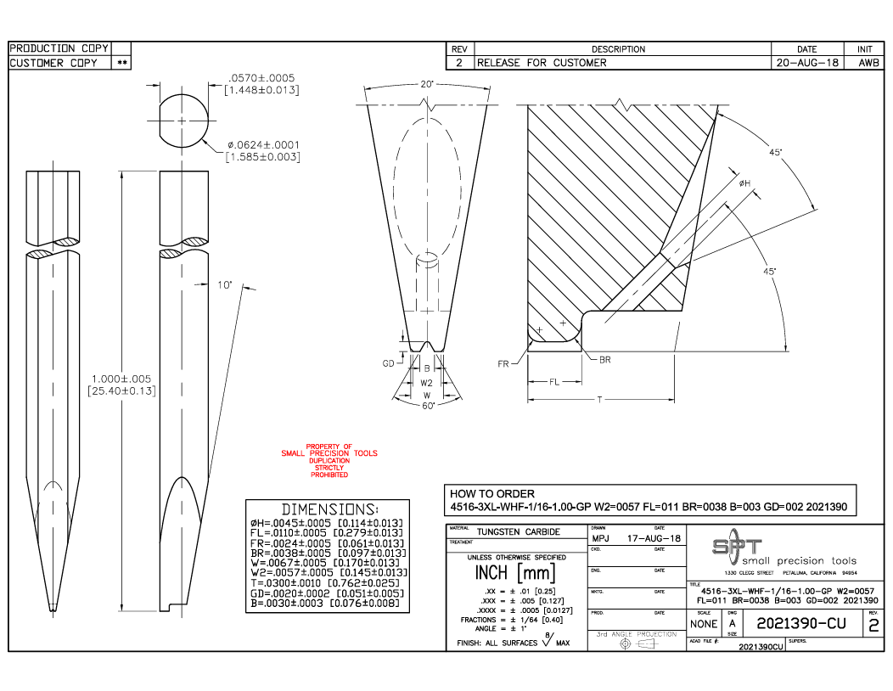
Customer Drawing Requirements
For customer drawing we will replicate as the same provided, following the same step as COB
Front, Right & Top Views
Detail & Section Views
Dimensions Tables
SMALL PRECISION TOOLS
Confidential
04

Slide 11
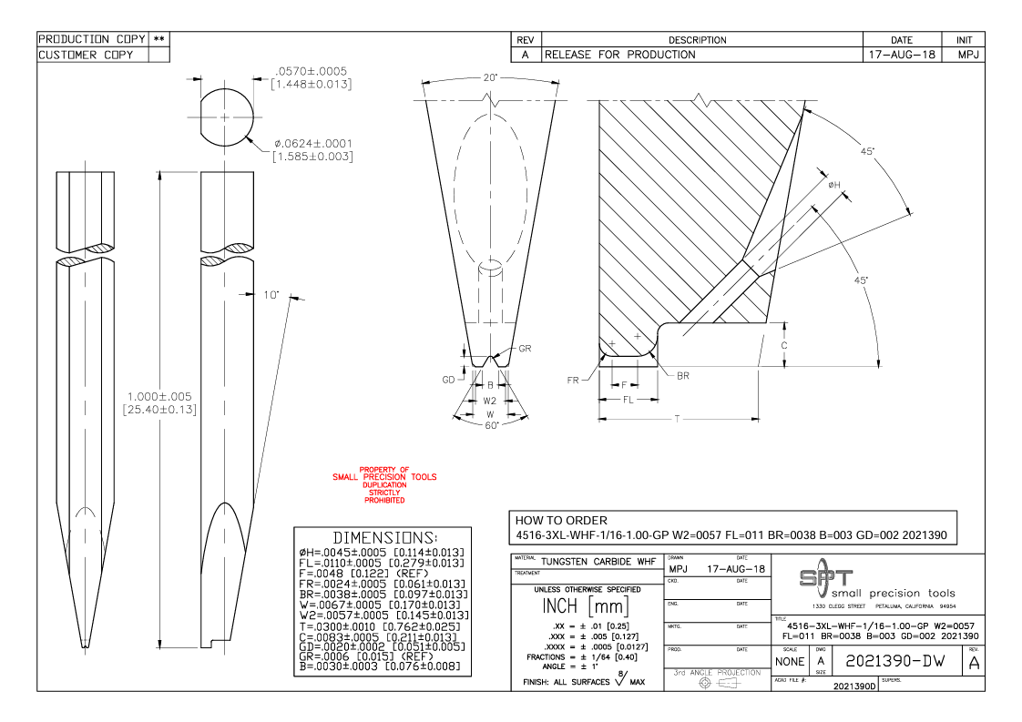
Production Drawing Requirements
For customer drawing we will replicate as the same provided, following the same step as COB
Front, Right & Top Views
Detail & Section Views
Dimensions Tables
Add all dimensions and parameters to views
SMALL PRECISION TOOLS
Confidential
04

Slide 12
Overlay Requirements: Finish Wedge
Similar to COB overlay, with different tolerance zone construction.
Special case: view must focus on the top of the part only — scale selection may need to change accordingly.
Note : Scaling the view the same way as COB will not work for 4516/3016
Note : Only add two views to the overlays
Note : No need to all the annotations
SMALL PRECISION TOOLS
Confidential
04

Slide 13
Overlay Requirements: PGB
Remains unchanged from the standard wedge overlay used across all tool families.
Note : PGB overlay may have VR/VW feature
SMALL PRECISION TOOLS
Confidential
04

