Slide 1
SMALL PRECISION TOOLS
Wedge Auto-Draw Rules
Small Wire (SW) Wedge Series – M Series – Rules
DOCUMENT NO.
DATE
PREPARED BY
STATUS
M_REL_Rev1_08222026
2026-22-08
Youssef
Draft

Slide 2
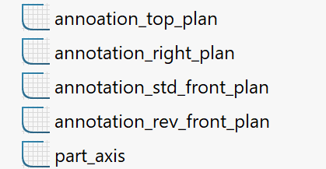
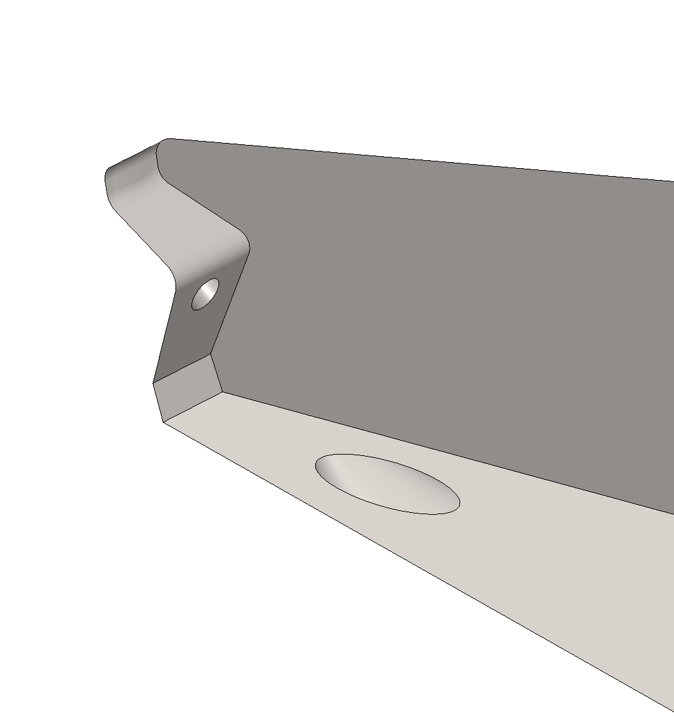
Rules
M Series – Autobonding : The M series incorporates all the common features of a wedge with the cavity guide design, which is widely used for small aluminum wire bonding. It comes with the elliptical back radius which keeps the wire in the center of the tool for better bond placement capability.
M Series – Construction : M has two shank style : STYLE_STD , with SLB feature & STYLE_180_REV, with SLB feature All the 3D models is based on the bellow sketches; these sketch has all the required dimension to construction the 3D models and drawings
Never suppresses these features !
For foot_depth we need to calculate it based on with foot type we have : VG groove , foot_depth = GD C groove , foot_depth = CD G groove, foot_depth = GD
Flate W, foor depth = 0
For funnel_gap we have the equation , just in case of SLB feature make in the equation that BA = 0deg
SMALL PRECISION TOOLS
Confidential

Slide 3
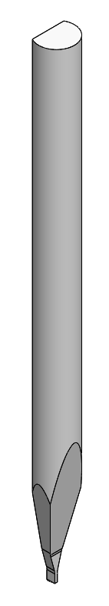
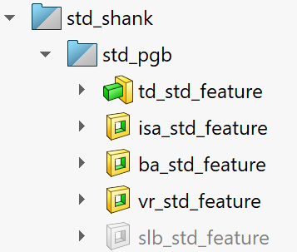

Rules
M Series – PGB 3D for Customer / Production Drawings : PGB 3D has the following feature case std shank :
Always ON : we need to have TD-TDF
Always ON : we need to have W-ISA
Always ON : we need to have FD-T-RA-BA
Optional : we need to have VR-VRA-VW-VRR
Optional : we need to have VBL-VBLR-T
Always On : Need C, ND, NR, NA, FTA
SMALL PRECISION TOOLS
Confidential

Slide 4
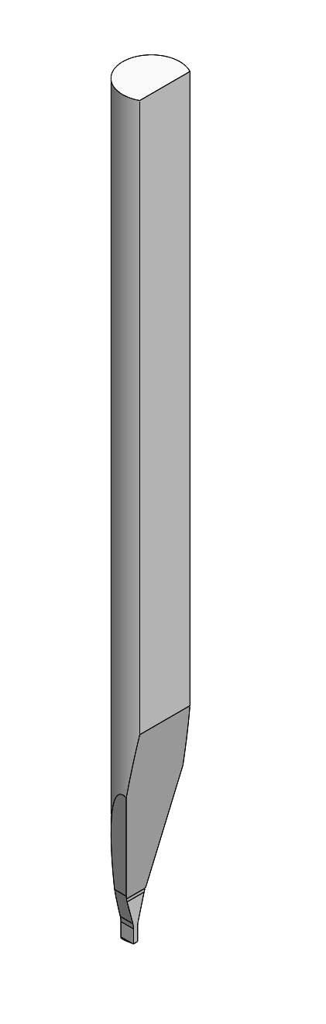
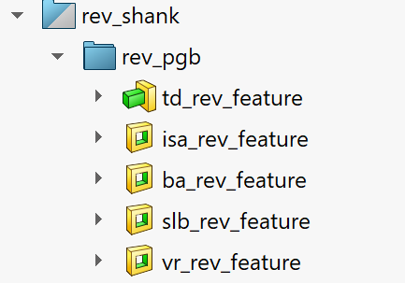

Rules
M Series – PGB 3D for Customer / Production Drawings : PGB 3D has the following feature case rev shank :
Always ON : we need to have TD-TDF
Always ON : we need to have W-ISA
Always ON : we need to have FD-T-RA-BA
Optional : we need to have VR-VRA-VW-VRR
Optional : we need to have VBL-VBLR-T
Always On : Need C, ND, NR, NA, FTA
SMALL PRECISION TOOLS
Confidential

Slide 5
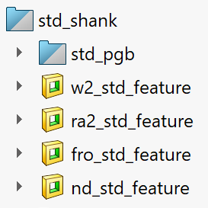
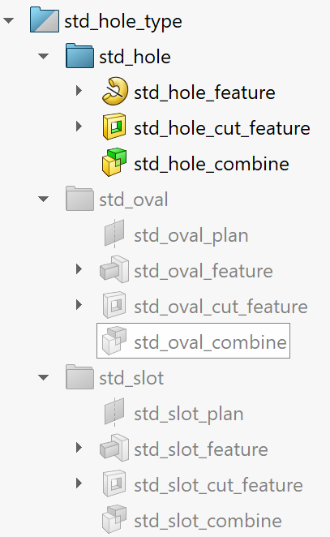
Rules
M Series – FG 3D for Customer / Production Drawings: FG 3D has the following feature case std shank :
Optional : we need to have W2
Optional : we need to have RA2-RA2H
Always ON : we need FRO
Always ON : we need C, FTA, ND, NR , for NR values needed to be added in the db by SPT
Optional if we have std hole wire exit : Activate all these features, we need to have H-HA-Y-FNA-funnel_gap
Optional if we have oval hole wire exit : Activate all these features, we need to have HW-HH-HA-Y-FNA-funnel_gap
Optional if we have slot wire exit : Activate all these features, we need to have SW-ST-Y-FNA-funnel_gap
SMALL PRECISION TOOLS
Confidential

Slide 6
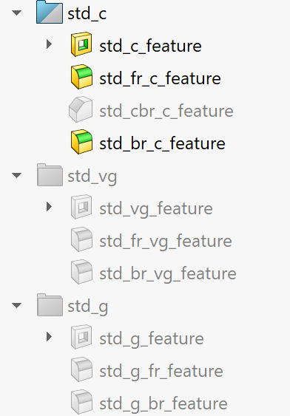
Rules
M Series – FG 3D for Customer / Production Drawings: FG 3D has the following feature case std shank :
Optional if we have C groove : activate std_c_feature We have cases : if FRO = FR : activate std_br_c_ If FRO ≠ FR : activate std_br_c_feature & std_c_fr_feature If we have C + CBR : activate std_cbr_c_feature & std_cbr_c_core_feature
Or activate std_cbr_c_feature & std_c_fr_feature Based on FRO and FR values , CBR needs CBRL & CBRD
Optional if we have VG groove : Activate all these features, we need to GA-GD
Optional if we have G groove : Activate all these features, we need to GO-GD
SMALL PRECISION TOOLS
Confidential

Slide 7
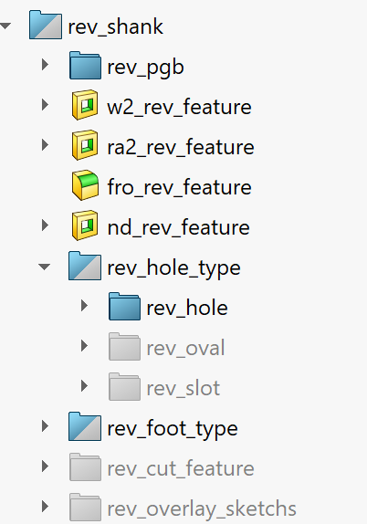
Rules
M Series – FG 3D for Customer / Production Drawings: FG 3D has the following feature case rev shank :
The same rules as std shank , main difference is the name of feature have rev rather then std
SMALL PRECISION TOOLS
Confidential

Slide 8

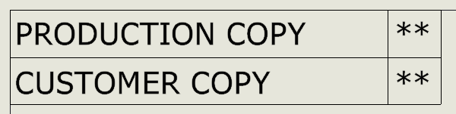
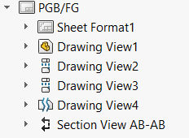
Rules
M Series – Customer / Production Drawings: We can select the type of drawing from drawings properties manager, PGB no need to fill these properties
Front view
Right view
Top view
Detail view
Section view
SMALL PRECISION TOOLS
Confidential

Slide 9
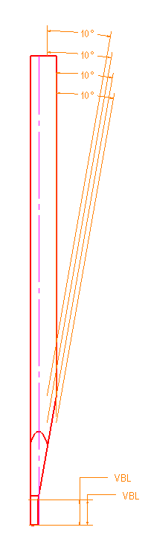
Rules
M Series – PGB Customer / Production Drawings: Front view in case of PGB :
Front view have many annotation, all the annotation are from annotation_std_front_plan & annotation_rev_front_plan In case of SYLE_STD we show only : BA@annotation_std_front_plan VBL@annotation_std_front_plan in case we have SLB feature BA_SLB@annotation_std_front_plan in case we have SLB feature In case of SYLE_180_DEG_REV we show only : BA@annotation_rev_front_plan VBL@annotation_rev_front_plan in case we have SLB feature BA_SLB@annotation_rev_front_plan in case we have SLB feature The view can be positioned based on your preference
SMALL PRECISION TOOLS
Confidential

Slide 10
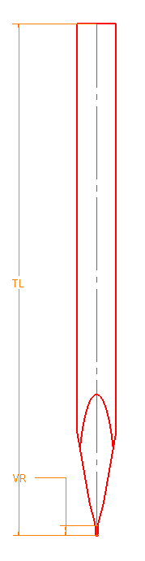
Rules
M Series – PGB Customer / Production Drawings: Right view in case of PGB :
Right view have many annotation, all the annotation are from annotation_right_plan
TL@annotation_right_plan
VR@annotation_right_plan Optional
The view can be positioned based on your preference
SMALL PRECISION TOOLS
Confidential

Slide 11
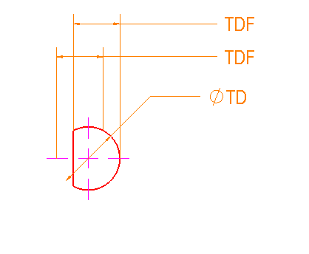
Rules
M Series – PGB Customer / Production Drawings: Top view in case of PGB :
Top view have many annotation, all the annotation are from annotation_top_plan TD@annotation_top_plan TDF_STD@annotation_top_plan in case std shank TDF_REV@annotation_top_plan in case rev shank The view can be positioned based on your preference
SMALL PRECISION TOOLS
Confidential

Slide 12
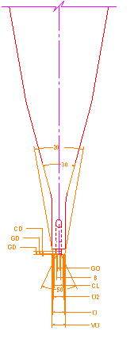
Rules
M Series – PGB Customer / Production Drawings: Detail view in case of PGB :
Detail view have many annotation, all the annotation are from annotation_right_plan W@annotation_right_plan ISA@annotation_right_plan VW@annotation_right_plan Optional VRA@annotation_right_plan Optional The view can be positioned based on your preference
SMALL PRECISION TOOLS
Confidential

Slide 13
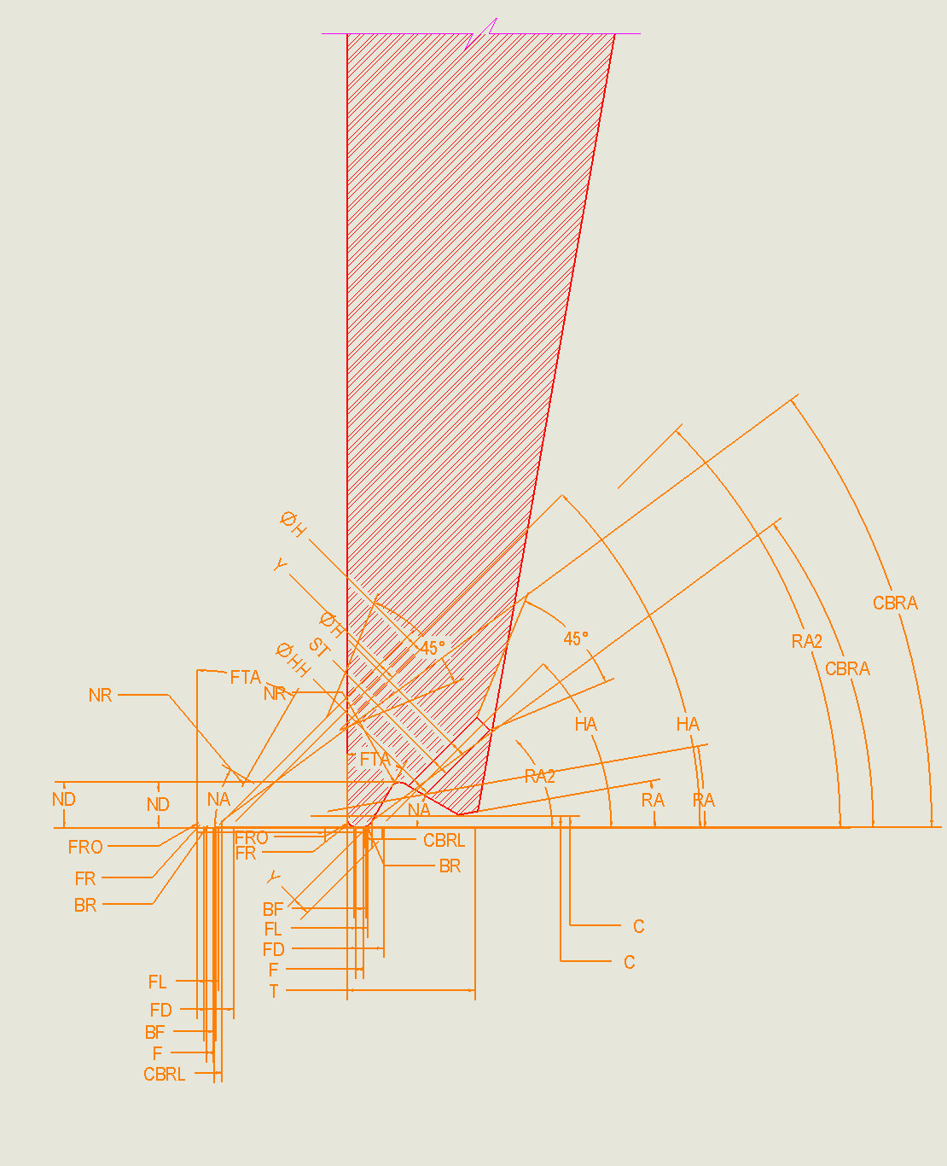
Rules
M Series – PGB Customer / Production Drawings: Section view in case of PGB :
Section view have many annotation, all the annotation are from annotation_std_front_plan & annotation_rev_front_plan In case of SYLE_STD we show only : FL@ annotation_std_front_plan
T@ annotation_std_front_plan In case of SYLE_180_DEG_REV we show only : FL@ annotation_rev_front_plan
T@ annotation_rev_front_plan
The view can be positioned based on your preference
SMALL PRECISION TOOLS
Confidential

Slide 14
Rules
M Series – FG Customer / Production Drawings: Front view in case of FG :
Front view have many annotation, all the annotation are from annotation_std_front_plan & annotation_rev_front_plan In case of SYLE_STD we show only : BA@annotation_std_front_plan VBL@annotation_std_front_plan in case we have SLB feature BA_SLB@annotation_std_front_plan in case we have SLB feature In case of SYLE_180_DEG_REV we show only : BA@annotation_rev_front_plan VBL@annotation_rev_front_plan in case we have SLB feature BA_SLB@annotation_rev_front_plan in case we have SLB feature The view can be positioned based on your preference
SMALL PRECISION TOOLS
Confidential

Slide 15
Rules
M Series – FG Customer / Production Drawings: Right view in case of FG :
Right view have many annotation, all the annotation are from annotation_right_plan
TL@annotation_right_plan
VR@annotation_right_plan Optional
The view can be positioned based on your preference
SMALL PRECISION TOOLS
Confidential

Slide 16
Rules
M Series – FG Customer / Production Drawings: Top view in case of FG :
Top view have many annotation, all the annotation are from annotation_top_plan TD@annotation_top_plan TDF_STD@annotation_top_plan in case std shank TDF_REV@annotation_top_plan in case rev shank The view can be positioned based on your preference
SMALL PRECISION TOOLS
Confidential

Slide 17
Rules
M Series – FG Customer / Production Drawings: Detail view in case of FG :
Detail view have many annotation, all the annotation are from annotation_right_plan W@annotation_right_plan ISA@annotation_right_plan
W2@annotation_right_plan Optional in case W2 option VW@annotation_right_plan Optional in case VR option VRA@annotation_right_plan Optional in case of VR option B@annotation_right_plan if VG groove
GA@annotation_right_plan if VG groove
GD@annotation_right_plan if GV groove
GD_G@annotation_right_plan if G groove
GO@annotation_right_plan if G groove
CL@annotation_right_plan if C groove
CD@annotation_right_plan if C groove The view can be positioned based on your preference
SMALL PRECISION TOOLS
Confidential

Slide 18
Rules
M Series – M Customer / Production Drawings: Section view in case of FG case std shank :
Section view have many annotation, all the annotation are from annotation_std_front_plan FL@annotation_std_front _plan
T@annotation_std_front _plan RA@annotation_std_front _plan
C@annotation_std_front _plan NA@annotation_std_front _plan FTA@annotation_std_front _plan ND@annotation_std_front _plan NR@annotation_std_front _plan RA2@annotation_std_front _plan if we have RA2 option FNAannotation_std_front _plan
HA@annotation_std_front _plan
H@annotation_std_front _plan if we have standard hole HH@annotation_std_front _plan if we have oval
ST@annotation_std_front _plan if we have slot
FR@ annotation_std_front _plan if FRO = FR don’t show FR
BR@ annotation_std_front _plan if we have CBR don’t show BR FRO@ annotation_std_front _plan
BF@annotation_front_plan only in production drawing
F@annotation_front_plan only in production drawing
Y@annotation_front_plan only in production drawing CBRL@annotation_front_plan only in production drawing
CBRA@annotation_front_plan only in production drawing The view can be positioned based on your preference
SMALL PRECISION TOOLS
Confidential

Slide 19
Rules
M Series – M Customer / Production Drawings: Section view in case of FG case rev shank :
Section view have many annotation, all the annotation are from annotation_rev_front_plan FL@annotation_rev_front _plan
T@annotation_rev_front _plan RA@annotation_rev_front _plan
RA2@annotation_rev_front _plan if we have RA2 option ND@annotation_rev_front _plan
NR@annotation_rev_front _plan
NA@annotation_rev_front _plan
C@annotation_rev_front _plan FNAannotation_rev_front _plan
HA@annotation_rev_front _plan
H@annotation_rev_front _plan if we have standard hole HH@annotation_rev_front _plan if we have oval
ST@annotation_rev_front _plan if we have slot
FR@ annotation_rev_front _plan if FRO = FR don’t show FR
BR@ annotation_rev_front _plan if we have CBR don’t show BR FRO@ annotation_rev_front _plan
BF@annotation_rev_plan only in production drawing
F@annotation_rev_plan only in production drawing
Y@annotation_rev_plan only in production drawing CBRL@annotation_rev_plan only in production drawing
CBRA@annotation_rev_plan only in production drawing The view can be positioned based on your preference
SMALL PRECISION TOOLS
Confidential

Slide 20
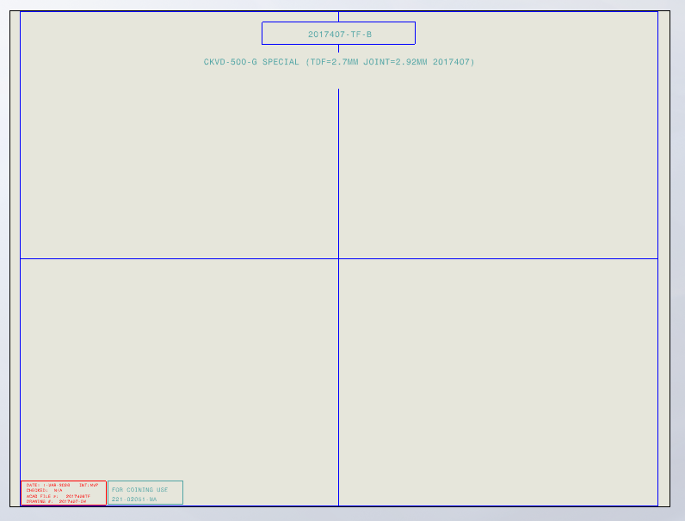
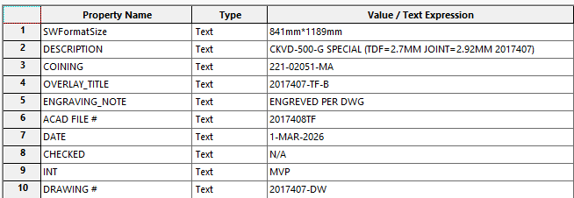
Rules
M Series –Overlay : Construction of overlays
In general, overlays respect the following shape : Right and Left view. Axillary view Optional Annotation Overlay Metadata controlled by properties manager's bellow
Annotation
Left view
Axillary view
Right view
SMALL PRECISION TOOLS
Confidential

Slide 21
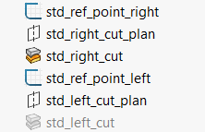

Rules
M Series –Overlay : Construction of overlays std_shank case :
View will pe positioned based on reference points :
std_ref_point_right will control the cut of the right view in the overlay; the right view is already assigned the righ_view configuration . The control of the cut is done by the programmer based by changing the value of std_ref_point_right@std_ref_point_right based on the cases we have . The old cut was based on the scale of the view was : std_ref_point_right@std_ref_point_right = 2.01175in/ "scale“ this is OK for most of standard cases but for cases with VR its no OK the programmer will need to give the appropriate value
std_ref_point_left will control the cut of the right view in the overlay; the right view is already assigned the left_view configuration . The control of the cut is done by the programmer based by changing the value of std_ref_point_left@std_ref_point_left based on the cases we have . The old cut was based on the scale of the view was : std_ref_point_left@std_ref_point_left = 2.01175in/ "scale“ this is OK for most of standard cases
SMALL PRECISION TOOLS
Confidential

Slide 22
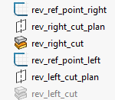
Rules
M Series –Overlay : Construction of overlays rev_shank case :
View will pe positioned based on reference points :
rev_ref_point_right will control the cut of the right view in the overlay; the right view is already assigned the righ_view configuration . The control of the cut is done by the programmer based by changing the value of rev_ref_point_right@rev_ref_point_right based on the cases we have . The old cut was based on the scale of the view was : rev_ref_point_right@std_ref_point_right = 2.01175in/ "scale“ this is OK for most of standard cases but for cases with VR its no OK the programmer will need to give the appropriate value
rev_ref_point_left will control the cut of the right view in the overlay; the right view is already assigned the left_view configuration . The control of the cut is done by the programmer based by changing the value of rev_ref_point_left@rev_ref_point_left based on the cases we have . The old cut was based on the scale of the view was : rev_ref_point_left@std_ref_point_left = 2.01175in/ "scale“ this is OK for most of standard cases
SMALL PRECISION TOOLS
Confidential

Slide 23
Rules
M Series –Overlay : Construction of overlays
Right & Left view will have the same scale; the scale is chosen based on FL values
Numerical Limits:
x400 : T ≤ 0.0134 in or 0.3403 mm
x300 : T ≤ 0.0180 in or 0.4572 mm
x200 : T ≤ 0.0272 in or 0.6908 mm
x100 : T ≤ 0.0542 in or 1.3766 mm The scales : S100 = 1:60.8
S200 = 1:121.1
S300 = 1:183.0
S400 = 1:246.0
SMALL PRECISION TOOLS
Confidential

Slide 24
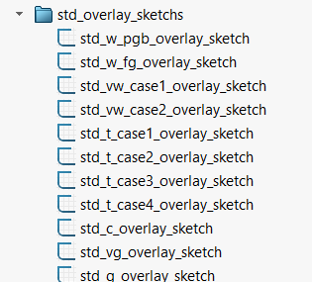
Rules
M Series – PGB Overlay : Construction of PGB overlays std_shank
Change W to MAX values & W_MIN inside the sketch
Turn off
If VW=W , Change VW , VRA to MAX & VR to MIN & VW_MIN , VRA_MIN, VRA_MAX inside the sketch
If VW≠W , Change VW , VRA, W, ISA to MAX & VR to MIN & VW_MIN , VRA_MIN, VRA_MAX, W_MIN, ISA_MIN
Change T, FL, to MAX & ND, C to MIN & T_MIN, FL_MIN, C_MAX, ND_MAX inside sketch this the standard case
If SLB Change T, FL, to MAX & ND, C to MIN & T_MIN, FL_MIN, C_MAX, ND_MAX inside sketch
If RA2 Change T, FL, to MAX & ND, RA2H to MIN & T_MIN, FL_MIN, RA2H_MAX, ND_MAX inside sketch
If RA2 & SLB, T, FL, to MAX & ND, RA2H to MIN & T_MIN, FL_MIN, RA2H_MAX, ND_MAX inside sketch
Turn off
Turn off
Turn off
Note 1 : The programmer need to change the values of the parameters in equation & inside the sketches based of above
SMALL PRECISION TOOLS
Confidential

Slide 25
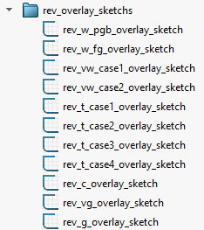
Rules
M Series – PGB Overlay : Construction of PGB overlays rev_shank
Change W to MAX values & W_MIN inside the sketch
Turn off
If VW=W , Change VW , VRA to MAX & VR to MIN & VW_MIN , VRA_MIN, VRA_MAX inside the sketch
If VW≠W , Change VW , VRA, W, ISA to MAX & VR to MIN & VW_MIN , VRA_MIN, VRA_MAX, W_MIN, ISA_MIN
Change T, FL, to MAX & ND, C to MIN & T_MIN, FL_MIN, C_MAX, ND_MAX inside sketch this the standard case
If SLB Change T, FL, to MAX & ND, C to MIN & T_MIN, FL_MIN, C_MAX, ND_MAX inside sketch
If RA2 Change T, FL, to MAX & ND, RA2H to MIN & T_MIN, FL_MIN, RA2H_MAX, ND_MAX inside sketch
If RA2 & SLB, T, FL, to MAX & ND, RA2H to MIN & T_MIN, FL_MIN, RA2H_MAX, ND_MAX inside sketch
Turn off
Turn off
Turn off
Note 1 : The programmer need to change the values of the parameters in equation & inside the sketches based of above
SMALL PRECISION TOOLS
Confidential

Slide 26
Rules
M Series – FG Overlay : Construction of FG overlays std_shank
Turn off
Change W to NOM values & W_MIN, W_MAX inside the sketch
If VW=W , Change VW , VRA to MAX & VR to MIN & VW_MIN , VRA_MIN, VRA_MAX inside the sketch
If VW≠W , Change VW , VRA, W, ISA to MAX & VR to MIN & VW_MIN , VRA_MIN, VRA_MAX, W_MIN, ISA_MIN
Change T, FL, to MAX & ND, C to MIN & T_MIN, FL_MIN, C_MAX, ND_MAX inside sketch this the standard case
If SLB Change T, FL, to MAX & ND, C to MIN & T_MIN, FL_MIN, C_MAX, ND_MAX inside sketch
If RA2 Change T, FL, to MAX & ND, RA2H to MIN & T_MIN, FL_MIN, RA2H_MAX, ND_MAX inside sketch
If RA2 & SLB, T, FL, to MAX & ND, RA2H to MIN & T_MIN, FL_MIN, RA2H_MAX, ND_MAX inside sketch
If c groove then , CL, CD to MIN & CD_MAX, CL_MAX inside the sketch
If vg groove then, GA, GD, B to MIN & GA_MAX,GD_MAX,B_MAX inside the sketch
If g groove then , GO, GD to MIN & GO_MAX, GD_MAX inside the sketch
Note 1 : The programmer need to change the values of the parameters in equation & inside the sketches based of above
SMALL PRECISION TOOLS
Confidential

Slide 27
Rules
M Series – FG Overlay : Construction of FG overlays rev_shank
Turn off
Change W to NOM values & W_MIN, W_MAX inside the sketch
If VW=W , Change VW , VRA to MAX & VR to MIN & VW_MIN , VRA_MIN, VRA_MAX inside the sketch
If VW≠W , Change VW , VRA, W, ISA to MAX & VR to MIN & VW_MIN , VRA_MIN, VRA_MAX, W_MIN, ISA_MIN
Change T, FL, to MAX & ND, C to MIN & T_MIN, FL_MIN, C_MAX, ND_MAX inside sketch this the standard case
If SLB Change T, FL, to MAX & ND, C to MIN & T_MIN, FL_MIN, C_MAX, ND_MAX inside sketch
If RA2 Change T, FL, to MAX & ND, RA2H to MIN & T_MIN, FL_MIN, RA2H_MAX, ND_MAX inside sketch
If RA2 & SLB, T, FL, to MAX & ND, RA2H to MIN & T_MIN, FL_MIN, RA2H_MAX, ND_MAX inside sketch
If c groove then , CL, CD to MIN & CD_MAX, CL_MAX inside the sketch
If vg groove then, GA, GD, B to MIN & GA_MAX,GD_MAX,B_MAX inside the sketch
If g groove then , GO, GD to MIN & GO_MAX, GD_MAX inside the sketch
Note 1 : The programmer need to change the values of the parameters in equation & inside the sketches based of above
SMALL PRECISION TOOLS
Confidential

