Slide 1

Systèmes Embarqués Microprogrammés
Geometry Dash
Pedro Pino Prieto and Yassin Alnuaimee

Slide 2
NDS features: checklist (1/2)
ARM Processors
ARM9 controls the two screens, the buttons and sends IPC messages to the ARM7 to control the sound and the touchscreen
Timers / Interrupts
Used to make the sprite jump and blinking effect
Graphics
Main screen: Mode 0 with backgrounds 3 and 2 (Tiled Mode)
Sub screen: Mode 0 with backgrounds 1 and 0 (Tiled Mode)
Keypad
Controlling the game:
KEY_UP= sprite jump
KEY_START=restart the game
Reading the keypad by polling

Slide 3
NDS features: checklist (2/2)
Touchscreen
Controlling the sprite’s action:
The sprite jumps when the touchscreen is touched
Reading touchscreen by polling
Sound
Playing music module in a loop when starting the game
Two sound effects are played when jumping or colliding with an obstacle
Sprites (optional)
The sprite is the main character of the game and its goal is to walk through the virtual world without colliding with obstacles

Slide 4
How to play?
When you press on the game, it starts instantly. Your goal is to avoid all obstacles by jumping using KEY_UP or the touchscreen. If you collide with an obstacle, you lose and you can restart the game by pressing KEY_START.

Slide 5
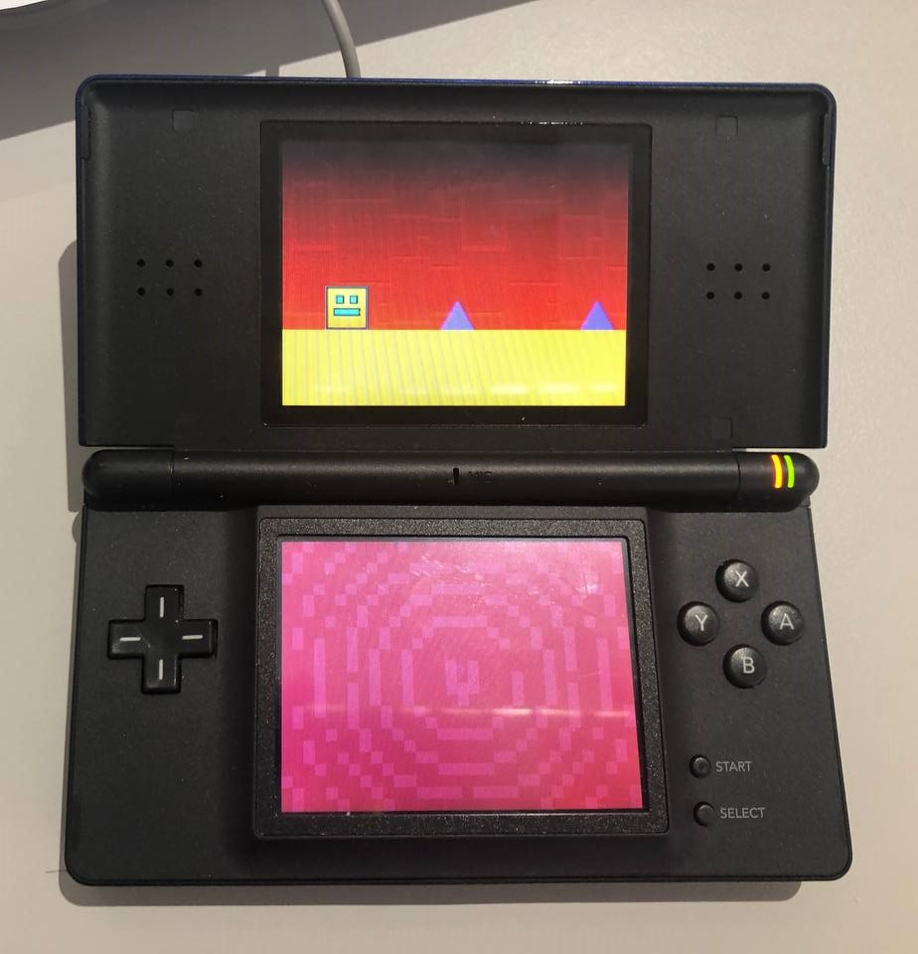
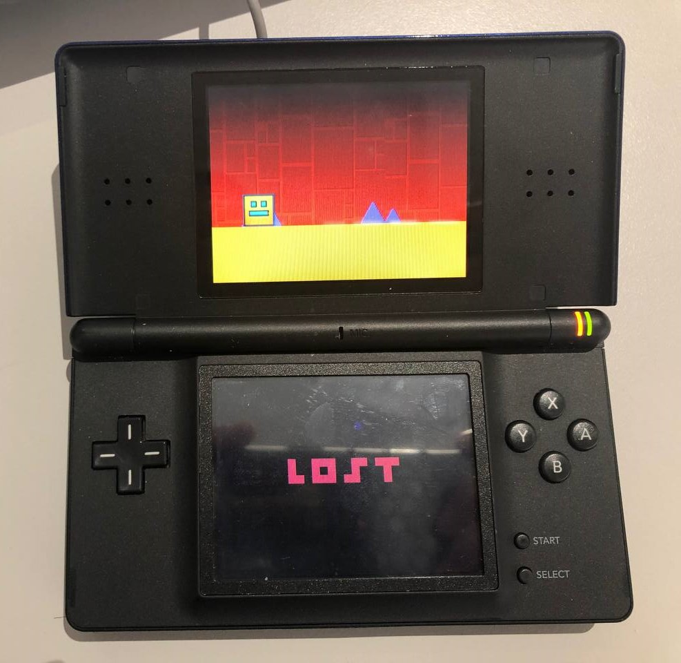
NDS project screenshot

