Slide 1
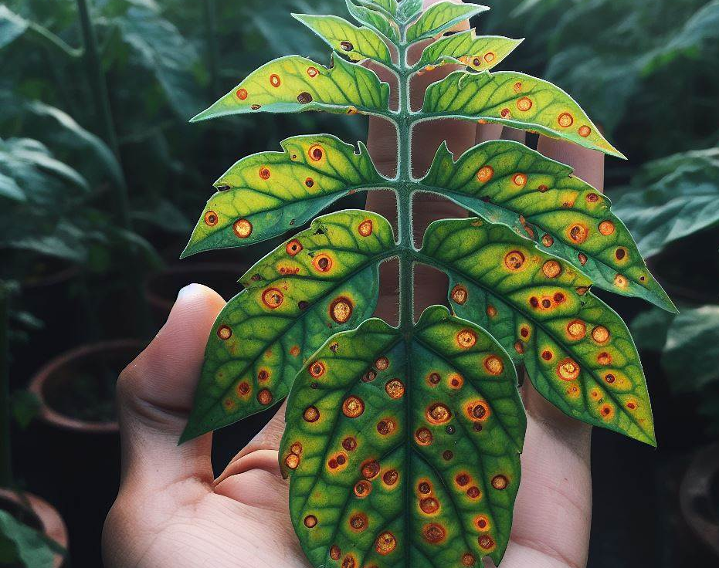

Keep Your Plants Healthy:
Disease Classification

