Slide 1
STROKE RISK PREDICTION
A Machine Learning Analysis of Patient Health Data
Exploratory Data Analysis · Risk Factors · Predictive Modeling
Dataset link
Presented By
yassmin abdelmonsif
Supervised by
Dr.Mohamed Kholief

Slide 2
PROJECT OVERVIEW
Why Predict Stroke Risk?
🩺
📊
🤖
Clinical Motivation
Data-Driven Approach
Predictive Goal
Stroke is a leading cause of death and long-term disability. Early risk identification allows preventive intervention.
We analyze demographic, lifestyle, and clinical variables to uncover patterns linked to stroke occurrence.
Build and evaluate a machine-learning model that estimates an individual patient's probability of stroke.
2

Slide 3
THE DATASET
Dataset Overview
5,110
12
201
0
Patient Records
Features Recorded
Missing BMI Values
Duplicate Rows
Features Captured
Demographic: gender, age, residence type, marital status
Clinical: hypertension, heart disease, avg. glucose level, BMI
Lifestyle: work type, smoking status
Target: stroke (0 = No, 1 = Yes)
3

Slide 4
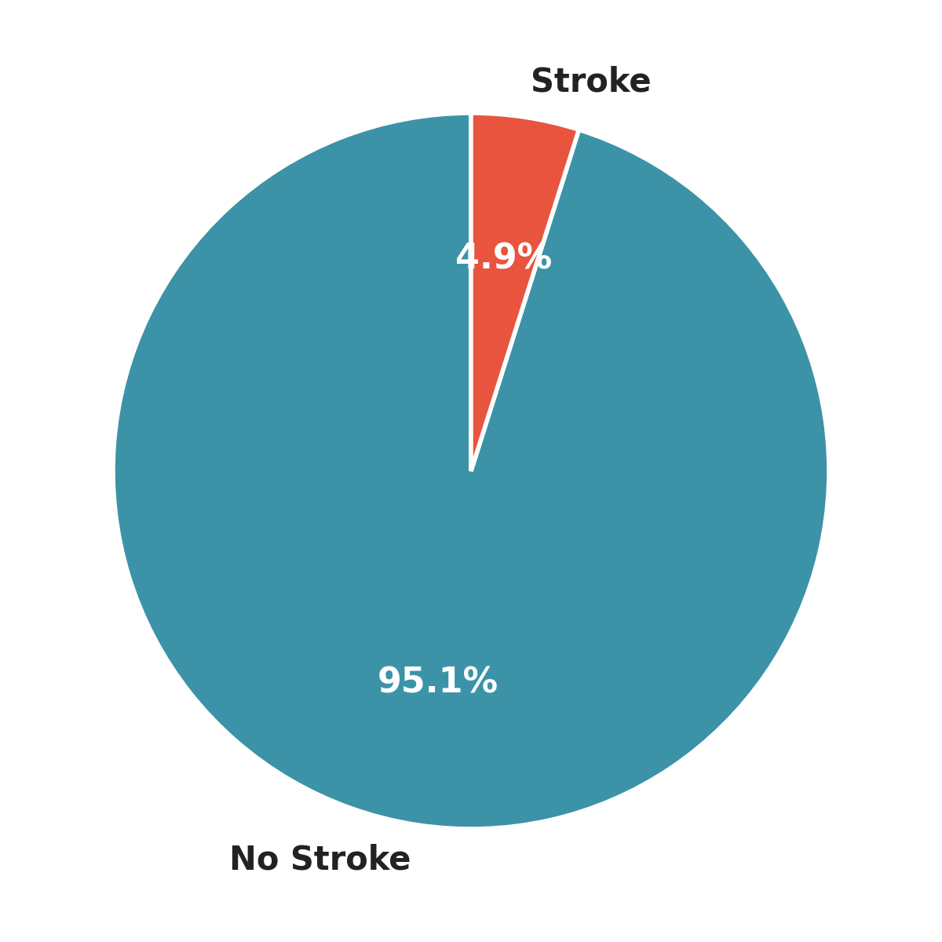
CLASS BALANCE
A Highly Imbalanced Target
4,861
patients with no stroke (95.1%)
249
patients with stroke (4.9%)
Only 1 in ~20 patients experienced a stroke — this imbalance is why accuracy alone is misleading, and why Recall, Precision and ROC-AUC matter more for model evaluation.
4

Slide 5
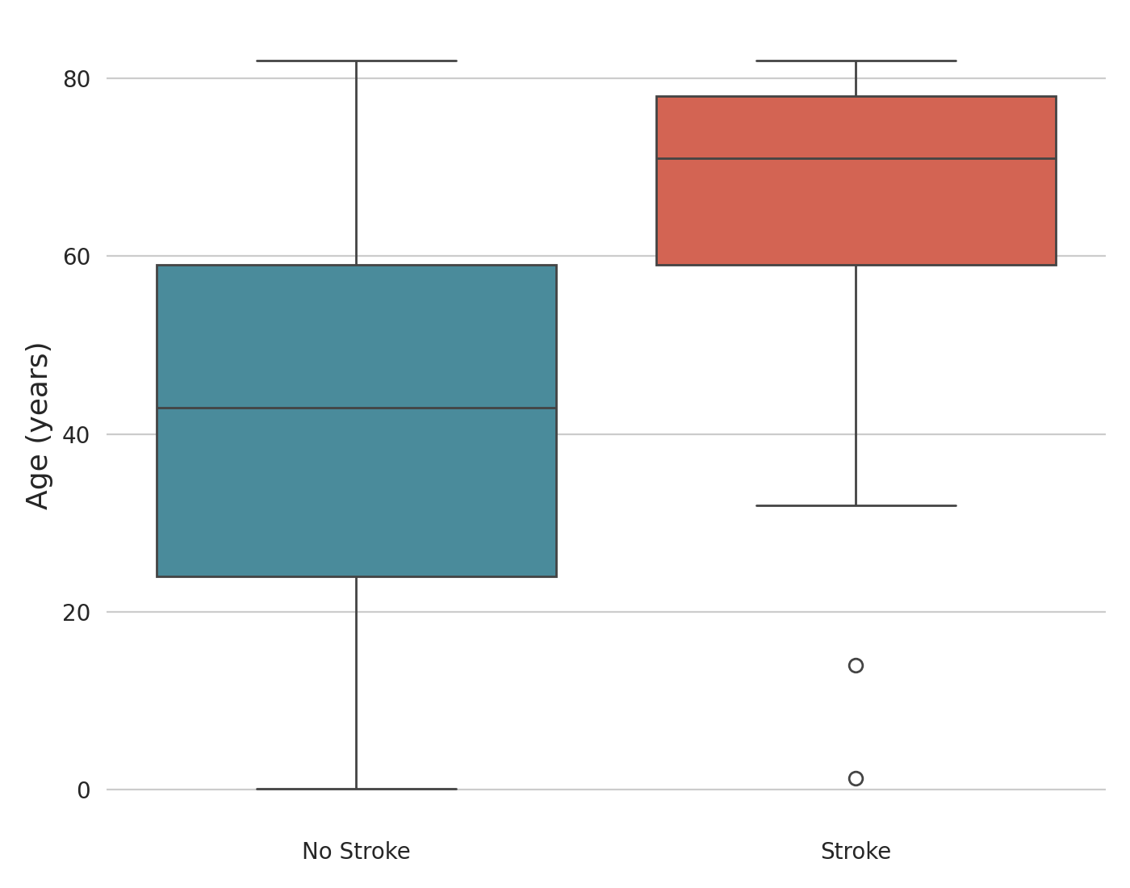
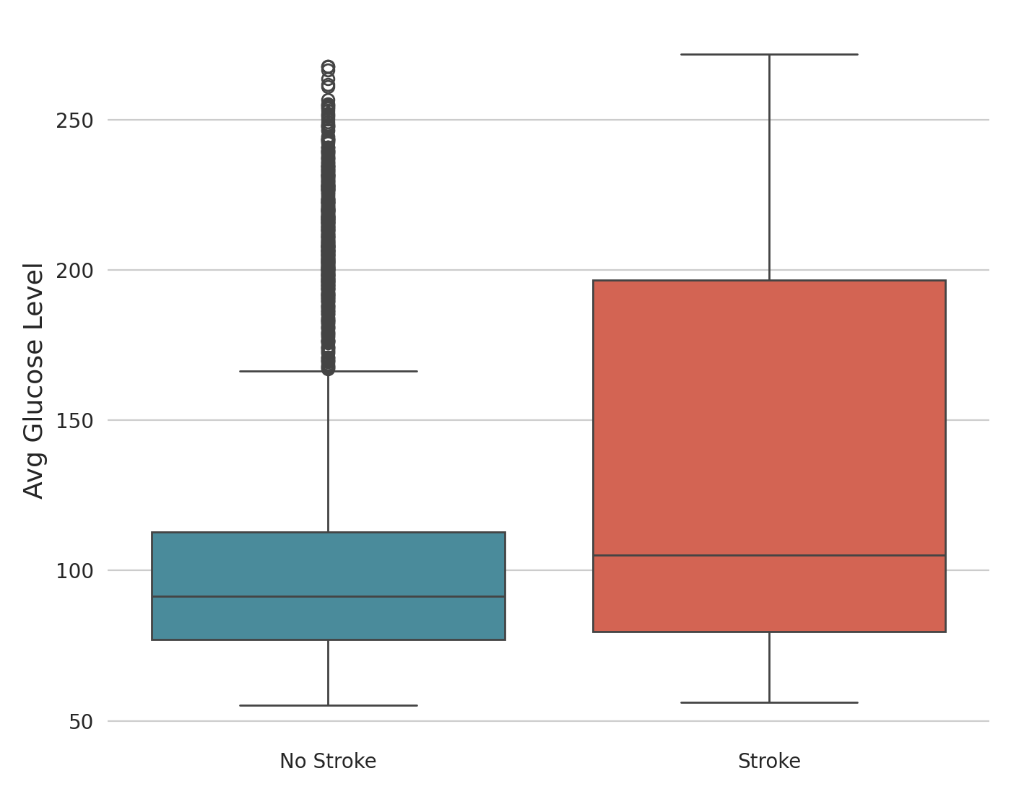
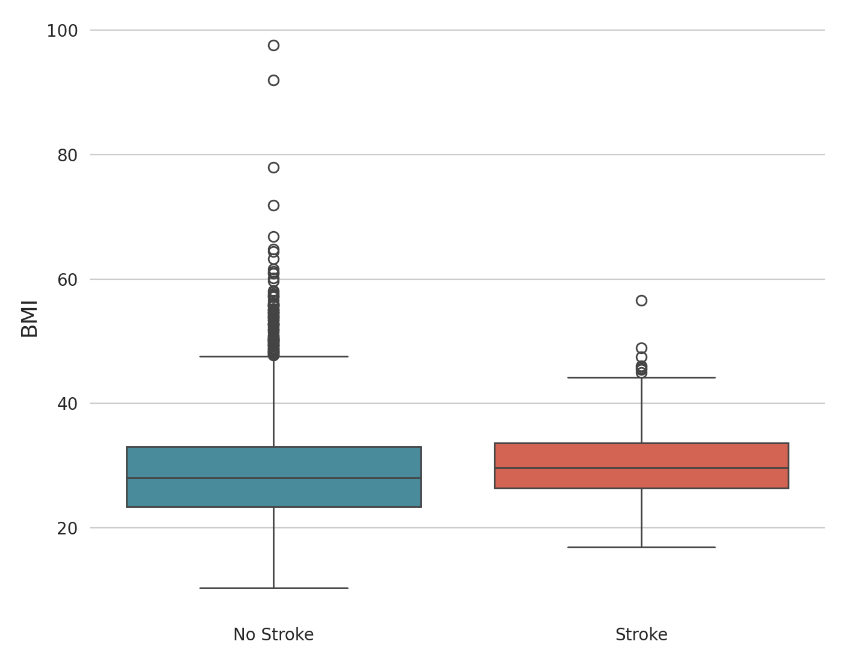
CLINICAL FACTORS
Age, Glucose & BMI vs. Stroke
Age
Avg. Glucose Level
BMI
Stroke patients skew markedly older, with higher glucose levels — a clearer signal than BMI.
5

Slide 6
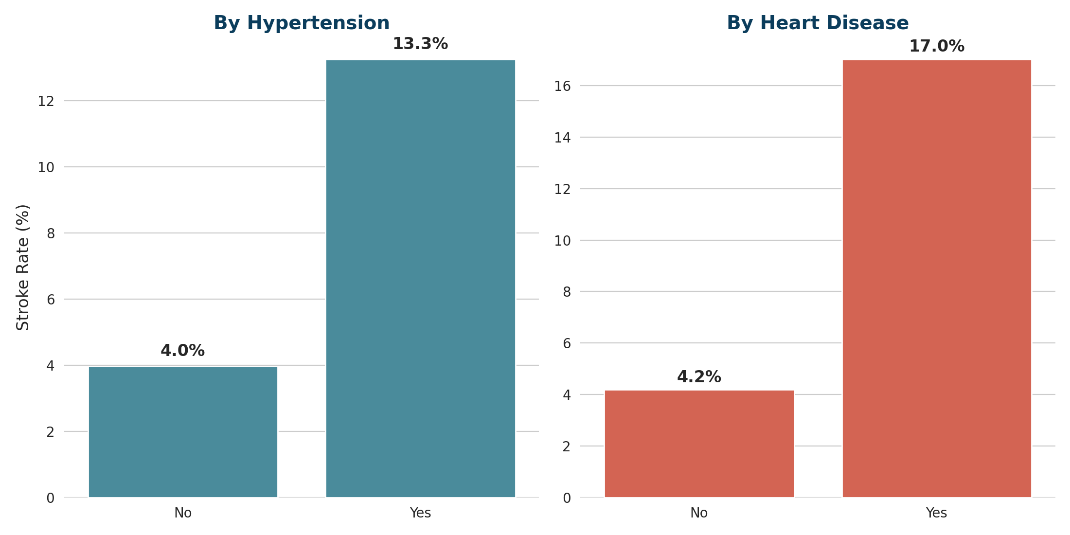
RISK FACTORS
Hypertension & Heart Disease Raise Stroke Risk
Hypertension: stroke rate more than triples, from 4.0% to 13.3%
Heart Disease: stroke rate rises from 4.2% to 17.0%
6

Slide 7
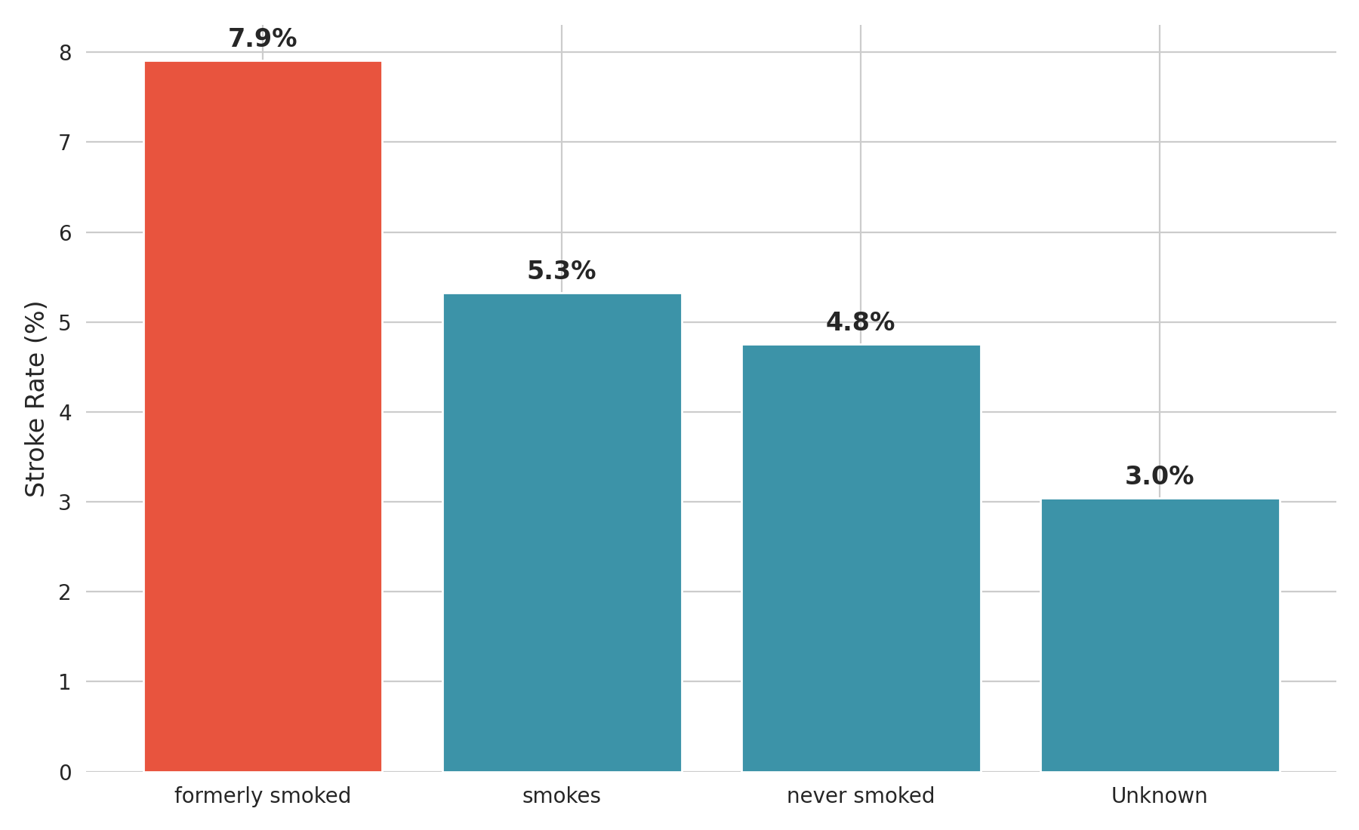
RISK FACTORS
Stroke Rate by Smoking Status
Former smokers show the highest stroke rate (7.9%) — likely reflecting cumulative exposure and older average age in this group.
7

Slide 8
METHODOLOGY
Modeling Approach
1
Preprocessing
Impute missing BMI values; scale numeric features; one-hot encode categorical variables.
2
Balancing
Apply SMOTE oversampling on the training set to correct the 95% / 5% class imbalance.
3
Feature Selection
Reduce from 21 processed features to the 10 most predictive (age, BMI, hypertension, heart disease, marital status, work type, smoking, and more).
4
Model Comparison
Train and evaluate Logistic Regression, Decision Tree, Random Forest, KNN and XGBoost using Accuracy, Precision, Recall, F1 and ROC-AUC.
8

Slide 9
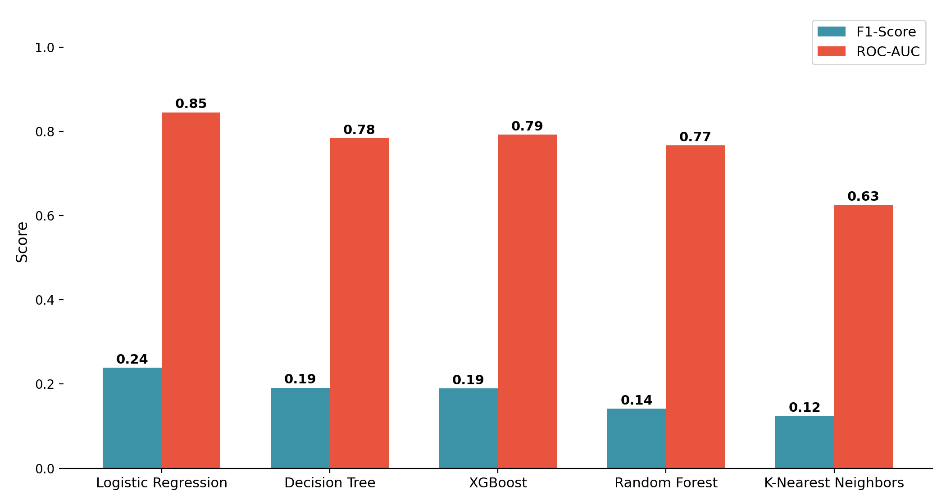
RESULTS
Comparing Five Models
Trained on all 21 processed features, ranked by F1-Score (as in the notebook's model comparison step)
Logistic Regression leads on F1-Score and ROC-AUC — the basis for choosing it (with feature selection) as the final model.
9

Slide 10
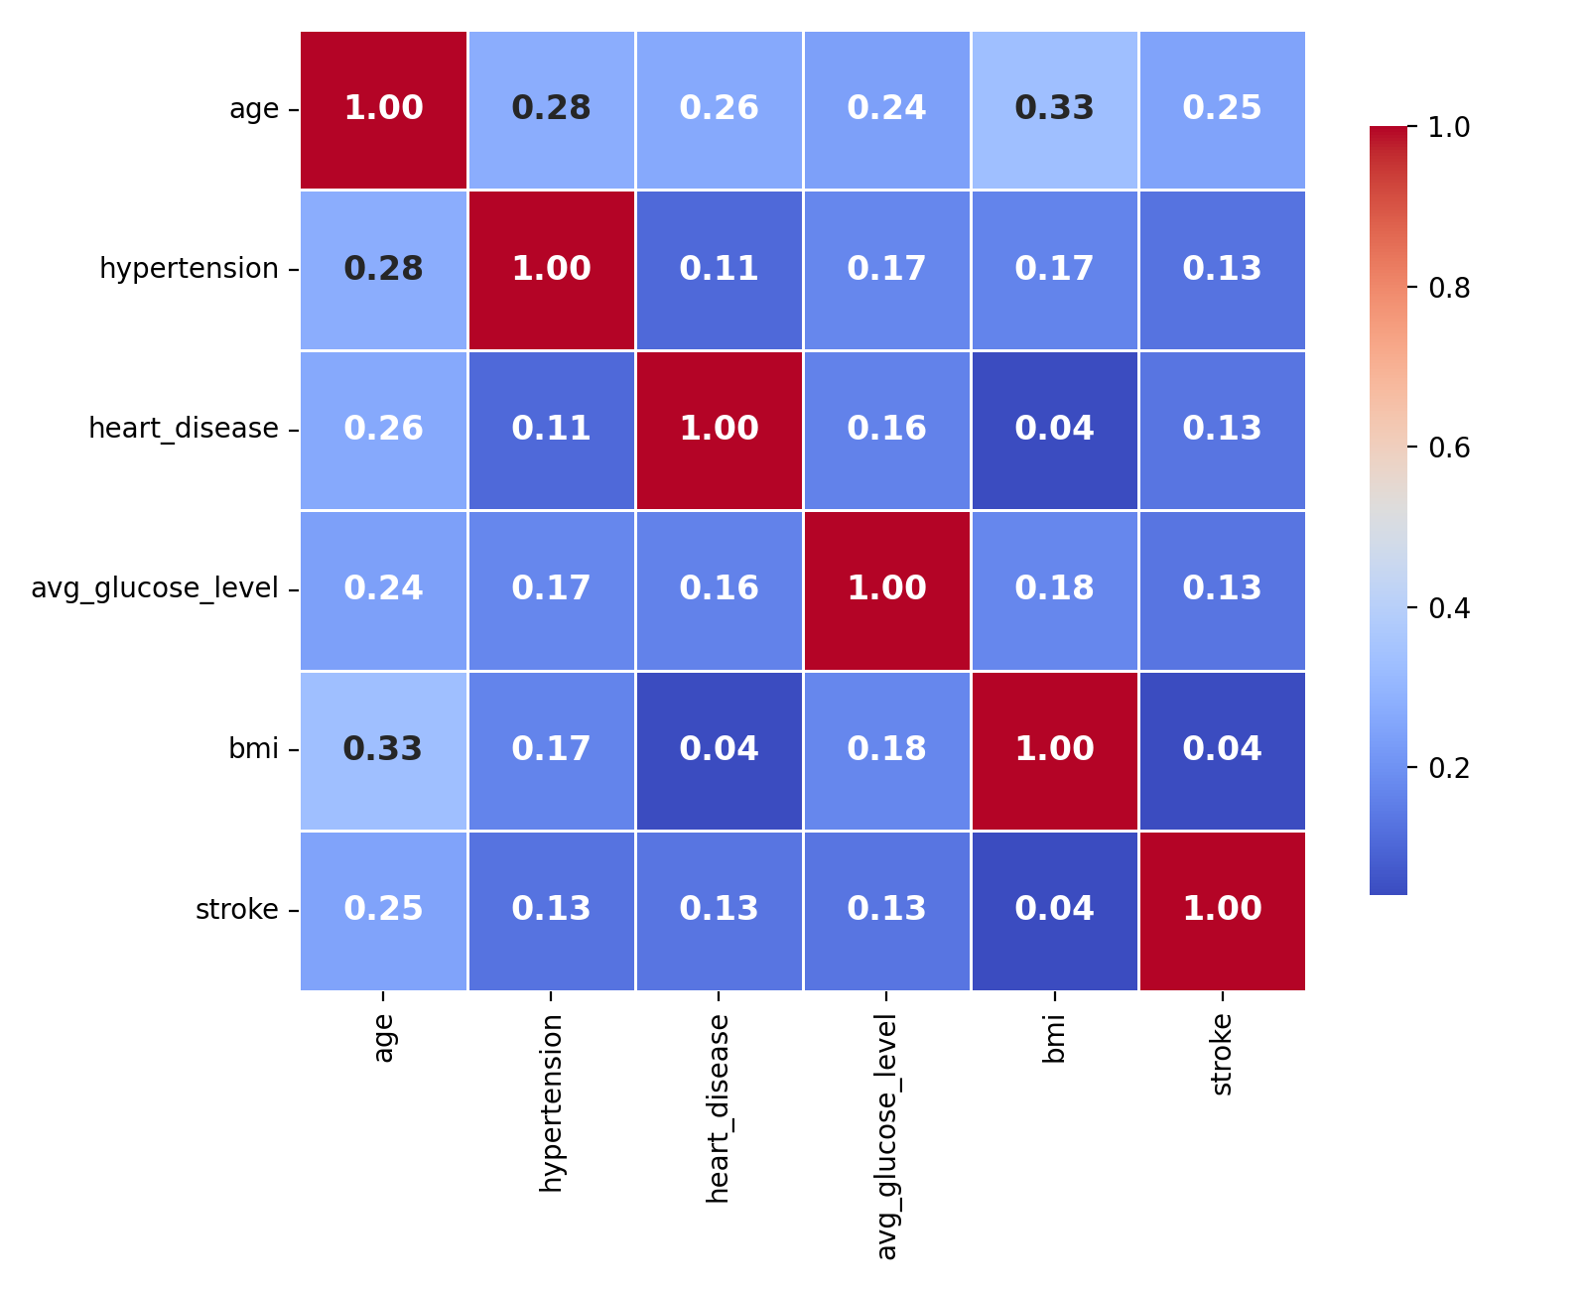
EXPLORATORY ANALYSIS
Correlation Between Clinical Variables
Age has the strongest correlation with stroke (0.25); hypertension, heart disease and glucose level follow, each weakly but positively correlated.
10

Slide 11
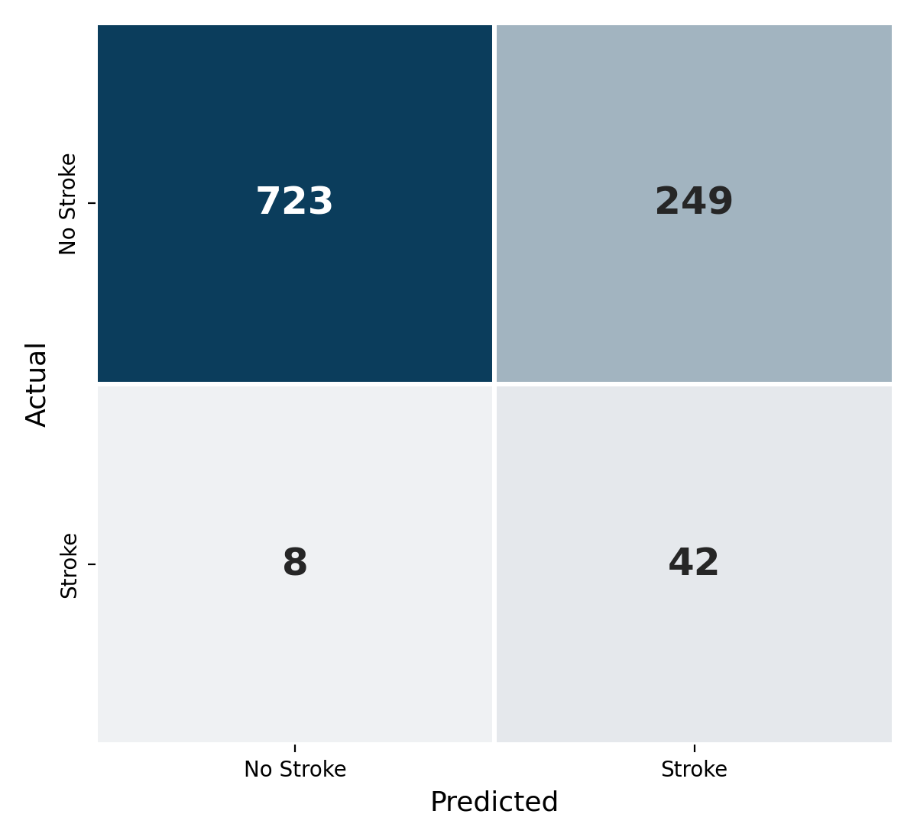
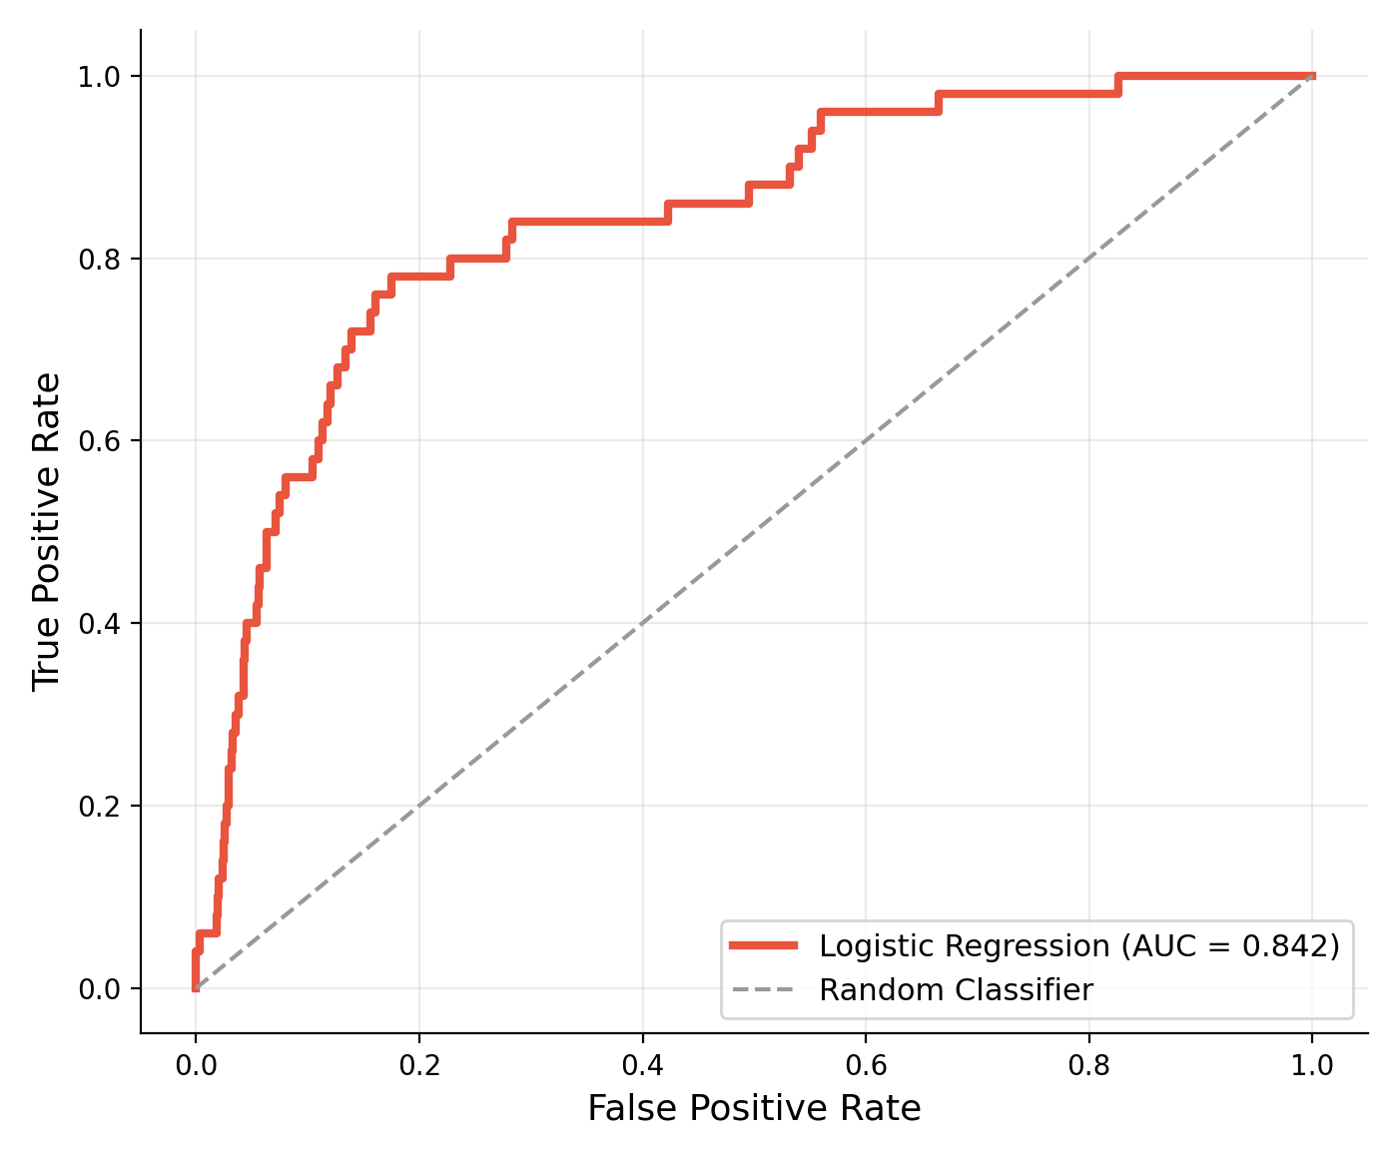
RESULTS
Final Model: Logistic Regression
Trained on the 10 selected features after SMOTE balancing
74.9%
Accuracy
84%
Recall
0.842
ROC-AUC
The model correctly flags 84% of true stroke cases (42 of 50), trading some false alarms for fewer missed diagnoses — a reasonable choice in a screening context.
11

Slide 12
16. Conclusion & Future Work
Conclusion
A complete data-mining workflow was implemented: EDA, cleaning, preprocessing, SMOTE, model comparison, feature selection, evaluation, and an interactive prediction interface.
The final experiment used Logistic Regression with 10 selected features and achieved ROC-AUC = 0.842 and Recall = 84% on the test set.
Future Work
• Hyperparameter tuning
• Cross-validation
• Alternative imbalance techniques
• Additional feature engineering
• External dataset validation
• Explainable AI for individual predictions
• Web-based deployment
• Further analysis of false positives/negatives
• Clinical validation before any real-world use
Stroke Prediction • Data Mining Project 17

Slide 13
CONCLUSION
Key Insights
Stroke cases are rare (4.9%) — accuracy alone is misleading; Recall and ROC-AUC drive evaluation.
Age, hypertension, heart disease and glucose level are the strongest observed risk signals.
SMOTE and feature selection meaningfully improved the model's ability to catch true stroke cases.
The final Logistic Regression model reaches 84% Recall and 0.842 ROC-AUC on unseen data.
This is a screening aid, not a diagnosis — findings should support, not replace, clinical judgment.
12

