Slide 1


SMART INDIA HACKATHON 2026
TEAM REGEX
Browse smarter • Stay private
Privacy-Preserving Vision Agent
PROBLEM STATEMENT ID
SIH26171
PROBLEM STATEMENT TITLE
A browser agent that reads your screen without ever receiving your data.
Privacy-Preserving Vision Agent
ORGANISATION
HOW IT WORKS
ISRO
ON YOUR DEVICE
AI SERVER
THEME
Read the page
Sees only sanitized context
Space Technology
Local vision model
PS CATEGORY
Returns exactly ONE action
Software
Redact text + pixels
TEAM NAME
Never sees raw PII
REGEX
Compute statistics
TEAM ID
PRIVACY BOUNDARY
<TEAM ID>
Local vision • On-device redaction • Sanitized context • One validated action

Slide 2
PROPOSED SOLUTION
REGEX | SIH26171 | ISRO
Privacy-preserving browser automation, with the boundary enforced by the compiler
Current Problems
Proposed Solution
PROVEN, NOT CLAIMED
Agents upload your entire screen to a cloud
Passwords, IDs and cards leave the device
Screenshots leak what redacted text does not
"We don't store data" is a promise, not a proof
Hostile pages hijack agents by prompt injection
Agents click freely, with no bounded authority
A local vision model reads the screen on-device
PII detected and redacted BEFORE anything leaves
Text and pixels redacted to the same standard
Two fail-closed egress gates verify every payload
Page content is typed as data, never as instruction
Server returns ONE action; the client validates it
Statistics computed locally: ~40 numbers, not 150,000 tokens
232,589 B
on-device vision model
30.3 ms
inference, p50
1,133
automated tests passing
Problems Addressed
Unique Value Proposition
0
Zero raw PII transmission, enforced structurally
Screenshot leakage closed by pixel redaction
Prompt injection blocked at the type level
Agent authority bounded by a validated allowlist
No vendor lock-in: four backends, one boundary
Privacy made auditable, not merely asserted
Privacy is a TYPE, not a policy - compiler-enforced
Runs fully offline: on-device backend needs no network
One boundary for every backend, byte-identical payloads
Per-step privacy receipt: no line may be a constant
232 KB vision model at 30.3 ms - runs on any laptop
Chrome and Firefox MV3 from one source tree
raw records ever transmitted
2
independent fail-closed gates
1,032x
faster redaction after fix
2

Slide 3


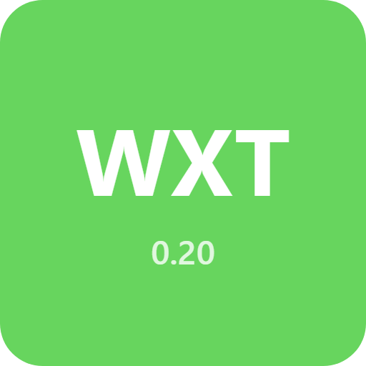



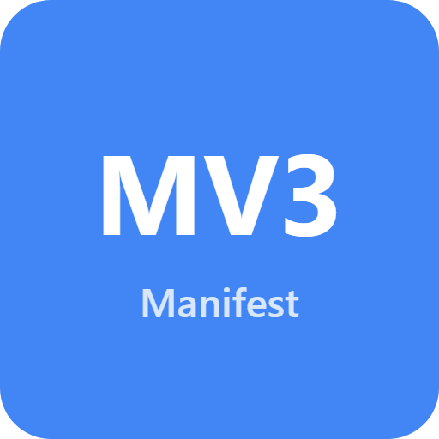
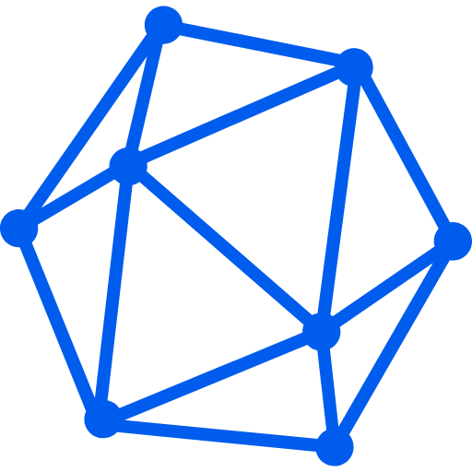







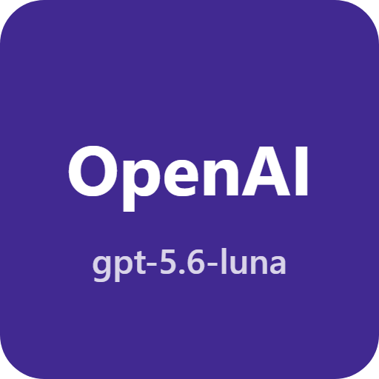


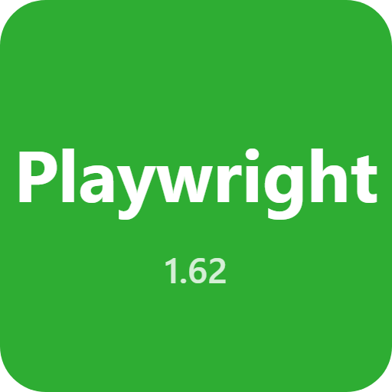

TECHNICAL APPROACH
REGEX | SIH26171 | ISRO
From browser perception to one validated action
TECHNOLOGY STACK
PROCESS FLOW - one agent step
FRONTEND
1
User gesture
2
Snapshot + capture
Toolbar click attaches one tab
DOM clone, real geometry, screenshot
TypeScript
Preact
WXT
Vite
3
Detect
4
Redact
EXTENSION
YuNet vision + DOM PII scan
HTML rewritten, pixels baked over
Chrome
Firefox
MV3
5
Analyse
6
GATE 1 + GATE 2
ON-DEVICE AI
Statistics computed on this device
Shape check, then PII re-scan
7
Plan
8
Validate + execute
ONNX RT
YuNet
WebGPU
WASM
VLM returns exactly ONE action
Ref allowlist, then click or type
BACKEND
Node 20+
Render
npm
The Privacy Boundary - enforced by the compiler
CLOUD AI
Untrusted<T> is a real wrapper - JSON.stringify() of one yields {}
DataAtom is the only page-derived shape allowed on the wire
SanitizedContext / AnalysisResult: nominal, one minting site each, pinned by a test
renderPrompt() takes only DataAtom, so page text cannot become instruction
The model may name only elements we sent it - a compromised server cannot widen that
Gemini
OpenAI
Ollama
TESTING
Vitest
Playwright
GitHub
3

Slide 4
FEASIBILITY AND VIABILITY
REGEX | SIH26171 | ISRO
Every challenge below was hit in this build; the right column is what was actually done
CHALLENGE
OUR APPROACH TO OVERCOME IT
MV3 service worker has no DOM, canvas or WebGPU
Model runs in an Offscreen Document; a host abstraction hides it
Firefox has no offscreen API at all
Two backends, one interface; Firefox uses its DOM-capable event page
Model weights inflate the extension package
Swapped yolos-tiny for YuNet: 26 MB to 232 KB, 1765 ms to 30.3 ms
Redacted text beside a leaking screenshot
Pixel redaction in the worker; the step refuses an uncovered image
A hostile page forging our redaction tokens
Per-session nonce; forgeries stripped at ingest and counted
Prompt injection from page content
Page text is DataAtom only, fenced, never in the instruction region
Large pages exhausting the client
Two quadratics removed: 378,745 ms to 367 ms; merge to 66 ms
Small model context windows
Budget sheds names, geometry, image, then elements - refs never renumber
A failing backend silently becoming another
No silent fallback: only an explicit user selection changes it
4

Slide 5
IMPACT AND BENEFITS
REGEX | SIH26171 | ISRO
Useful browser automation without unrestricted data sharing
Potential Impacts
ISRO / Government & Defence
Enterprise, Health & Finance
Automation without losing data sovereignty
AI help on regulated and classified screens
Auditable privacy instead of vendor promises
Lower inference cost through on-device compute
A reusable privacy boundary for any agent
Accessibility gains for screen-driven work
Sensitive telemetry never leaves the workstation
Deployable fully air-gapped (on-device backend)
Private on-premise server option available
Per-step receipt gives a compliance audit trail
No vendor lock-in - swap models freely
DPDP / GDPR / HIPAA-aligned by construction
Patient and customer records stay on the device
Analyse 100,000-row tables without sending a row
Redaction proven by re-scanning the payload
One boundary across local, private and cloud
MEASURED, BEFORE vs AFTER
End Users
Developers & Research
Model size
113x
Passwords, OTPs and cards never reach any server
Works on ordinary hardware - 232 KB model, 30 ms
Sees exactly what was redacted, on every step
Nothing to configure: it opens ready to run
Chrome and Firefox, same behaviour
Open architecture with 1,133 automated tests
Architecture and type-level tests enforce the boundary
Known gaps documented rather than hidden
A model-agnostic OpenAI-compatible server
A reusable pattern for any privacy-critical agent
26 MB -> 232 KB
Inference p50
58x
1765.8 ms -> 30.3 ms
Package
44%
60.01 MB -> 33.54 MB
Redact 1k rows
1032x
378,745 ms -> 367 ms
Merge 100k rows
~27000x
1,767,327 ms -> 66 ms
5

Slide 6
RESEARCH AND REFERENCES
REGEX | SIH26171 | ISRO
Technical foundations this project is built on
YuNet: A Tiny Millisecond-level Face Detector
libfacedetection - reference implementation
Wu, Peng, Yu et al., Machine Intelligence Research, 2023
Shiqi Yu et al.
https://doi.org/10.1007/s11633-023-1423-y
https://github.com/ShiqiYu/libfacedetection
ONNX Runtime Web - in-browser inference
W3C WebGPU Specification
WebGPU and WebAssembly execution providers
GPU compute in the browser
https://onnxruntime.ai/docs/tutorials/web/
https://www.w3.org/TR/webgpu/
Chrome Extensions - Offscreen Documents API
Firefox MV3 background scripts / no offscreen API
The only MV3 context with a DOM for workers
Bugzilla 1573659
https://developer.chrome.com/docs/extensions/reference/api/offscreen
https://bugzilla.mozilla.org/show_bug.cgi?id=1573659
OWASP Top 10 for LLM Applications - LLM01
NIST SP 800-122
Prompt injection threat model
Protecting the Confidentiality of PII
https://owasp.org/www-project-top-10-for-large-language-model-applications/
https://doi.org/10.6028/NIST.SP.800-122
Digital Personal Data Protection Act, 2023 (India)
Statutory basis for on-device processing
https://www.meity.gov.in/data-protection-framework
Project repository - github.com/yassudicoder/Privacy-Preserving-Vision-Agent
6

