Slide 1

SMART INDIA HACKATHON 2026
TITLE PAGE
Problem Statement ID – 26121
Problem Statement Title – eRTMAC-NWIS (Nearby Wells Intelligence System): An AI-Powered Offset Well Knowledge and Decision Support Platform for Drilling Operations
Theme – Smart Automation
PS Category – Software
Team ID – [Enter Team ID]
Team Name (Registered on portal) – [Enter Team Name]

Slide 2
NWIS: Nearby Wells Intelligence System
Your Team Name
Proposed Solution (Describe your Idea/Solution/Prototype)
Problem – offset-well knowledge is scattered across well completion reports (WCR), daily drilling reports (DDR), mud logs, scans and memory; the nearest well is not always the relevant one; past trouble surfaces too late
Idea – NWIS, a standalone AI/ML decision-support platform beside eRTMAC, turns those records into a searchable knowledge base and warns the driller before the bit reaches trouble seen in nearby wells
Prototype – working end to end on a synthetic Upper Assam pilot: 61 wells, 10 fields, 180 reports, 7-screen dashboard
Detailed explanation of the proposed solution
Read – OCR + NLP pull every event from the reports: depth, formation, severity, lost time (NPT), remedial action, lessons
Remember – one knowledge base with events, lessons, casing, cement jobs, reservoir data; one search box over every event, lesson and report line
Rank – nearby wells on a map within a user-defined radius, scored on 7 factors, not distance alone
Correlate – formation tops tie each offset to this well's depth scale
Warn – look-ahead alerts for the next 300 m: risk, confidence, reasons, evidence, recommended actions
Predict – six trained hazard models and a mud-weight check for overpressure
How it addresses the problem
Map – offset wells around the active well within a chosen radius
Instant access – offset events, lessons and mitigations, one click from the source report page
Correlation – mud losses, kicks, stuck pipe and cementing projected across wells by depth and formation; drilling parameters compared per formation; casing, cement and reservoir records for every well
Proactive alerts – before the bit reaches past trouble, refreshed as the bit advances
Prediction – mud loss, stuck pipe, kick, instability, torque & drag, cementing issues
Innovation and uniqueness of the solution
Relevance, not proximity – explained 7-factor ranking engineers can re-weight
Formation-tie correlation – a loss at 2,840 m in an offset is placed where this well meets the same rock
Evidence-first – every offset event traces to document → page → line
Two views – evidence score and trained-model probability, side by side
One vote per well – an incident in WCR, DDR and mud log counts once, all citations kept
Crew-proven actions first – recommendations lead with what offset crews actually did

Slide 3
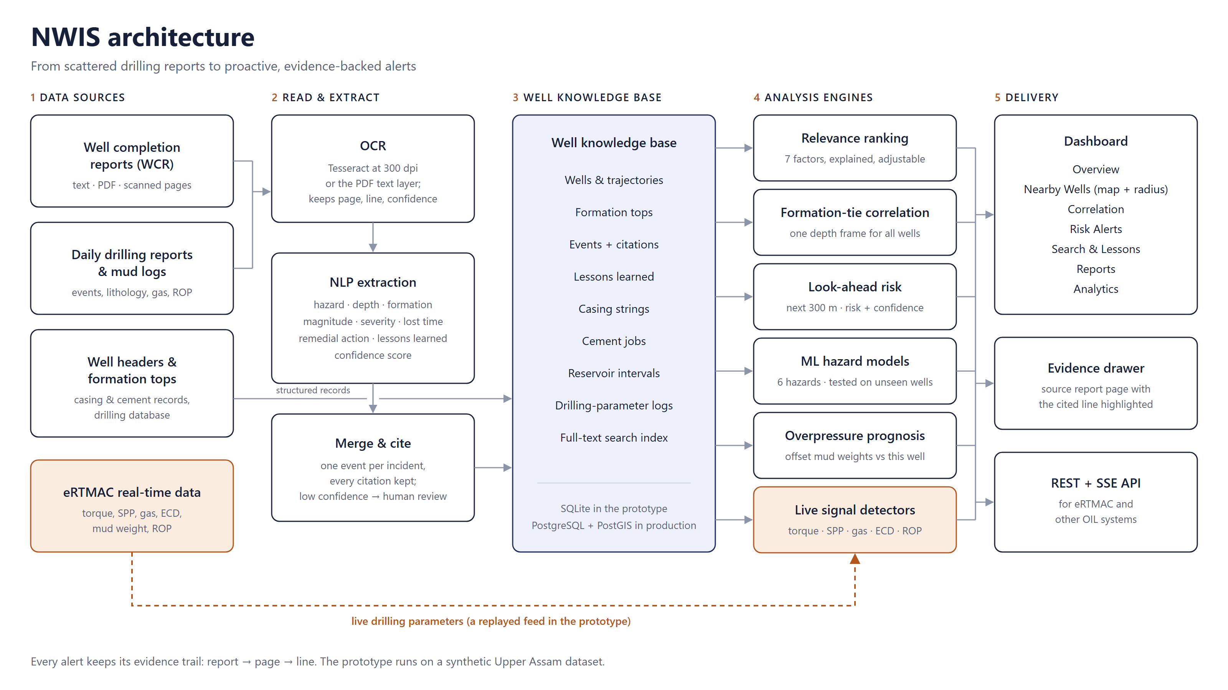
TECHNICAL APPROACH
Your Team Name
Technologies to be used
Frontend – React 18, Vite, Tailwind CSS, Leaflet maps (OpenStreetMap)
Backend / API – Python 3.11+, FastAPI, Uvicorn, Server-Sent Events
Data & search – SQLite with FTS5 (BM25); PostgreSQL + PostGIS in production
AI / ML / NLP – rule-based NLP extraction, logistic-regression hazard models, OCR (Tesseract + PyMuPDF)
Analytics – geo-distance, formation-tie correlation, trend detection, hazard clustering
DevOps – Docker, Git/GitHub, 39 automated tests
Integration – WITSML / eRTMAC connector (simulated feed in prototype)
Methodology and process for implementation (Flow Charts/Images/ working prototype)
How NWIS decides
Relevance – geology 26%, proximity 18%, experience 15%, depth 14%, parameters 12%, trajectory 10%, recency 5%
Risk – recurrence × severity × depth agreement; confidence shown separately
Models – leave-one-well-out AUC 0.82–0.93 (synthetic pilot)
Working prototype: github.com/yassudicoder/eRTMAC-NWIS · reports → OCR/NLP → cited events → knowledge base → ranked offsets → formation-tie correlation → look-ahead risk + ML → dashboard and REST/SSE API for eRTMAC

Slide 4
FEASIBILITY AND VIABILITY
Your Team Name
Analysis of the feasibility of the idea
Works today – reports to cited alerts end to end; 7-screen dashboard, REST API, 39 passing tests
Pilot data – synthetic Upper Assam: 61 wells, 10 fields, 180 reports; 1,284 mentions merged into 547 cited events
Measured – extraction precision 100%, recall 99.1%; model AUC 0.82–0.93 on unseen wells (synthetic data; real accuracy measured in the pilot)
Data exists – OIL has 3,000+ wells of history [1]; WCRs, DDRs, mud logs and eRTMAC feeds are recorded today
Proven payoff – offset-driven planning saved 15 rig days on a deep well in NE India [3]
Low cost, sustainable – open-source stack on OIL's own servers; OIL owns the knowledge base; models retrain as wells are drilled
Roadmap – Prototype (done) → Pilot on one Upper Assam structure with real data + eRTMAC (3–6 months) → all OIL areas
Potential challenges and risks | Strategies for overcoming these challenges
Scattered, inconsistent, scanned records | OCR + NLP with confidence scores; low-confidence items flagged for review
Nearest well may not be relevant | Explained 7-factor relevance with adjustable weights
Same formation at different depths | Formation-tie correlation with a tie-quality score
Wrong or invented AI output | Every event cited to page and line; confidence shown apart from risk; model accuracy published
No live eRTMAC access in the prototype | Simulated real-time connector; swap in a WITSML / eRTMAC client
Proprietary, sensitive data | Synthetic data for the prototype; on-premise deployment with role-based access and encryption
Few offsets drilled a formation | Each alert states how many wells support it; single-well evidence is flagged

Slide 5
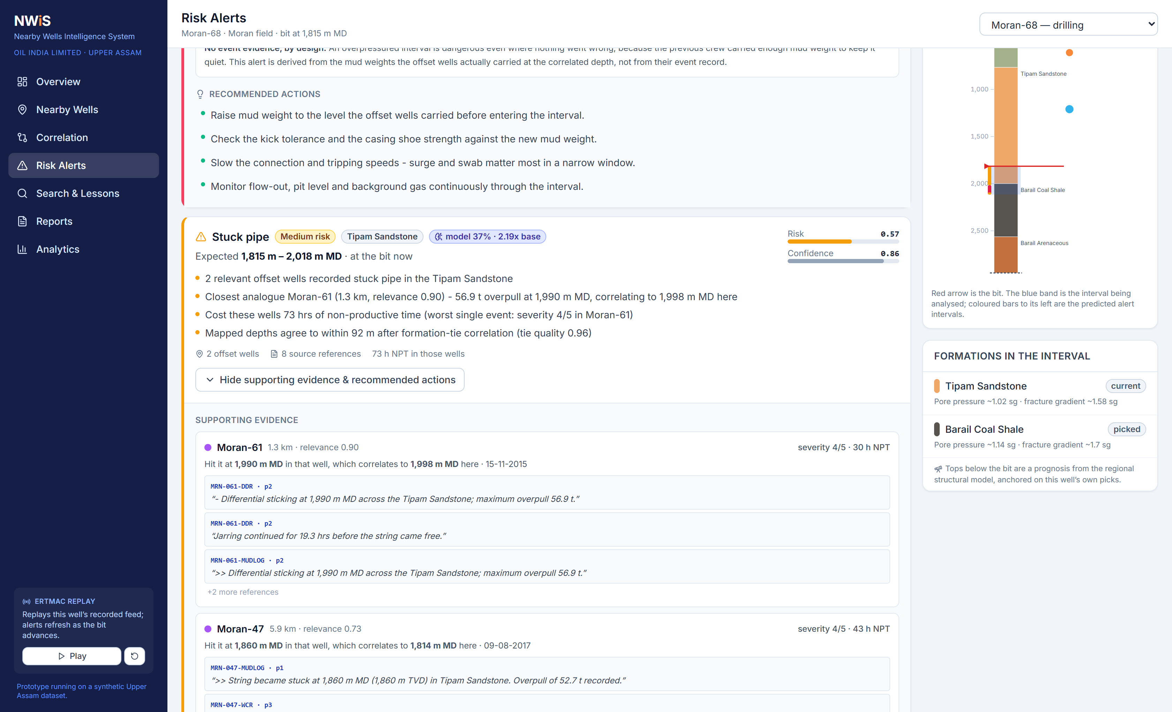
IMPACT AND BENEFITS
Your Team Name
Potential impact on the target audience
Drilling engineers – relevant offset experience and risk warnings in seconds, before the bit reaches the interval
Geologists – automatic cross-well correlation and formation-wise event history
Rig & operations teams – fewer surprises, crew-proven mitigation steps, less non-productive time
OIL management – recurring hazard zones and lost time by hazard and formation; knowledge retained when people move on
Why it matters
In the Netherlands, an estimated 20% of drilling time goes to recovering from unexpected, potentially avoidable incidents [4]
Stuck pipe and borehole problems: over 24% of NPT in one operator's shaly formations [5]; lost circulation about 12% of NPT, USD 1–2 billion a year [6][7]
Overpressure mapped in the Barail and Kopili of the upper Assam Shelf [8]
Benefits of the solution (social, economic, environmental, etc.)
Economic – cuts avoidable NPT; better casing, mud and cement design from past lessons; lower well cost
Safety & social – earlier warning of well-control risk; knowledge shared across teams and generations
Environmental – fewer well-control incidents, less drilling fluid lost to formations, fewer sidetracks and re-drills
National – India imported 88.7% of its crude oil in 2025-26 (provisional) [9]; safer, faster domestic drilling supports energy security, Atmanirbhar Bharat and Viksit Bharat 2047
Prototype: a stuck-pipe alert with offset evidence and the model's second opinion (synthetic pilot data)

Slide 6
RESEARCH AND REFERENCES
Your Team Name
Details / Links of the reference and research work
[1] Oil India Limited, Drilling (official website) – oil-india.com/drilling
[2] Oil India Limited, Integrated Annual Report 2025-26 – oil-india.com (financial results)
[3] Bhardwaj et al., Deep wells aided by geomechanics and real-time decisions, NE India, SPE-200627-MS, 2020 – onepetro.org
[4] Hoetz, Jaarsma & Kortekaas, Drilling Hazards Inventory, SPE-166254-MS, 2013 – onepetro.org
[5] Aljubran, Al-Yami & Madan, Preventing stuck pipe in offshore shaly formations, SPE-183717-MS, 2017 – onepetro.org
[6] Arshad et al., Lost circulation in Rumaila field, IPTC-18245-MS, 2015 – onepetro.org
[7] Omer et al., Curing dynamic losses with self-degradable LCM, SPE-219656-MS, 2024 – onepetro.org
[8] Rai, Singha & Chatterjee, 3D pore pressure and overpressure, upper Assam Shelf, Acta Geophysica 70, 2022 – doi.org/10.1007/s11600-022-00771-1
[9] PPAC (MoPNG), India's Oil & Gas Ready Reckoner FY 2025-26 – ppac.gov.in
[10] Krygier et al., NPT due to well stability issues (93 wells), SPE-200732-MS, 2020 – onepetro.org
[11] Selveindran et al., Automated offset well analysis, SPE-201590-MS, 2020 – onepetro.org
[12] Parmar et al., Risk assessment of offset wells using cognitive analysis, IPTC-24705-MS, 2025 – onepetro.org
[13] Hoffimann et al., Deep NLP on drilling reports, SPE-191505-MS, 2018 – arxiv.org/abs/1712.01476
[14] Guillot et al., ML prediction of lost circulation at well planning, OTC-34764-MS, 2024 – onepetro.org
[15] DGH National Data Repository, Assam Arakan Basin – ndrdgh.gov.in
[16] Wandrey, Sylhet-Kopili/Barail-Tipam petroleum system, USGS Bulletin 2208-D, 2004 – pubs.usgs.gov
[17] Energistics, WITSML data standards – energistics.org/witsml-data-standards
[18] Docs: FastAPI (fastapi.tiangolo.com), SQLite FTS5 (sqlite.org/fts5.html), Tesseract OCR, PostGIS ST_DWithin, Leaflet (leafletjs.com)
Prototype & code
github.com/yassudicoder/eRTMAC-NWIS · FastAPI + React dashboard · synthetic Upper Assam dataset (no OIL data used) · 39 automated tests

