Slide 1
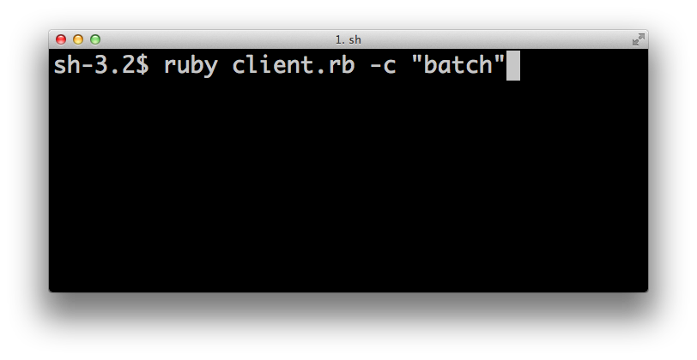

Slide 2
executer
client
executer
server
client
executer
executer

